Slide 1
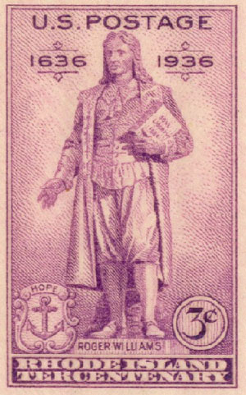
Puritan Dissenters https://learnaboutamerica.com

Slide 2

LearnAboutAmerica.com
*For our presentations, lesson plans, articles, printables, interactives, stories, and games related to the Puritan dissenters, please visit:
https://learnaboutamerica.com/american-history/13-colonies/people-of-the-13-colonies/roger-williams
* For the greatest American History website for teachers, parents, and students, visit:
https://learnaboutamerica.com

Slide 3
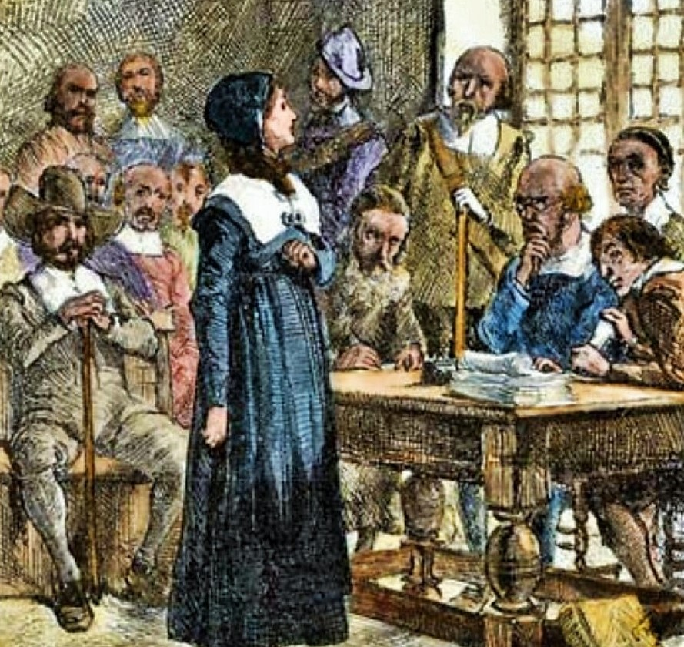
Puritan Dissenters in New England
Some colonists challenged Puritan authority
Two famous dissenters were Anne Hutchinson and Roger Williams
Both believed Puritan leaders were too controlling
Their ideas changed the course of American history

Slide 4
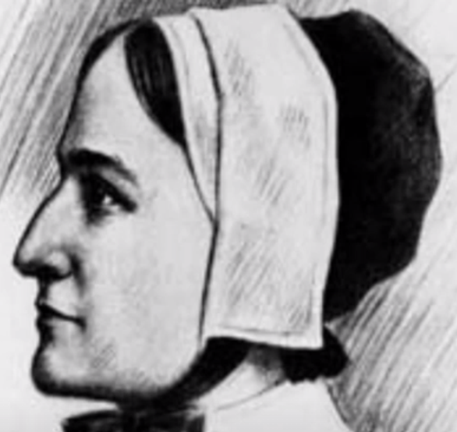
Anne Hutchinson: Early Life
Born in 1591 in Alford, England
Raised in a deeply religious family
Learned to read the Bible at a young age
Moved to Massachusetts Bay Colony in 1634

Slide 5
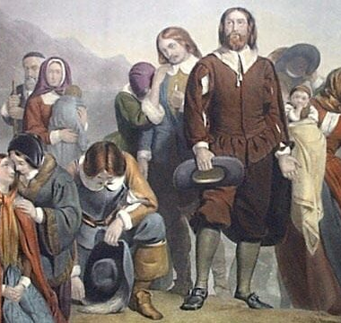
Anne Hutchinson’s Religious Beliefs
Held meetings in her home to discuss sermons
Believed people could connect directly with God
Questioned the authority of Puritan ministers
Attracted many followers

Slide 6
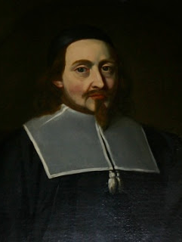
The Antinomian Controversy
Major religious dispute in Massachusetts
Hutchinson criticized ministers’ teachings
She believed faith mattered more than good deeds
Puritan leaders feared losing control

Slide 7
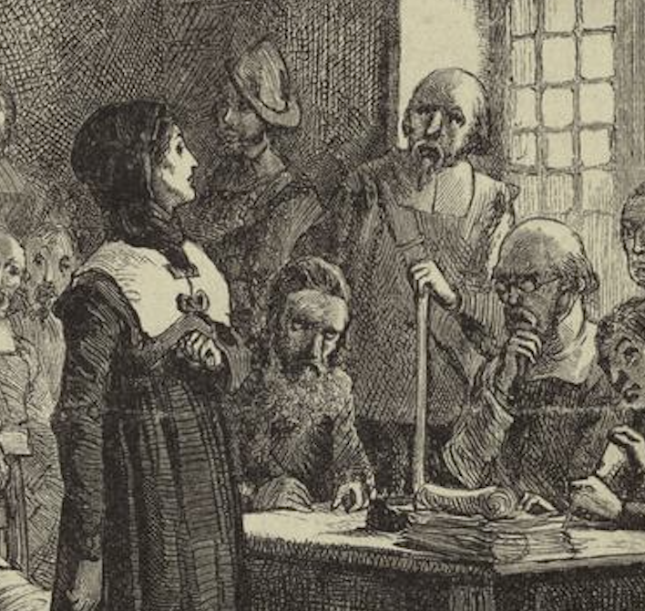
Trial and Banishment of Anne Hutchinson
Put on trial in 1637
Accused of heresy
Defended herself confidently
Banished from Massachusetts to Rhode Island

Slide 8
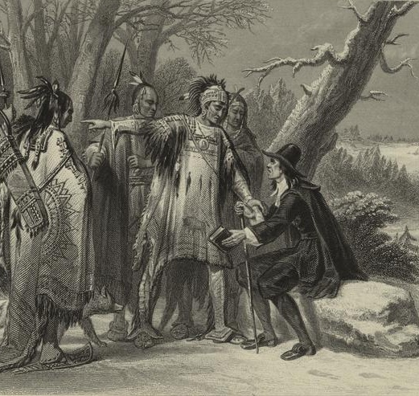
Roger Williams: Speaking Out
Arrived during the Great Migration
Believed Puritan church was not pure enough
Refused to serve as a minister in Boston
Spoke out against forced church attendance

Slide 9
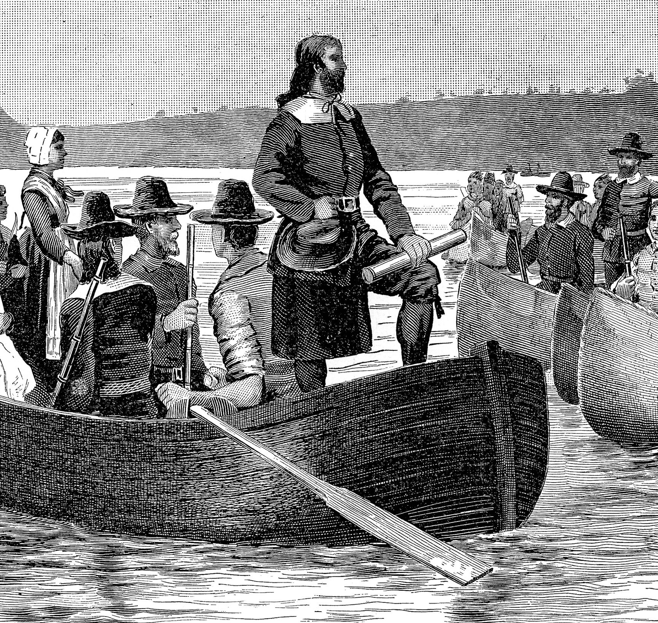
Roger Williams’ Radical Ideas
Declared colonial land grants invalid
Believed land belonged to Native Americans
Opposed taxes that supported churches
Called for religious tolerance

Slide 10
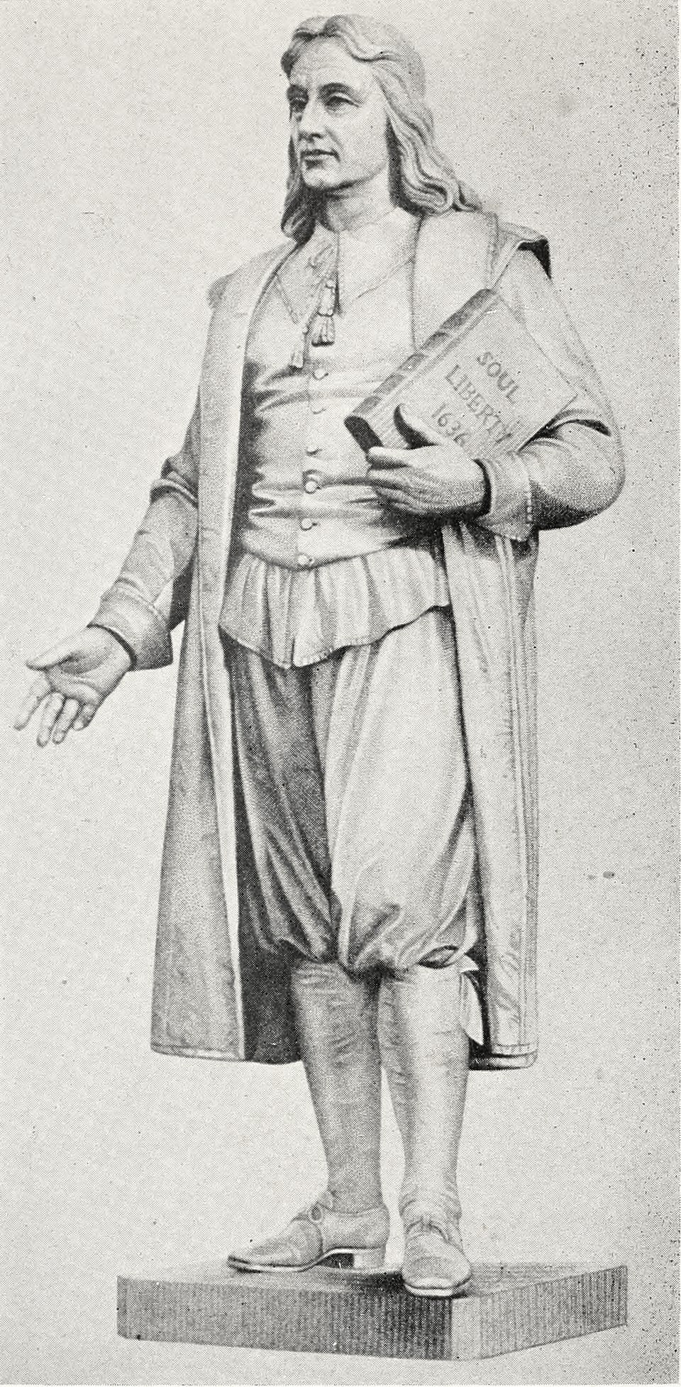
Separation of Church and State
Williams argued government should not control religion
Believed faith must be voluntary
Opposed Puritan laws controlling behavior
Influenced modern American freedoms

Slide 11
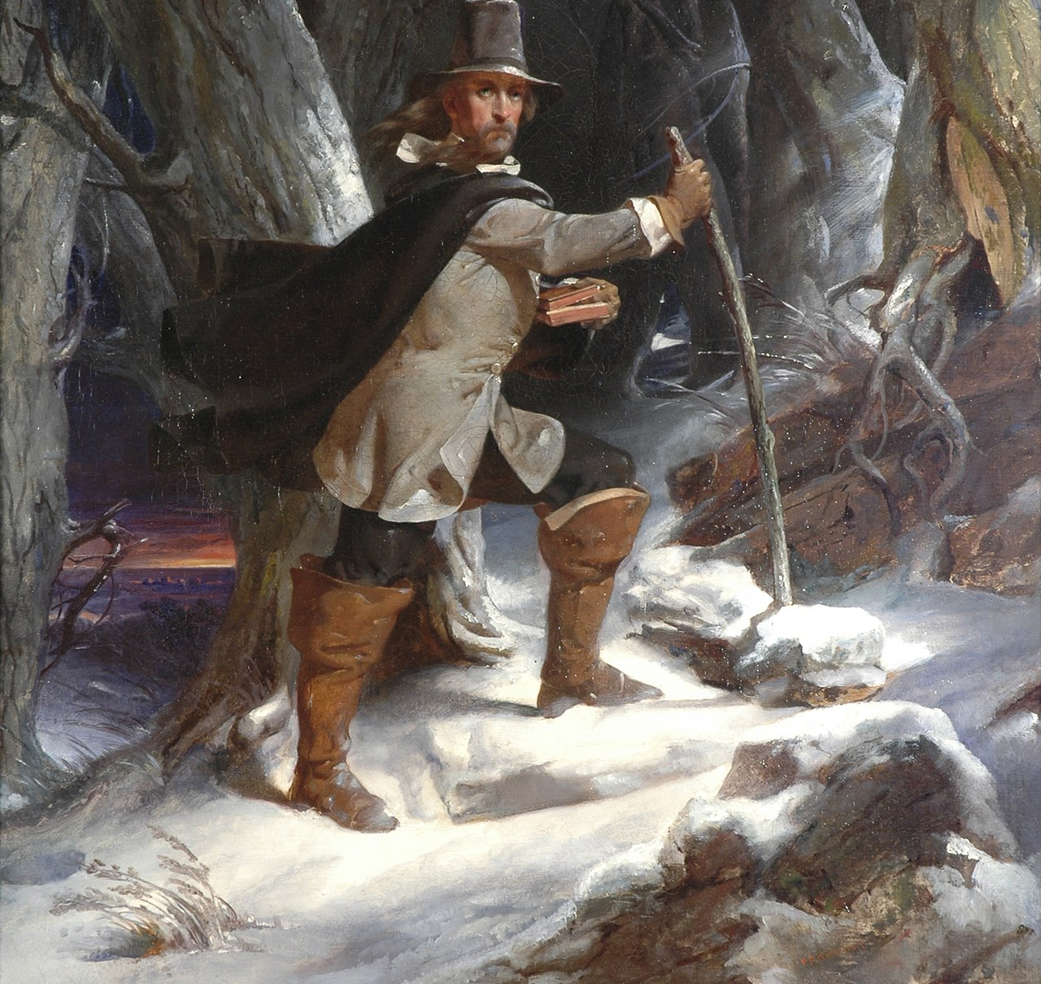
Founding of Providence
Banished from Massachusetts in 1635
Traveled through the wilderness in winter
Founded Providence in 1636
Allowed religious freedom for all residents

Slide 12
Legacy of the Puritan Dissenters
Hutchinson stood up for free speech
Williams promoted religious tolerance
Both challenged unfair authority
Their ideas shaped American democracy

