Slide 1
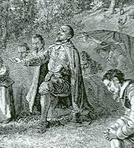
Thomas Hooker & the Fundamental Orders of Connecticut
https://learnaboutamerica.com

Slide 2

LearnAboutAmerica.com
*For our presentations, lesson plans, articles, printables, interactives, stories, and games related to the Fundamental Orders of Connecticut, please visit:
https://learnaboutamerica.com/american-history/13-colonies/events-of-the-13-colonies/fundamental-orders-of-connecticut
* For the greatest American History website for teachers, parents, and students, visit:
https://learnaboutamerica.com

Slide 3
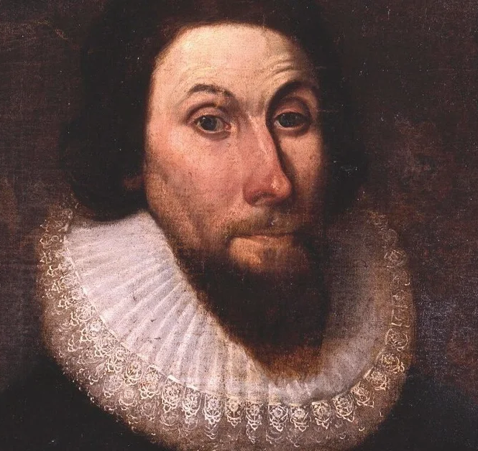
Thomas Hooker was an important Puritan leader
He believed government should serve the people
His ideas helped shape American democracy
He played a key role in founding Connecticut

Slide 4
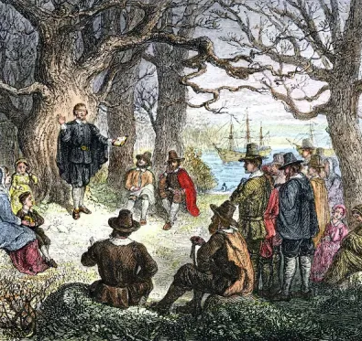
Who Was Thomas Hooker?
Born in England in 1586
Educated and trained as a minister
Strong Puritan beliefs
Believed in fair and just government

Slide 5
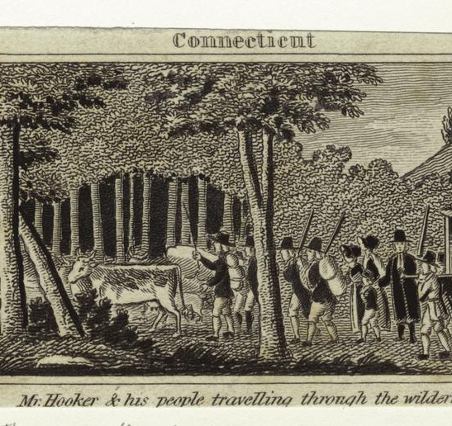
Thomas Hooker Comes to America
Arrived in Massachusetts Bay Colony
Served as a minister in Newtown (Cambridge)
Disagreed with Puritan leaders about voting rights
Believed more people should have a voice in government

Slide 6
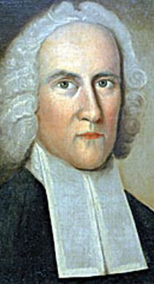
Why Did Thomas Hooker Leave Massachusetts?
Voting was limited to church members
Hooker believed government power came from the people
He wanted a more democratic society
Religious leaders held too much political power

Slide 7
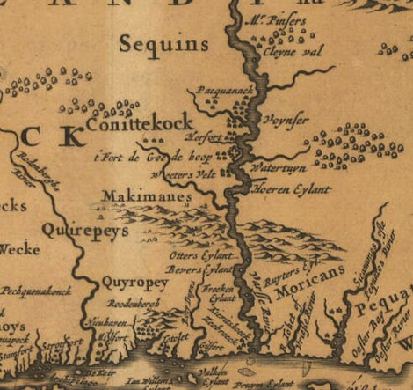
Journey to Connecticut
In 1636, Hooker led settlers west
Traveled through the wilderness
Founded the town of Hartford
Other towns soon followed

Slide 8
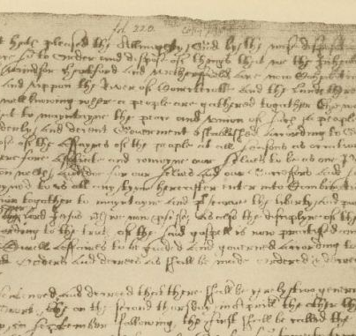
What Were the Fundamental Orders?
Written in 1639
Established a framework for government
Outlined how leaders would be chosen
Protected the rights of citizens

Slide 9
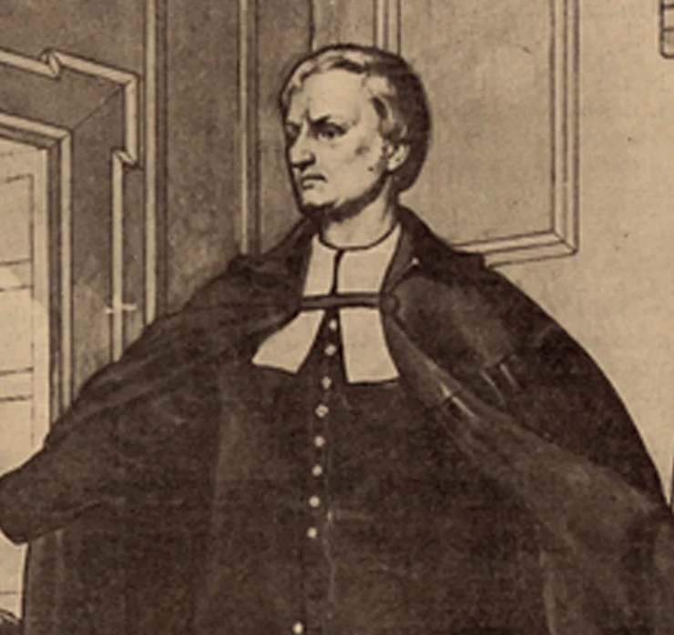
Key Ideas in the Fundamental Orders
Government authority comes from the people
Elected officials represent the citizens
Regular elections were required
No mention of the king

Slide 10
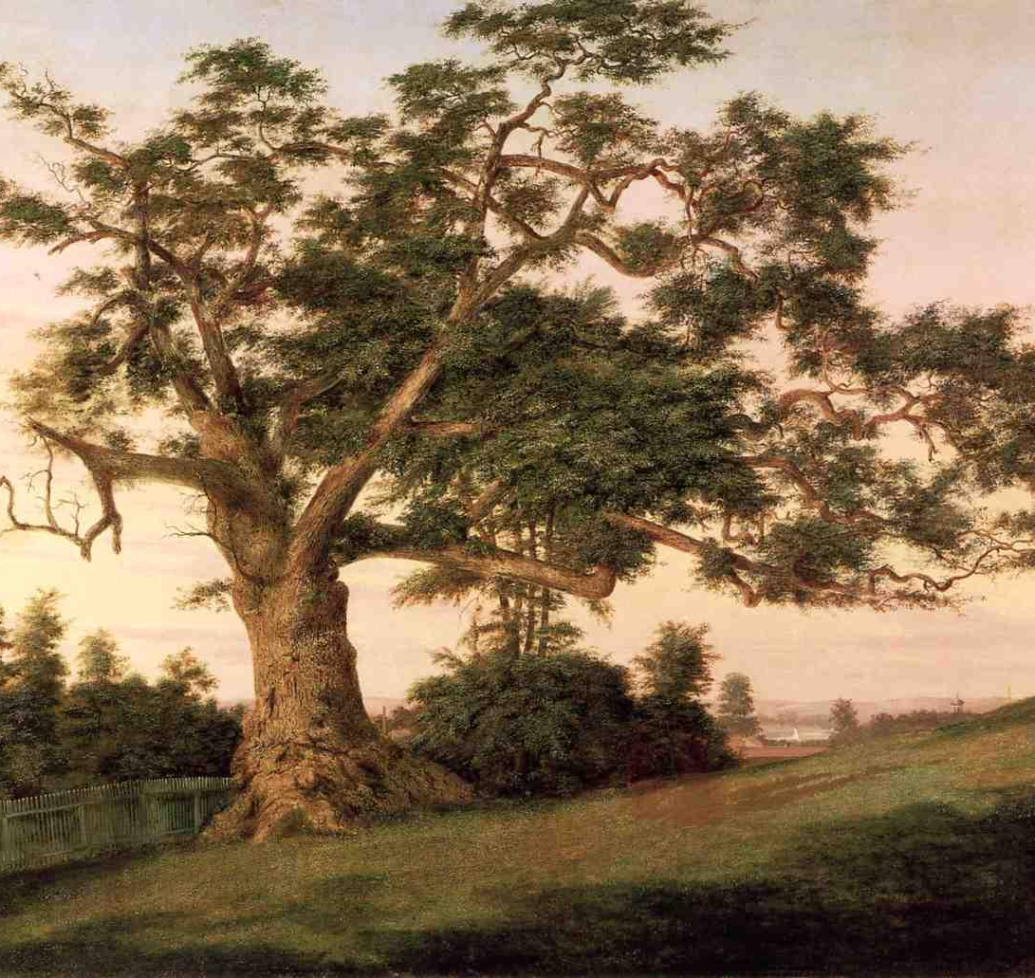
Why Were the Fundamental Orders Important?
Often called the first written constitution in America
Limited government power
Expanded voting rights
Influenced later colonial governments

Slide 11
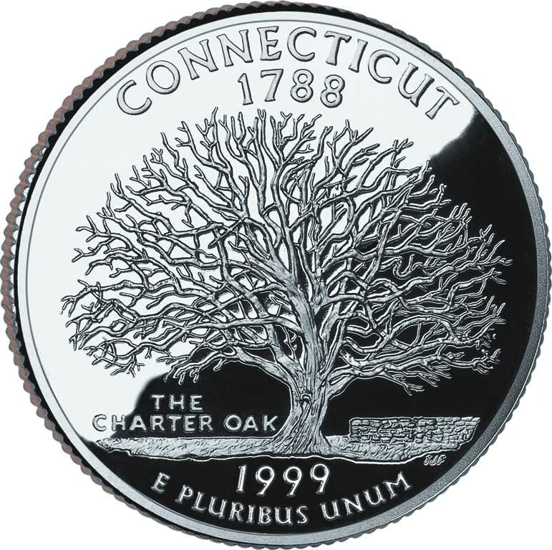
Thomas Hooker’s Legacy
Known as the Father of Connecticut
Promoted representative government
Inspired democratic ideas in America
Helped lay groundwork for the U.S. Constitution

