Slide 1
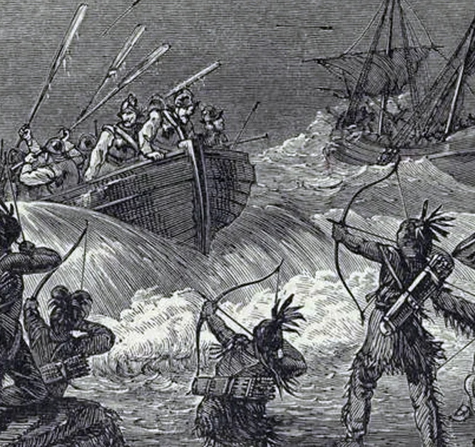
Puritan Wars with Native Americans in New England

Slide 2

LearnAboutAmerica.com
*For our presentations, lesson plans, articles, printables, interactives, stories, and games related to the Puritan Wars, please visit:
https://learnaboutamerica.com/american-history/13-colonies/events-of-the-13-colonies/king-phillips-war
* For the greatest American History website for teachers, parents, and students, visit:
https://learnaboutamerica.com

Slide 3
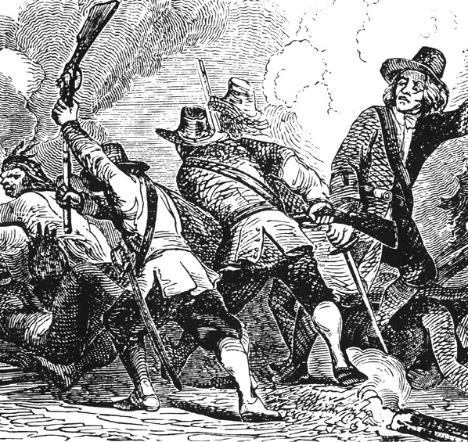
Background: Rising Tensions
Puritan settlements expanded rapidly
Native Americans and Puritans viewed land differently
Competition over trade and resources
European diseases weakened Native communities

Slide 4
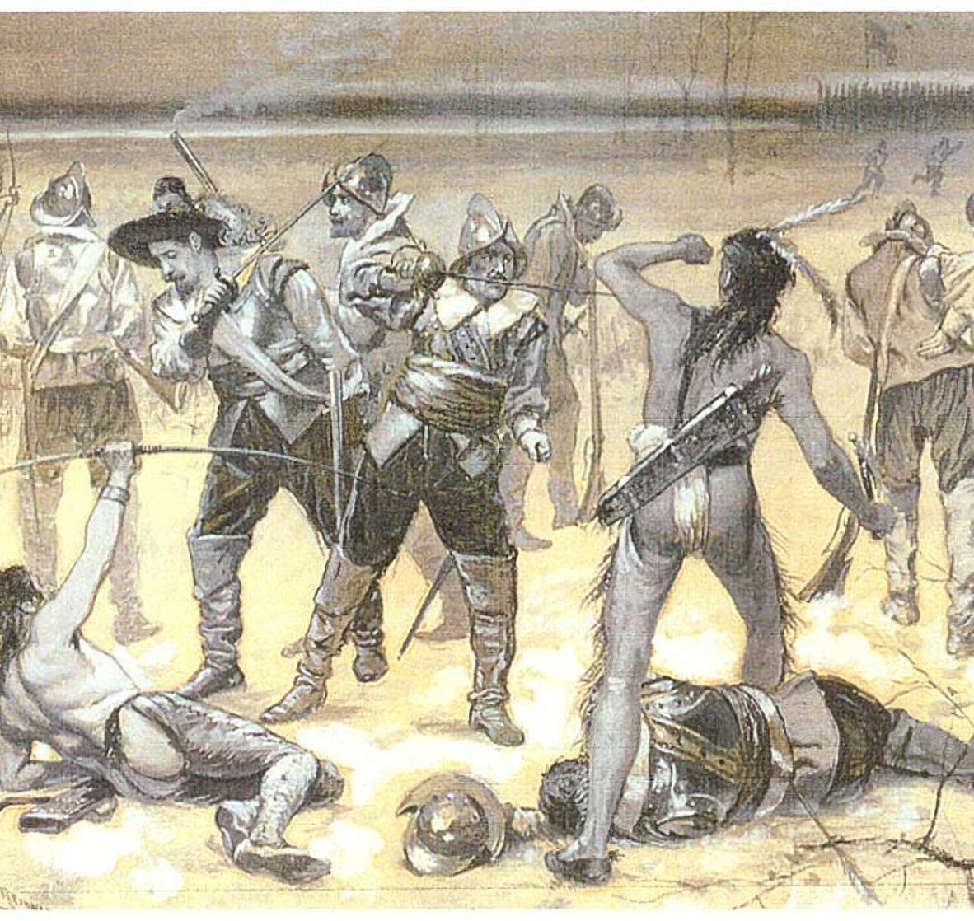
The Pequot War (1636–1638)
First major war between Puritans and Native Americans
Fought mainly in present-day Connecticut
Pequot vs. English settlers and Native allies
Marked by extreme violence

Slide 5
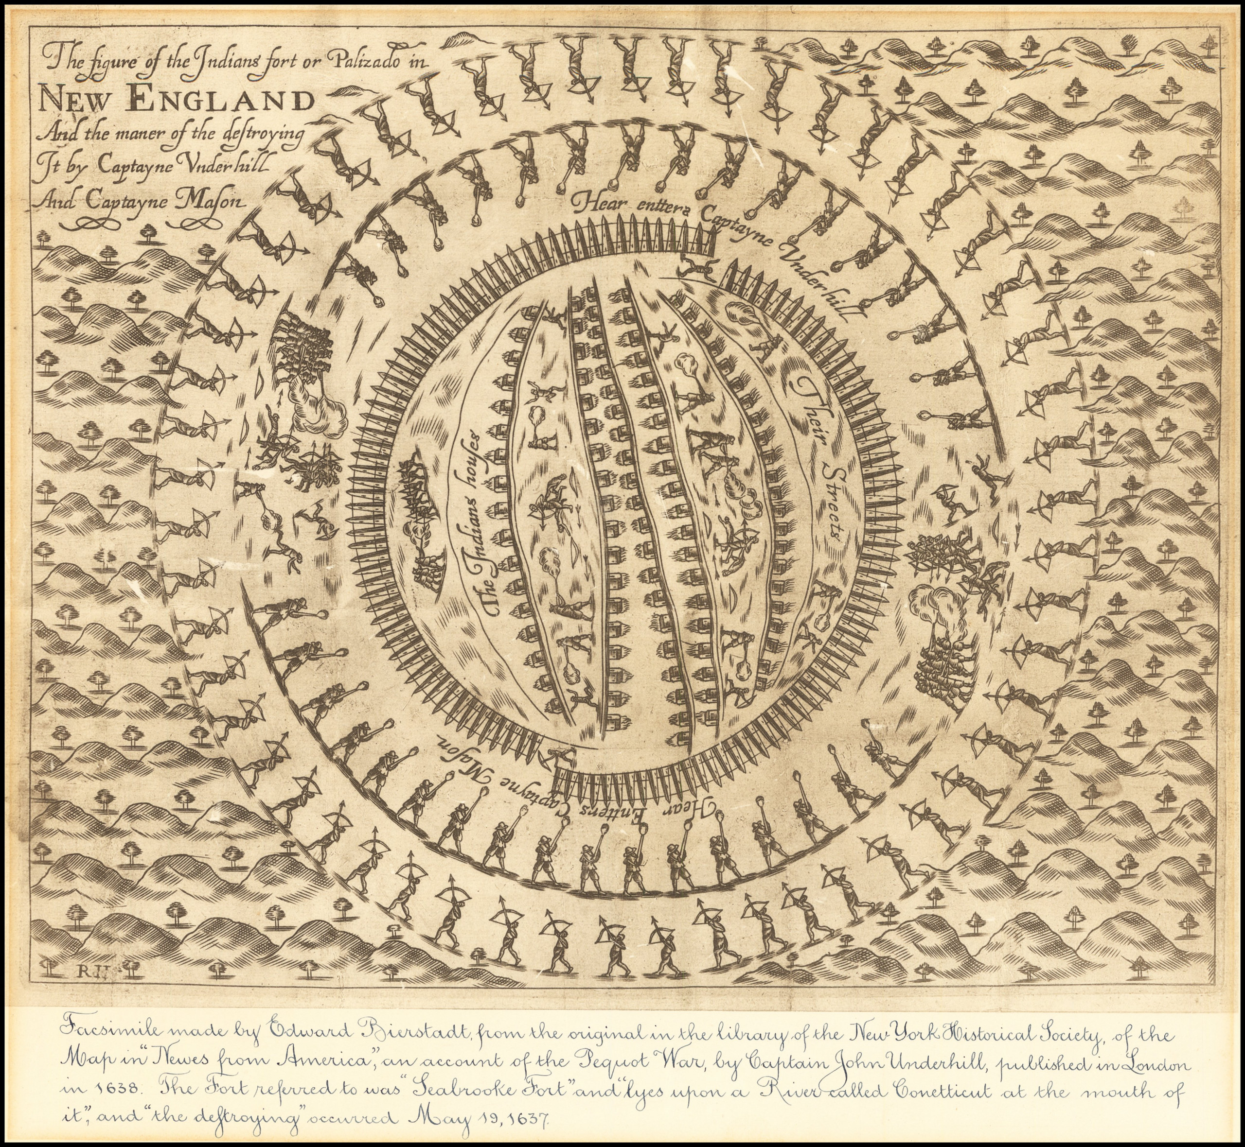
Causes of the Pequot War
Disputes over land and trade routes
Murder of English traders
Desire for English control of the region
Alliances with rival Native tribes

Slide 6
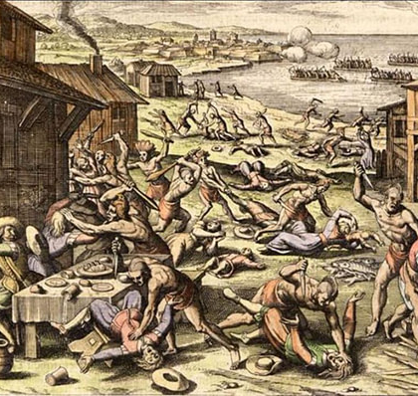
The Mystic Massacre
English and Native allies attacked a Pequot village
Village set on fire
Hundreds of men, women, and children killed
Turning point of the war

Slide 7
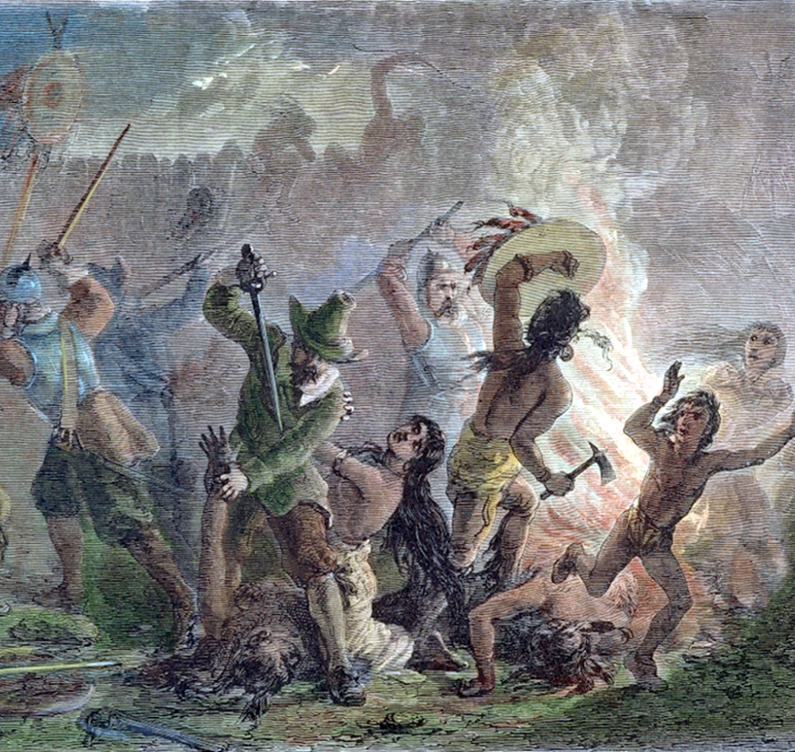
Results of the Pequot War
Pequot tribe nearly destroyed
Survivors enslaved or absorbed into other tribes
English gained control of Connecticut
Pequot name outlawed

Slide 8
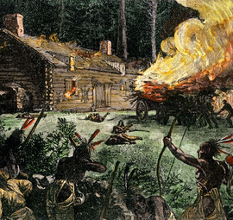
King Philip’s War (1675–1678)
Led by Metacom (King Philip)
Involved many Native tribes and colonies
Bloodiest war per capita in colonial history
Affected nearly all of New England

Slide 9
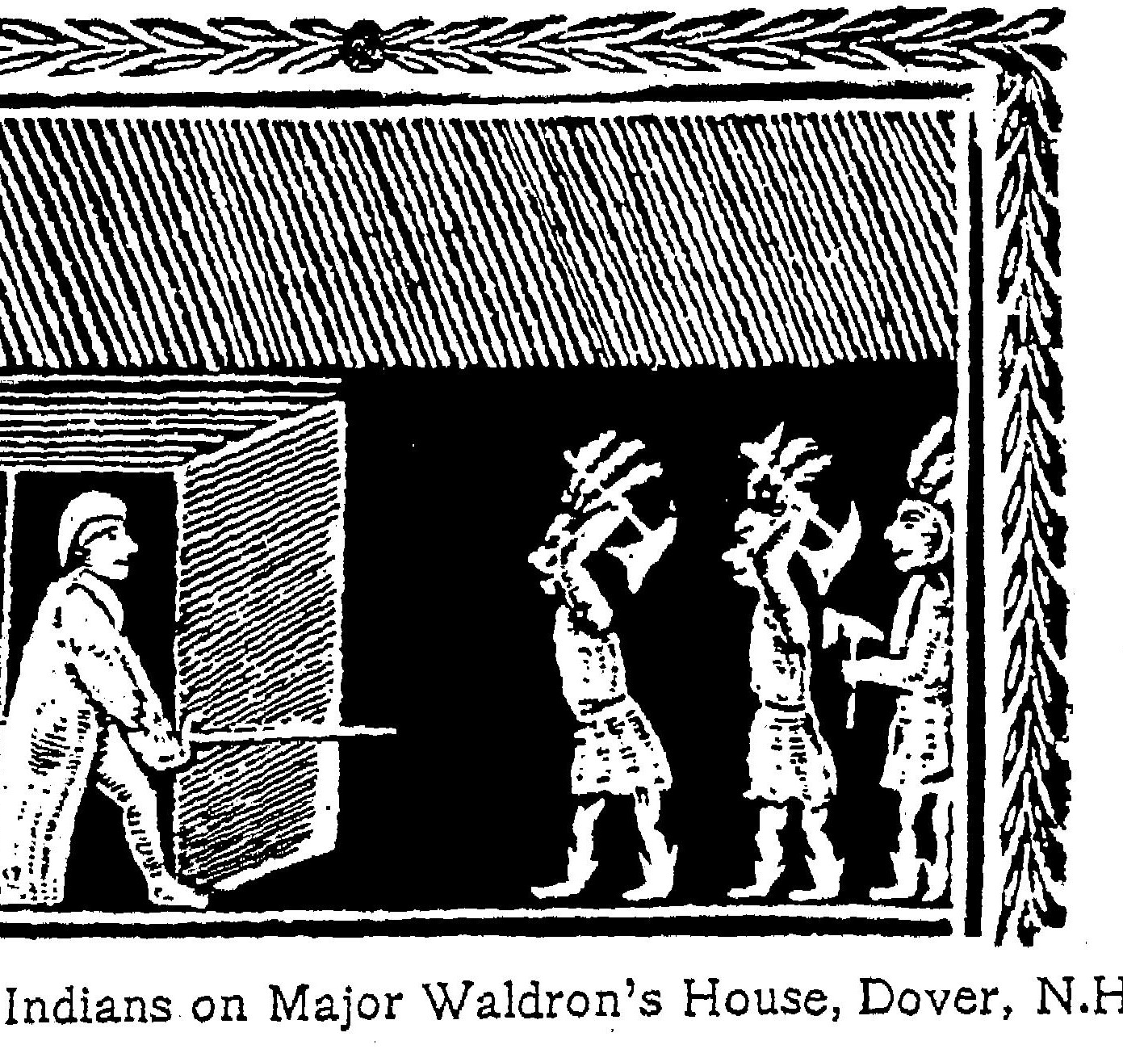
Causes of King Philip’s War
Continued loss of Native land
Colonial interference in Native leadership
Execution of Wampanoag men
Growing resentment toward English rule

Slide 10
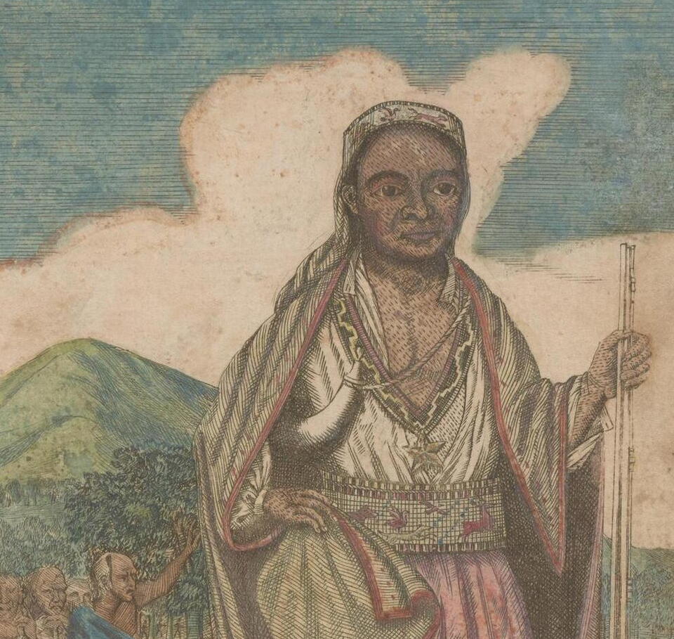
Major Events of King Philip’s War
Attacks on colonial towns
Great Swamp Fight against the Narragansett
Widespread destruction
Death of Metacom in 1676

Slide 11
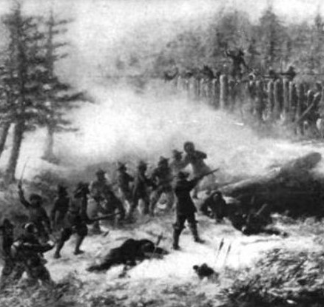
Results of King Philip’s War
Native resistance in New England crushed
Thousands of Native people killed or enslaved
English dominance firmly established
Native societies permanently disrupted

Slide 12
Other Related Conflicts
Narragansett War (part of King Philip’s War)
Mohegan and Pequot alliances
Smaller frontier raids and reprisals
No other major named Puritan wars

Slide 13
Legacy of the Puritan Wars
English control of New England expanded
Native populations greatly reduced
Land ownership permanently changed
Long-lasting consequences for Native peoples

