Slide 1
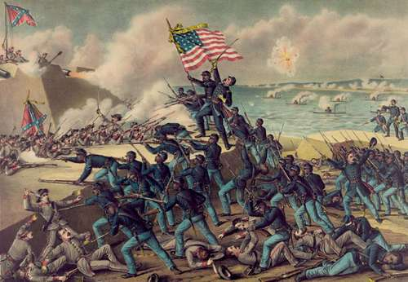

Battle of Antietam
9/17/1862

Slide 2
Where are we in the path to Civil War?
Union forces under Ulysses S. Grant have scored major victories in the “Western Theater” at Forts Henry and Donelson and Shiloh in middle and western Tennessee. Most of Tennessee is already in Union control.
In Virginia, Confederate forces under Robert E. Lee and Stonewall Jackson had defeated the Union army at the Second Battle of Bull Run. Lee, buoyed in confidence by the decisive victory, thought foreign recognition could now be achieved with success in Union territory.
We Start in September, 1862.

Slide 3
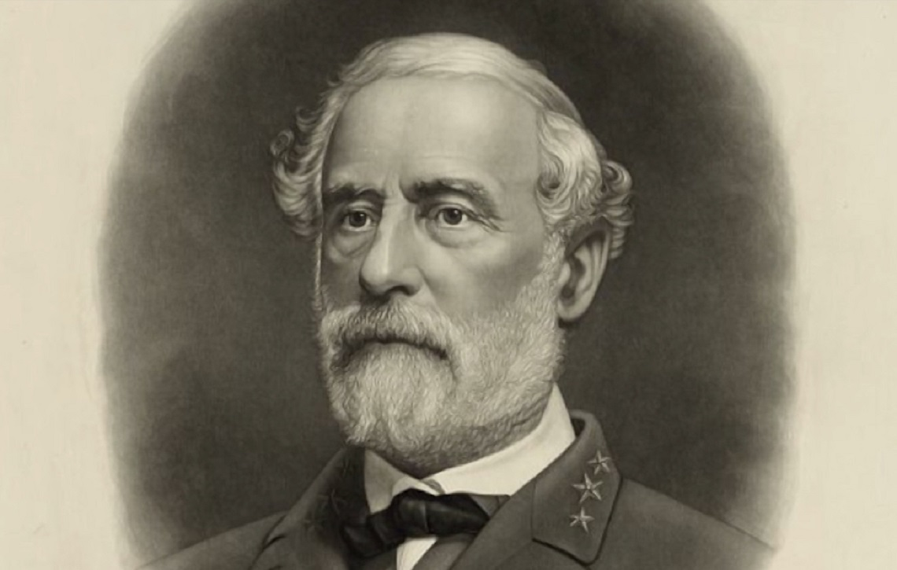
September 1862
Lee’s Army of Northern Virginia crosses the Potomac River into Maryland.
Lee believes that he and his army will be regarded as heroes in Maryland, and that eager farm boys from the state’s countryside will rush to swell his ranks.
Lee’s assumption, however, is flawed. Much of western Maryland was against secession and sided with the United States.

Slide 4
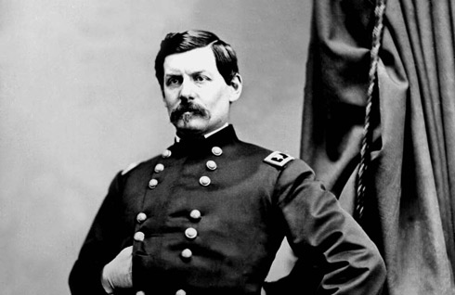
Union Army
Union forces were under the command of General George B. McClellan.
While he was beloved by his men, he had developed a reputation for inaction and indecision.
Prior to the fighting, McClellan was presented with intelligence that suggested Confederate forces were split, leaving Lee’s army vulnerable. McClellan dismissed the intelligence and squandered a major advantage.
McClellan’s forces follow the Confederates from Virginia into Maryland, setting the stage for a major engagement.

Slide 5
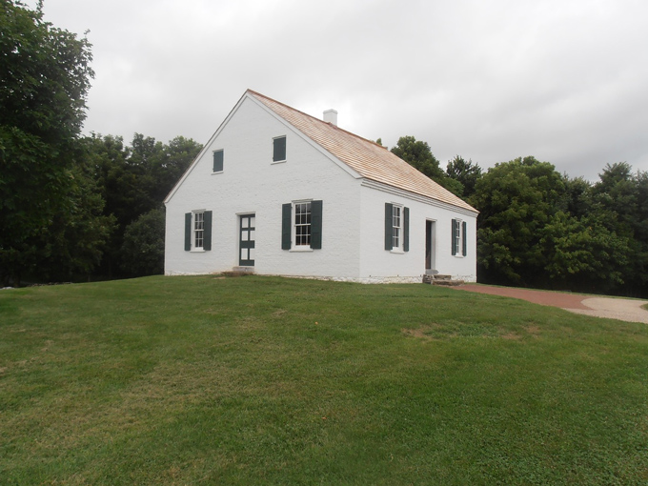
What was at stake?
For the Confederate Army, a victory at Antietam could lead to foreign recognition and military help from European powers.
For the Union, a Confederate victory could lead to further attacks on northern cities and war against European powers who would join forces with the Confederacy.
A victory could improve sagging morale and to at least one major decision (stay tuned).

Slide 6
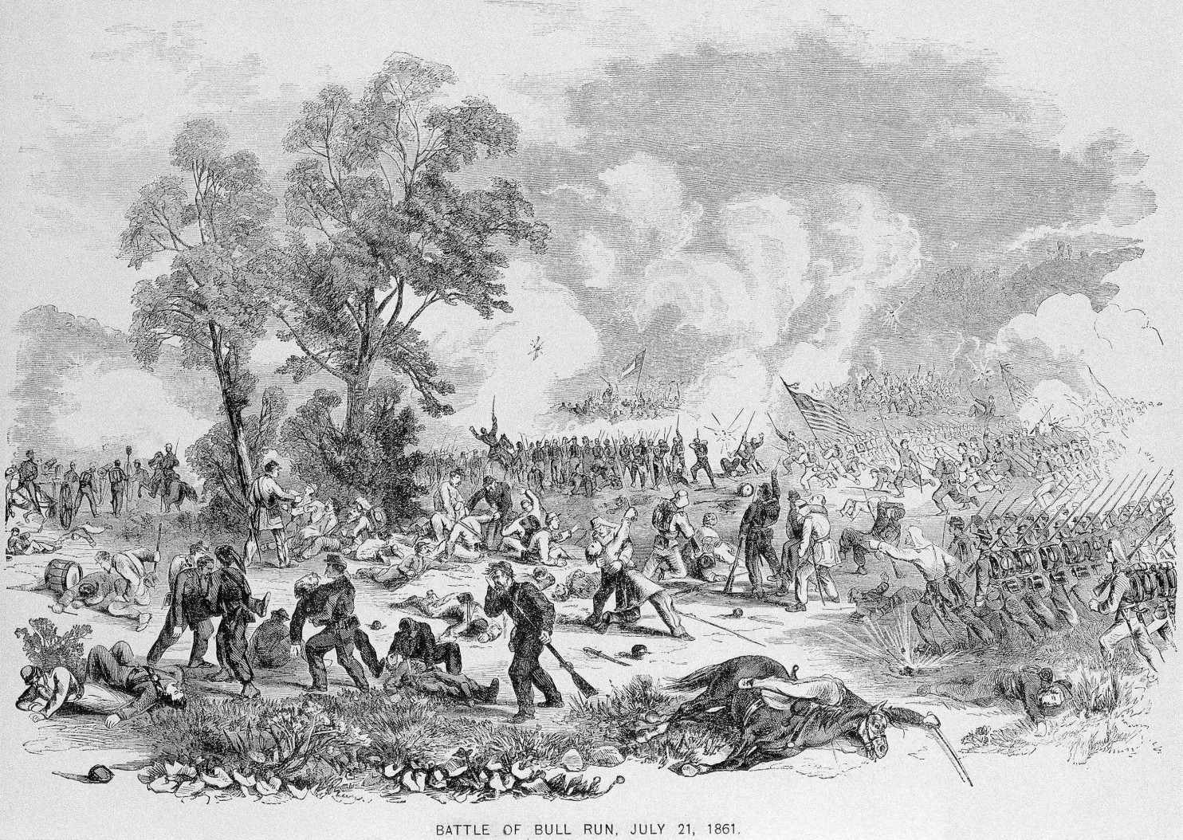
What happened?
Fighting between the two armies began early on the morning of September 17th.
The two sides initially fought over control of the high ground near the Dunker Church (see picture).
The fighting was vicious and included hand-to-hand combat. By 12:00, there were over 13,000 casualties.

Slide 7
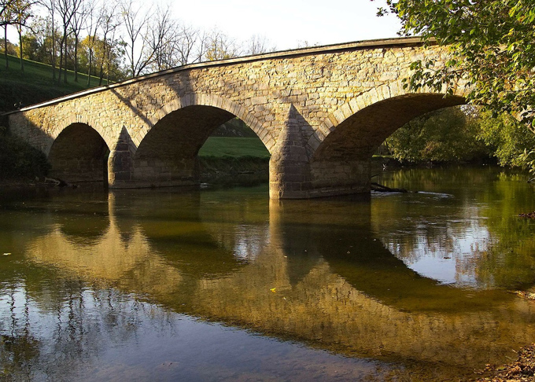
The Afternoon
In the afternoon, fighting shifted to an old sunken road that would soon be referred to as “Bloody Lane.” Over 5,600 casualties would be reported here.
Fighting eventually moved to a bridge that spanned Antietam Creek that would eventually be called Burnside’s Bridge. Union forces finally crossed after three attempts, but suffered unthinkable casualties as a result.

Slide 8
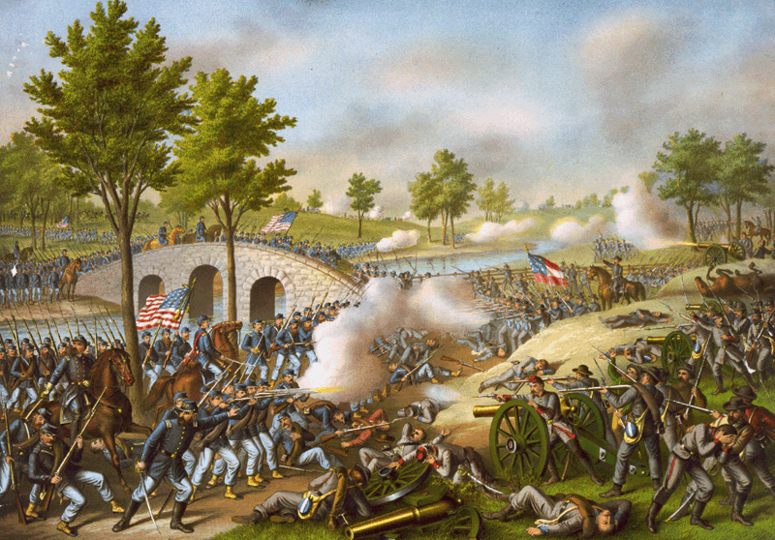
The Result
As the day transitioned to night, it was clear there would be no winner.
The Battle of Antietam was the bloodiest one-day battle in American history, with over 22,000 casualties.
On September 18th, when it was clear Union forces would not launch additional attacks, a truce was called so both sides could attend to their dead and wounded.
That night, Confederate forces retreated to Virginia; their objective unfulfilled.

Slide 9
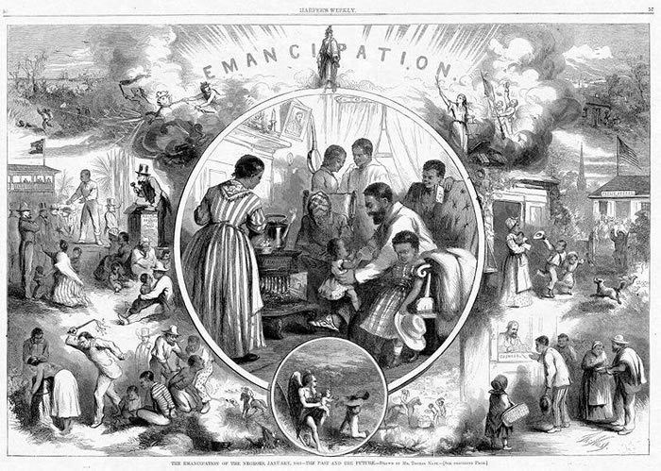
The Effect
The Battle of Antietam was a crucial battle in the Union war strategy.
Five days after the battle, President Lincoln issued the Emancipation Proclamation, freeing all slaves in “enemy territory.”
The goals of the war now included both preservation of the Union and now a permanent end to slavery.

Slide 10
Antietam and the Emancipation Proclamation on MrNussbaum.com
I have tons of free printable and online activities available at:
https://mrnussbaum.com/battle-of-antietam-sharpsburg
Make sure you complete:
Antietam Battle Breakdown
“The Great Squander”
“I’ll Always Remember Where I was”
Antietam Correct-me Passage

