Slide 1
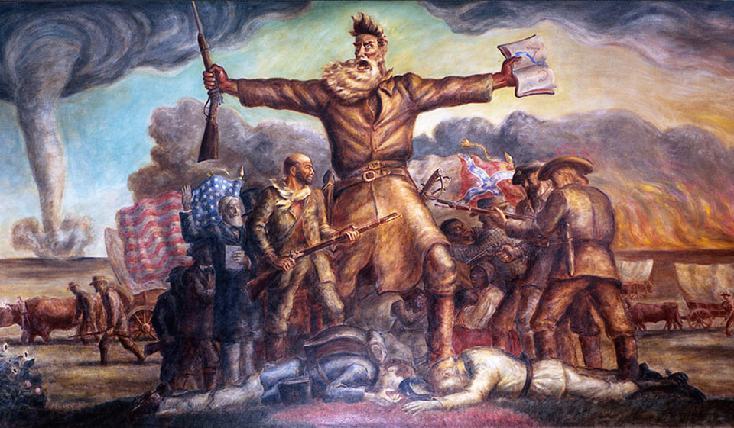

John Brown
Rebellion
Causes of the Civil War

Slide 2
Where are we in the path to Civil War?
The 1854 Kansas-Nebraska Act allowed for popular sovereignty in all the newly organized Kansas and Nebraska Territories, leading to violence known as “Bleeding Kansas.”
The Dred Scott Decision handed down by the United States Supreme Court reaffirmed that slaves were considered property and had no personal or civil rights. It also declared the territorial limits on slavery as defined by the Missouri Compromise were unconstitutional.
We start this history in 1859, but first, let’s learn a little bit about John Brown

Slide 3
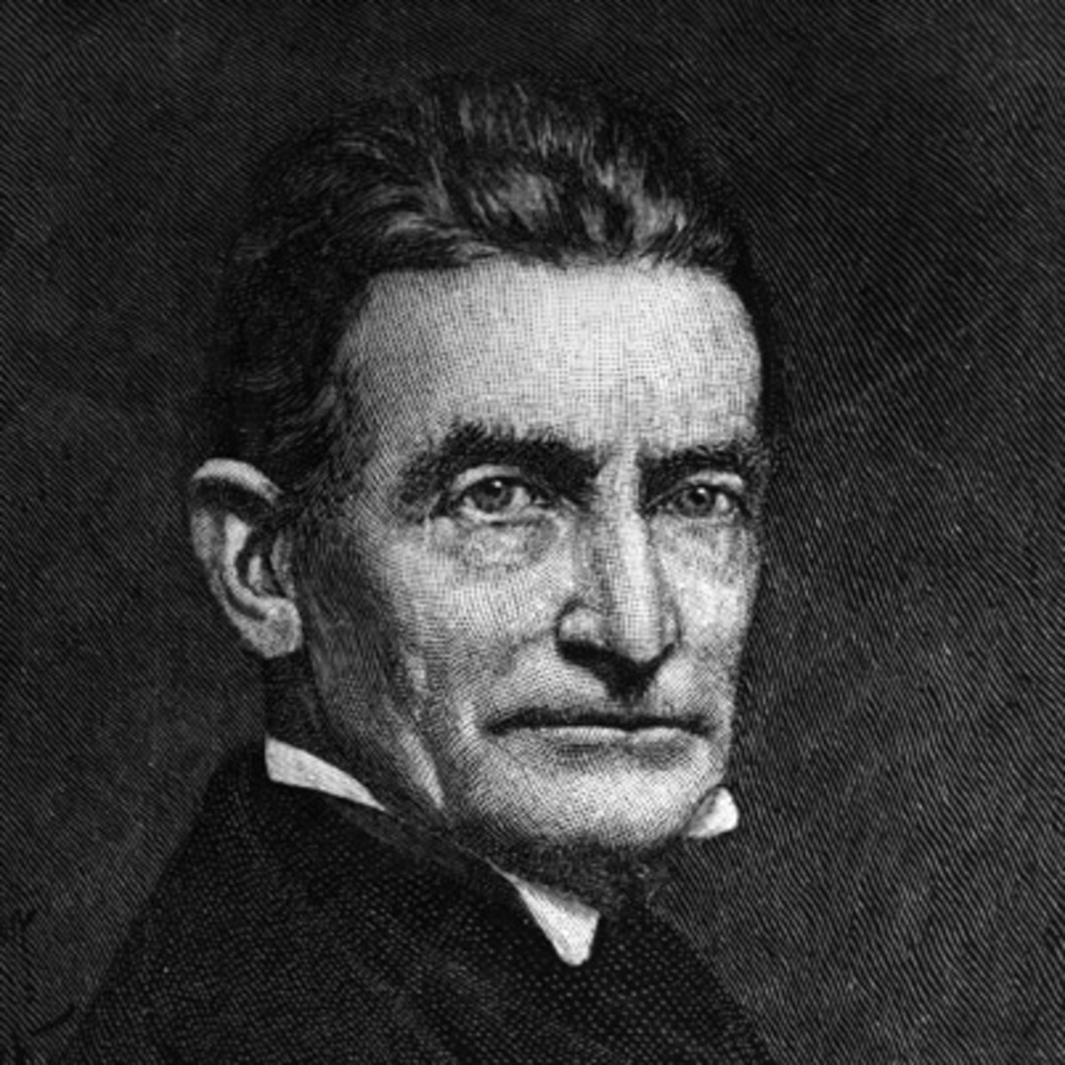
Who was John Brown?
Born in 1800 in Connecticut
Developed a deep hatred for slavery at an early age when he stayed with a family in Michigan and witnessed a slave being beaten.
Started a school to help educate young Black people.
Became a radical abolitionist
Had 12 Children

Slide 4
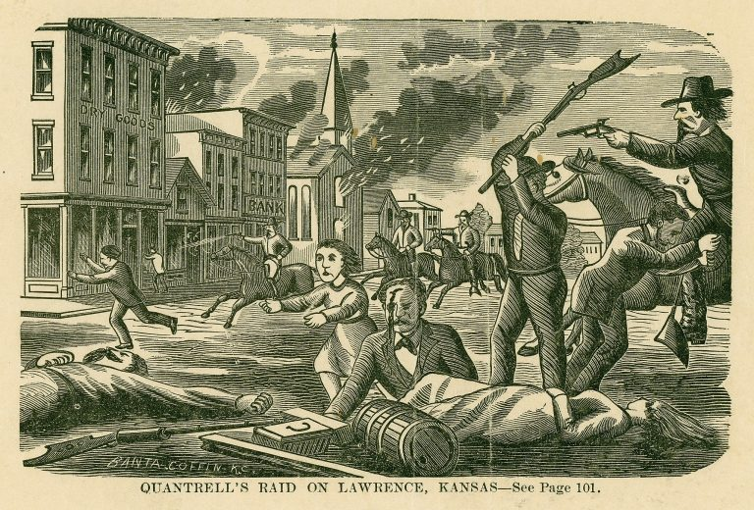
“Bleeding Kansas”
Violence erupted in Kansas following the Kansas-Nebraska Act.
Abolitionists and Pro-slavery groups moved into the state to try to sway the vote on whether the state would allow slavery.
Violence erupted, people were murdered, and the town of Lawrence, Kansas – an abolitionist stronghold, was burned to the ground.

Slide 5
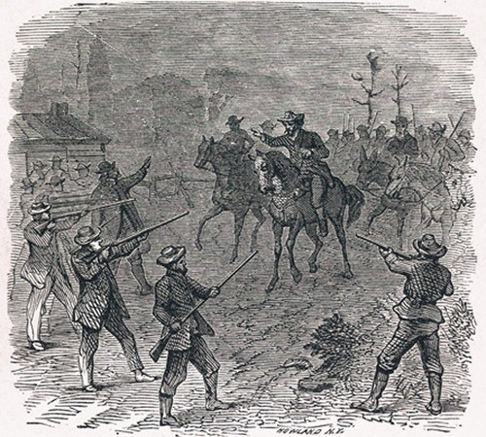
Pottawatomie
To avenge the murder of five abolitionists in Kansas, Brown, and five of his sons traveled to Kansas, where they brutally murdered five slavery advocates on May 24, 1856.
Brown and his sons were able to escape back to Connecticut, where they were hailed as heroes by many.

Slide 6
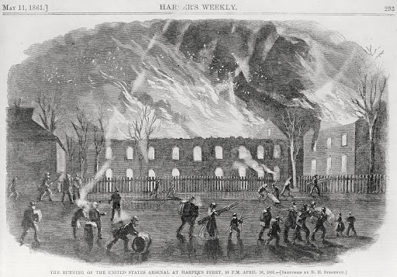
Planning for a Slave Rebellion
When Brown returned east, he formulated a plan to free slaves by force.
His plan was supported by wealthy abolitionists
It included a refuge for runaway slaves in the mountains of Virginia.
He planned to seize the federal arsenal at Harper’s Ferry, Virginia. He believed this would inspire slaves to rebel against their owners.

Slide 7
John Brown’s Rebellion
On October 16, 1859, Brown, his sons, and other loyal supporters easily took the town of Harper’s Ferry and occupied the arsenal.
Once inside the arsenal, the group took defensive positions and failed to launch any further offensives.
The town’s militia and U.S. Marines under Robert E. Lee surrounded the arsenal and easily defeated the men inside.
Two of Brown’s sons were killed in the raid.

Slide 8
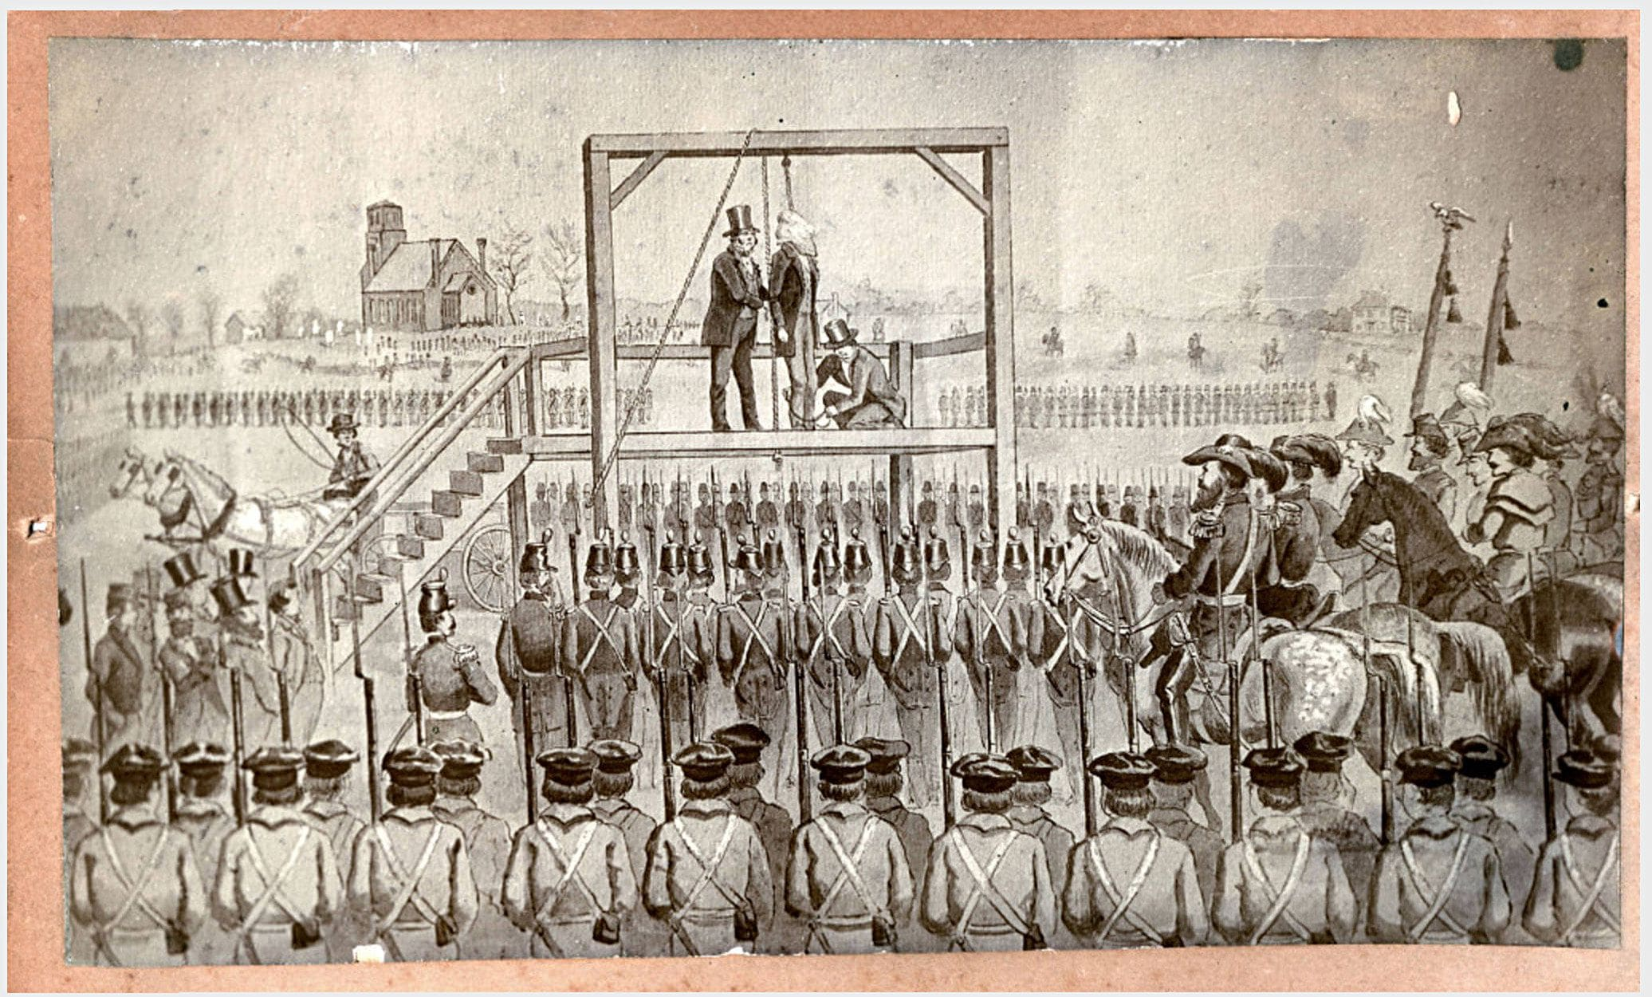
John Brown’s Rebellion
Brown was tried and convicted of murder and treason.
He was hanged on December 2, 1859.
Among his last words were:
I John Brown am now quite certain that the crimes of this guilty, land: will never be purged away; but with Blood.
I had as I now think: vainly flattered myself that without very much bloodshed; it might be done.

Slide 9
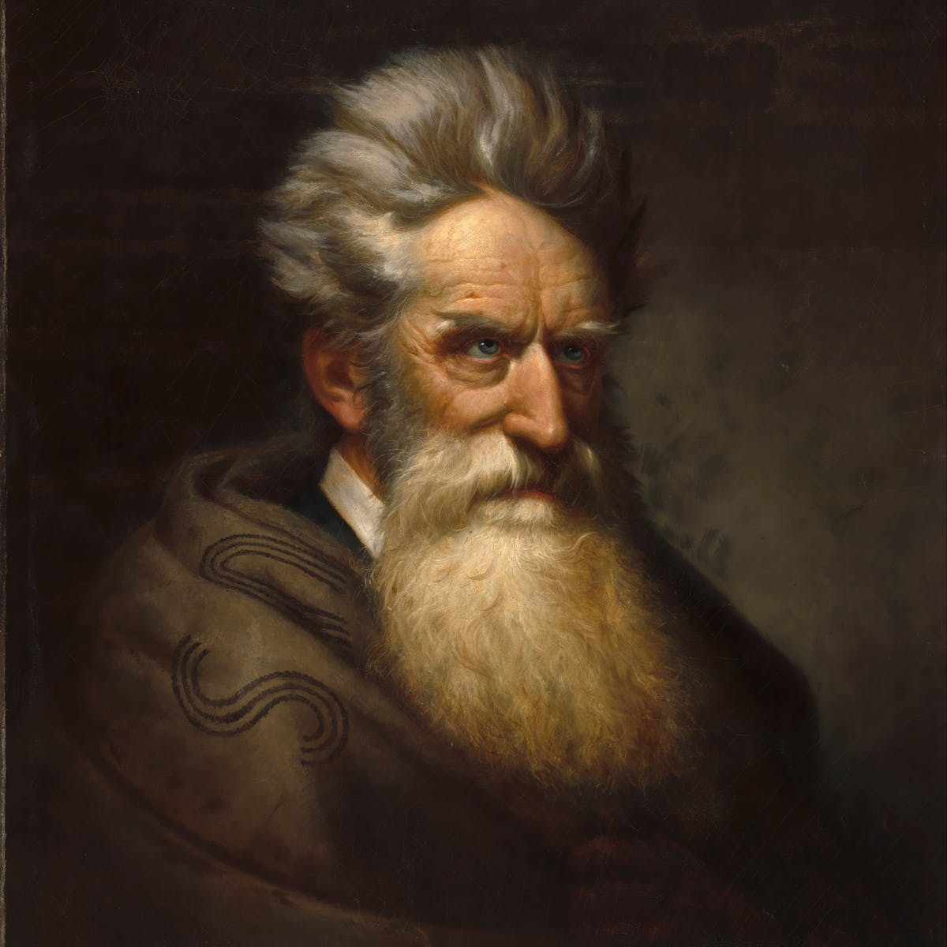
Effect of the John Brown Rebellion
Relations between the North and South deteriorated further
Many southerners believed the John Brown Rebellion was sanctioned by the U.S. Government in an attempt to free the slaves.
Because no slaves had volunteered to help in the rebellion, Southern slaveholders took this to mean that slaves were content in their condition.

