Slide 1
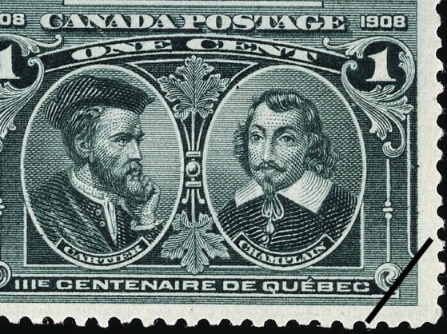
French Exploration in the New World
https://learnaboutamerica.com

Slide 2

LearnAboutAmerica.com
*For our presentations, lesson plans, articles, printables, interactives, and games related to French exploration in the New World, please visit:
https://learnaboutamerica.com/american-history/explorers-and-the-age-of-exploration/unit-and-curriculum/french-exploration-in-the-new-world
* For the greatest American History website for teachers, parents, and students, visit:
https://learnaboutamerica.com

Slide 3
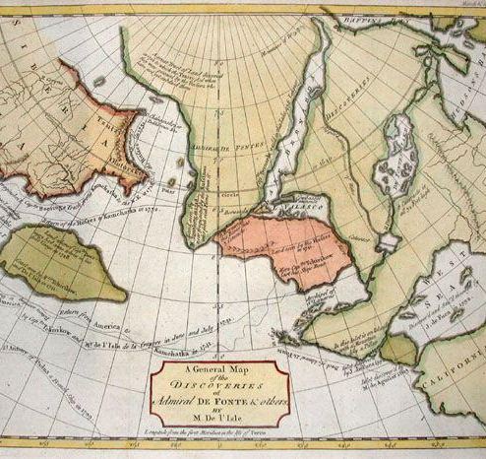
Why the French Explored
- Search for a Northwest Passage.
- Expand the fur trade.
- Establish alliances with Native peoples.
- Increase French power and influence.

Slide 4
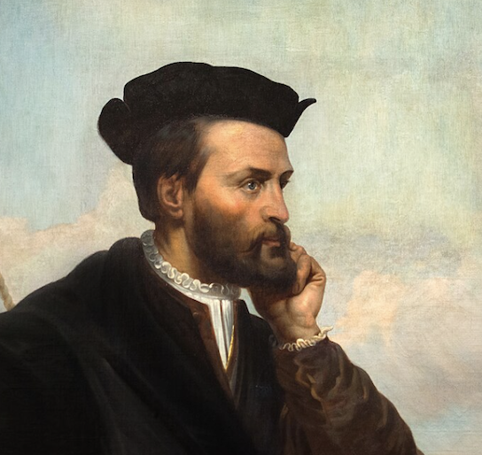
Jacques Cartier (1534–1542)
- Explored the Gulf of St. Lawrence.
- Claimed land for France.
- Attempted to find a route to Asia (Northwest Passage).
- Began France's long-term interest in Canada.

Slide 5
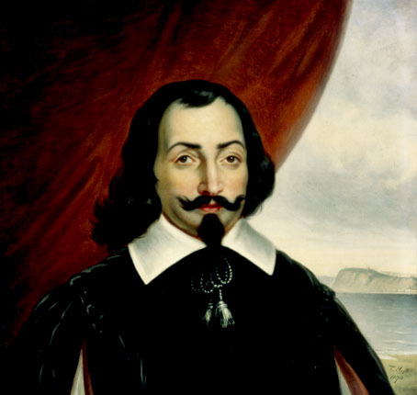
Samuel de Champlain (1603–1635)
- Founder of Quebec in 1608.
- Strengthened French-Native alliances.
- Mapped rivers and lakes.
- Helped establish New France.

Slide 6
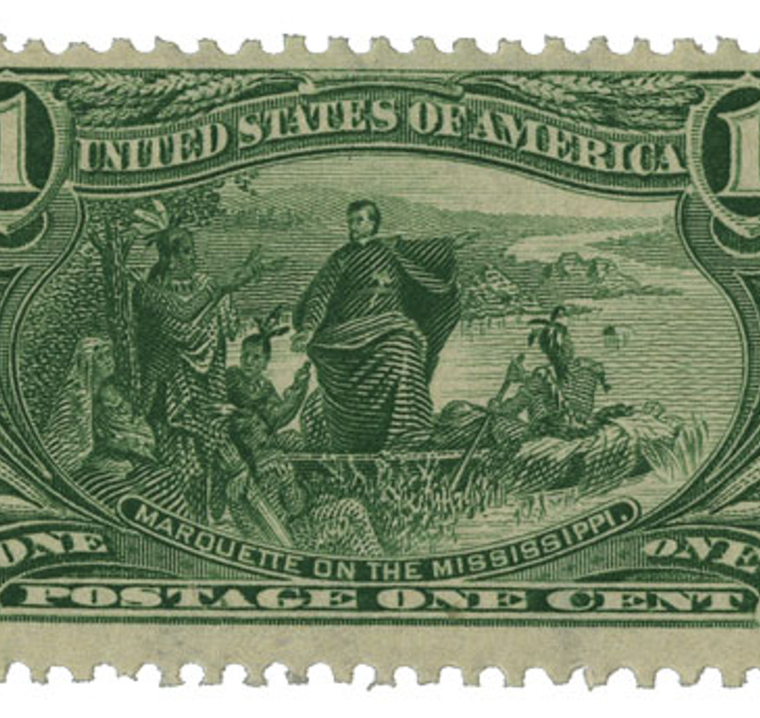
Marquette & Joliet (1673)
- Explored the Mississippi River.
- Sought new trade routes.
- Mapped major interior waterways.
- Expanded France’s knowledge of North America.

Slide 7
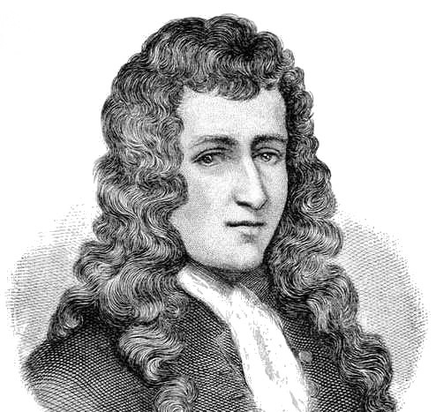
Robert de La Salle (1682)
- Explored Great Lakes and Mississippi River.
- Claimed the Mississippi Valley for France (Louisiana).
- Expanded French control over central North America.

Slide 8
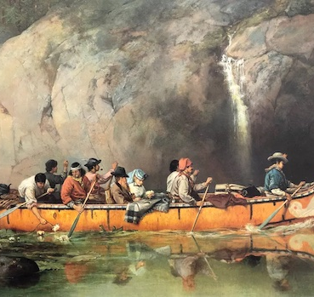
The Voyageurs
- French-Canadian fur traders.
- Traveled by canoe across rivers and lakes.
- Essential to the fur trade economy.
- Connected French settlements with Native trading partners.

Slide 9
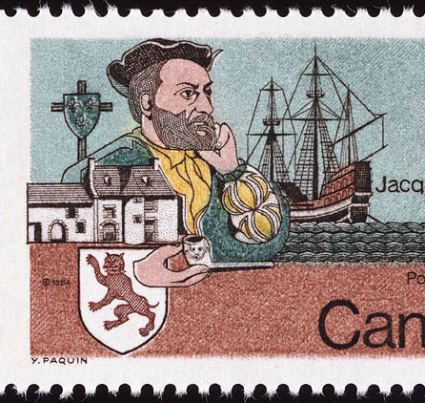
Impact of French Exploration
- Built the fur trade economy.
- Formed alliances with Native nations.
- Expanded French territory.
- Mapped interior North America.

Slide 10
Summary
French explorers sought trade and routes to Asia.
Cartier opened French claims.
Champlain built New France.
Marquette, Joliet, and La Salle explored the interior.
Voyageurs spread the fur trade across the continent.

