Slide 1
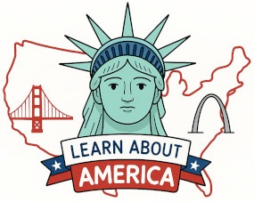
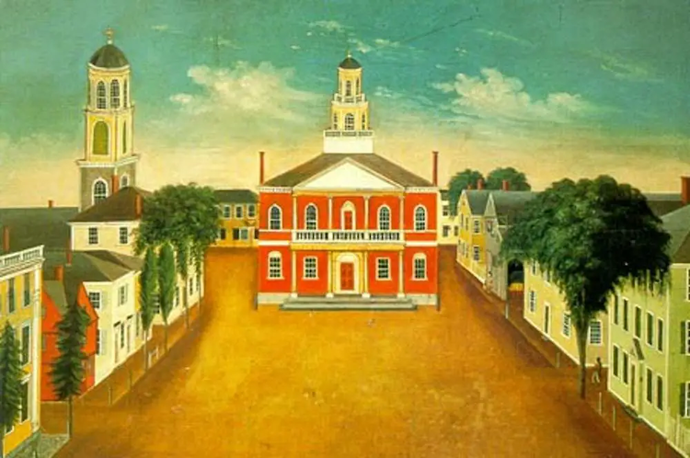
The Middle Colonies
New York • New Jersey • Pennsylvania • Delaware
The Middle Colonies
https://learnaboutamerica.com

Slide 2
LearnAboutAmerica.com
*For our presentations, lesson plans, articles, printables, interactives, stories, and games related to the Middle Colonies, please visit:
https://learnaboutamerica.com/american-history/13-colonies/13-colonies-regions/mid-atlantic-colonies
* For the greatest American History website for teachers, parents, and students, visit:
https://learnaboutamerica.com

Slide 3
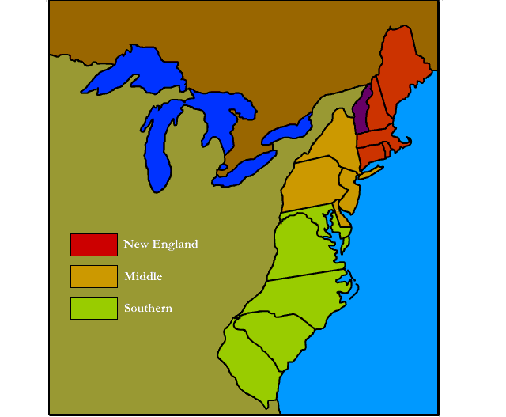
Middle Colonies
New York
New Jersey
Pennsylvania
Delaware

Slide 4
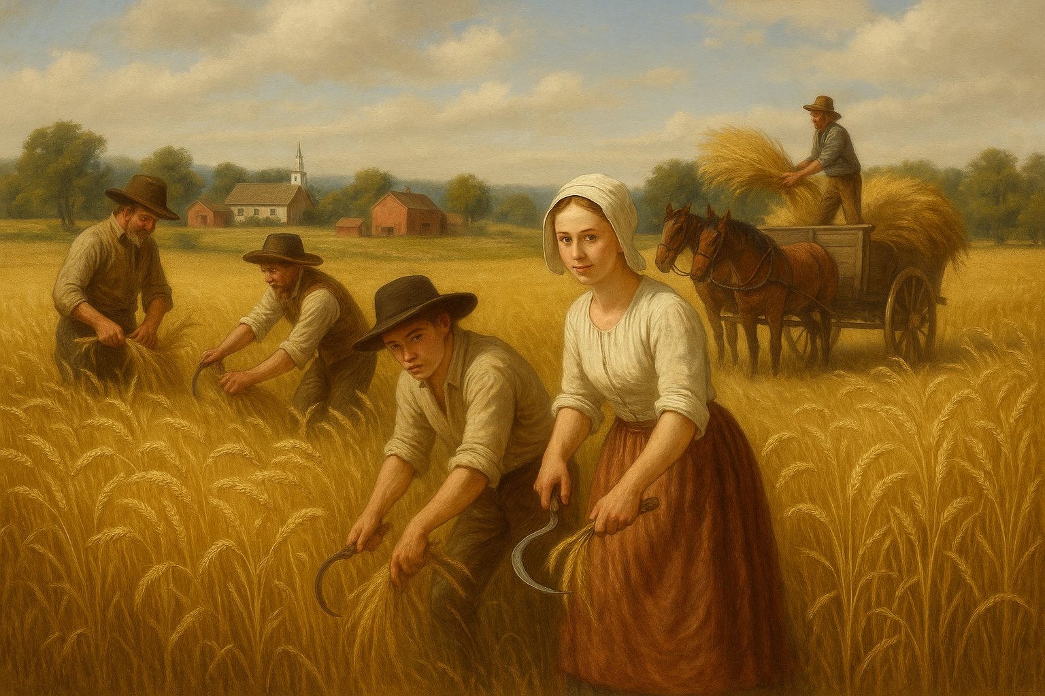
Climate & Geography
Warm summers and cold winters (temperate climate)
Coastal plains, piedmont hills, and inland mountains
Good coastal harbors for shipping
Ideal soil and climate for large-scale grain farming ('breadbasket')

Slide 5
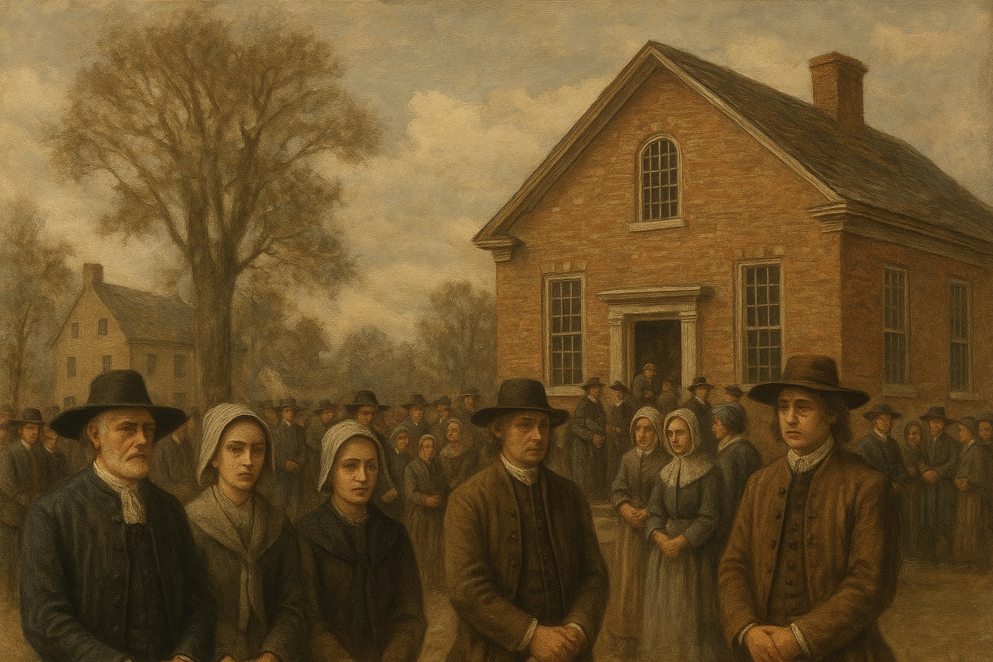
Religion in the Middle Colonies
No single dominant religion
Widespread religious tolerance
Immigrants from many nations
Groups included Quakers, Catholics, Jews, Lutherans, Presbyterians

Slide 6
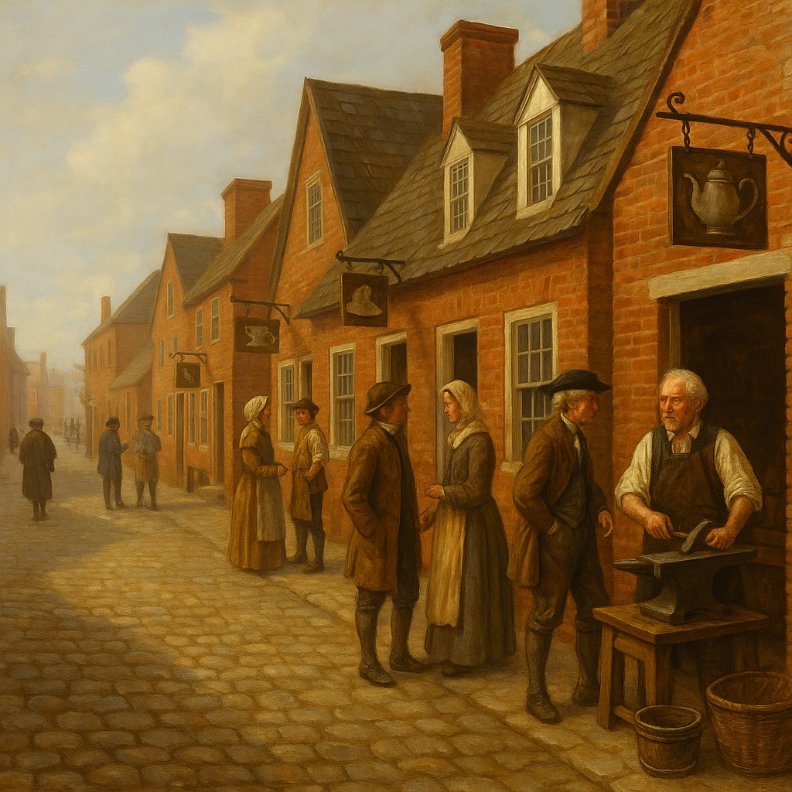
Economy of the Middle Colonies
Agriculture: wheat, barley, oats, and rye
Logging, shipbuilding, textiles, papermaking
Philadelphia and New York were major shipping hubs
Craftsmen supported city economies

Slide 7
Discussion Questions
Why were the Middle Colonies called the 'breadbasket'?
How did religious freedom make the colonies different?
What jobs did people have in Middle Colony cities?
How did geography help the Middle Colonies succeed?

Slide 8
Glossary
Temperate – Mild climate with warm summers and cold winters
Piedmont – Rolling hills between coast and mountains
Breadbasket – Region producing large amounts of grain
Religious tolerance – Acceptance of different beliefs
Craftsmen – Skilled workers who make things by hand

