Slide 1

The New England Colonies
Overview of Colonial Life, Geography, Religion, and Economy
https://learnaboutamerica.com

Slide 2
LearnAboutAmerica.com
*For our presentations, lesson plans, articles, printables, interactives, stories, and games related to the New England Colonies, please visit:
https://learnaboutamerica.com/american-history/13-colonies/13-colonies-regions/new-england-colonies
* For the greatest American History website for teachers, parents, and students, visit:
https://learnaboutamerica.com

Slide 3
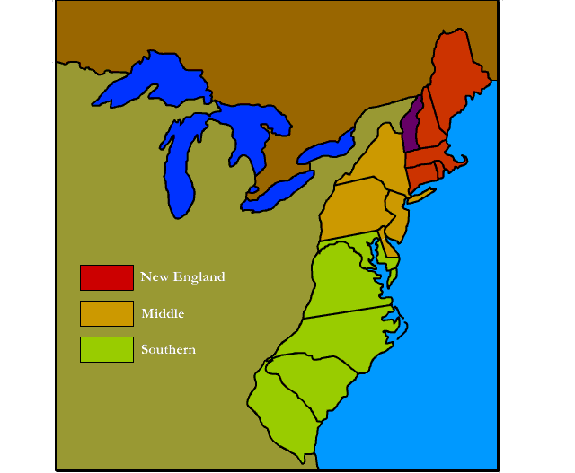
The New England Colonies
New Hampshire
Massachusetts
Rhode Island
Connecticut

Slide 4
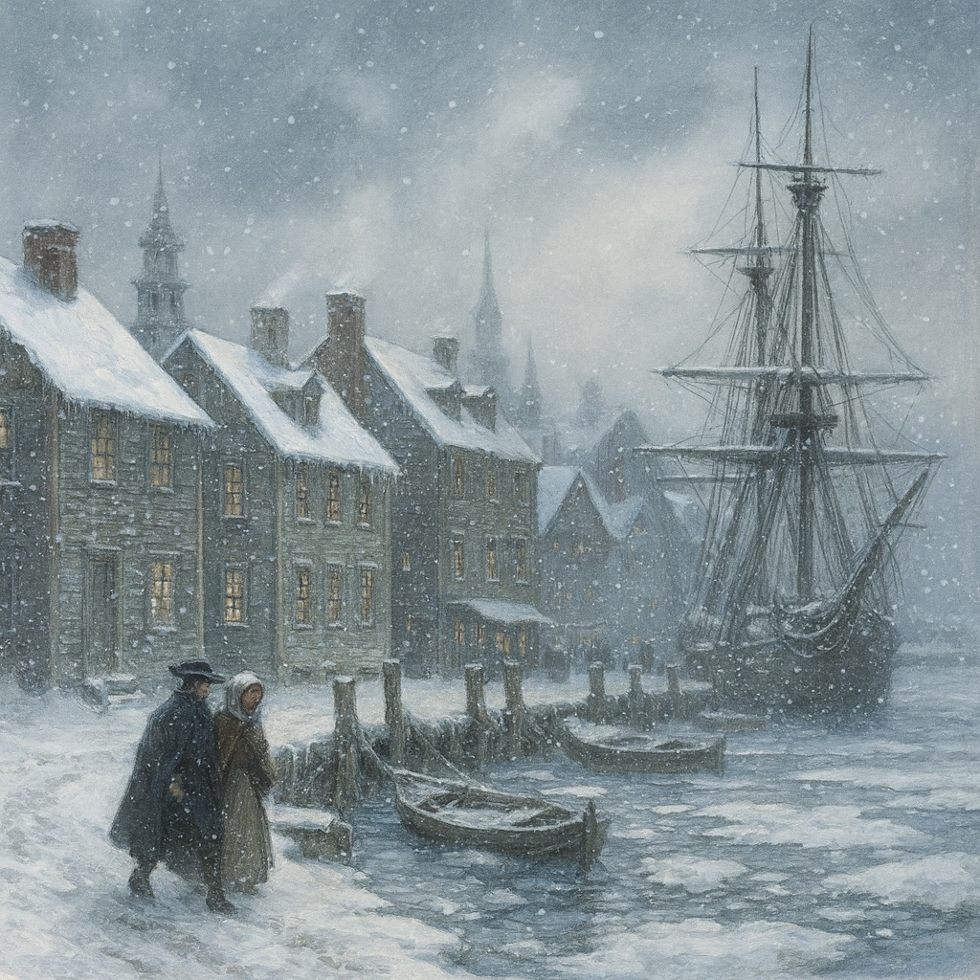
Climate & Geography
Bitterly cold winters and mild summers
Flat coastline; hilly/mountainous inland
Rocky soil made farming difficult
Cold winters reduced spread of disease

Slide 5
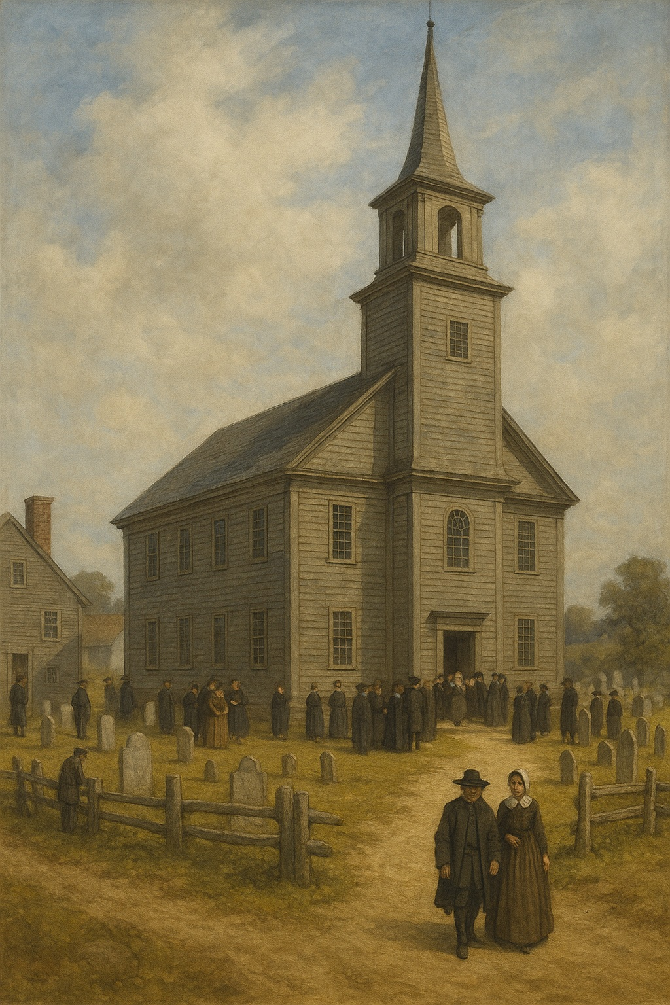
Religion in New England
Dominated by Puritans seeking to 'purify' Christianity
Strict religious rules; intolerance of other beliefs
Church dominated daily life
Severe consequences for dissent
Singing and holiday celebrations prohibited

Slide 6
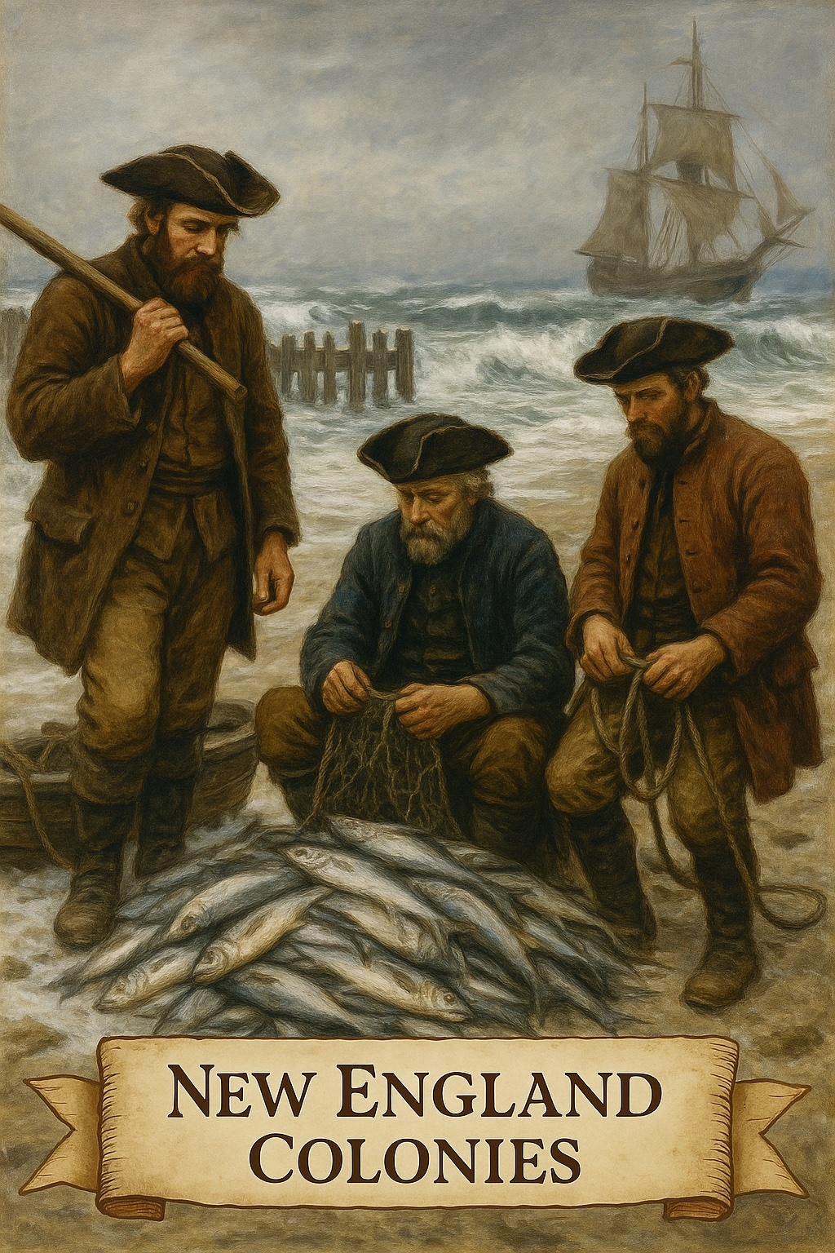
Economy: Ocean-Based Industries
Fishing (especially codfish)
Whaling and trapping
Shipbuilding and logging
Triangular Trade

Slide 7
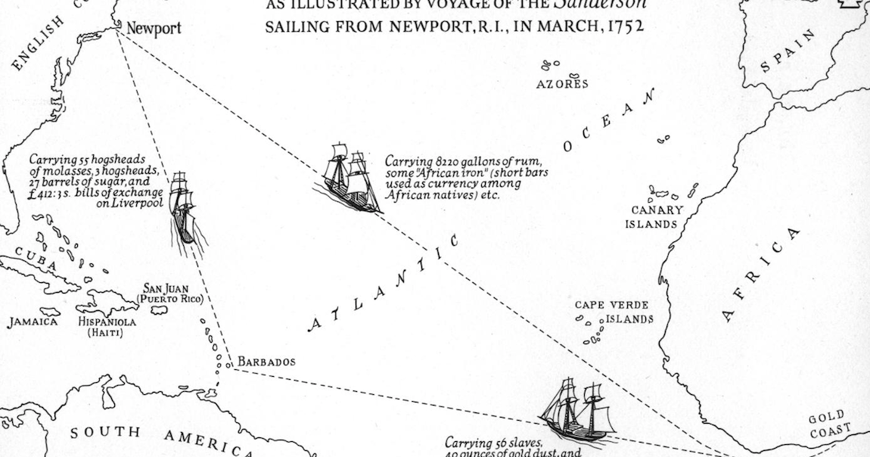
Triangular Trade
New England shippers traded rum for enslaved Africans
Slaves sold in West Indies for molasses
Molasses used to produce more rum
Cycle became known as the ‘triangular trade’

Slide 8
Summary of New England Colonies
Harsh climate shaped daily life
Strong Puritan religious influence
Economy relied heavily on the Atlantic Ocean
Important role in early colonial trade networks

