Slide 1
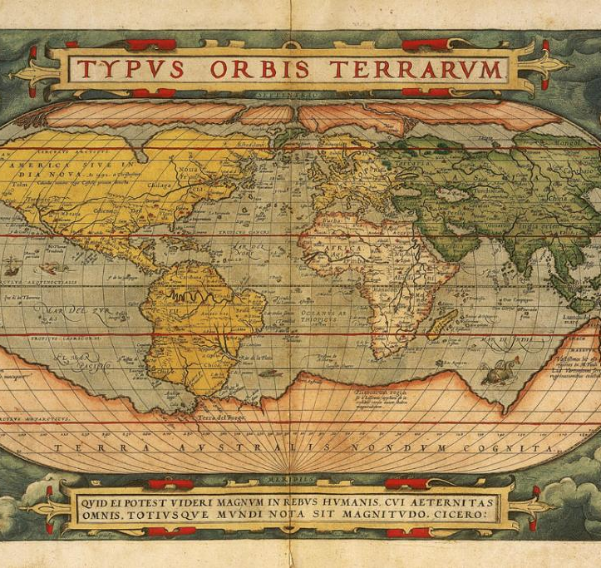
The Search for the Northwest Passage
Explorers seeking a sea route through North America to reach Asia.
https://learnaboutamerica.com

Slide 2

LearnAboutAmerica.com
*For our presentations, lesson plans, articles, printables, interactives, and games related to the Northwest Passage, please visit:
https://learnaboutamerica.com/american-history/explorers-and-the-age-of-exploration/unit-and-curriculum/the-search-for-the-northwest-passage
* For the greatest American History website for teachers, parents, and students, visit:
https://learnaboutamerica.com

Slide 3
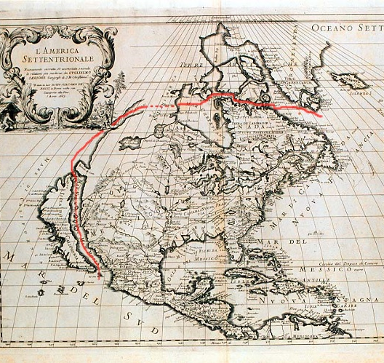
What Was the Northwest Passage?
- A hoped‑for water route linking the Atlantic and Pacific Oceans.
- Europeans believed it would provide a faster trade route to Asia.
- Many explorers risked dangerous voyages trying to find it.

Slide 4
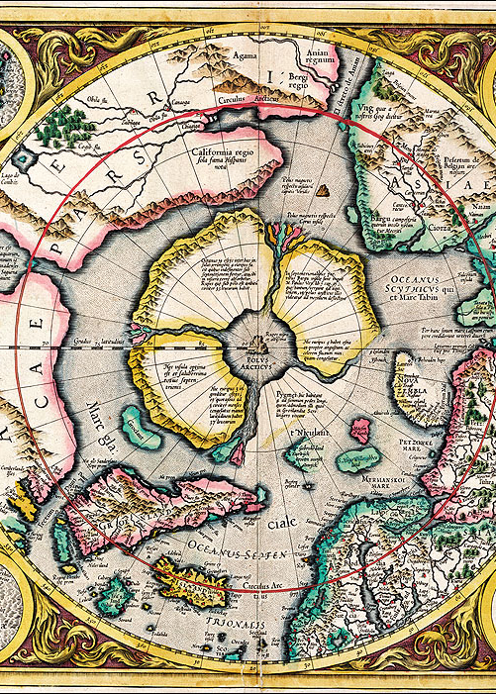
Why Explorers Searched for It
- Desire for wealth from Asian trade.
- Growing competition among European powers.
- Curiosity and the push for global discovery.

Slide 5
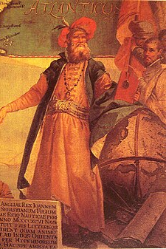
John Cabot (1497)
- Explored for England.
- Reached Newfoundland.
- Believed he had found a western route to Asia, stimulating further searches.

Slide 6
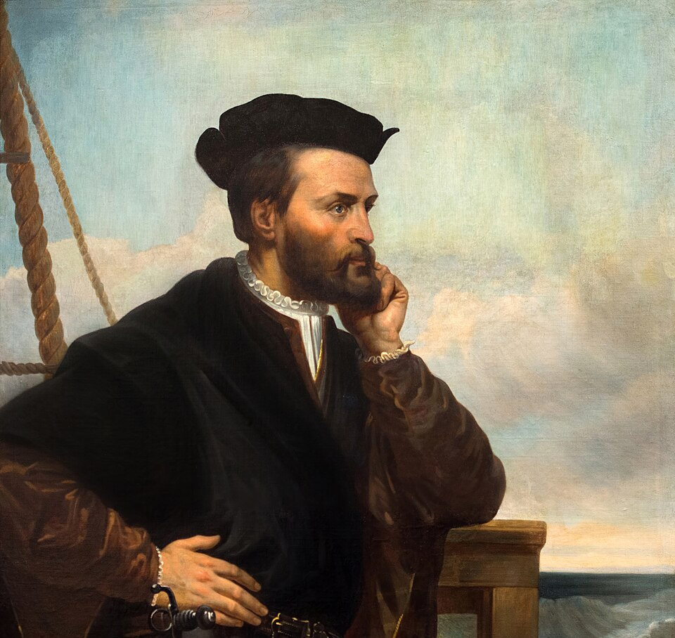
Jacques Cartier (1534–1542)
- Explored the Gulf of St. Lawrence.
- Looked for a western sea route but found inland waterways instead.
- Claimed land for France.

Slide 7
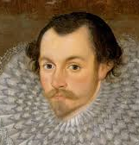
Martin Frobisher (1576–1578)
- Made three voyages into Arctic waters.
- Explored what is now Frobisher Bay.
- Returned samples believed to be gold, later discovered to be iron pyrite.

Slide 8
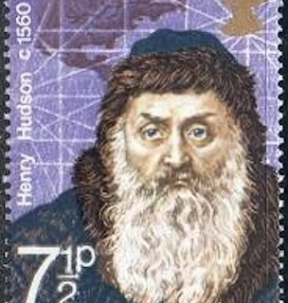
Henry Hudson (1609–1611)
- Explored the Hudson River and Hudson Bay.
- Continued searching for a northern route to Asia.
- His final voyage ended in mutiny when his crew set him adrift.

Slide 9
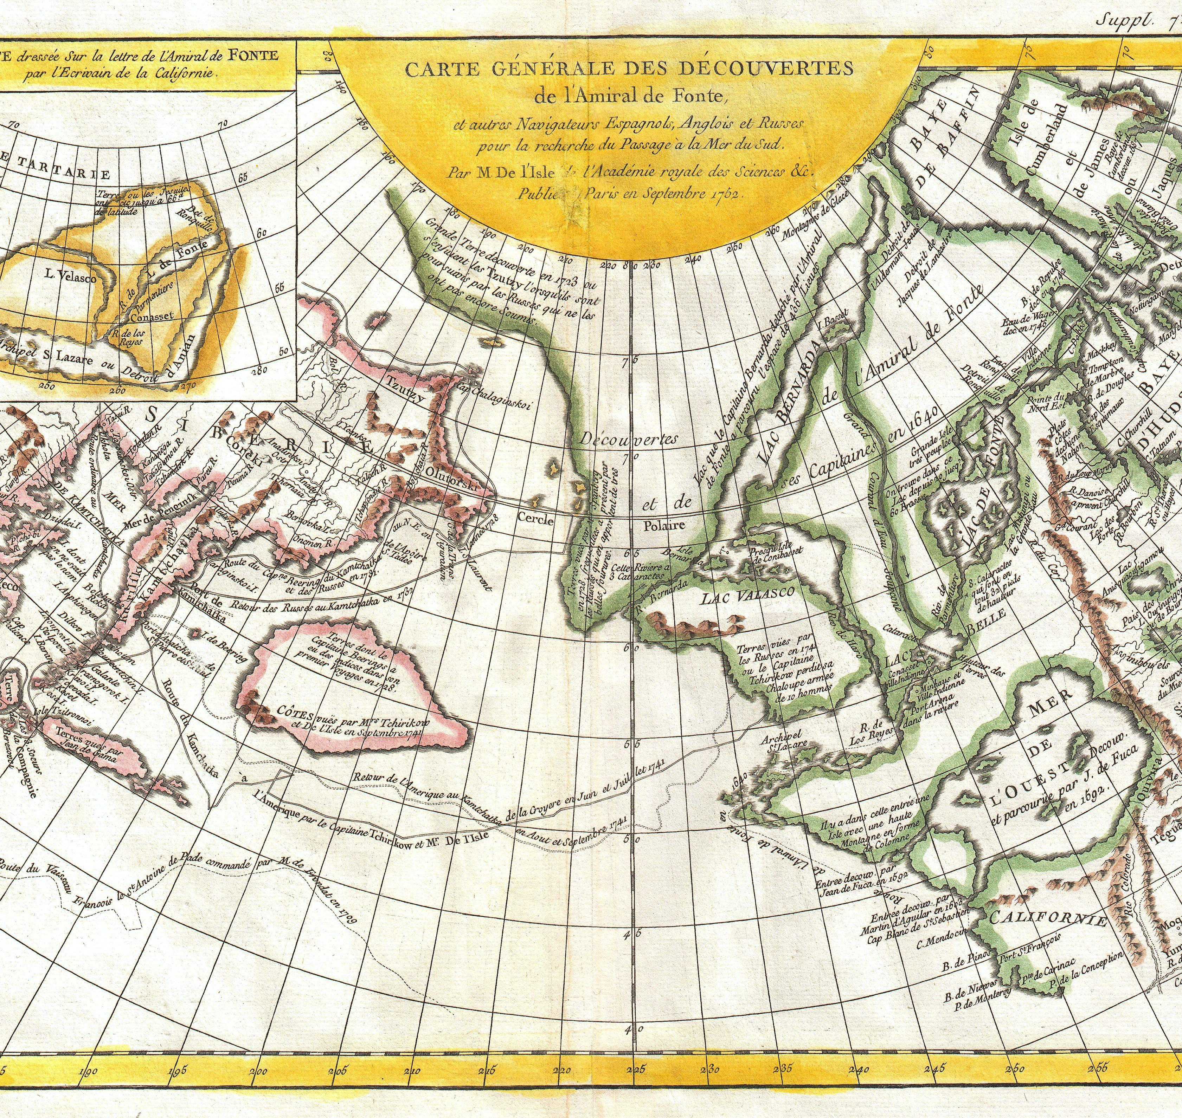
Challenges Faced
- Massive ice barriers and freezing temperatures.
- Storms, unpredictable seas, and limited navigation tools.
- Lack of accurate maps and unknown geography.

Slide 10
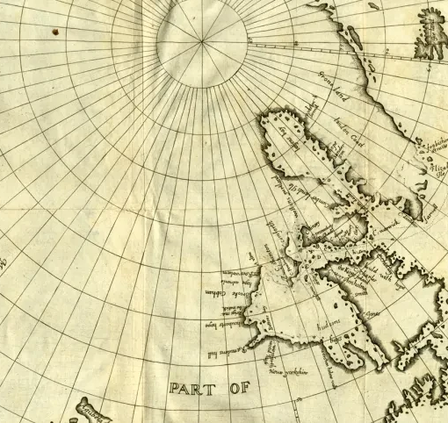
Impact of the Search
- Expanded European understanding of North America's geography.
- Led to detailed mapping of bays, rivers, and coastlines.
- Motivated future exploration and colonization.

Slide 11
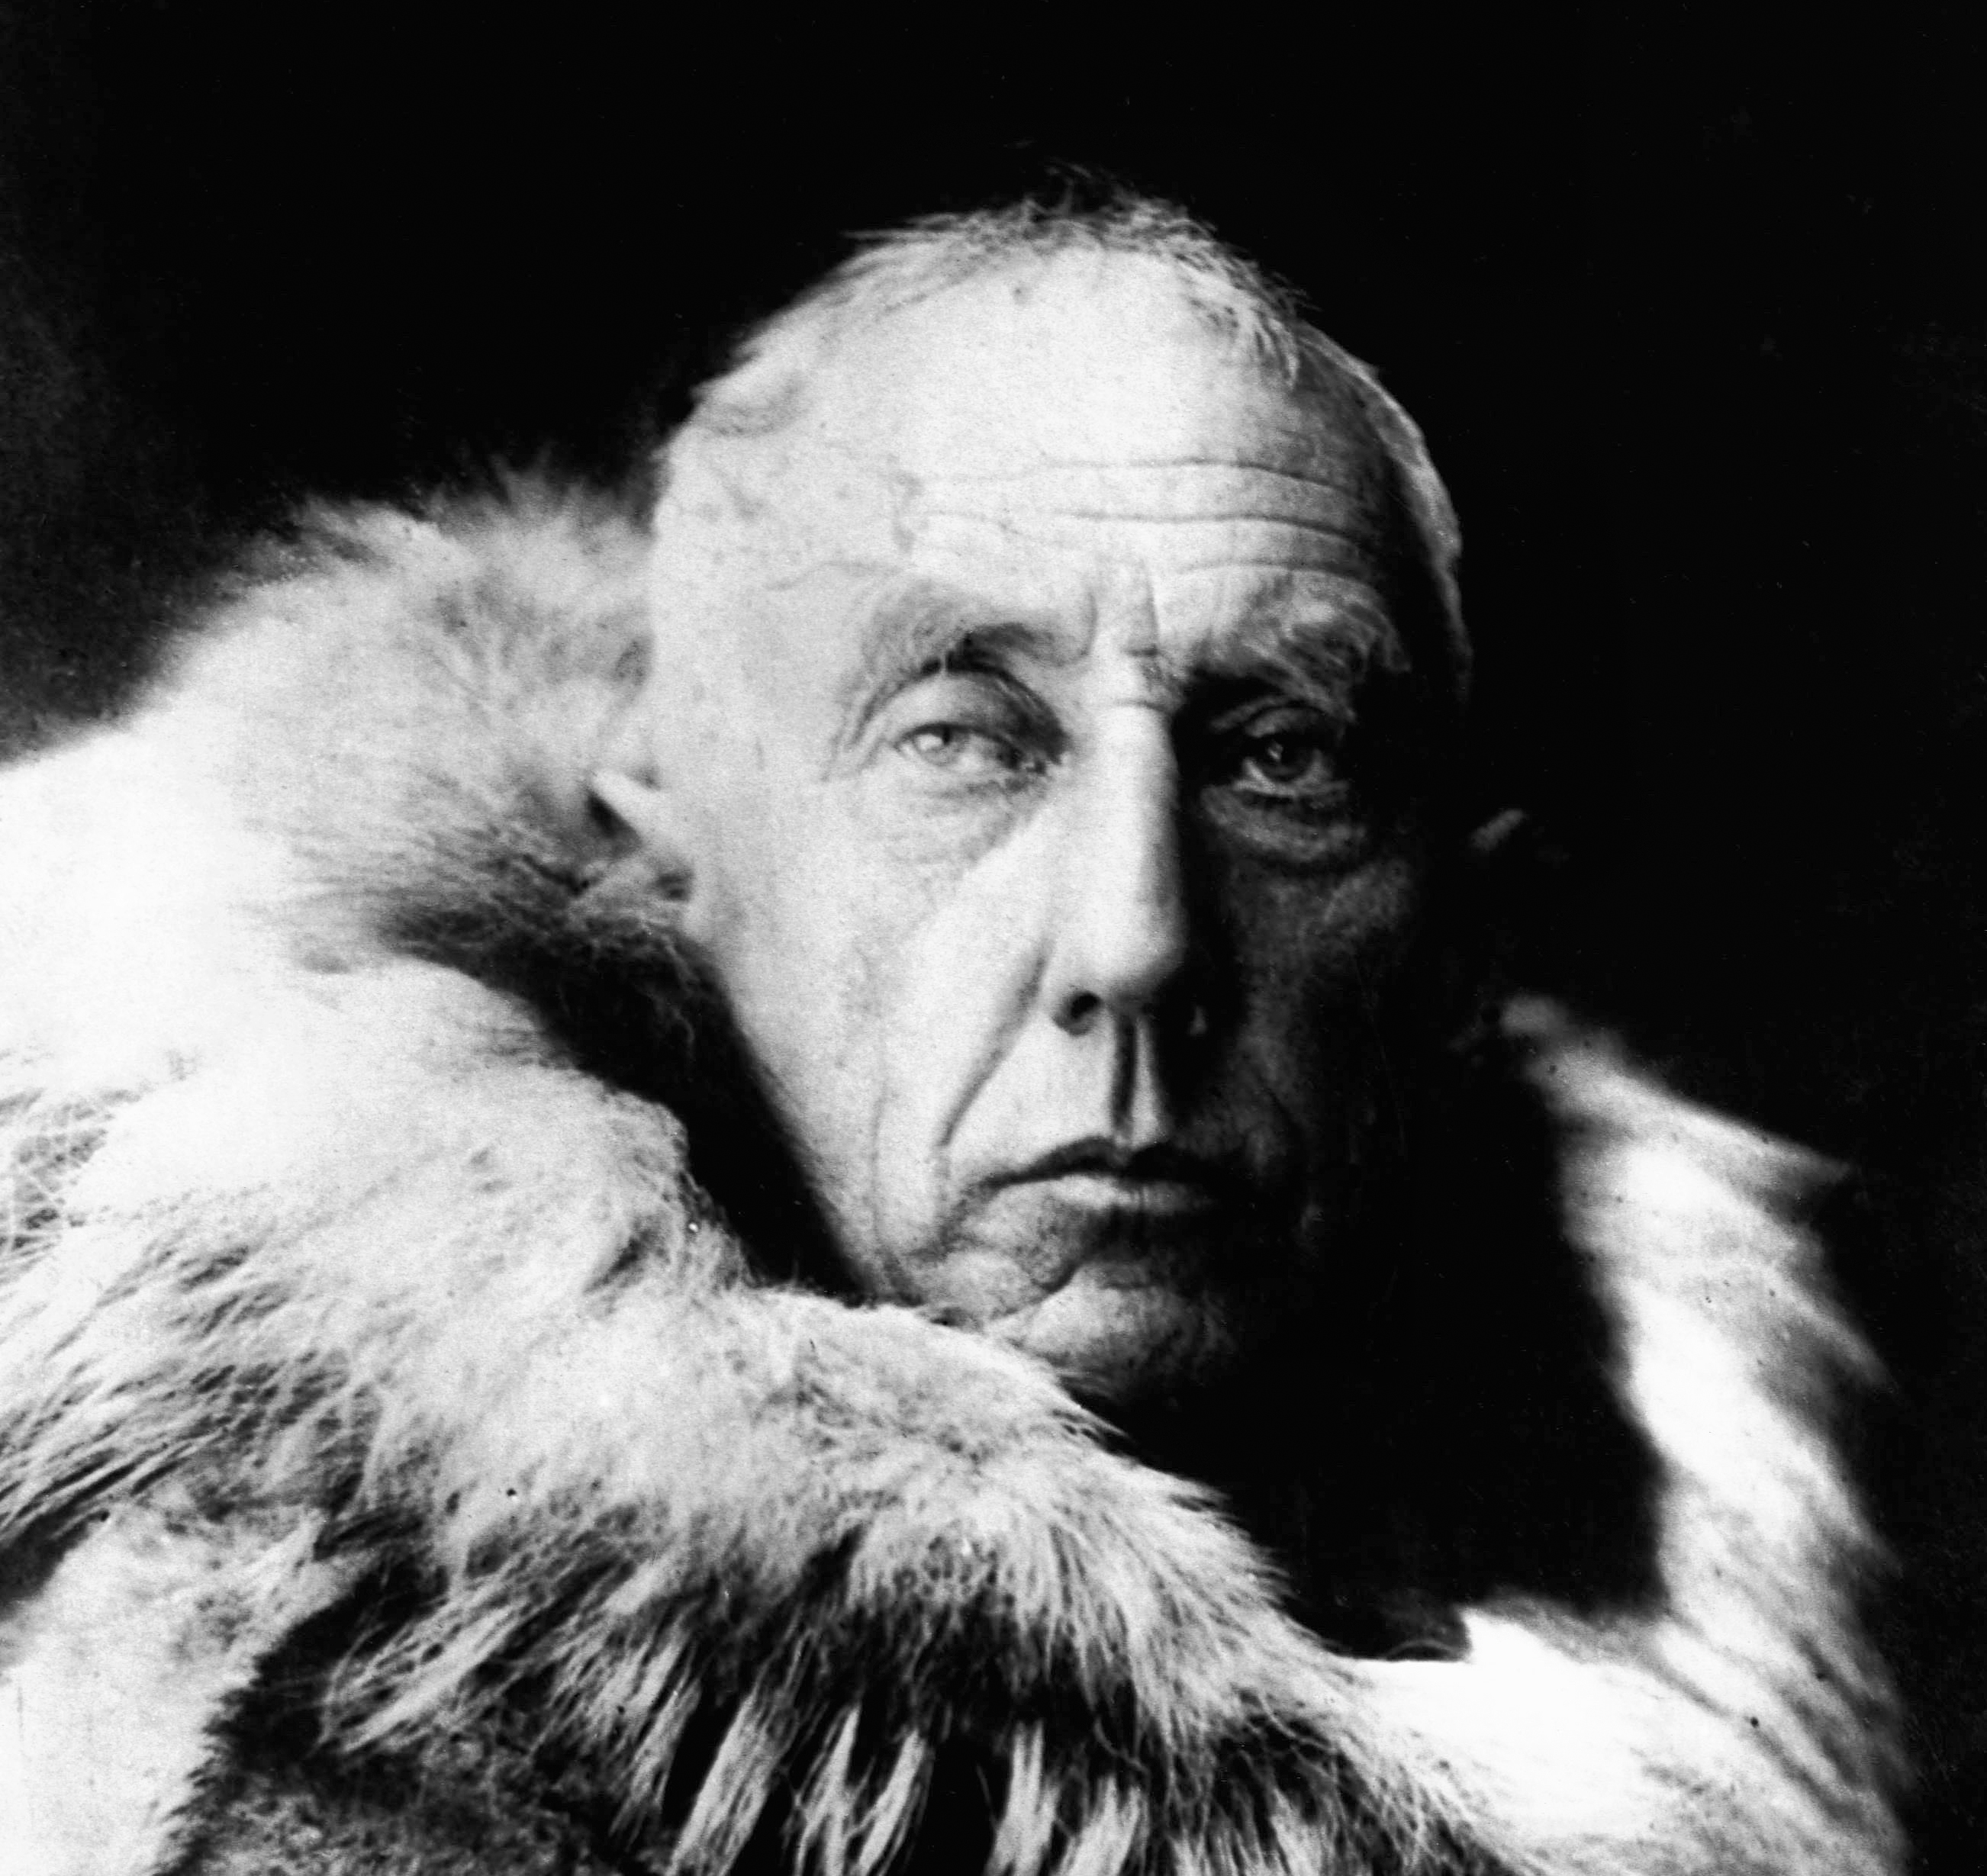
Discovery of the Passage (1906)
- Norwegian explorer Roald Amundsen completed the first full transit.
- Route proved too icy and slow for practical trade.
- Modern melting ice has made parts of the passage navigable today.

Slide 12
Discussion Questions
Why were European explorers so determined to find the Northwest Passage, even though the journey was extremely dangerous?
How did the geography and climate of the Arctic make the search for the passage difficult for explorers like Hudson, Frobisher, and Cartier?
Even though early explorers never found a usable Northwest Passage, how did their voyages still change history?
Do you think explorers of the Age of Exploration were mostly motivated by curiosity, wealth, national pride, or something else? Explain your reasoning.

