Slide 1
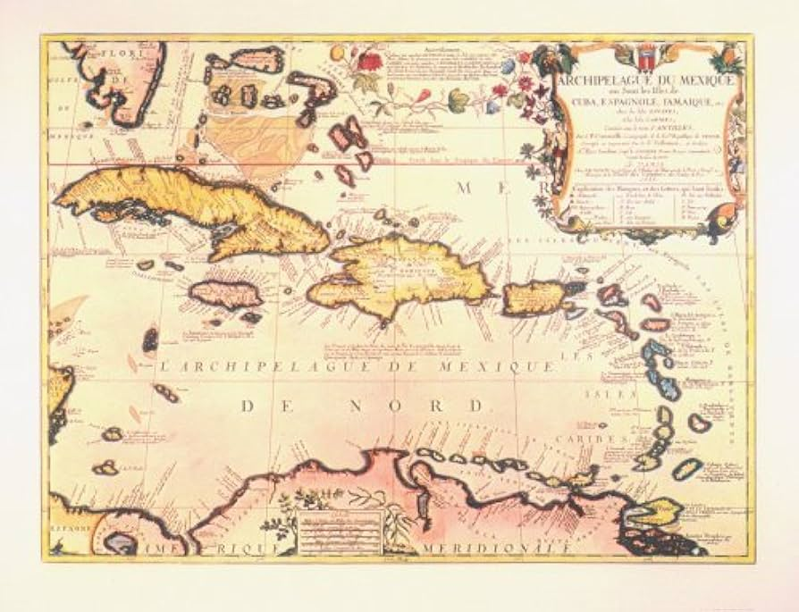
The Sea Dogs of the Age of Exploration https://learnaboutamerica.com

Slide 2

LearnAboutAmerica.com
*For our presentations, lesson plans, articles, printables, interactives, and games related to Sea Dogs and Pirates, please visit:
https://learnaboutamerica.com/american-history/explorers-and-the-age-of-exploration/unit-and-curriculum/the-sea-dogs-of-the-age-of-exploration
* For the greatest American History website for teachers, parents, and students, visit:
https://learnaboutamerica.com

Slide 3
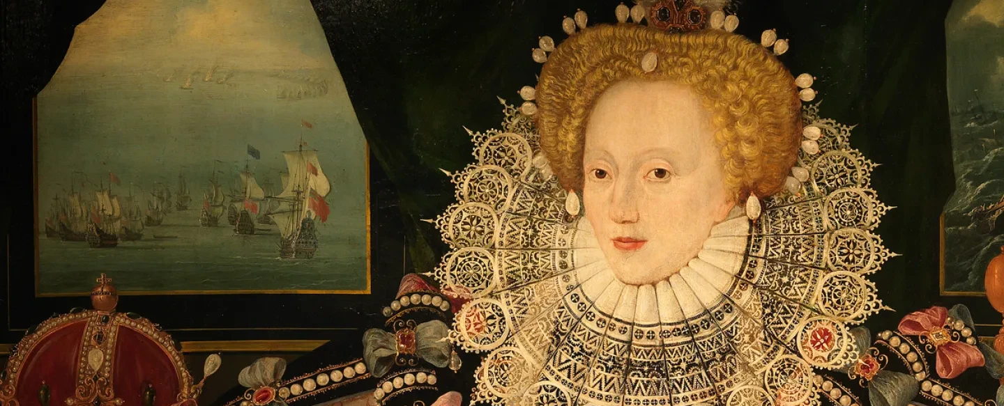
Who Were the Sea Dogs?
- English sailors licensed by Queen Elizabeth I.
- Raided Spanish ships and colonies.
- Helped weaken Spanish control in the New World.

Slide 4
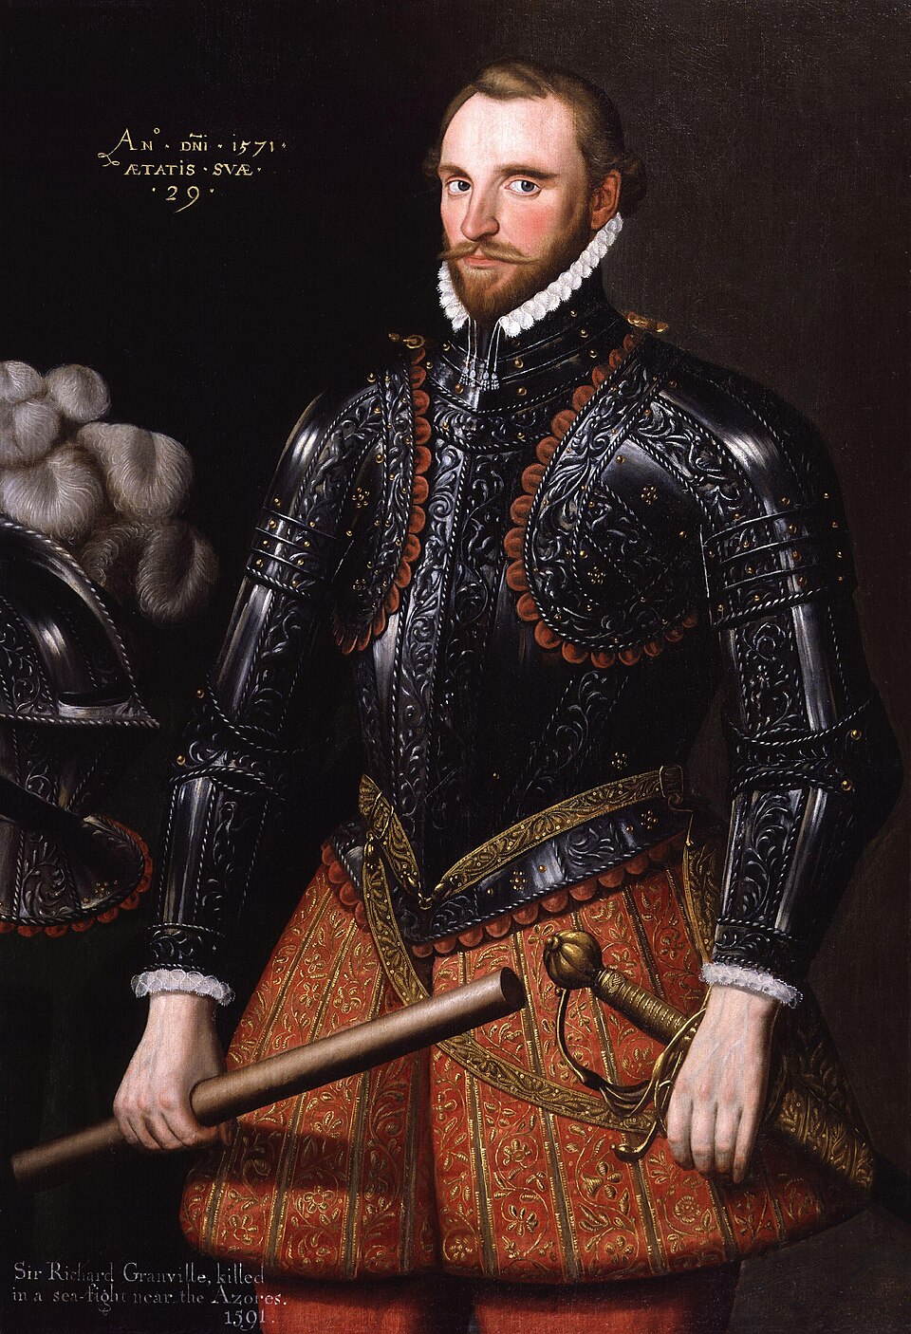
Why England Supported the Sea Dogs
- Break Spanish dominance in the Americas.
- Capture treasure and wealth.
- Strengthen England's navy and global influence.

Slide 5
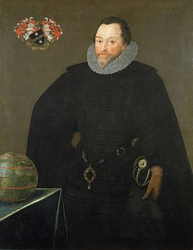
Sir Francis Drake
- Most famous Sea Dog.
- Raided Spanish ports and treasure fleets.
- First Englishman to circumnavigate the globe (1577–1580).

Slide 6
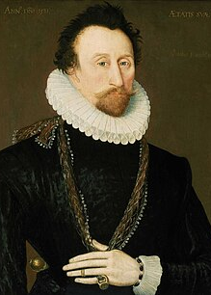
Sir John Hawkins
- Naval commander and early Sea Dog.
- Helped build a stronger English navy.
- Fought Spain during major conflicts.

Slide 7
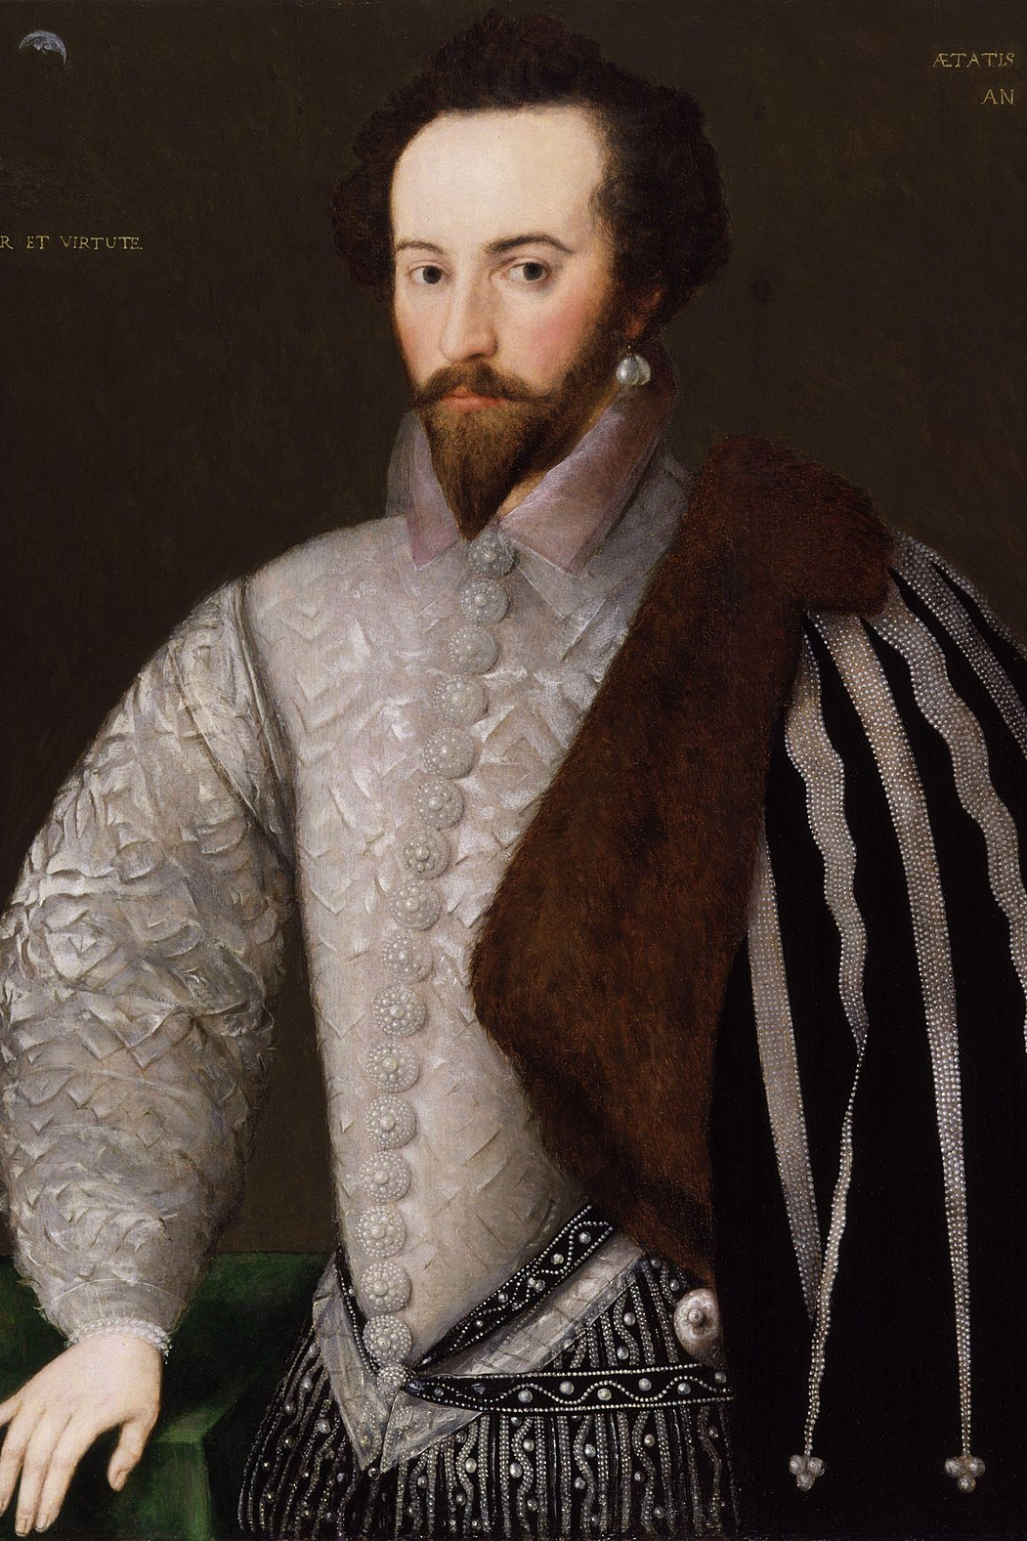
Sir Walter Raleigh
- Supported exploration and colonization.
- Linked to the Roanoke Colony.
- Promoted English settlement in the New World.

Slide 8
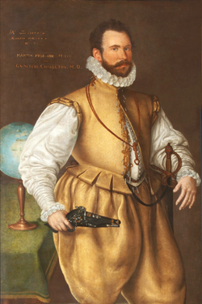
Martin Frobisher
- Searched for the Northwest Passage.
- Explored Arctic regions.
- Served England as a privateer against Spain.

Slide 9
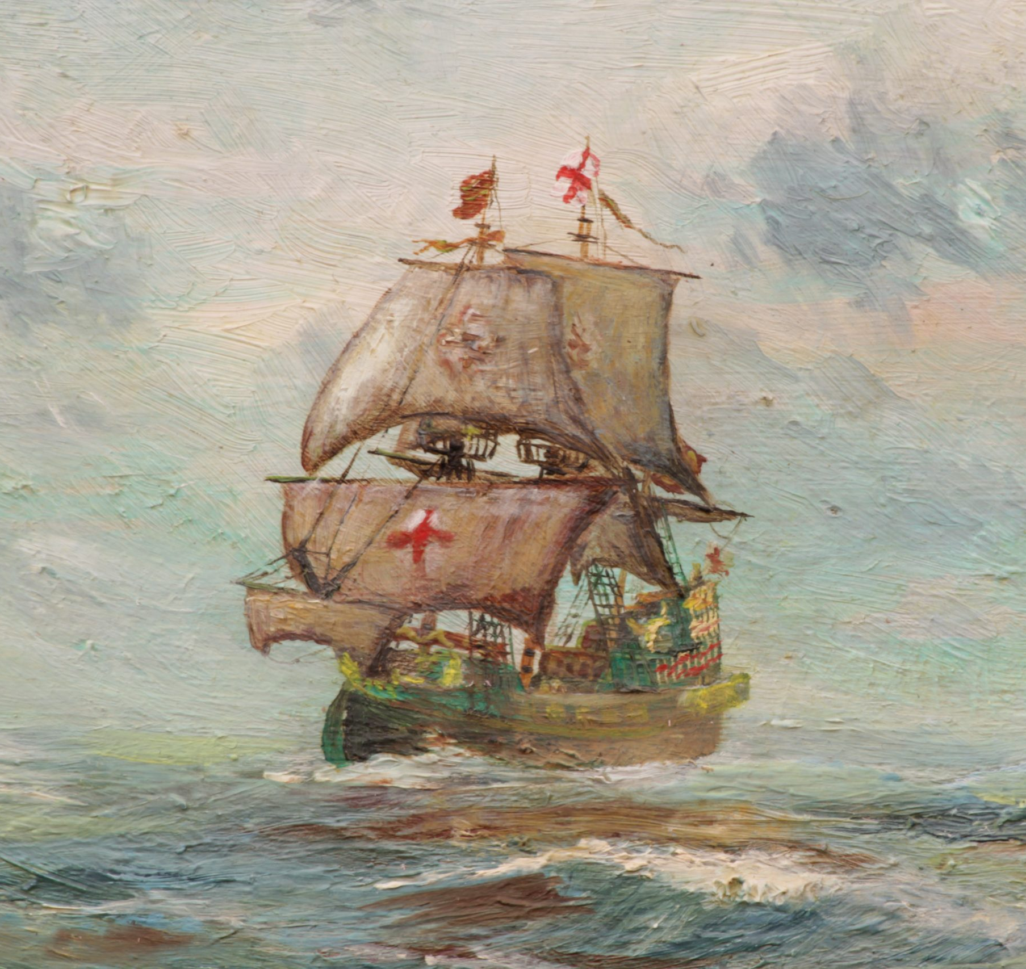
Impact of the Sea Dogs
- Brought wealth to England.
- Weakened Spanish dominance.
- Contributed to England’s rise as a naval power.

Slide 10
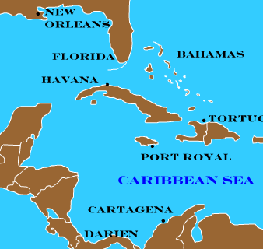
Legacy
- Viewed as heroes in England and pirates by Spain.
- Influenced English exploration and colonization.

