Slide 1
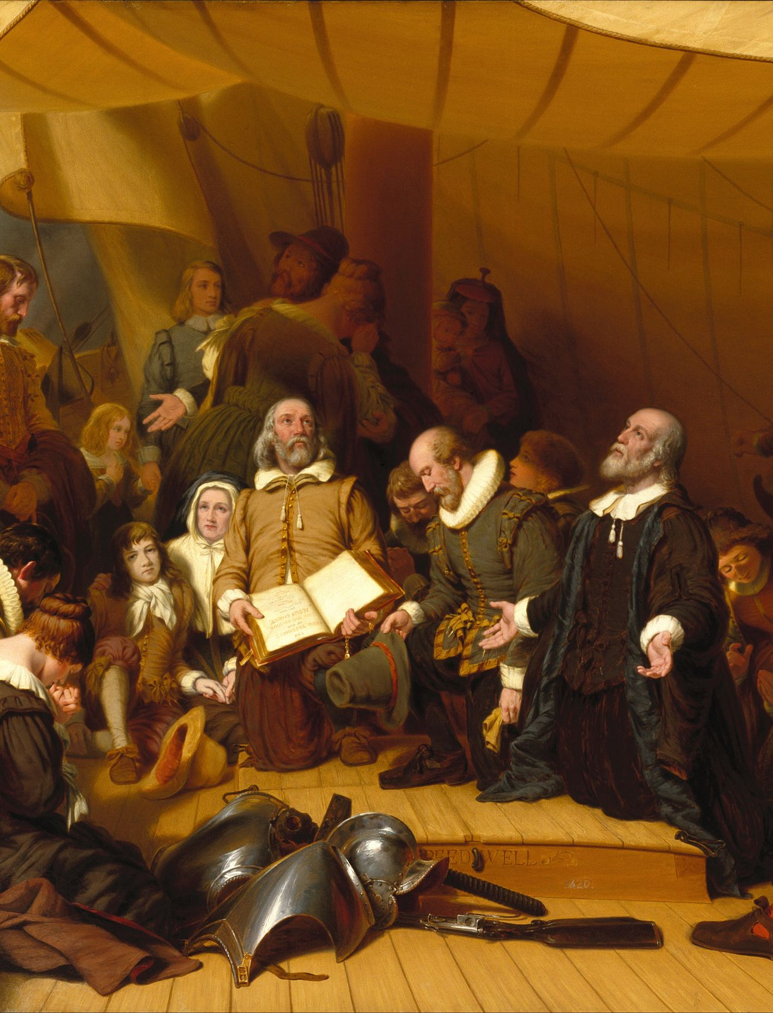
Pilgrims, the Mayflower Compact, and Squanto
A Journey Toward Freedom and Survival
https://learnaboutamerica.com

Slide 2

LearnAboutAmerica.com
*For our presentations, lesson plans, articles, printables, interactives, stories, and games related to Plymouth, please visit:
https://learnaboutamerica.com/american-history/13-colonies/colonies-and-cities/plymouth-colony
* For the greatest American History website for teachers, parents, and students, visit:
https://learnaboutamerica.com

Slide 3
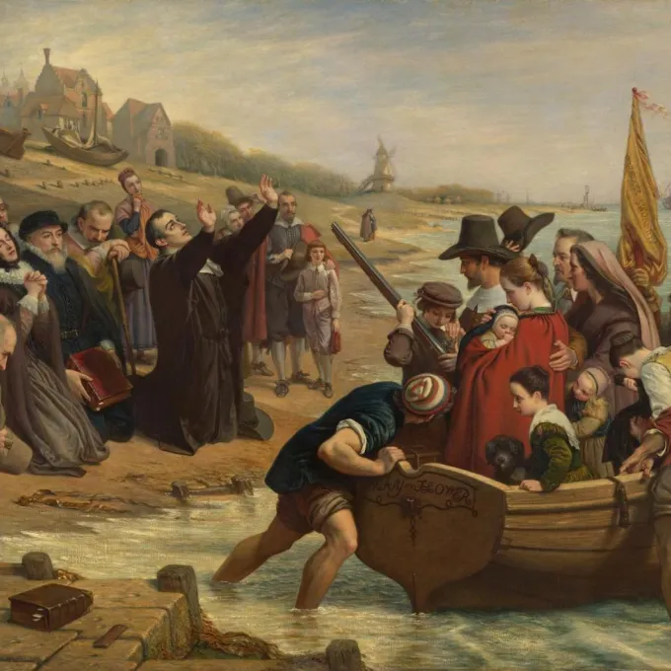
Escaping Persecution
• Puritan separatists left England in 1607 seeking religious freedom.
• Lived in the Netherlands but denied citizenship and skilled jobs.
• Concerned their children were drifting from the church.
• Struck a deal with the Merchant Adventurers to travel to America.
• Passage financed in exchange for future repayment and profits.

Slide 4
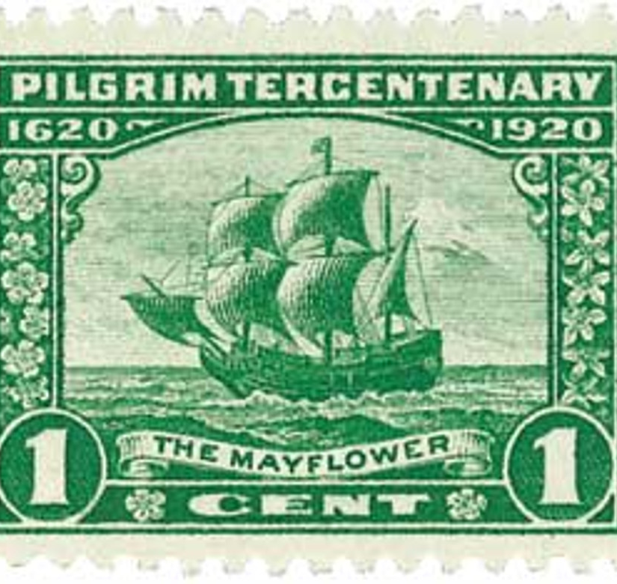
We Thought Virginia Was the Destination!
• Mayflower departed Sept. 16, 1620 with 35 Pilgrims and 67 others.
• Stormy 10‑week Atlantic journey.
• Landed at Cape Cod, not Virginia, on Nov. 11, 1620.
• Some believe the ship intended New England all along.
• Passengers threatened mutiny since charter applied only to Virginia.

Slide 5
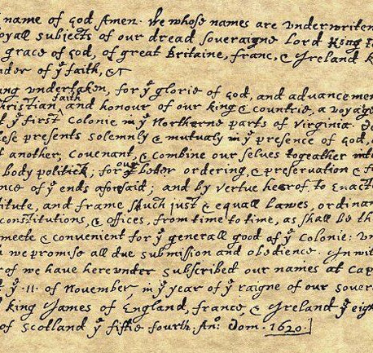
The Mayflower Compact (Expanded)
• Created to establish order and unity among settlers.
• Promised equal treatment and fair laws for all male colonists.
• Formed the first self‑governing civil body in the New World.
• Affirmed loyalty to England but allowed independent decisions.
• Signed by 41 men—foundation for later colonial democracy.
• Ensured cooperation for survival during the first hard winter.

Slide 6
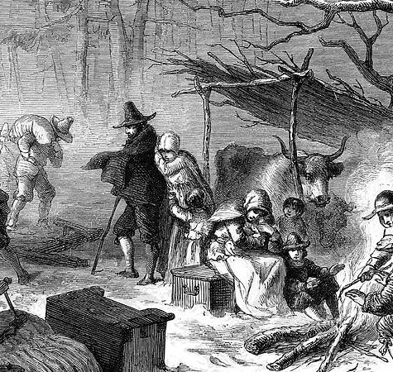
Should We Stay or Should We Go?
• Arrived too late in the year to plant crops.
• No established relations with Abenaki tribe.
• Half of the settlers returned to England.
• Those who stayed endured a brutal winter.
• 44 of 45 remaining colonists survived.

Slide 7
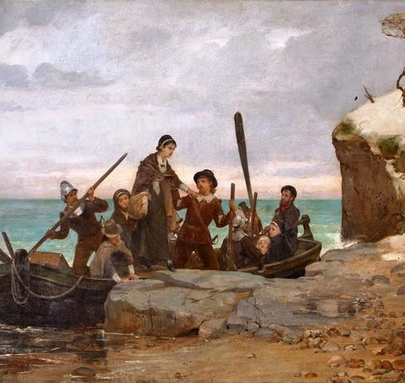
Finding a Home at Plymouth
• Mayflower Compact united the settlers.
• Council of New England formed for governance.
• Promised 100 acres to each settler who stayed seven years.
• After weeks exploring the coast, chose Plymouth on Dec. 21, 1620.

Slide 8
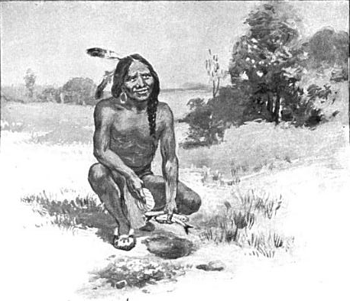
Squanto and Massasoit Save the Pilgrims
• Harsh winter killed half of the Mayflower passengers.
• Wampanoag attacks were not a threat—relations remained peaceful.
• Squanto, kidnapped years earlier, lived in Europe and spoke English.
• Returned to find his village destroyed; joined Wampanoag.
• Taught Pilgrims farming, fishing, and trapping.
• Massasoit formed a critical alliance ensuring Pilgrim survival.

Slide 9
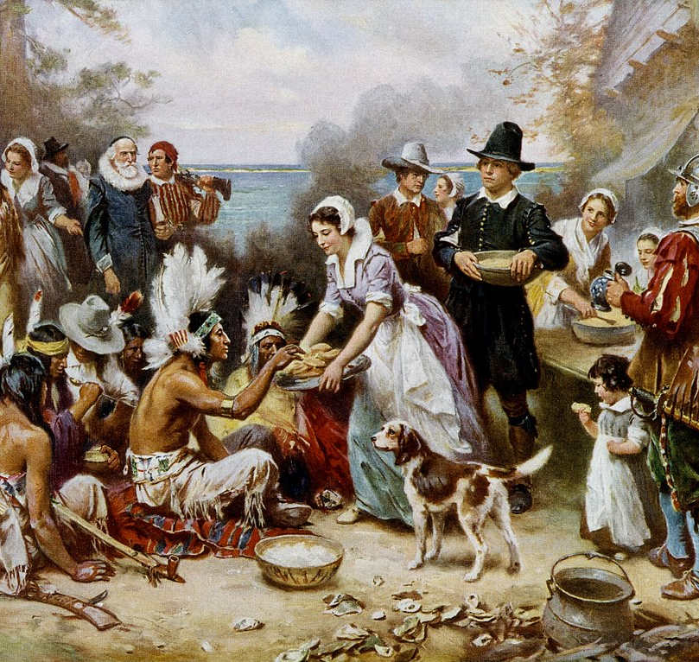
The First Thanksgiving
• Pilgrims survived their first year with Wampanoag help.
• Celebrated fall harvest with a large feast.
• Invited 91 Wampanoag neighbors.
• Often considered the first Thanksgiving.
• Symbol of cooperation and shared survival.

Slide 10
Discussion Questions
Discussion Questions
Why do you think the Pilgrims chose to stay in America despite the hardships they faced during their first winter?
How did the Mayflower Compact influence the future of self-government in the colonies?
In what ways did Squanto’s unique life experiences make him essential to the Pilgrims’ survival?
How might the First Thanksgiving have been different without the alliance between the Pilgrims and the Wampanoag?

