Slide 1

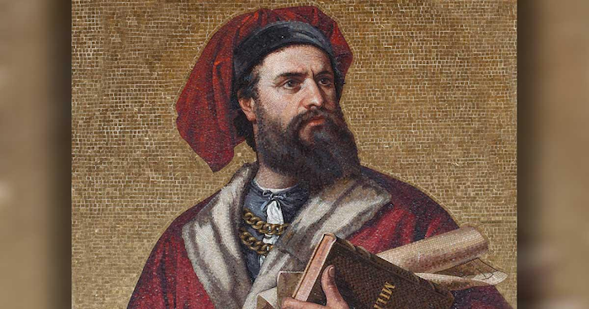
Marco Polo and the Silk Road

Slide 2
LearnAboutAmerica.com
* For detailed lesson plans, articles, interactive activities, and printables related to Marco Polo and the Silk Road, visit
https://learnaboutamerica.com/american-history/explorers-and-the-age-of-exploration/battles/marco-polo
* For the greatest American History website for teachers, parents, and students, visit:
https://learnaboutamerica.com

Slide 3
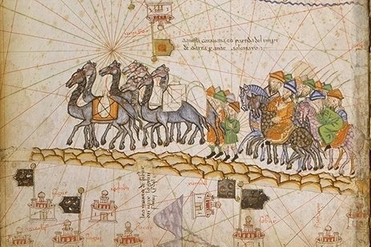
Marco Polo: Explorer of the East
He was an Italian explorer whose travels to China helped inspire the Age of Exploration.

Slide 4
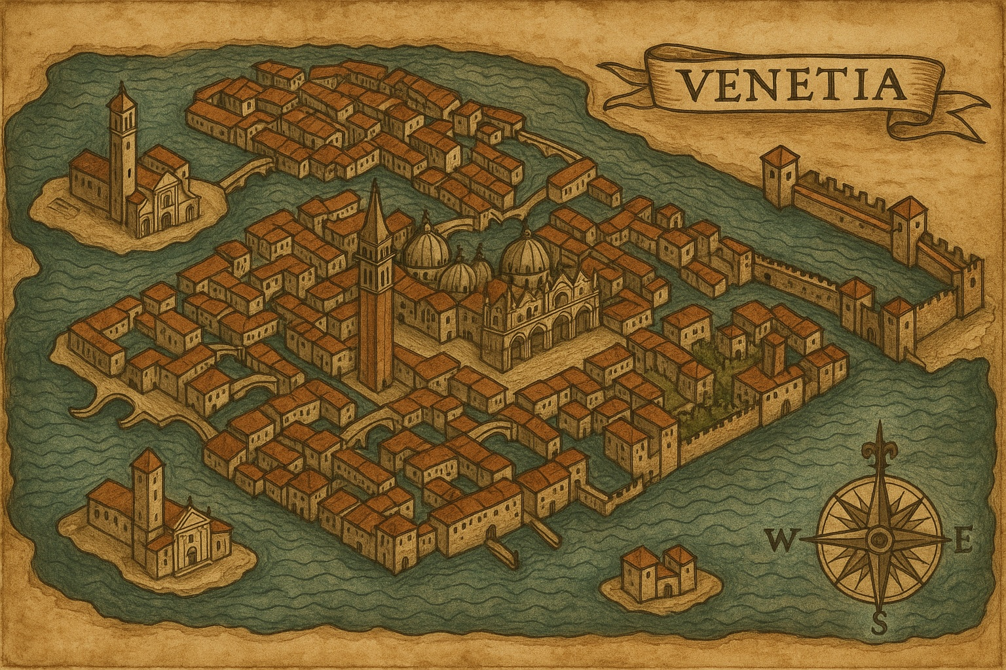
Early Life
Marco Polo was born in Venice, Italy in 1254 to a family of merchants.

Slide 5
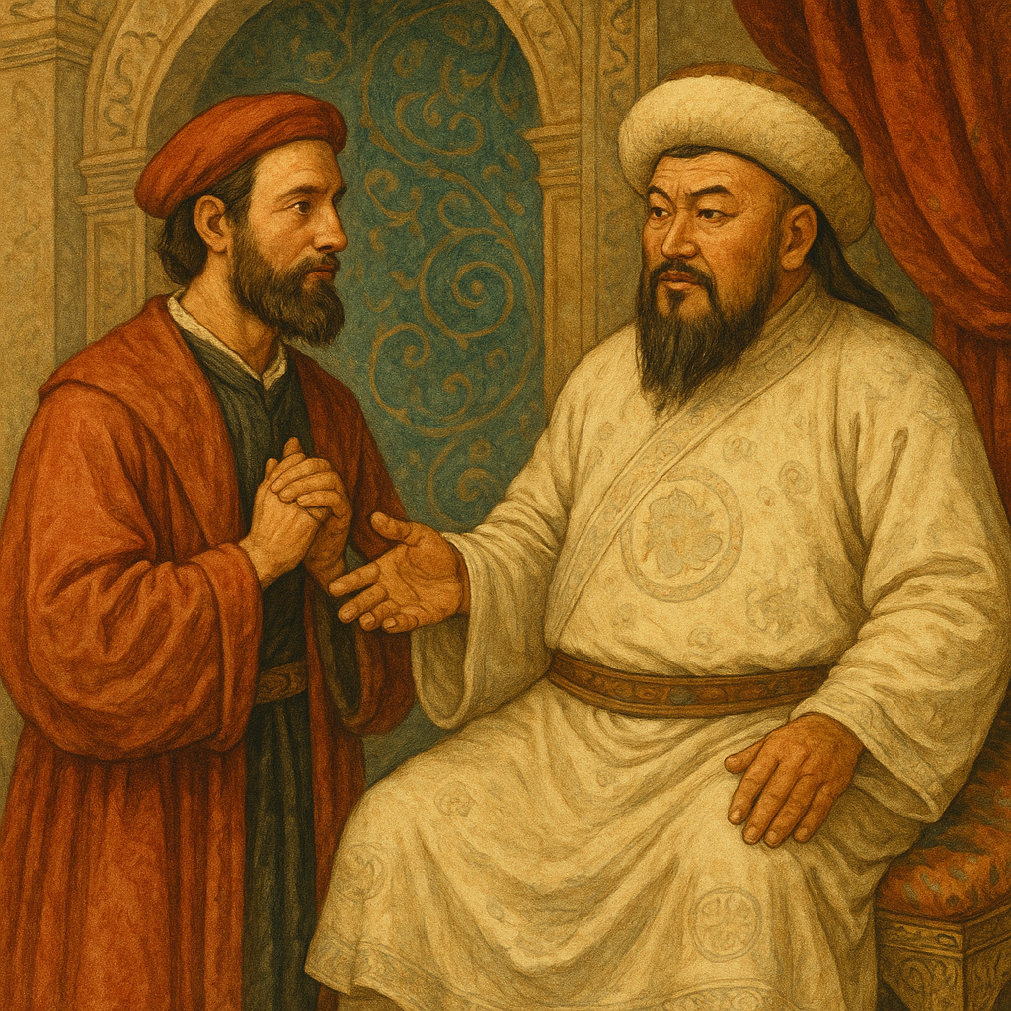
Journey to Meet Kublai Khan
In 1264, his father and uncle traveled for two years to meet Kublai Khan in China. In 1271, they traveled again and brought Marco along.

Slide 6
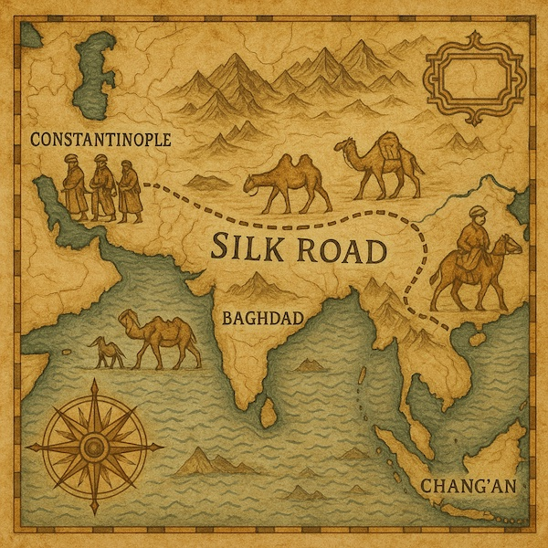
Crossing the Silk Road
They traveled through Iraq, Iran, Turkmenistan, and the Gobi Desert to reach Shangdu in 1275.

Slide 7
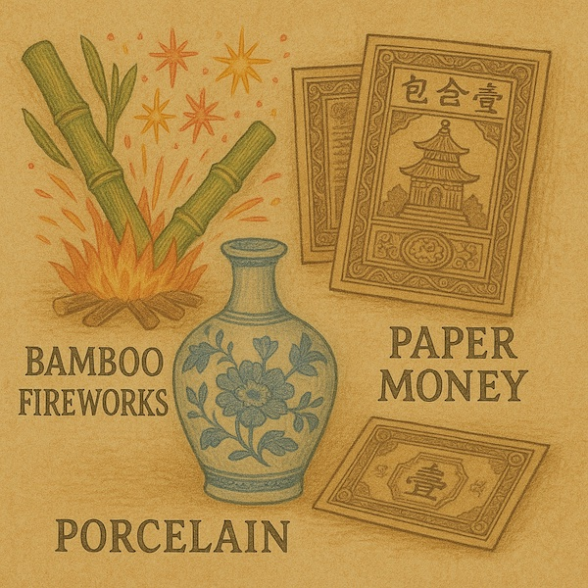
Descriptions of China
Marco kept a detailed journal and wrote about paper money, porcelain, vast cities, and powerful trade networks he saw.

Slide 8
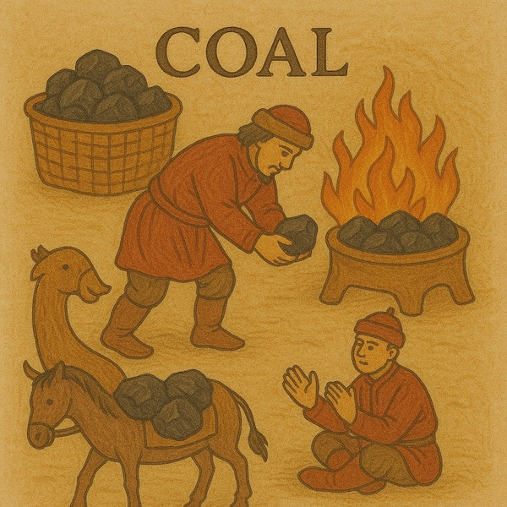
Descriptions of China
Polo also wrote about the prodigious iron works, salt mines, and network of canals that connected China's cities. He also described the coal that Mongolians used as black rocks that burn like wood.

Slide 9
Primary Source
Polo described the city of Beijing, which was then called Cambuluc below:
"It has a vast population inside the walls and outside, that it seems quite past all possibility. There is a suburb outside each of the gates, which are twelve in number; and these suburbs are so great that they contain more people than the city itself [for the suburb of one gate spreads in width till it meets the suburb of the next, whilst they extend in length some three or four miles]."

Slide 10
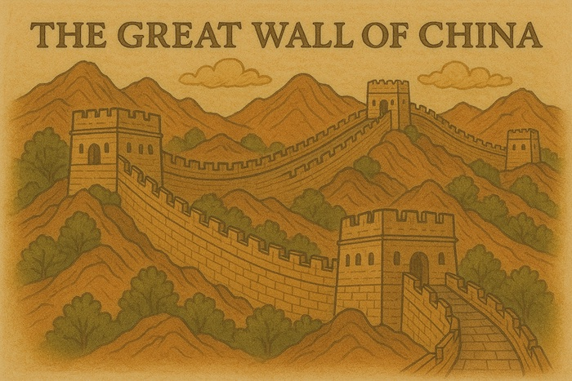
Were his Writings True?
Doubters point out that he failed to mention things like the Great Wall of China and described the Mongols in a much more complimentary way than did previous explorers.

Slide 11
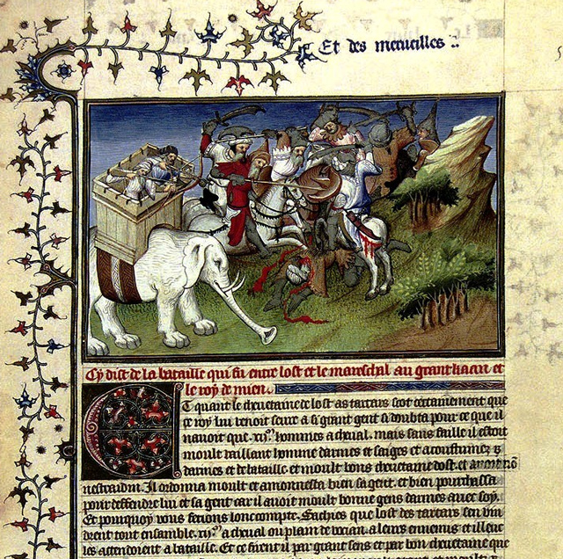
Impact on Europe
Nevertheless, his writings fascinated Europeans and inspired future explorers seeking riches in the East.

Slide 12
Questions to Consider
• Why was Marco Polo's journey important for Europe?
• What made his stories so interesting?
• How might he have felt traveling so far?
• What would you ask Marco Polo?

