Slide 1
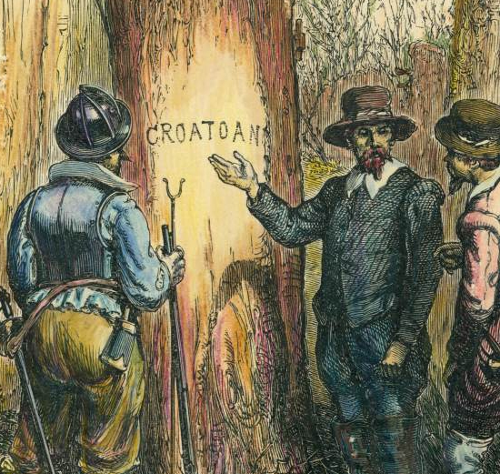
The Lost Colony at Roanoke
Sir Walter Raleigh’s Mysterious Settlement

Slide 2

LearnAboutAmerica.com
*For our presentations, lesson plans, articles, printables, interactives, and games related to the Lost Colony, please visit:
https://learnaboutamerica.com/american-history/13-colonies/events-of-the-13-colonies/the-lost-colony-of-roanoke-island
* For the greatest American History website for teachers, parents, and students, visit:
https://learnaboutamerica.com

Slide 3
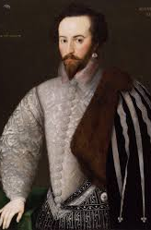
Sir Walter Raleigh's Colony Had Dual Purposes
• First English colony in the New World (1587)
• Funded by Sir Walter Raleigh; led by John White
• Main goal: search for riches
• Secondary goal: base for privateers to attack Spanish ships
• Settlers originally believed site might be Chesapeake Bay

Slide 4
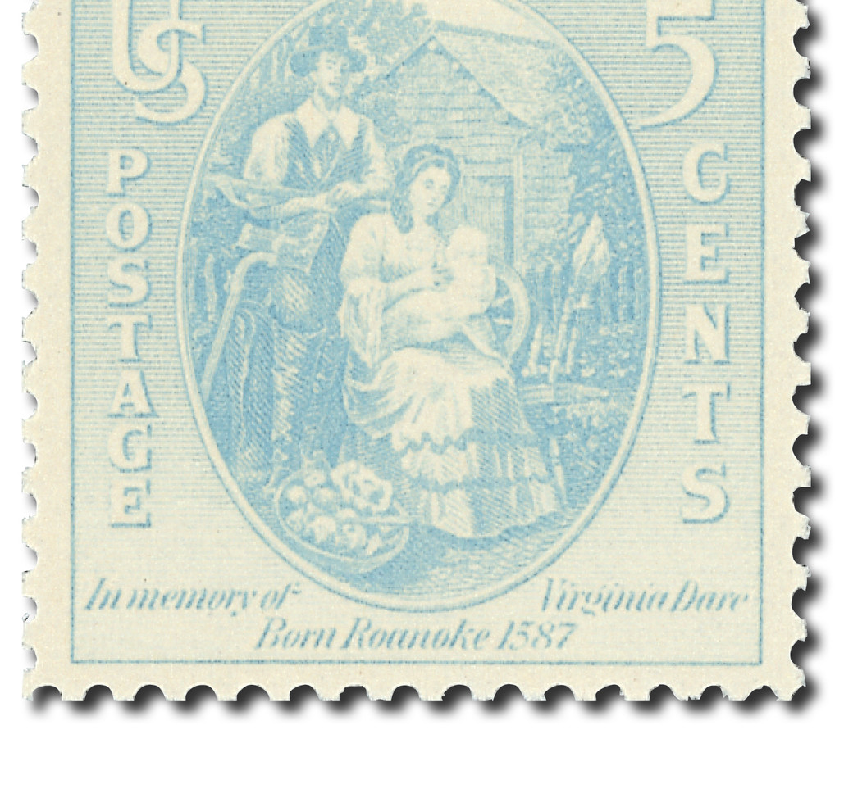
John White's Absence
• Virginia Dare, first English child, born soon after arrival
• Colony needed supplies—White returned to England
• Anglo-Spanish War prevented his return
• All ships were being used for war efforts

Slide 5
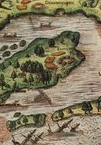
What Happened to the Colonists?
• White returned in 1590—colony deserted
• No signs of struggle; fortifications dismantled
• Only clue: “Croatoan” carved into a post
• Theories:
– Joined local native groups to survive
– Died due to severe drought
– Killed by Spanish or other native groups
– Powhatan claimed responsibility

Slide 6
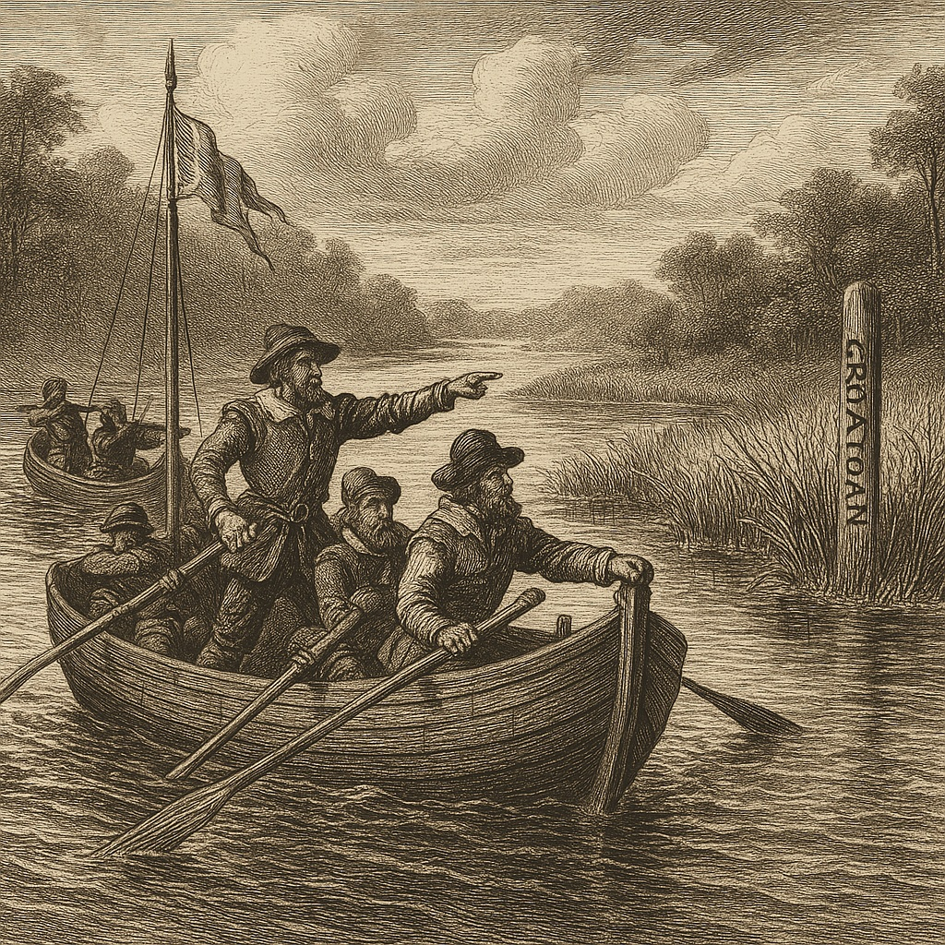
Will We Ever Know?
• Mystery remains unsolved
• Fate of settlers still unknown
• Failure of Roanoke led to founding of Jamestown in 1607

Slide 7
Roanoke timeline
1584 – Raleigh receives charter to start a colony.
1585 – First Roanoke attempt fails.
1587 – 117 settlers arrive; John White leads; Virginia Dare born.
1587 (Late) – White returns to England for supplies.
1588 – War with Spain prevents his return.
1590 – White returns; colony is gone; “CROATOAN” carved on post.
1607 – Jamestown founded; Roanoke remains a mystery.

Slide 8
Discussion Questions
Why do you think the colonists agreed to let John White return to England, even though it was risky?
What does the word “CROATOAN” suggest about what might have happened to the settlers?
How did the Anglo-Spanish War influence the fate of the colony?
Why is the mystery of Roanoke still important for understanding early American history?

Slide 9
Deep Thought
If you were one of the Roanoke colonists facing drought, scarce supplies, and an uncertain future, what choice would you have made for survival—and why? Explain your reasoning using evidence from the story of the Lost Colony.

