Slide 1

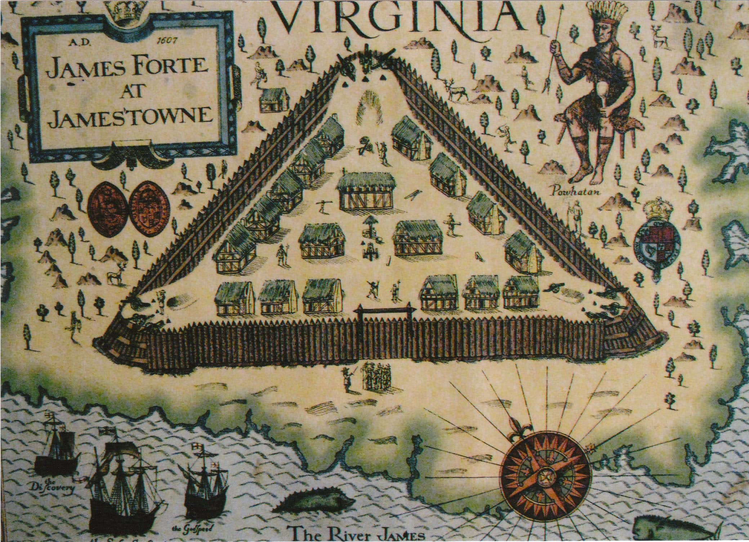
The Southern Colonies
Maryland • Virginia • North Carolina • South Carolina • Georgia
Southern Colonies
https://learnaboutamerica.com

Slide 2
LearnAboutAmerica.com
*For our presentations, lesson plans, articles, printables, interactives, stories, and games related to the Middle Colonies, please visit:
https://learnaboutamerica.com/american-history/13-colonies/13-colonies-regions/southern-colonies
* For the greatest American History website for teachers, parents, and students, visit:
https://learnaboutamerica.com

Slide 3
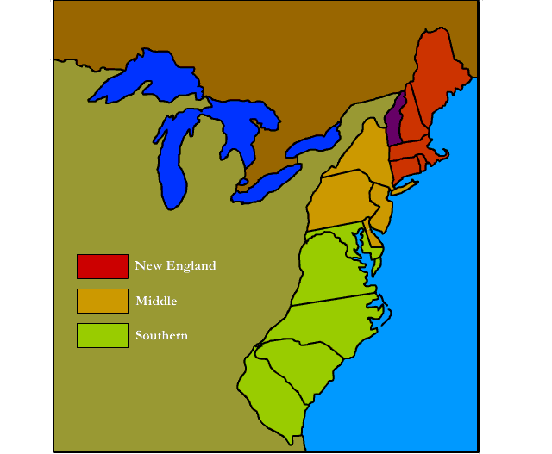
Southern Colonies
Maryland
Virginia
North Carolina
South Carolina
Georgia

Slide 4
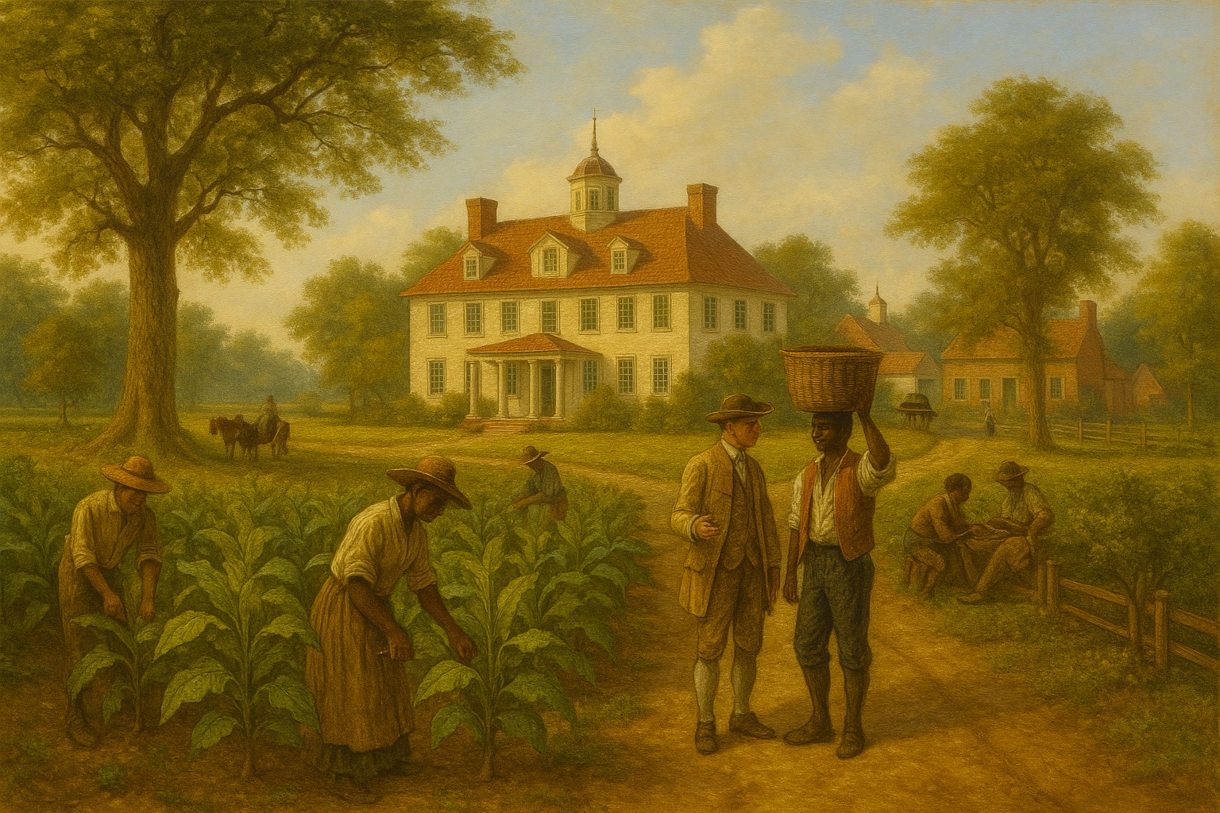
Climate & Geography
Warm climate with hot summers and mild winters
Coastal plains, piedmont, and mountainous western regions
Rich soil ideal for farming
Longest growing season of all colonial regions
Hot climate increased diseases like malaria and yellow fever

Slide 5
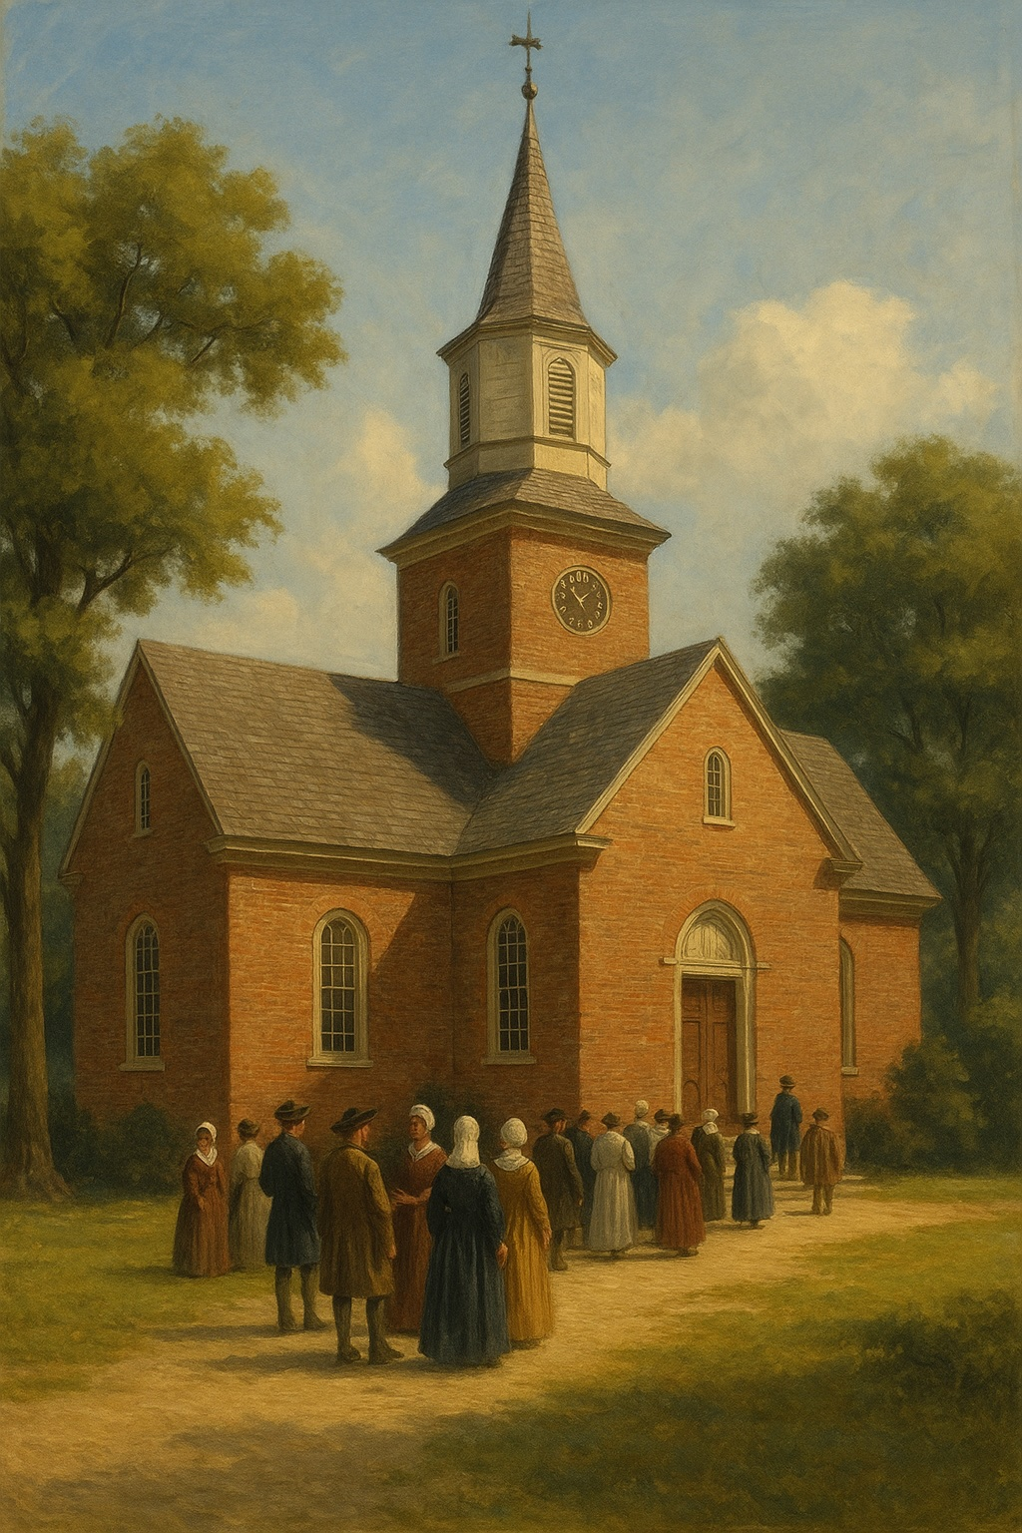
Religion in the Southern Colonies
Most were Anglican (Baptist or Presbyterian)
Maryland founded as a refuge for English Catholics
Religion less influential because plantations were far apart

Slide 6
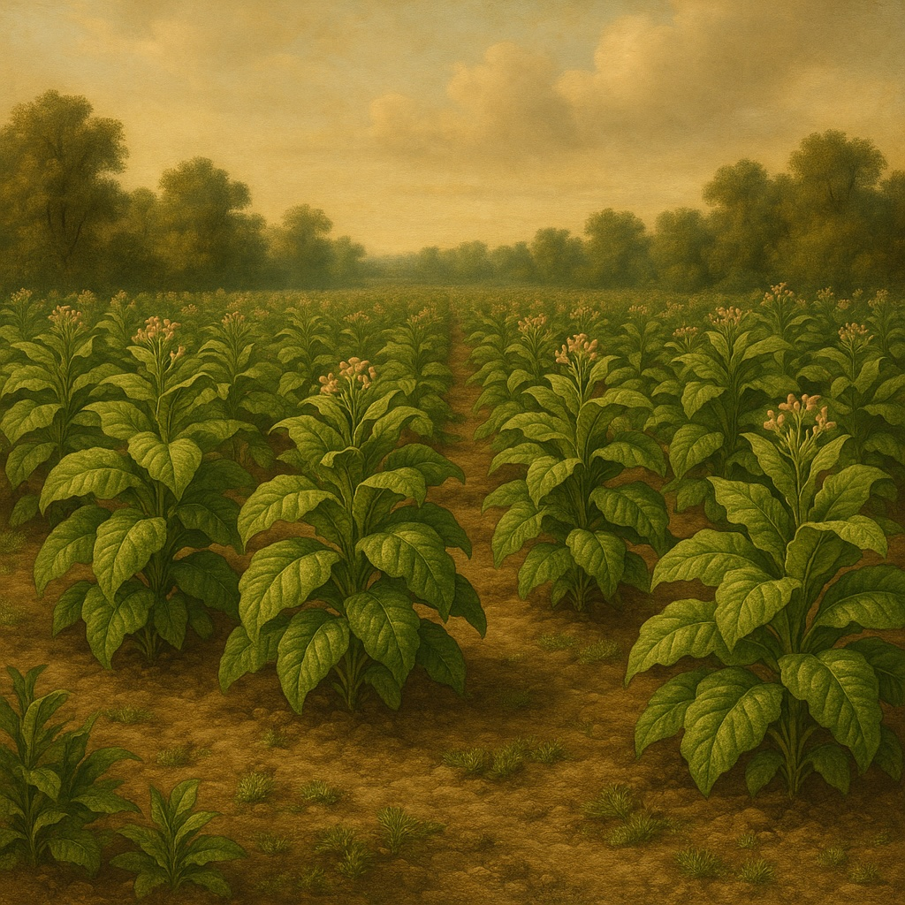
Economy of the Southern Colonies
Economy centered on farming
Cash crops: rice, indigo, tobacco, sugarcane, cotton
Plantations used enslaved Africans and indentured servants
Charleston, SC was a major slave‑trade center in the 1700s

Slide 7
Timeline
1. 1607 – Jamestown Founded
The first permanent English settlement in North America was established in Virginia, beginning England’s long-term colonization of the South.
2. 1612 – Tobacco Becomes a Cash Crop
John Rolfe successfully cultivated tobacco in Virginia, transforming the Southern economy and creating huge demand for labor.
3. 1619 – First Enslaved Africans Arrive in Virginia
A Dutch ship brought about 20 enslaved Africans to Jamestown, marking the beginning of race-based slavery in the English colonies.
4. 1634 – Maryland Colony Established
Founded by Lord Baltimore as a refuge for English Catholics, Maryland became an important Southern Colony with religious tensions and tobacco farming.
5. 1733 – Georgia Founded
Georgia was established as the last of the 13 colonies, intended as a buffer against Spanish Florida and a place for debtors and the poor to start new lives.

Slide 8
Discussion Questions
How did the warm climate and long growing season shape the economy of the Southern Colonies?
Why did religion play a smaller role in daily life in the Southern Colonies compared to New England and the Middle Colonies?
What were the major cash crops grown on Southern plantations, and why were they so important to the region’s economy?
How did the use of enslaved labor and indentured servants affect the growth and development of Southern society?

