Slide 1
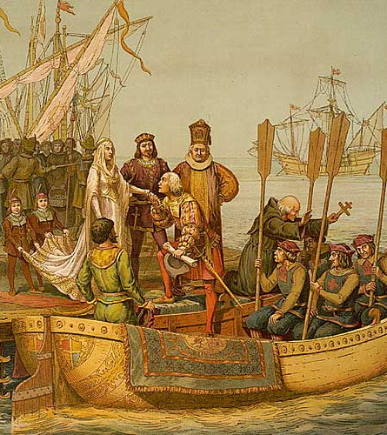
Spanish Explorers in the New World
A chronological overview of major Spanish and European explorers who shaped the Age of Exploration.

Slide 2

LearnAboutAmerica.com
*For our presentations, lesson plans, articles, printables, interactives, and games related to Spanish Explorers, please visit:
https://learnaboutamerica.com/american-history/explorers-and-the-age-of-exploration/unit-and-curriculum/spanish-exploration-in-the-new-world
* For the greatest American History website for teachers, parents, and students, visit:
https://learnaboutamerica.com

Slide 3
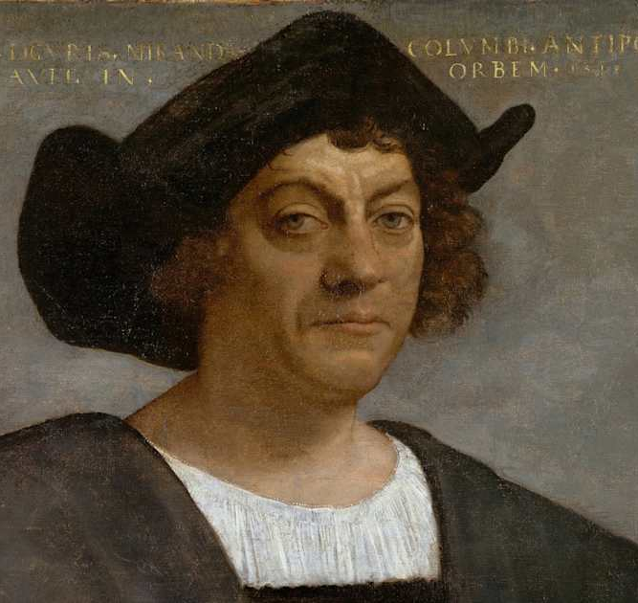
Christopher Columbus (1492)
Italian navigator sailing for Spain
Attempted to reach Asia by sailing west across the Atlantic
Landed in the Caribbean in 1492, believing he had reached islands near Asia
His voyages connected Europe with the Americas, beginning major cultural and economic exchanges
Encounters with Indigenous peoples had lasting positive and negative consequences
Completed four voyages across the Atlantic between 1492–1504

Slide 4
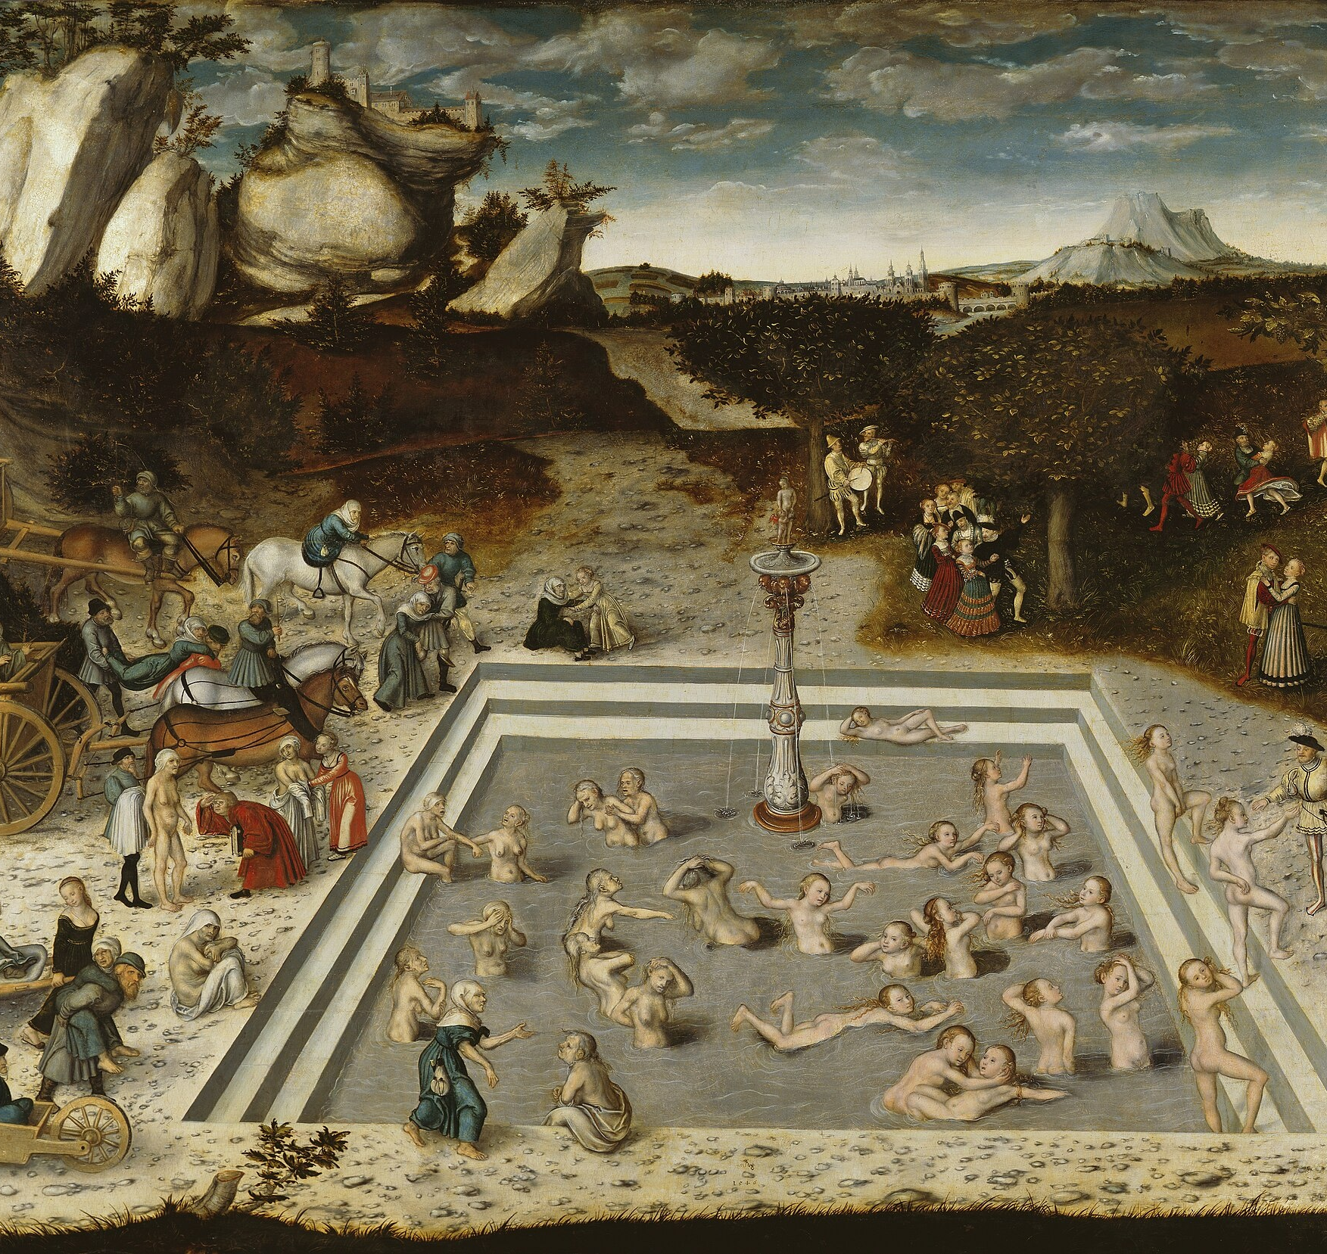
Juan Ponce de León (1513)
Explored Florida while searching for new lands
First documented European to reach Florida
Was said to have searched for rumored 'Fountain of Youth,’ although recent findings have refuted this.

Slide 5
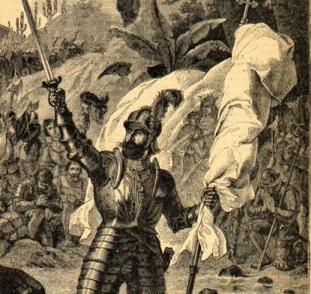
Vasco Núñez de Balboa (1513)
Crossed the Isthmus of Panama
First European to see the Pacific Ocean from the Americas
Claimed the Pacific and surrounding lands for Spain

Slide 6
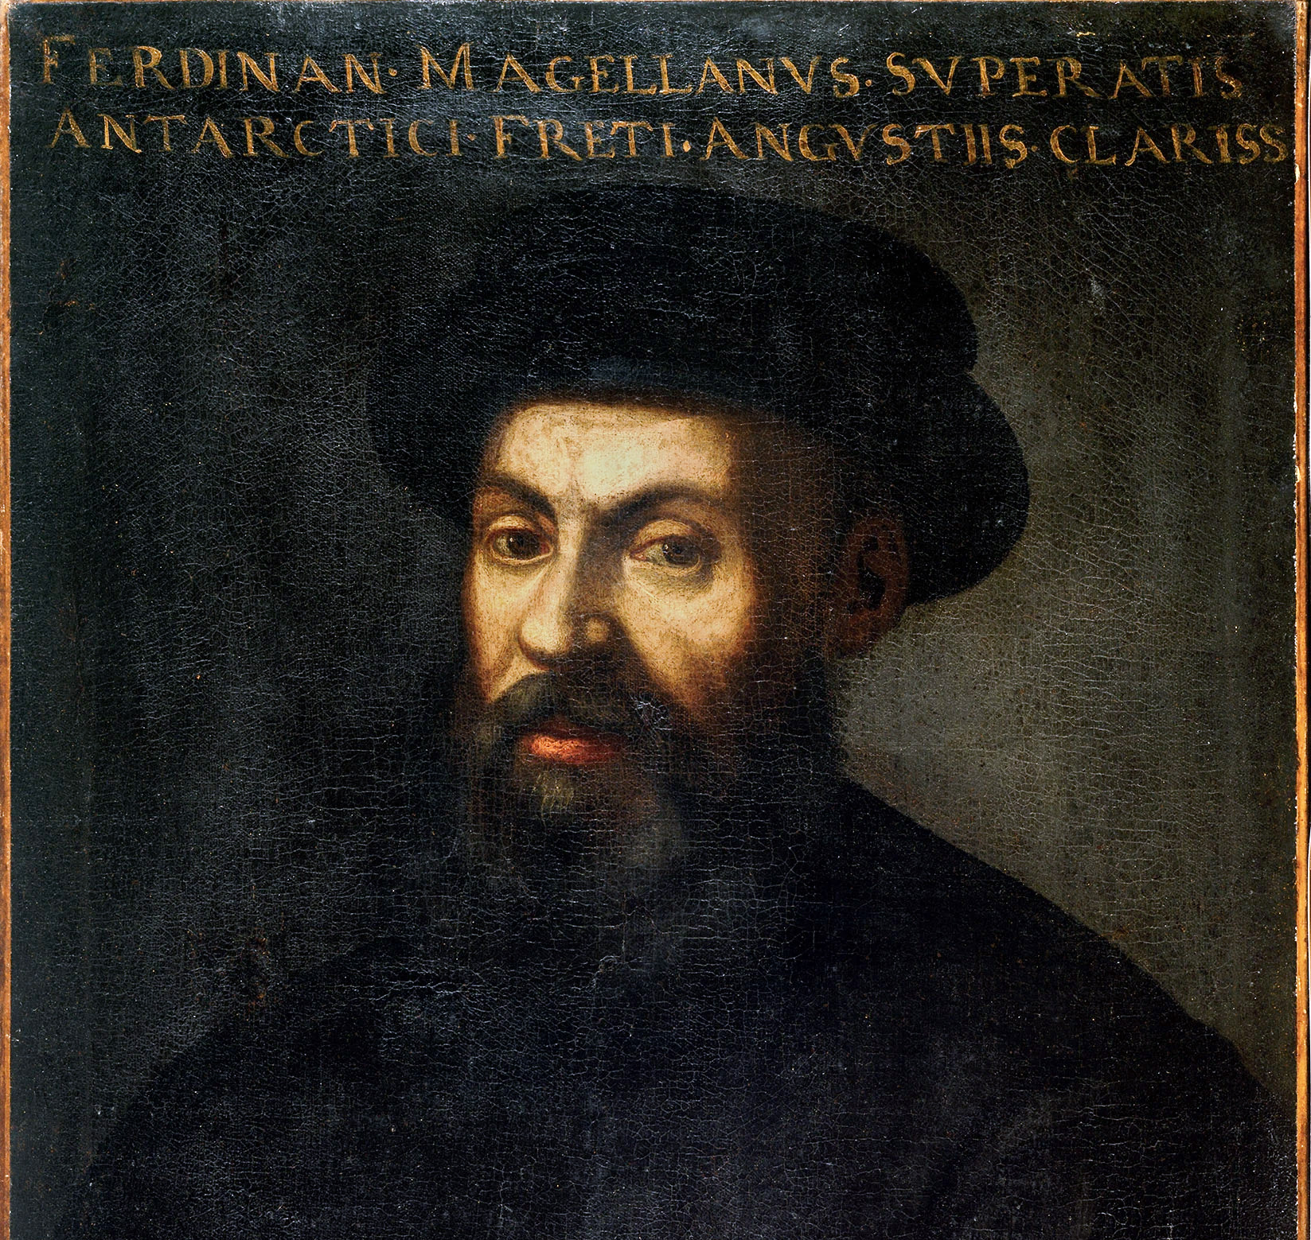
Ferdinand Magellan (1519–1522)
- Led the first expedition to circumnavigate the globe
- Reached the Pacific via the strait that now bears his name
- Crew completed the first circumnavigation

Slide 7
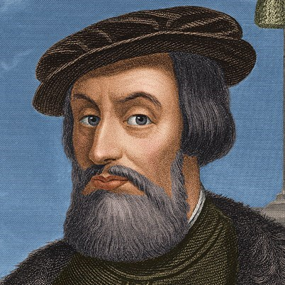
Hernán Cortés (1519–1521)
- Conquered the Aztec Empire in Mexico
- Defeated Emperor Moctezuma II
- Expanded Spanish influence and wealth

Slide 8
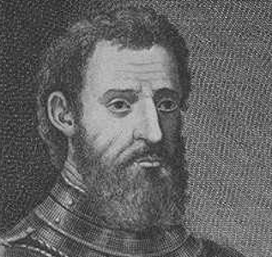
Giovanni da Verrazzano (1524)
- Italian explorer sailing for France
- First European to explore much of the Atlantic coast of North America
- Mapped areas from the Carolinas to Newfoundland

Slide 9
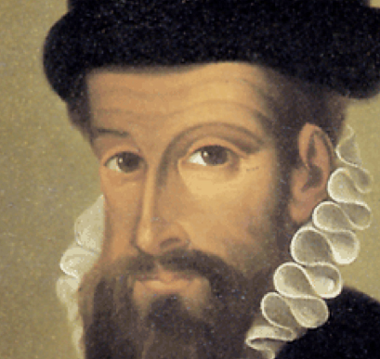
Francisco Pizarro (1532–1533)
- Conquered the Inca Empire in Peru
- Captured Emperor Atahualpa
- Claimed vast land and riches for Spain

Slide 10
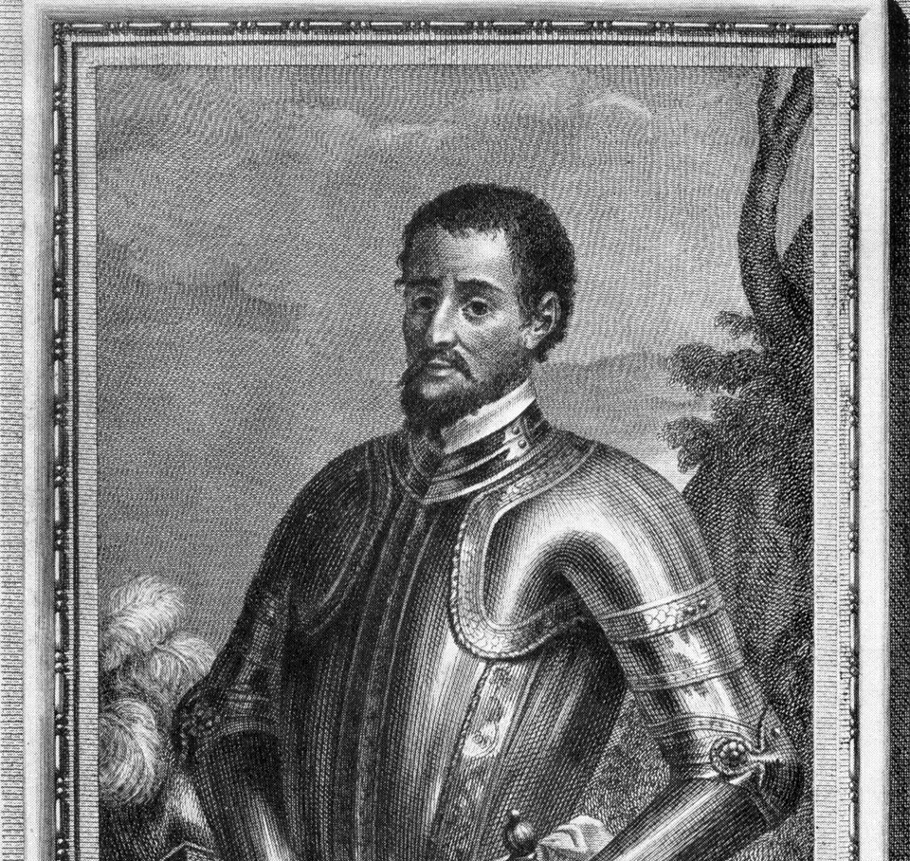
Hernando de Soto (1539–1542)
- Explored the southeastern United States
- Traveled through Florida, Georgia, the Carolinas, Tennessee, and Mississippi
- First documented European to cross the Mississippi River

Slide 11
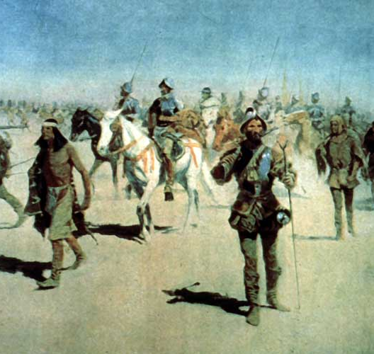
Francisco Coronado (1540–1542)
- Searched for the mythical Seven Cities of Gold
- Explored the American Southwest: Arizona, New Mexico, Texas, Kansas
- First European to document the Grand Canyon

Slide 12
Summary Timeline
1513 – Ponce de León & Balboa
1519 – Magellan's voyage begins
1519–1521 – Cortés conquers the Aztecs
1524 – Verrazzano explores the East Coast
1532 – Pizarro conquers the Inca Empire
1539 – De Soto explores the Southeast
1540 – Coronado explores the Southwest

