Slide 1
Trades of the 13 Colonies
Detailed Descriptions of Colonial Professions

Slide 2
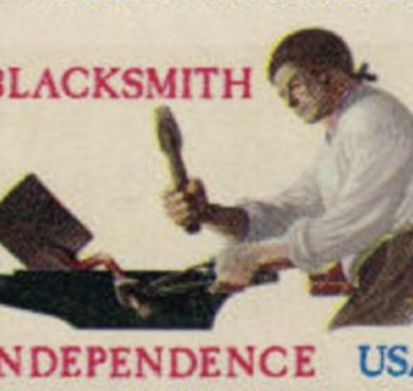
Blacksmith
Blacksmiths were essential members of every colonial community. Using a hot forge, tongs, and a heavy anvil, they heated iron until it glowed red and could be hammered into shape. They crafted tools like axes, hoes, and nails; made horseshoes and wagon parts; and repaired broken metal items for farmers, merchants, and travelers. The rhythmic sound of a hammer striking metal was a constant in colonial towns, and nearly every household relied on a blacksmith for daily needs.

Slide 3
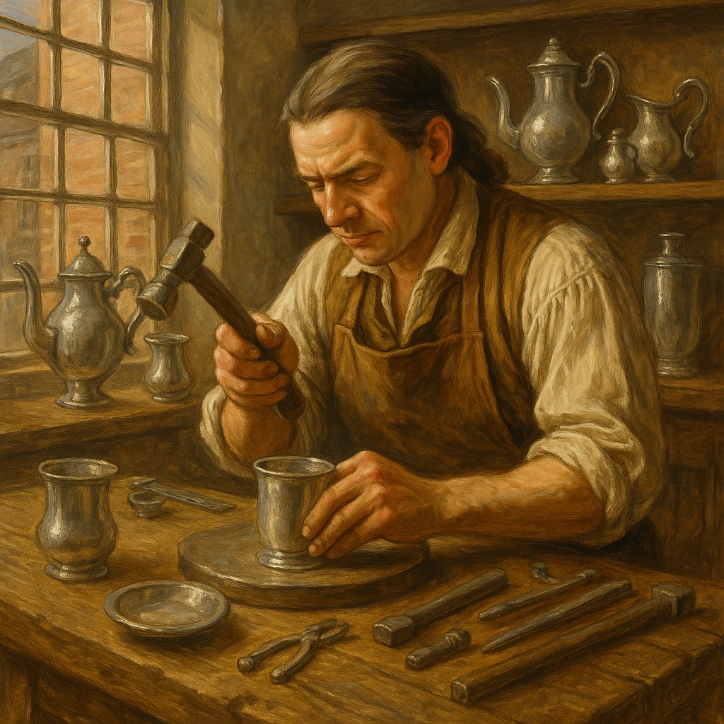
Silversmith
Silversmiths were highly skilled artisans who produced fine goods such as spoons, teapots, buttons, and jewelry. They shaped silver by hammering flat sheets, molding molten metal, and engraving detailed patterns into their work. Many silversmiths also dealt in imported goods and repaired damaged silverware. Their shops required precision tools like files, anvils, and molds, and their finished pieces were often passed down through generations as treasured family heirlooms.

Slide 4
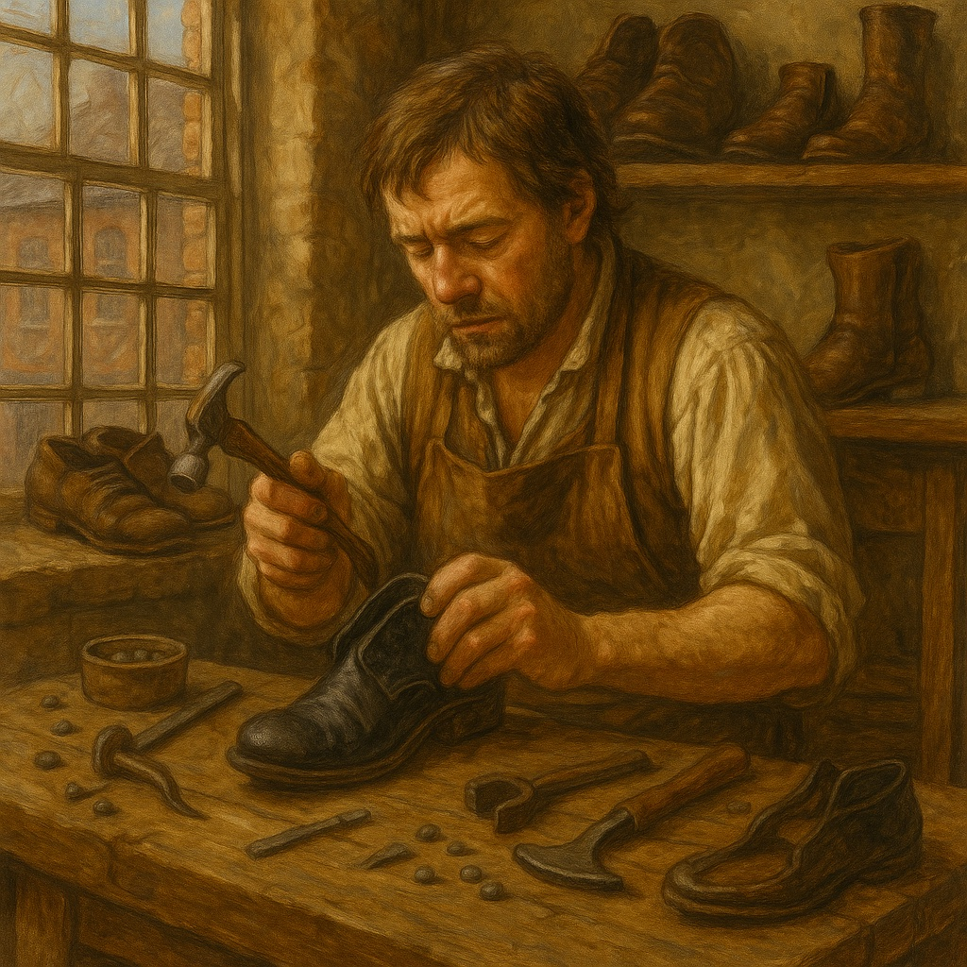
Cobbler
Cobblers kept the colonies moving by repairing worn shoes and making new ones when needed. They worked with leather, cutting out patterns and stitching shoes together with sturdy waxed thread. Because shoes were expensive and difficult to replace, colonial families often visited the cobbler to repair soles, patch holes, or resize footwear. Cobbler shops were stocked with wooden lasts—foot-shaped molds—along with awls, knives, and hammers used in every repair.

Slide 5
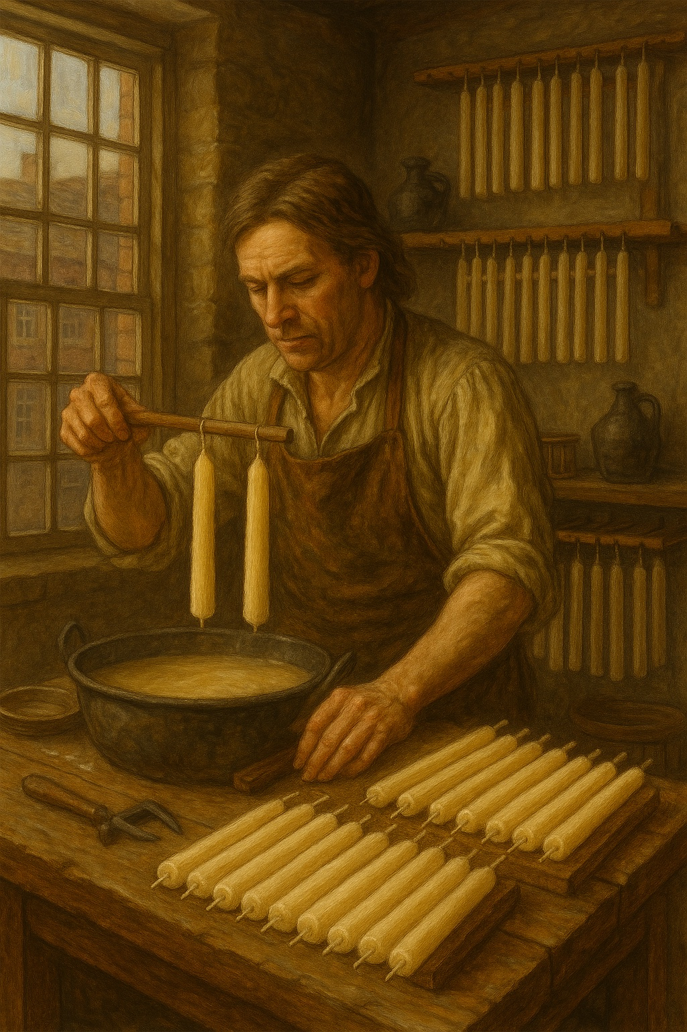
Chandler
Chandlers made candles, which were vital before electricity. They melted tallow (animal fat) or beeswax and repeatedly dipped wicks into the hot liquid to build layers. Some chandlers also made soap or sold household goods. In wealthier towns, chandlers produced scented or molded candles, while rural families often relied on local chandlers for simple tallow candles that burned quickly but were essential for lighting homes at night.

Slide 6
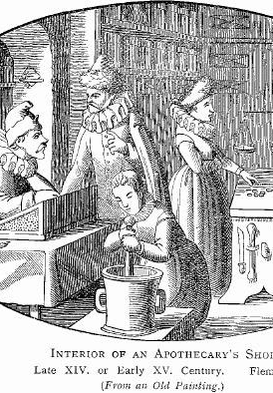
Apothecary
Apothecaries served as early pharmacists, preparing medicines for common illnesses using herbs, minerals, and plant extracts. They ground ingredients with mortars and pestles, mixed them into tonics or powders, and sometimes performed minor medical treatments. Apothecaries sold spices, tobacco, inks, and other imported goods as well. Colonists trusted apothecaries for advice on fevers, infections, and injuries in a time before modern hospitals or trained doctors were common.

Slide 7
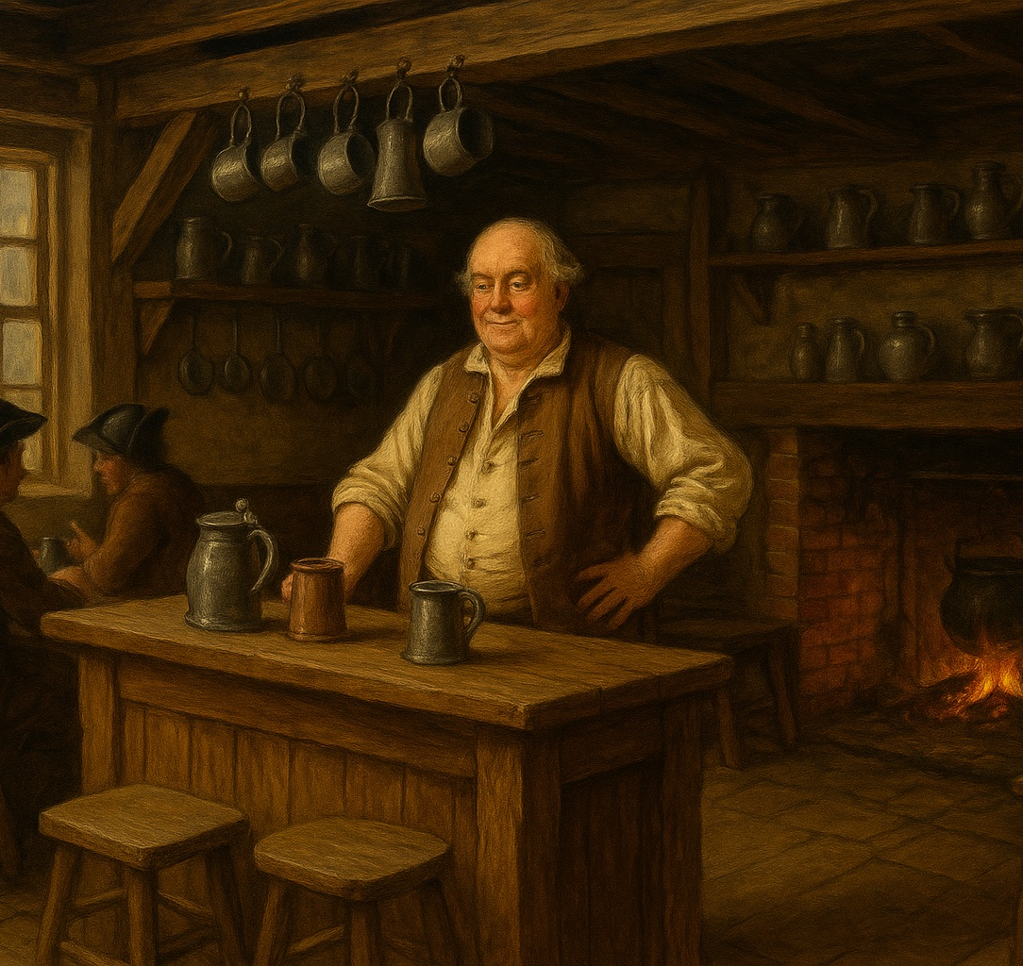
Tavern Keeper
Tavern keepers ran one of the busiest places in any colonial town. Their taverns offered food, drink, and lodging for travelers, but they also served as centers for news, politics, and trade. Travelers gathered to hear the latest information from other colonies, and many important political meetings occurred in taverns. A tavern keeper had to cook, brew ale, care for guests, manage supplies, and maintain order among lively crowds.

Slide 8
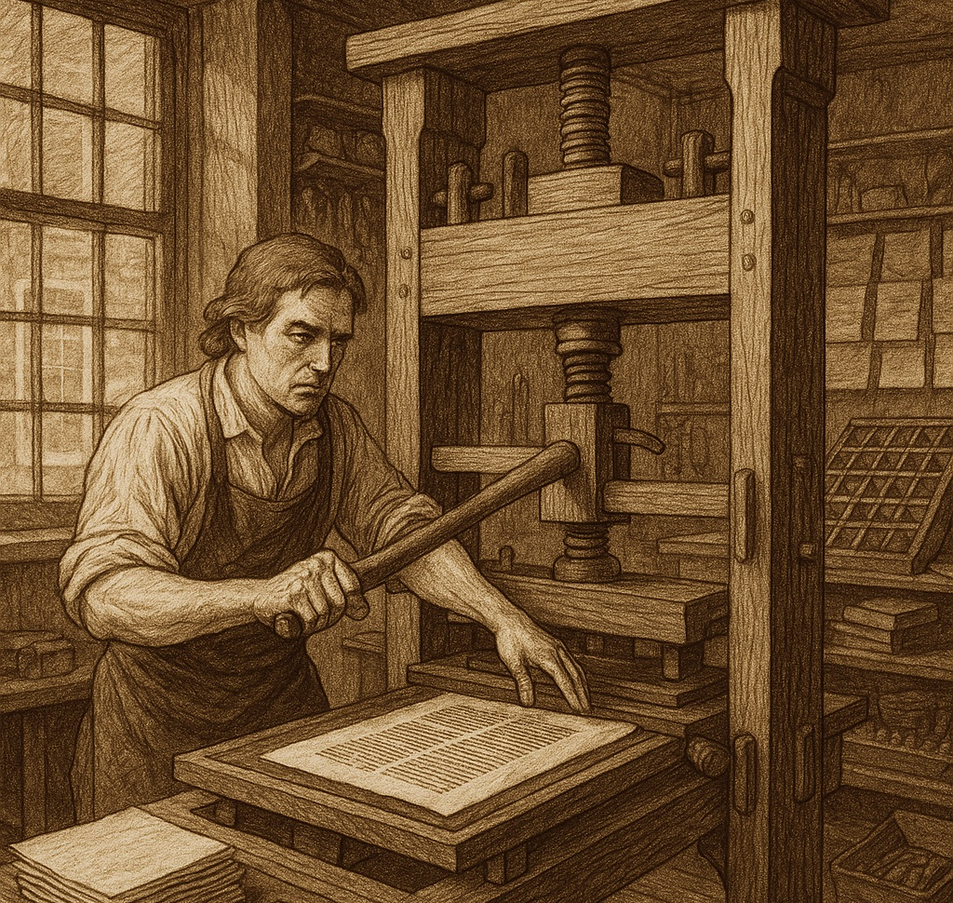
Printer
Printers played a vital role in spreading ideas and information throughout the colonies. They set small metal letters by hand to form words and pressed inked pages using heavy wooden presses. Printers published newspapers, pamphlets, almanacs, books, and legal documents. Their shops were often noisy and busy, with apprentices helping to mix ink, operate presses, and hang pages to dry. Many colonial printers, such as Benjamin Franklin, also became influential community leaders.

Slide 9
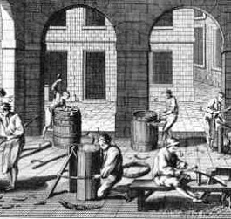
Cooper
Coopers crafted barrels, buckets, and casks used to store and transport goods like food, water, salted meat, flour, and gunpowder. They shaped wooden staves, steamed them to create a curve, and fitted them tightly with iron hoops to make containers strong and watertight. Barrels were essential for shipping goods across the Atlantic, and nearly every household owned cooper-made storage items. The work required strength, precision, and years of apprenticeship.

Slide 10
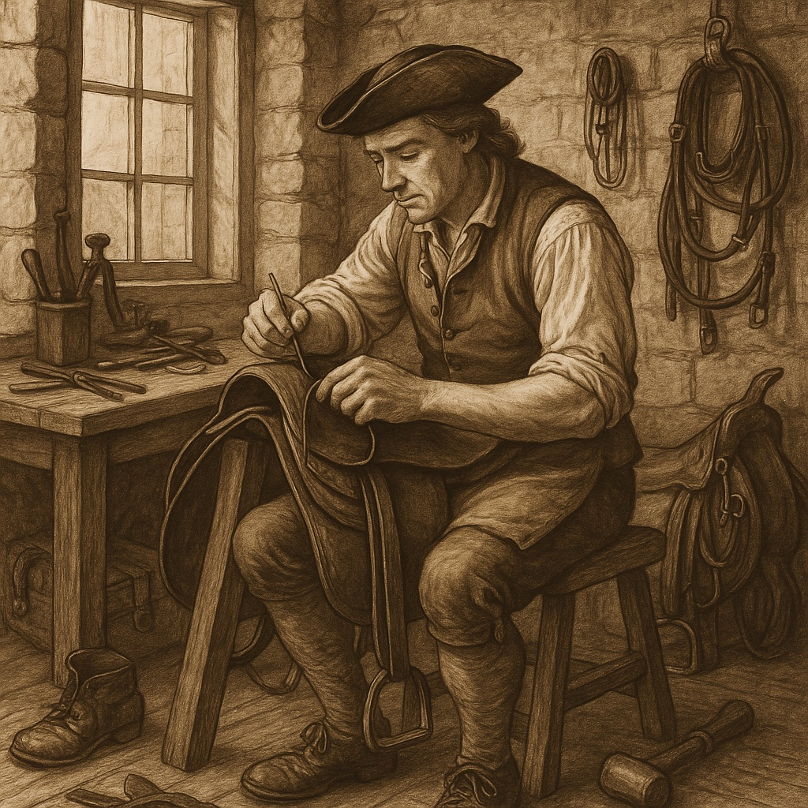
Saddlemaker
Saddlemakers crafted saddles and other leather equipment vital for transportation. Using high-quality leather, they designed and stitched saddles, bridles, reins, and harnesses. Their work supported farmers, travelers, merchants, and the postal system. Saddlemakers softened hides, carved wooden frames, and used metal tools to shape each piece to fit both the horse and the rider. A well-made saddle was expensive and often lasted for many years.

Slide 11
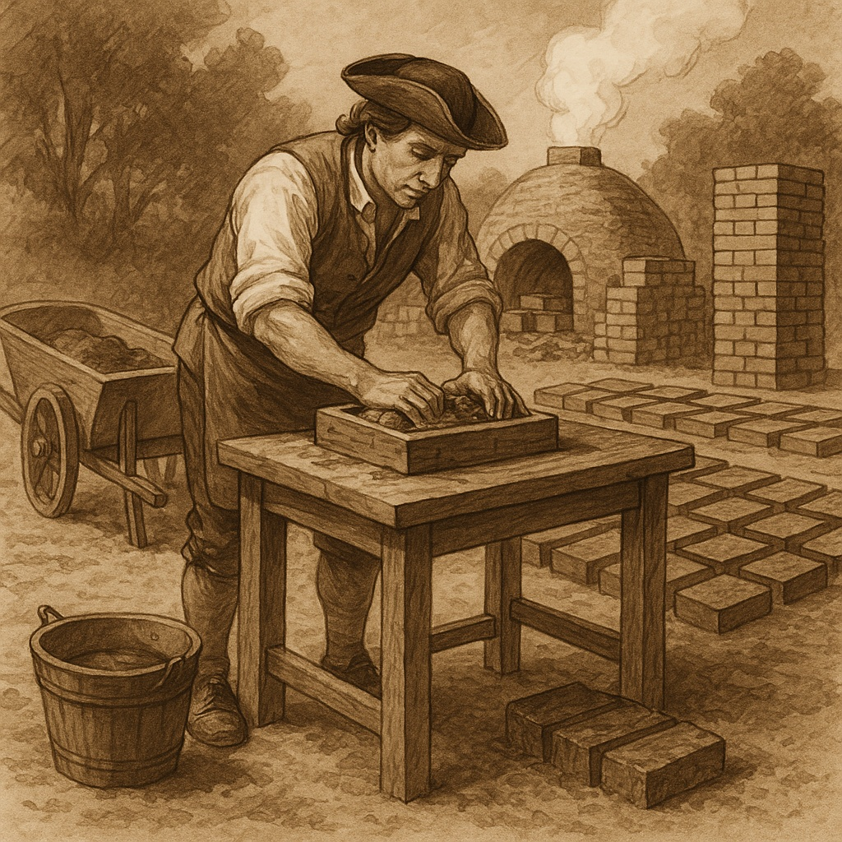
Brickmaker
Brickmakers supplied the materials needed to build homes, churches, and public buildings. They dug clay from the ground, mixed it with sand and water, and shaped it using wooden molds. After drying, the bricks were baked in large outdoor kilns until hardened. The process was labor-intensive, and brickmakers often worked in teams. Their bricks helped create stronger and longer-lasting buildings than wooden structures alone.

Slide 12
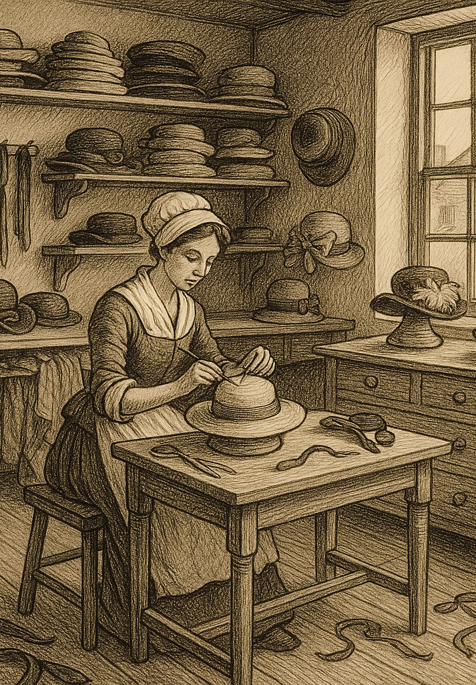
Milliner
Milliners were often women who designed and sold fashionable clothing accessories such as hats, caps, ribbons, lace, and gloves. They did not typically sew every item themselves but instead assembled, altered, or imported parts from Europe. Their shops were important social spaces where women gathered to hear news, select fabrics, and keep up with the latest styles. Milliners needed artistic skill, business sense, and an eye for fashion.

Slide 13
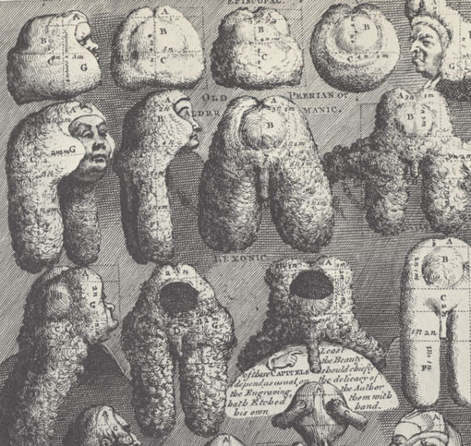
Wigmaker
Wigmakers created stylish wigs worn by wealthy colonists, judges, and political leaders. They cleaned and prepared horsehair or human hair, boiled it to remove oils, and tied it strand by strand onto woven frames. Wigs required expert styling with curls, powder, and ribbons. Because wigs symbolized status and fashion, wigmakers enjoyed steady business among the upper class, especially in larger cities.

Slide 14
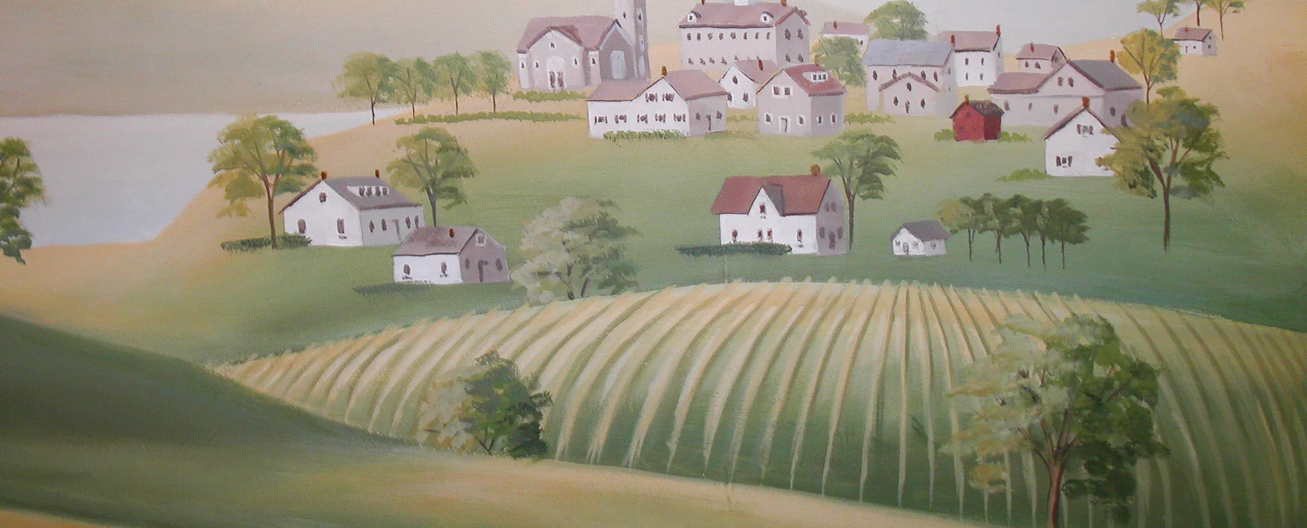
Farmer
Farmers formed the backbone of colonial life. They tended fields, planted and harvested crops such as wheat, corn, tobacco, and vegetables, and cared for animals including cows, pigs, and chickens. Most families produced their own food, with extra crops traded or sold. Farming required long hours, hard labor, and knowledge of the land and seasons. Nearly all colonial communities depended on successful farmers for survival.

Slide 15
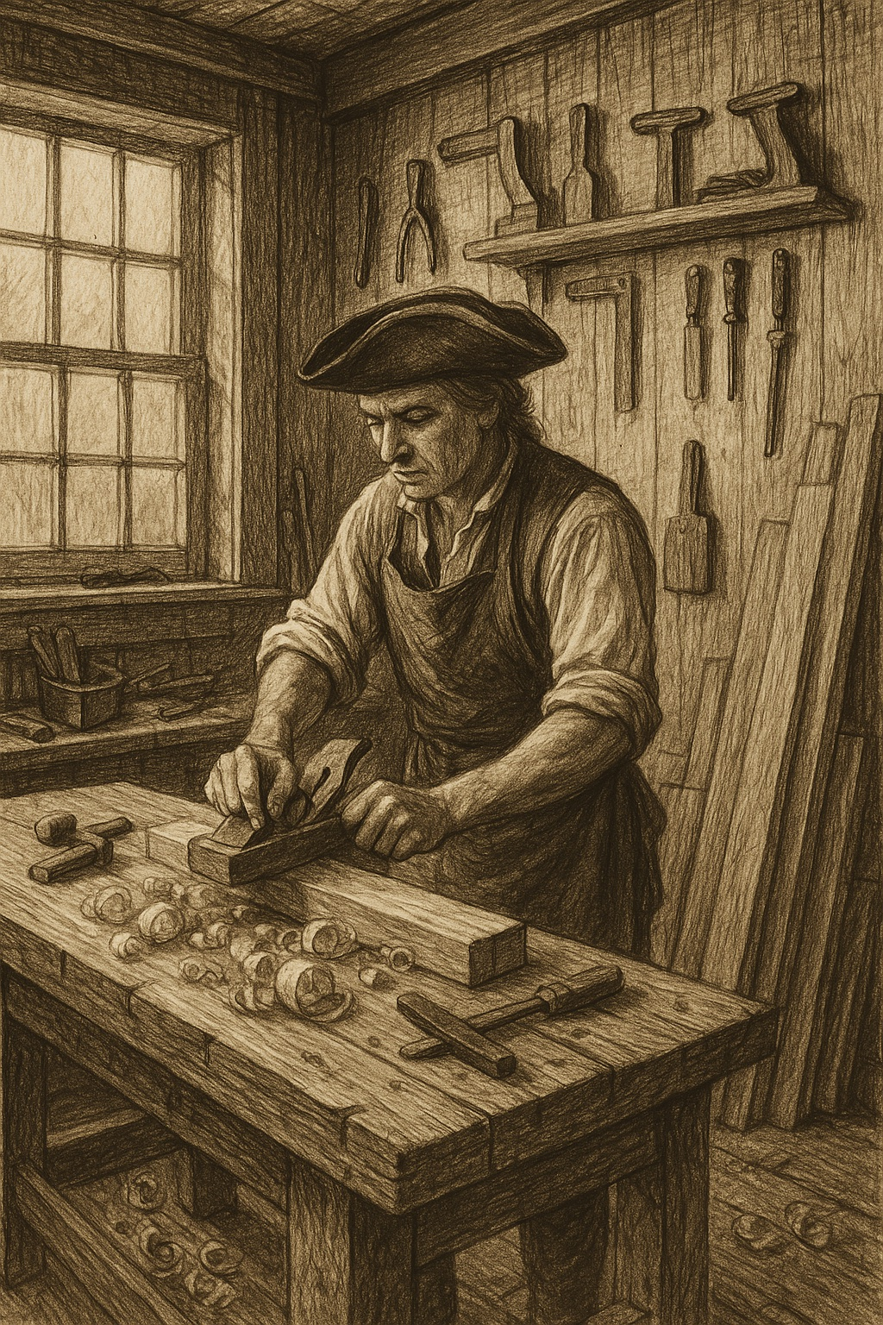
Carpenter
Carpenters were skilled woodworkers who built homes, barns, fences, and furniture. Using saws, planes, chisels, and mallets, they shaped timber into beams, floors, and walls. Carpenters also repaired buildings and crafted items such as chairs, tables, windows, and doors. Their work demanded careful measurement and strong problem-solving skills. Most towns relied heavily on carpenters for construction and community growth.

Slide 16
Discussion Questions
Why were specialized trades (like blacksmiths, coopers, and printers) essential to the daily life and survival of colonial communities?
Which colonial trade do you think required the most skill or training, and why? Use examples from the descriptions.
How did the tools and techniques used by colonial tradespeople shape the quality and types of products they created?
If you lived in the 13 Colonies, which trade would you choose to pursue, and what factors would influence your decision?

