Slide 1
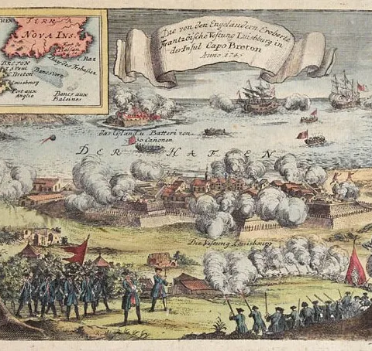
Battles of the French and Indian War
A Global Rivalry Between France and England
1754–1763

Slide 2

LearnAboutAmerica.com
*For our presentations, lesson plans, articles, printables, interactives, stories, and games related to the battles of the French and Indian War, please visit:
https://learnaboutamerica.com/american-history/french-and-indian-war/french-and-indian-war-interactive-map
* For the greatest American History website for teachers, parents, and students, visit:
https://learnaboutamerica.com

Slide 3
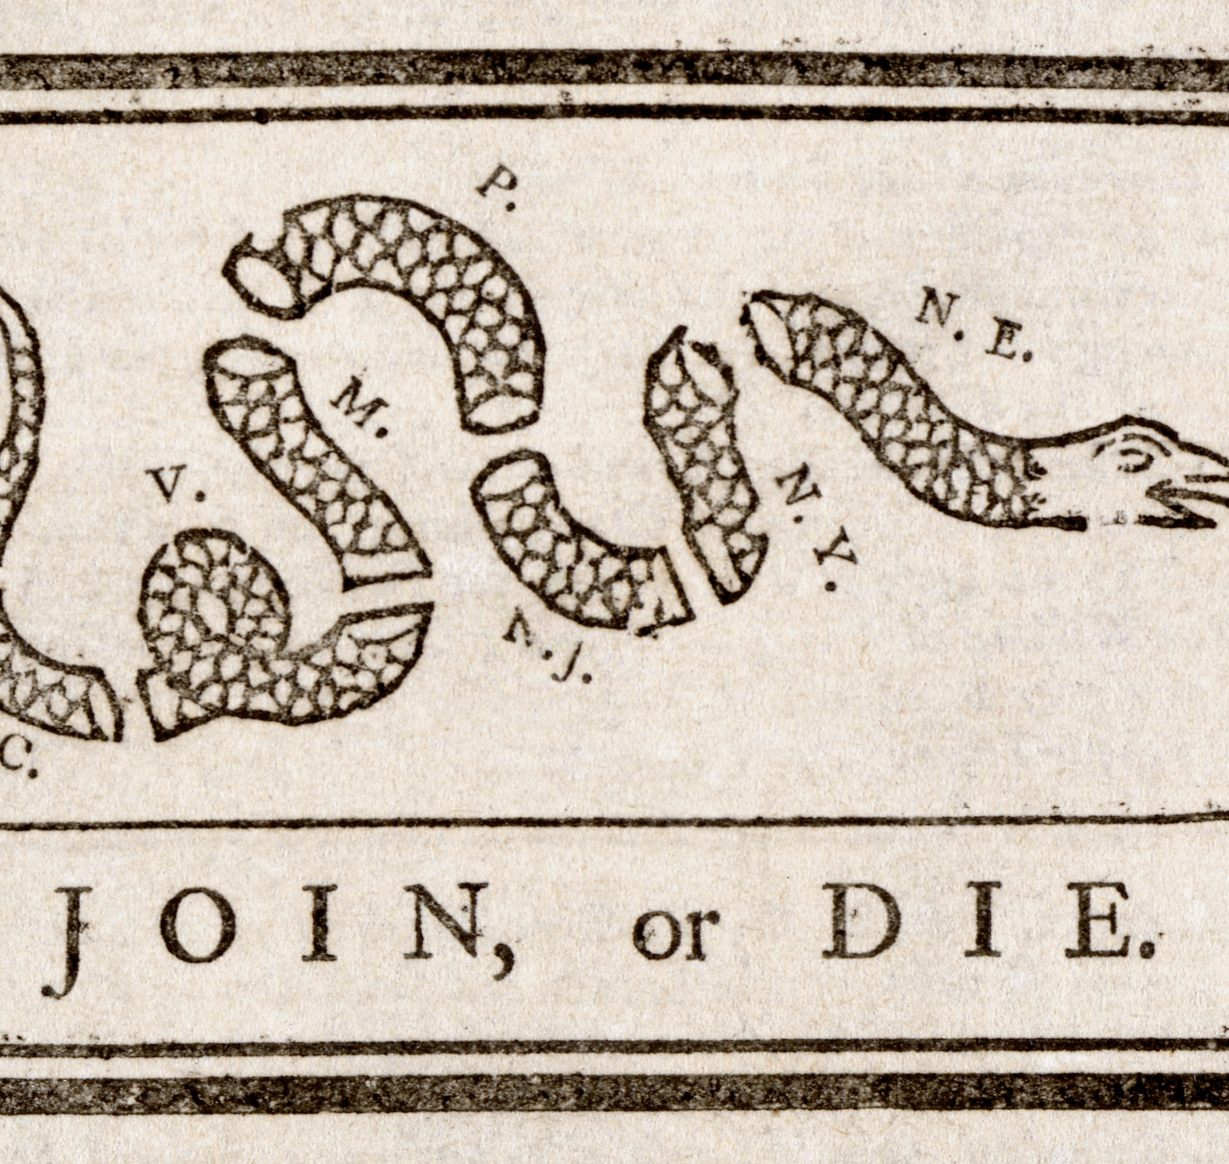
A War Over Empire
The French and Indian War was fought between Britain and France
  Both nations wanted control of land and trade in North America
  Many key battles took place in Canada and the Great Lakes region
  The war was part of a larger global conflict

Slide 4
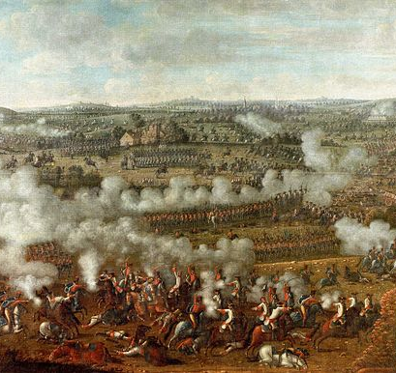
A Global Rivalry
France and England were longtime rivals
  Battles took place in Europe, the Caribbean, Africa, and India
  In Europe, the conflict was known as the Seven Years’ War
  Events in North America affected the entire world

Slide 5
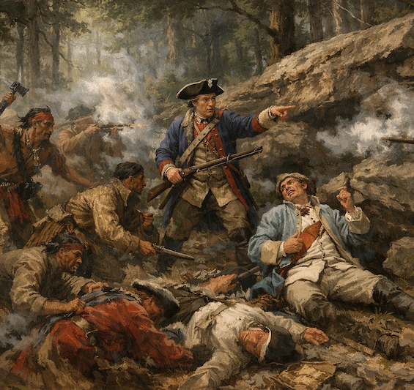
Jumonville Glen (1754)
One of the first battles of the war
  Fought in the Ohio River Valley
  A young George Washington led British colonial forces
  The skirmish increased tensions between France and Britain

Slide 6
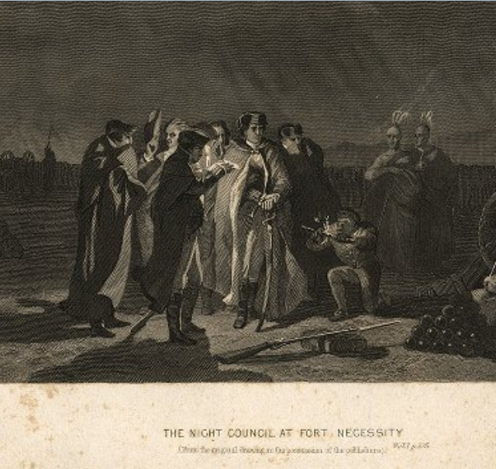
Fort Necessity (1754)
Built by George Washington after Jumonville Glen
  Poorly located in a low, muddy area
  French forces attacked and surrounded the fort
  Washington was forced to surrender

Slide 7
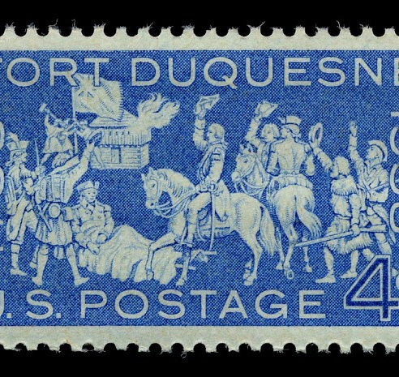
Fort Duquesne
Located at the forks of the Ohio River
  A key French stronghold in the region
  Controlled western lands and trade routes
  Captured by the British and renamed Fort Pitt

Slide 8
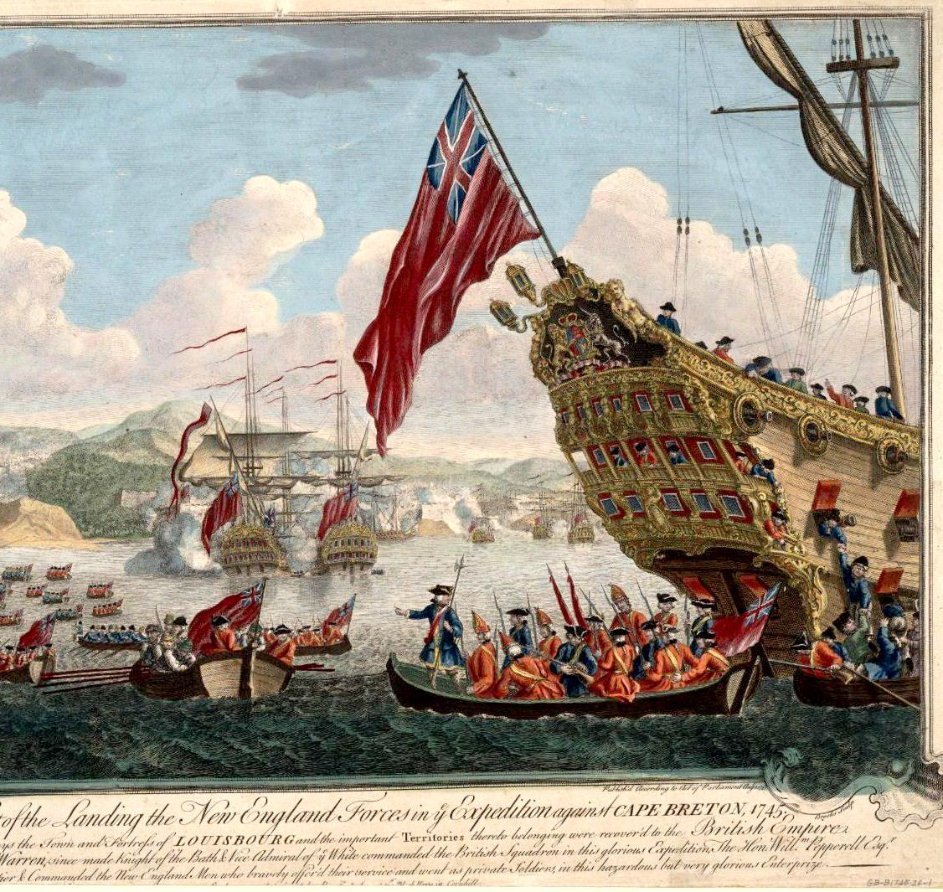
Louisbourg (1758)
A heavily fortified French city in present-day Canada
  Protected access to the St. Lawrence River
  Captured by British forces after a major siege
  Its fall opened the route to French Canada

Slide 9
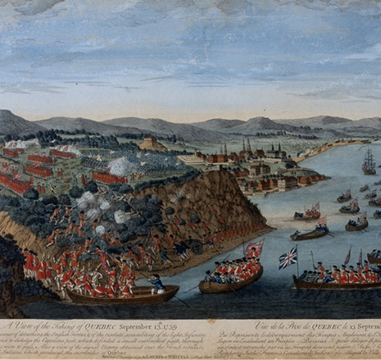
Plains of Abraham (1759)
Fought near Quebec City
  One of the most important battles of the war
  British forces defeated the French army
  Both commanding generals were killed

Slide 10
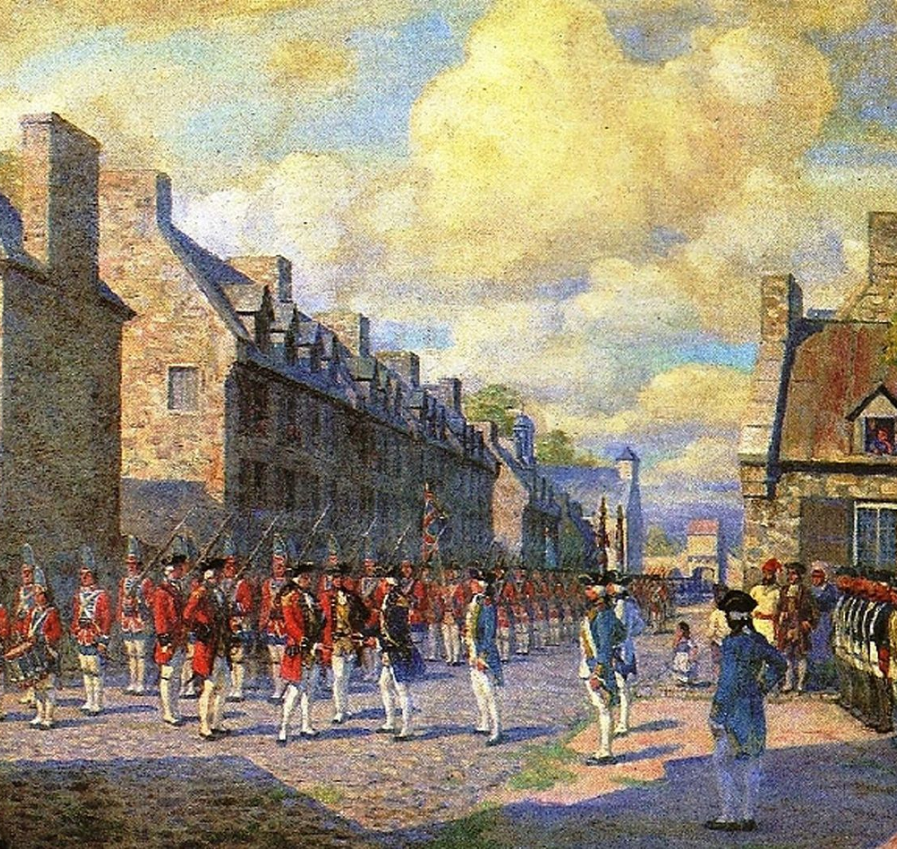
The Capture of Montreal (1760)
Final defeat of French forces in Canada
  French troops surrendered to the British
  Ended French control of Canada
  Confirmed British victory in North America

Slide 11
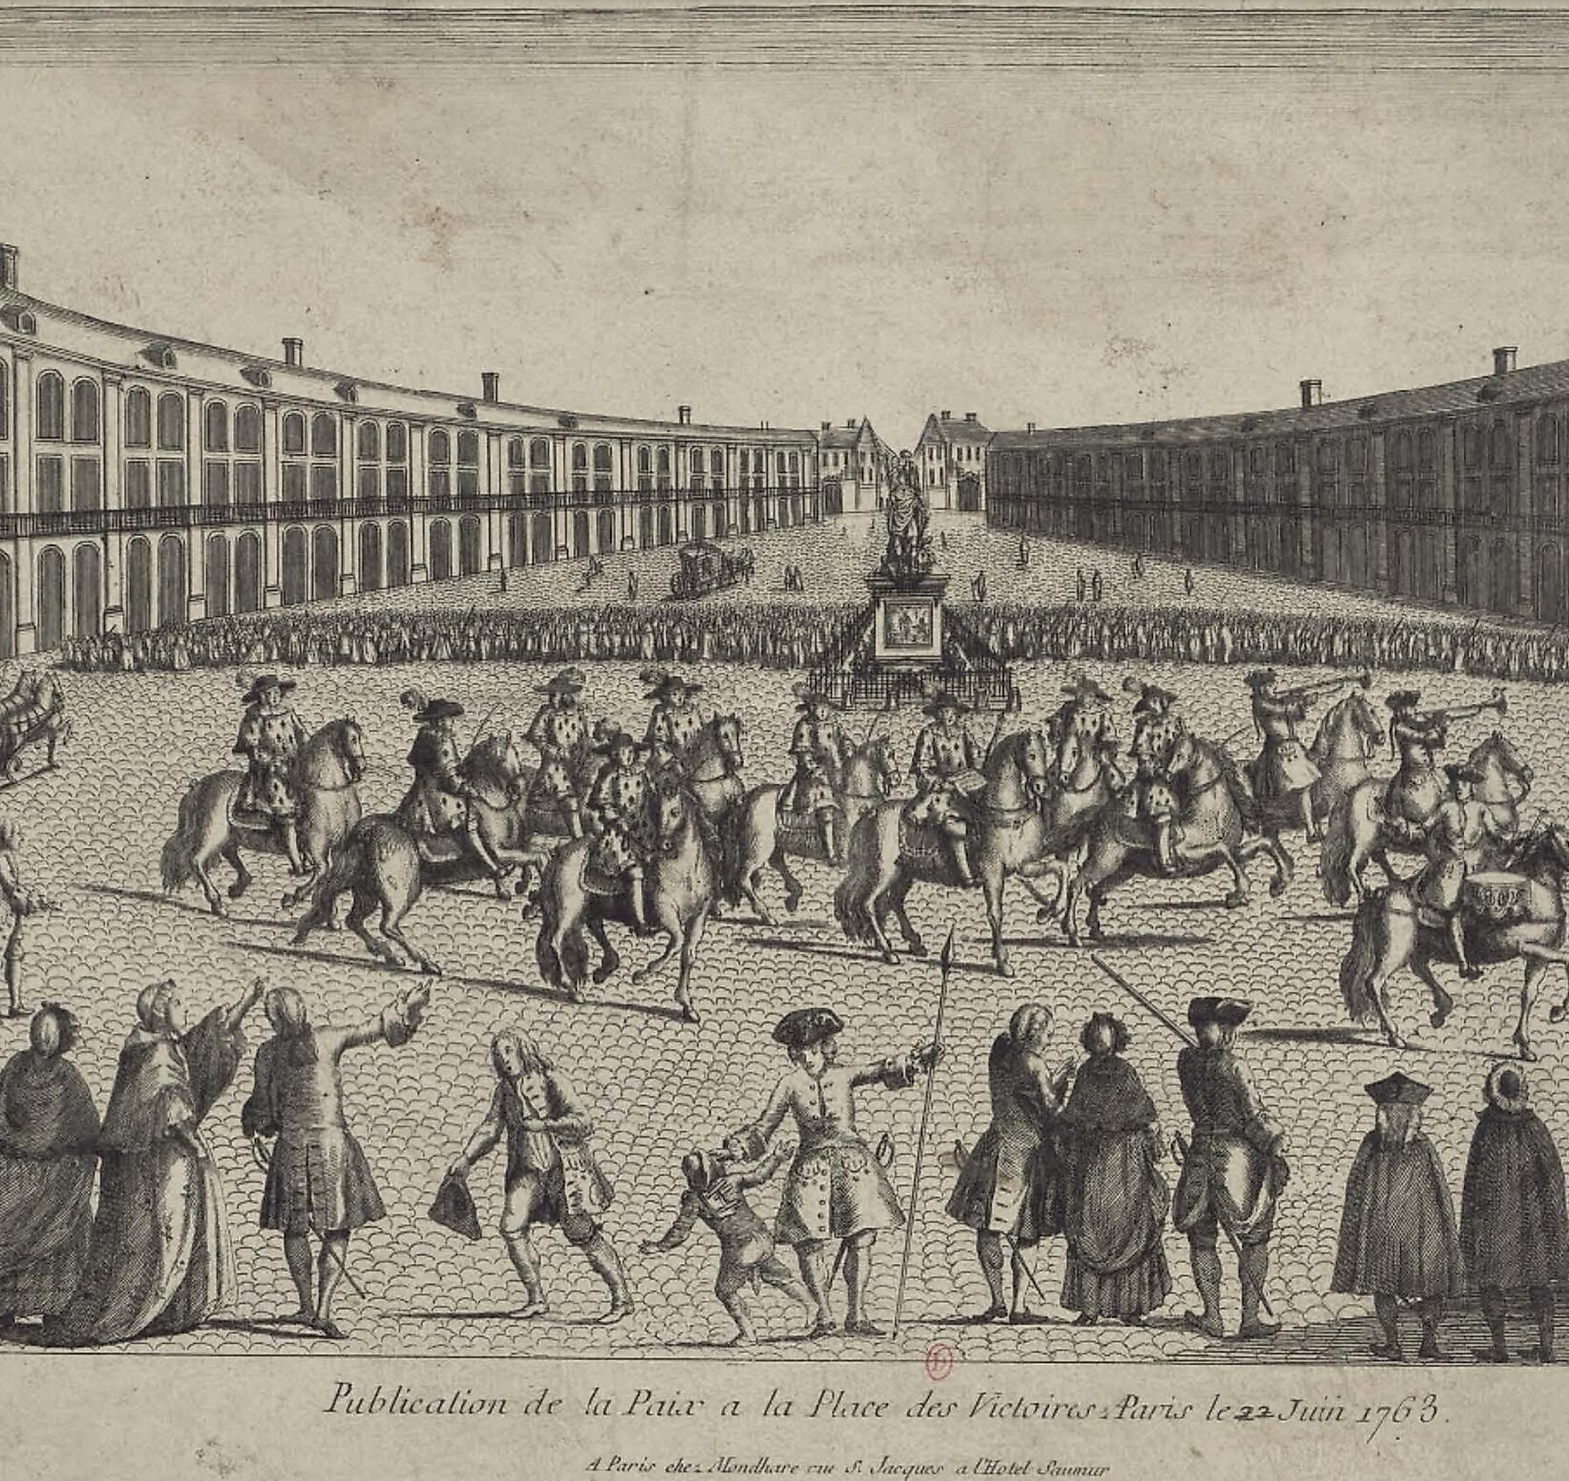
Surrender and the Treaty of Paris (1763)
France surrendered most of its North American claims
  Britain gained Canada and land east of the Mississippi River
  France gave up most of its colonial territory
  Spain received Louisiana from France

Slide 12
Why the War Mattered
Britain became the dominant power in North America
  France lost most of its empire on the continent
  The war left Britain deeply in debt
  Colonial taxes helped lead to the American Revolution

