Slide 1
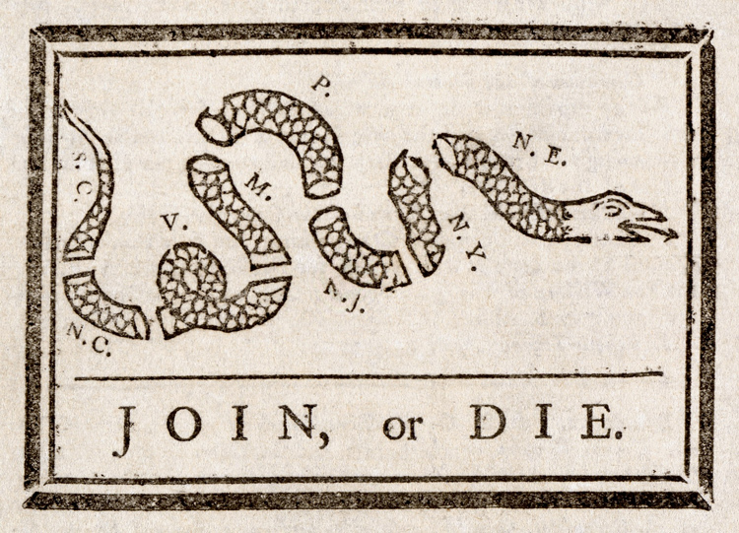
Join, or Die https://learnaboutamerica.com

Slide 2

LearnAboutAmerica.com
*For our presentations, lesson plans, articles, printables, interactives, stories, and games related to Join, or Die, please visit:
https://learnaboutamerica.com/american-history/french-and-indian-war/causes-and-effects
* For the greatest American History website for teachers, parents, and students, visit:
https://learnaboutamerica.com

Slide 3
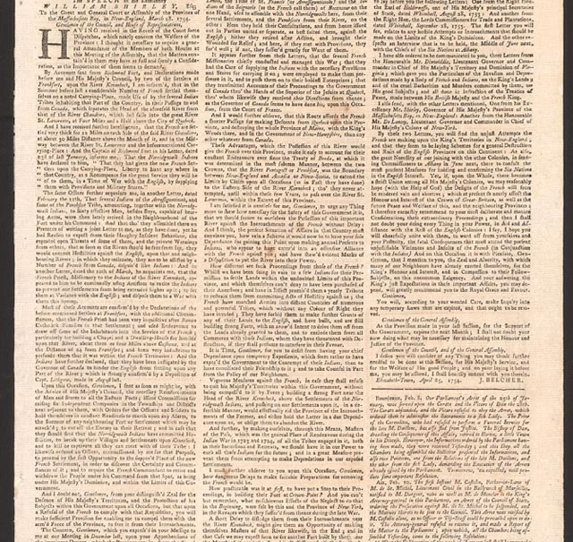
What Is Join, or Die?
A political cartoon and woodcut
Created during the French and Indian War
Encouraged colonies to unite
Published in the Pennsylvania Gazette

Slide 4
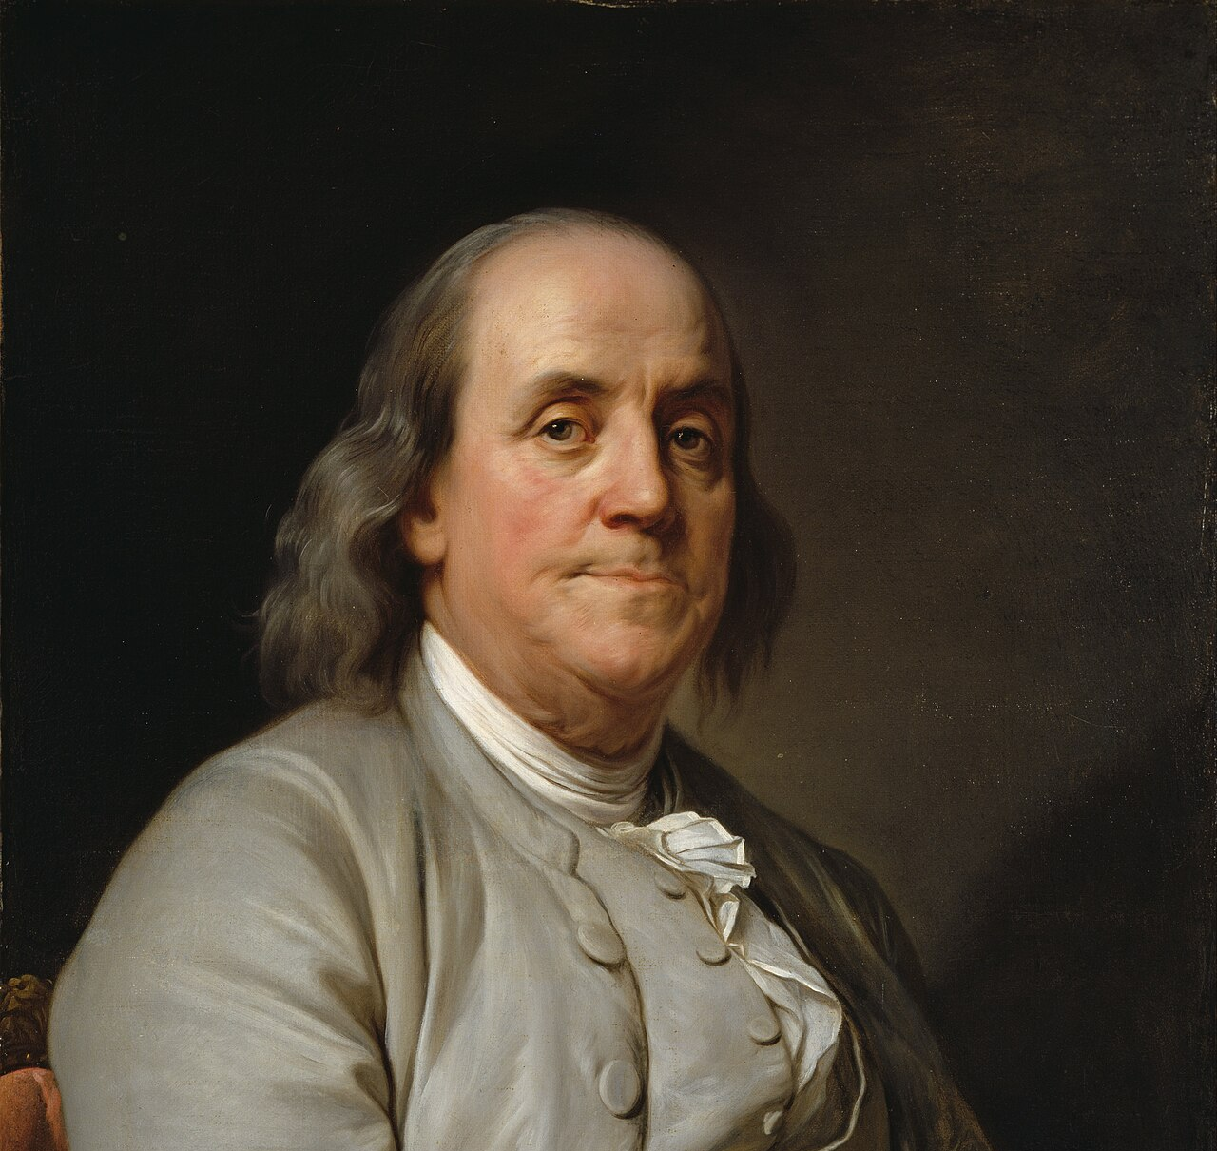
Who Created Join, or Die?
The cartoon is credited to Benjamin Franklin
Franklin wrote the editorial that included the image
The actual artist of the snake is unknown
Franklin supported the message of unity

Slide 5
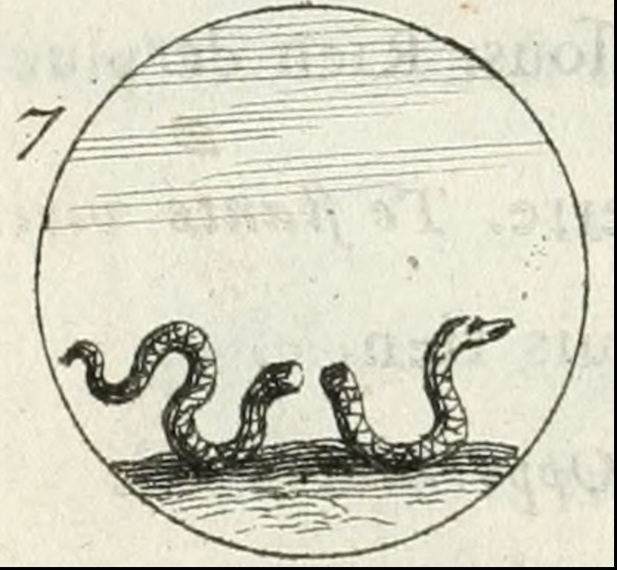
Why a Snake?
Snakes were symbols of renewal
Snakes shed their skin
A popular legend said snakes could live again
The image suggested colonies could survive if united

Slide 6
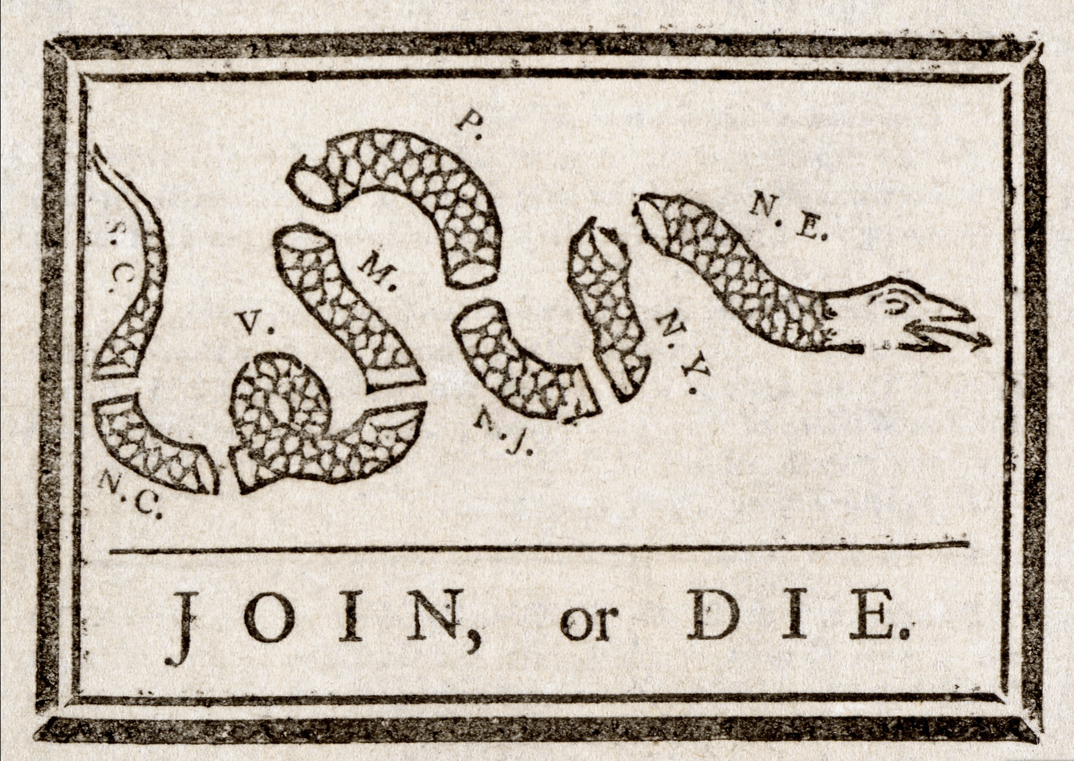
The Snake and the Colonies
The snake is cut into eight pieces
Each piece represents a colony or region
New England colonies grouped as 'N.E.'
Georgia and Delaware are not shown

Slide 7
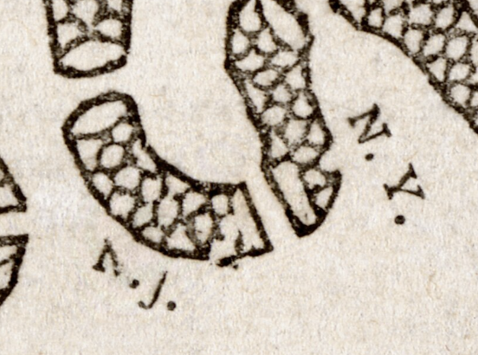
Why Use Initials?
Many colonists could not read well
Initials were easier to recognize
The image could be understood quickly
Helped spread the message widely

Slide 8
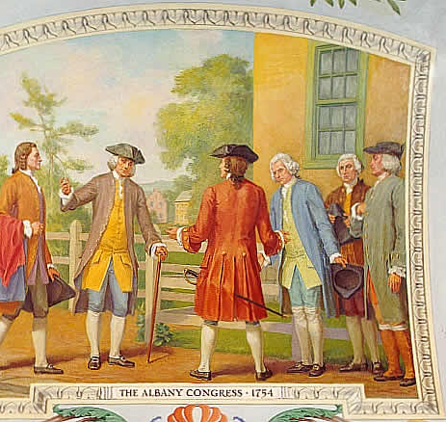
Purpose During the French and Indian War
Warned colonies they must unite
Encouraged cooperation against France
Supported a unified colonial government
Connected to the Albany Plan of Union

Slide 9
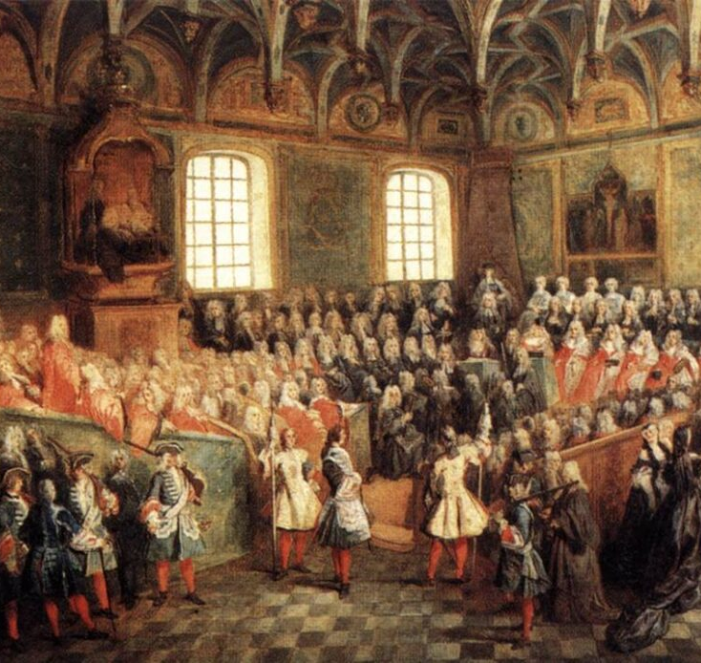
Reaction in Britain
British leaders did not support colonial unity
Feared loss of control
The message failed to influence Parliament
Unity was seen as a threat

Slide 10
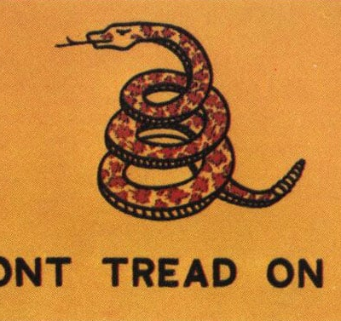
A Symbol of Colonial Anger
Later used during the Stamp Act protests
Represented resistance to British taxes
Symbolized colonial frustration
Gained new meaning before the Revolution

Slide 11
Why Join, or Die Matters
First political cartoon in American history
Introduced the idea of colonial unity
Influenced later revolutionary thinking
Remains an iconic historical image

