Slide 1
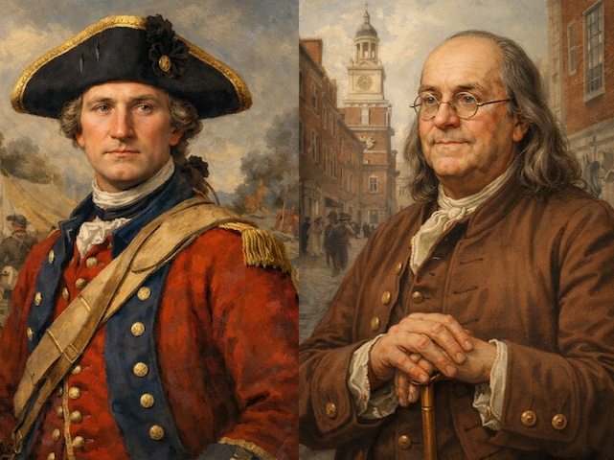
Washington & Franklin in the French and Indian War https://learnaboutamerica.com

Slide 2

LearnAboutAmerica.com
*For our presentations, lesson plans, articles, printables, interactives, stories, and games related to early founding fathers, please visit:
https://learnaboutamerica.com/american-history/french-and-indian-war/events-of-the-french-and-indian-war/future-founding-fathers-washington-and-franklin-in-the-french-and-indian-war
* For the greatest American History website for teachers, parents, and students, visit:
https://learnaboutamerica.com

Slide 3
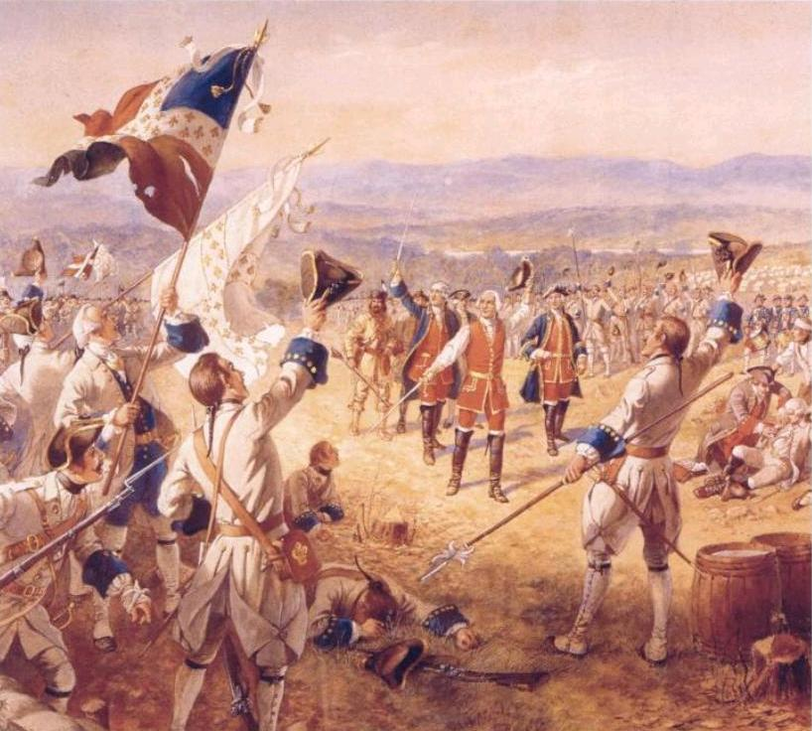
Background: The French and Indian War
Fought between Britain and France
Control of land in North America
Native American nations were involved
War began in 1754

Slide 4
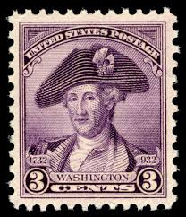
George Washington: A Young Officer
From Virginia
Sent to the Ohio River Valley
Ordered to warn French to leave
Tensions soon turned violent

Slide 5
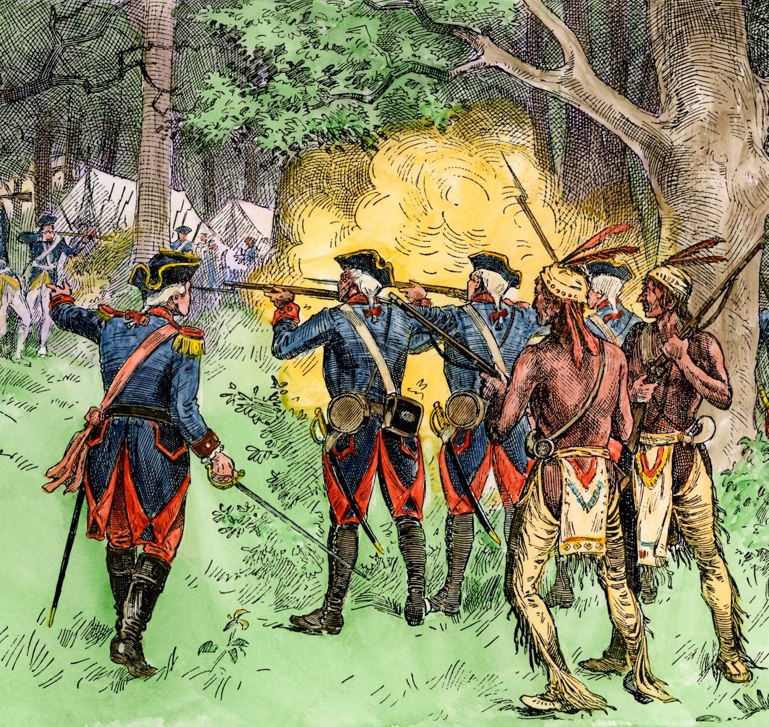
Washington and Early Fighting
Clashed with French forces in 1754
Built Fort Necessity
French attacked the fort
Washington was forced to surrender

Slide 6
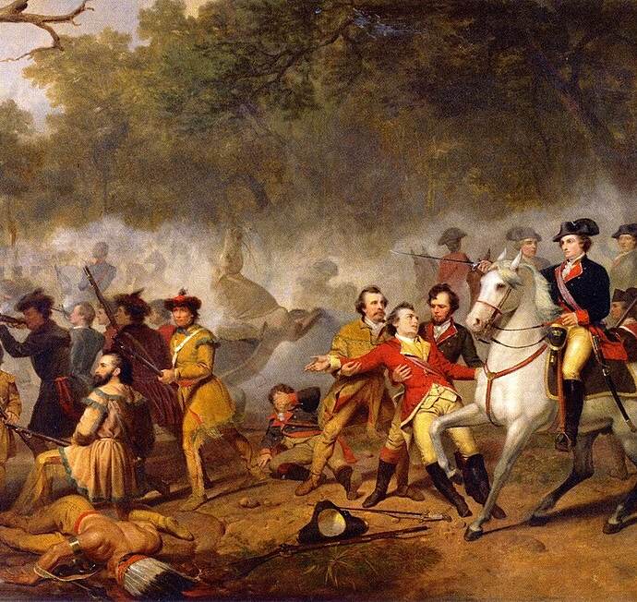
Washington’s Impact
Gained valuable military experience
Learned frontier warfare
Prepared for future leadership
Later led colonial forces in the Revolution

Slide 7
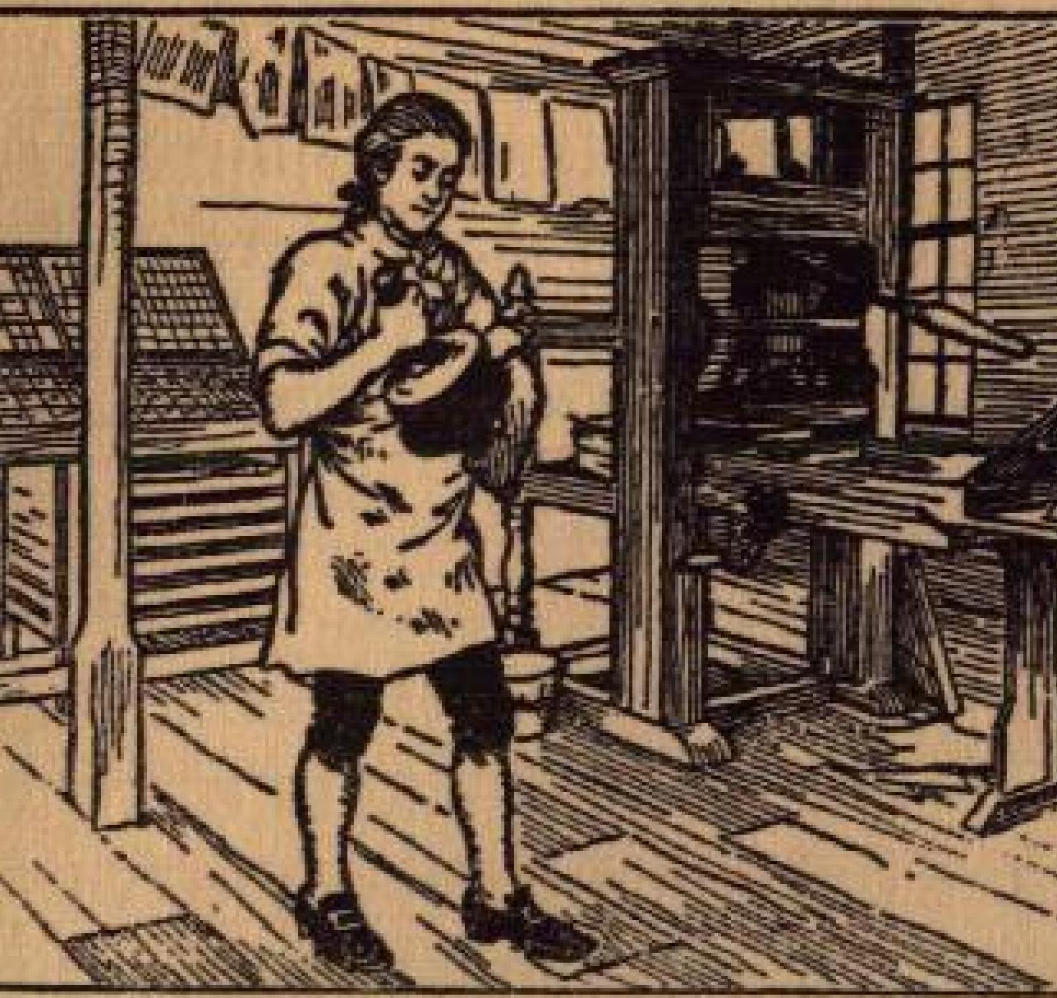
Benjamin Franklin: A Different Kind of Leader
Writer, printer, and political leader
Did not fight in battles
Helped support the war effort
Focused on organization and cooperation

Slide 8
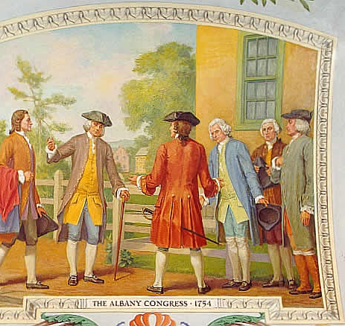
The Albany Plan of Union
Proposed in 1754
Plan to unite the colonies
Shared defense against France
Plan was not approved

Slide 9
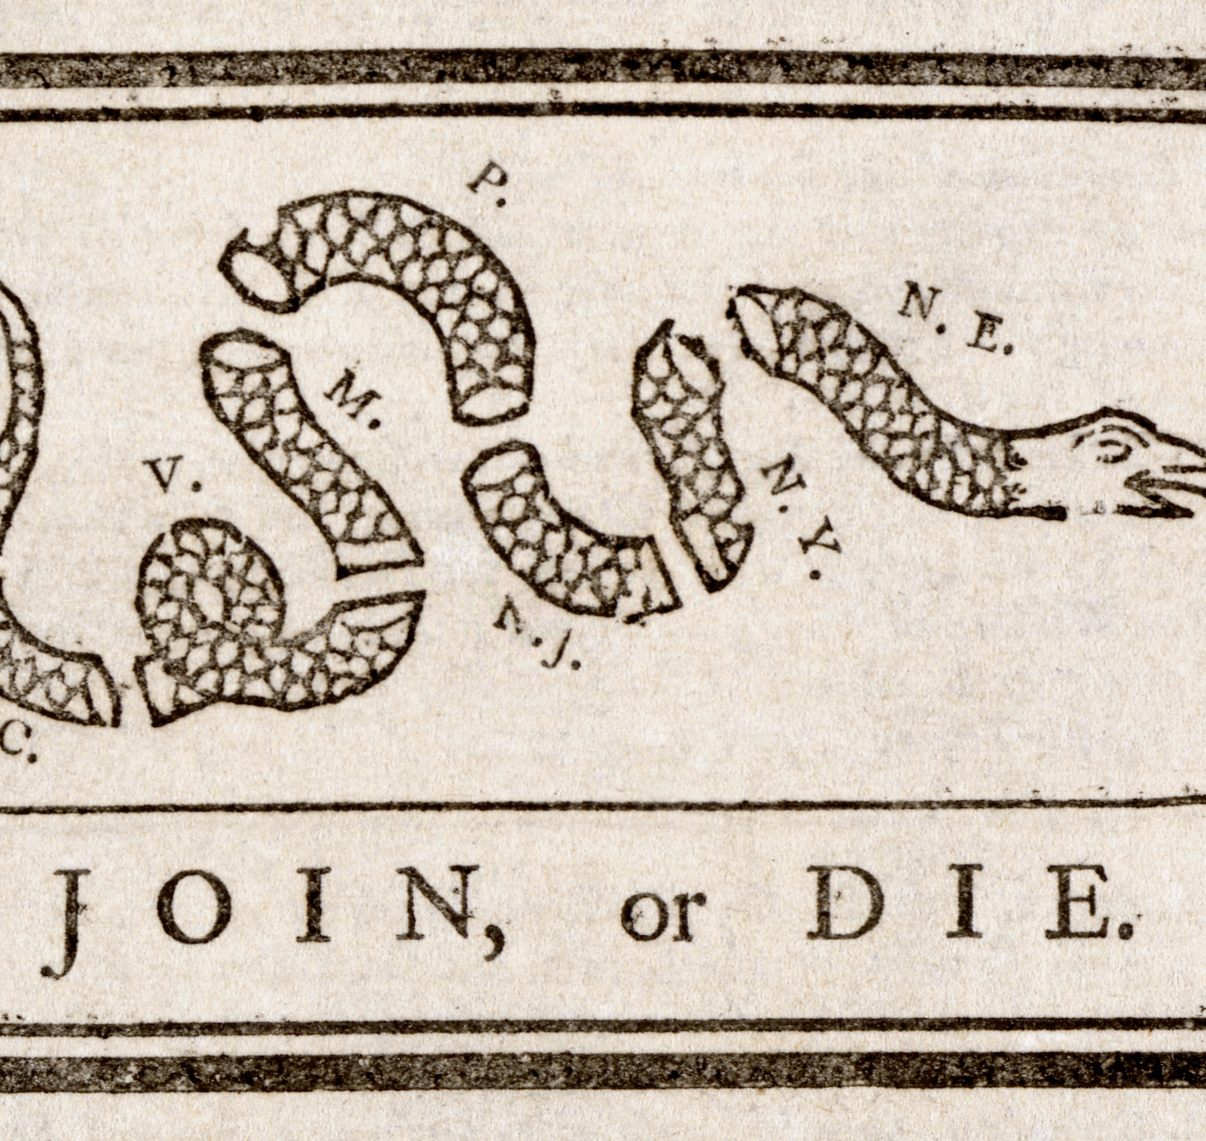
“Join, or Die”
Famous cartoon by Benjamin Franklin
Showed a snake cut into pieces
Each piece represented a colony
Warned colonies must unite

Slide 10
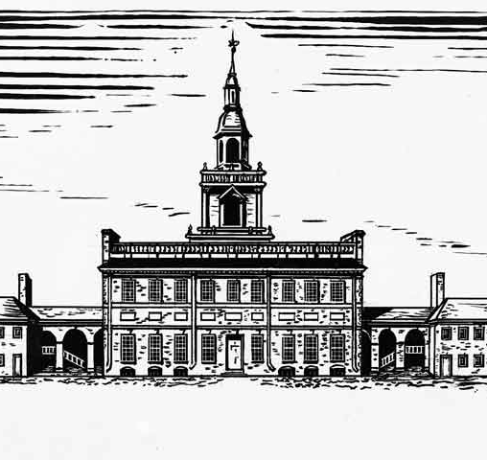
Franklin’s Impact
Encouraged colonial cooperation
Helped gather supplies for soldiers
Promoted unity between colonies
Ideas influenced later independence

Slide 11
Comparing Their Roles
Washington: military leadership
Franklin: political and organizational leadership
Both roles were important
Together shaped America’s future

