Slide 1
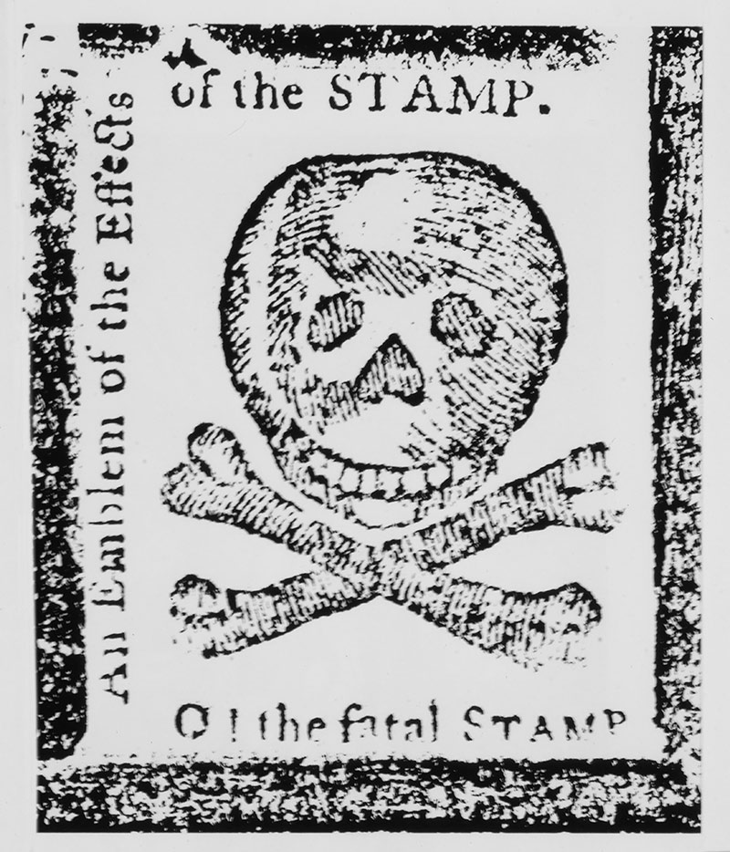

The American Revolution
Battles

Slide 2
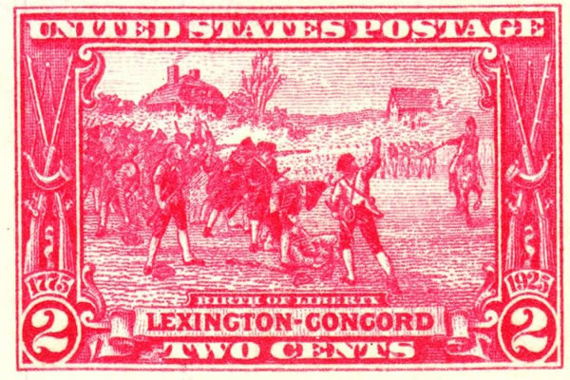
April 19, 1775
The First Battle of the Revolutionary War is known as the Battles of Lexington and Concord.
The first shot fired is sometimes referred to as “the shot heard ‘round’ the world.”

Slide 3
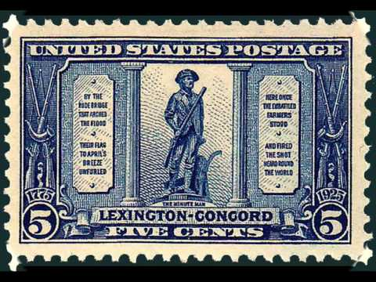
April 19, 1775
It occurred in Massachusetts as British “Redcoats” marched from Boston, through Lexington, to Concord, to destroy military supplies and weapons stockpiled by the Massachusetts militia. Before the Redcoats reached Lexington however…

Slide 4
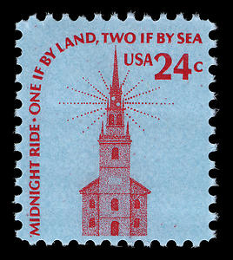
April 18, 1775
The Sons of Liberty had received intelligence warning of the British march and Paul Revere and others rode through town around midnight shouting “the regulars are coming!”
Two lanterns lit in Boston’s Old North church signaled that the British were arriving by sea. Thus, the famous warning, “one if by land, two if by sea.”

Slide 5
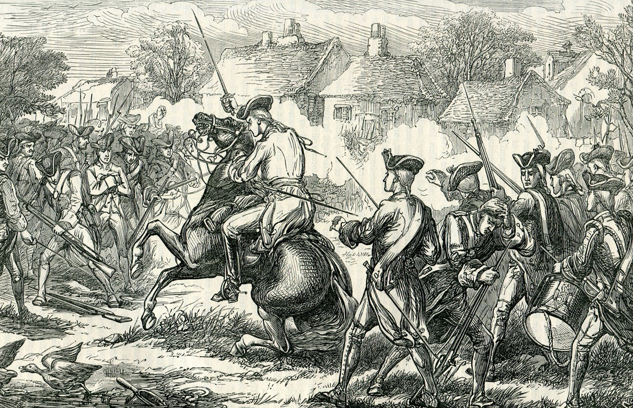
April 19, 1775
The first shots were fired at Lexington. No one knows if the British or Patriots fired it. In the gun battle that followed, however, eight minutemen were killed. The Redcoats marched on to Concord where they destroyed a cache of Patriot weapons.

Slide 6
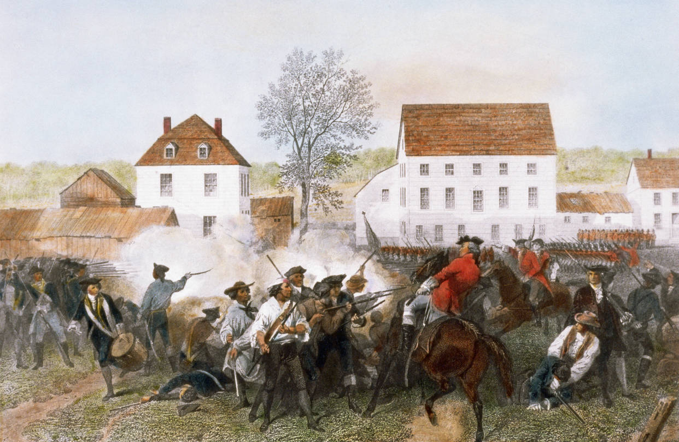
April 19, 1775
In Concord, and during the British march back to Boston, minutemen fired at the Redcoats from behind trees, under bridges and from behind large rocks. By the time the Redcoats made it back to Boston, 73 had been killed and nearly 200 injured. The war had begun!

Slide 7
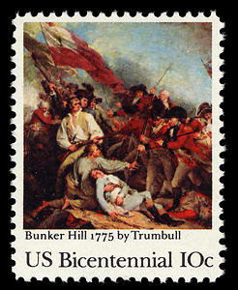
Battle of Bunker Hill June 17, 1775
In the second major battle of the war, British forces scored a “pyrrhic” victory over the Patriots. The battle was waged for control of the hills overlooking Boston. In the Battle, the British suffered over 1,000 casualties.
A pyrrhic victory is one that is very costly. In this case, the British victory came with over 1,000 casualties!

Slide 8
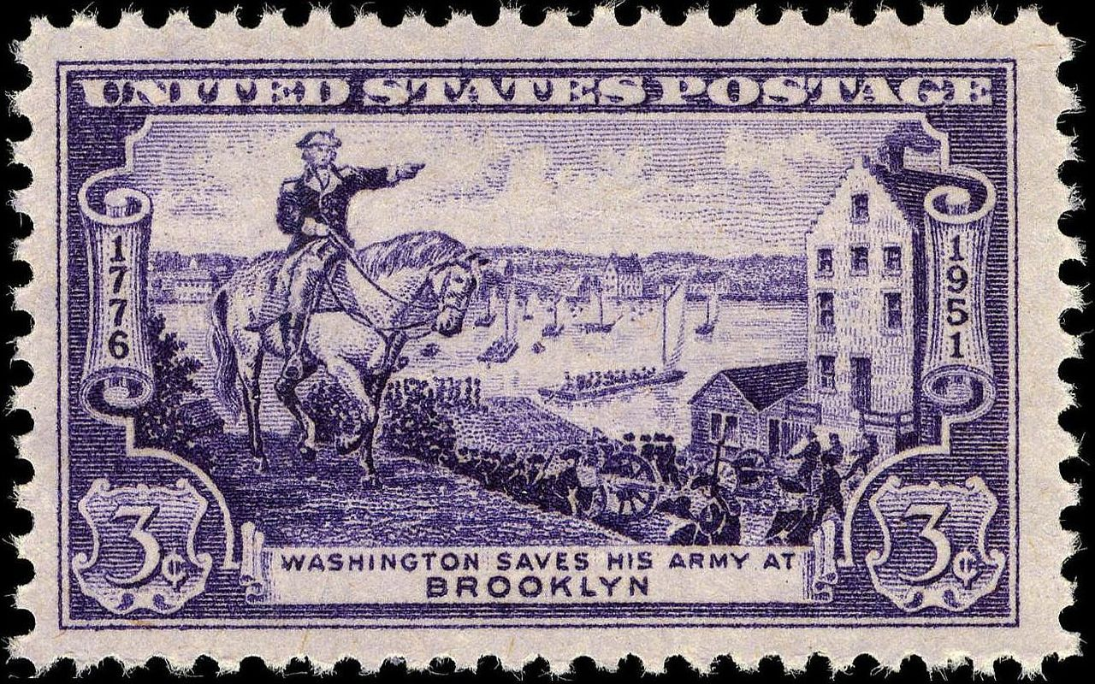
1776
Following the Battle of Bunker Hill, the British changed their strategy.
They planned a campaign aimed at occupying New York and New Jersey
Tens of thousands of British and Hessian soldiers were sent to New York City
Was the Continental Army ready? Could they stop the British?
A campaign is a military plan that aims to conquer a geographic region

Slide 9
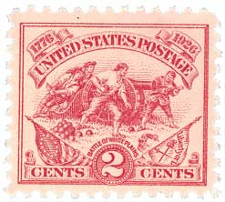
Battles in and around New York - 1776
The Continental Army, under George Washington, proved no match for the well-trained and overwhelming British forces.
In the series of battles at Brooklyn Heights, Harlem Heights, and White Plains, Patriot forces were decimated and chased all the way to the Pennsylvania side of the Delaware River. Thousands were killed or captured.
New York city was captured by the British.
The Continental Army was nearly destroyed and morale sunk.
A campaign is a war plan that includes a series of battles

Slide 10
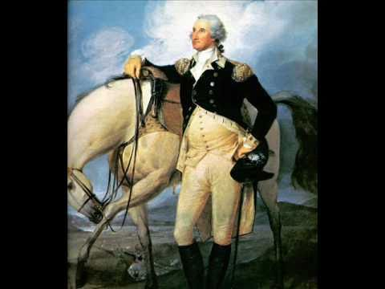
George Washington and the Battle of Trenton
Following the disastrous battles of New York, the outlook was grim for the Patriots.
Morale was low in the Continental Army and enlistments were ending.
It was up to George Washington to inject hope into what seemed a lost cause.
An enlistment is the period of time a soldier is obligated to perform military service

Slide 11
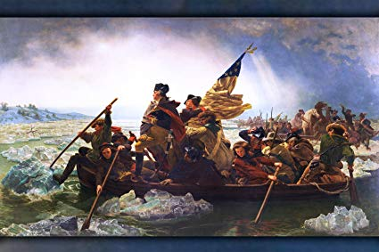
George Washington and the Battle of Trenton
Washington saw an opportunity; albeit a small one.
On Christmas night, he and 2,400 Continental soldiers crossed the icy Delaware River and marched nine miles to Trenton, New Jersey. Many lacked shoes and left a trail of blood in the ice and snow.
An enlistment is the period of time a soldier is obligated to perform military service

Slide 12
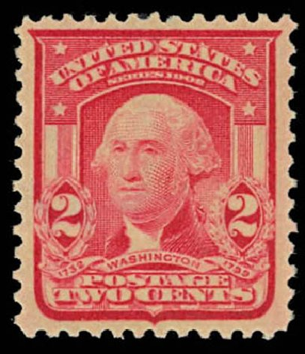
George Washington and the Battle of Trenton
Early the next morning, Washington and his soldiers surprised a garrison of about 1,000 Hessian soldiers, capturing roughly 800.
The small but important victory had a significant effect – it boosted morale and inspired re-enlistments. 1776 ended on a positive note and the Continental Army survived.

Slide 13
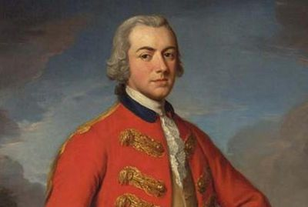
1777
On September 11, British General William Howe occupied the Patriot capital of Philadelphia.
While it seemed a great strategic move, there was a HUGE opportunity cost.
Because Howe committed his army to the occupation of Philadelphia, he could not help General John Burgoyne in his quest to capture parts of the Hudson River Valley in New York to sever New England from the other colonies.
Opportunity Cost can be defined as what is given up when a choice to do something is made.

Slide 14
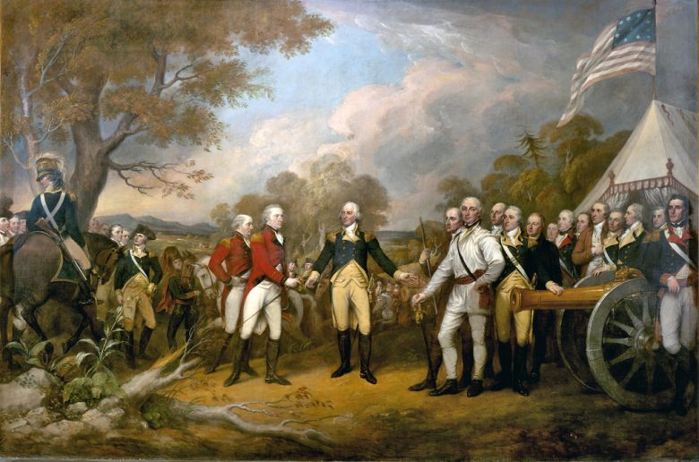
September and October 1777
Without help from General Howe, and with further delays due to supplies and troop movements, General Burgoyne and his large army became trapped at Saratoga, New York.
In a series of major battles in and around Saratoga, Patriot forces led by Horatio Gates and Benedict Arnold defeated Burgoyne’s army and captured over 6,200 soldiers.
Saratoga marked the first decisive victory for Patriot forces in the war.
Burgoyne’s Surrender

Slide 15
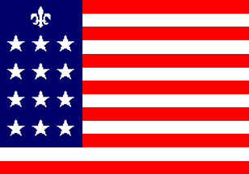
Effect of the Battle of Saratoga
France had been closely monitoring the Revolutionary War. It sought revenge on England for its loss in the French and Indian War.
Following the Patriot victory at Saratoga, and with help from the diplomacy of Benjamin Franklin, it agreed to help the Patriot cause and declared war on England. It was now France and America fighting the English
France committed supplies, money, soldiers and military expertise to help the Patriots.
Spain and the Netherlands also agreed to help.
French Alliance Flag

Slide 16

Winter of 1777-1778
The Continental Army took up winter quarters at Valley Forge, Pennsylvania.
Conditions were terrible. One in six soldiers died of disease or exposure to the elements. Many lacked simple supplies such as clothing and blankets.
During this time, however, the Continental Army was trained in weaponry, formations, and military strategy by the German General Baron Von Steuben.
Following the Winter at Valley Forge, the Continental Army was much improved as a fighting force.
Washington praying for his army at Valley Forge

Slide 17
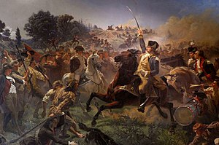
1778
On June 19th, 1778, Patriot forces left Valley Forge.
British forces were evacuating Philadelphia and marching toward New York.
Washington attacked the caravan of British soldiers on June 28th at Monmouth Courthouse, NJ.
The Continental Army fought well and battled the British to a tactical draw.
The British, however, successfully completed the relocation to New York.

Slide 18
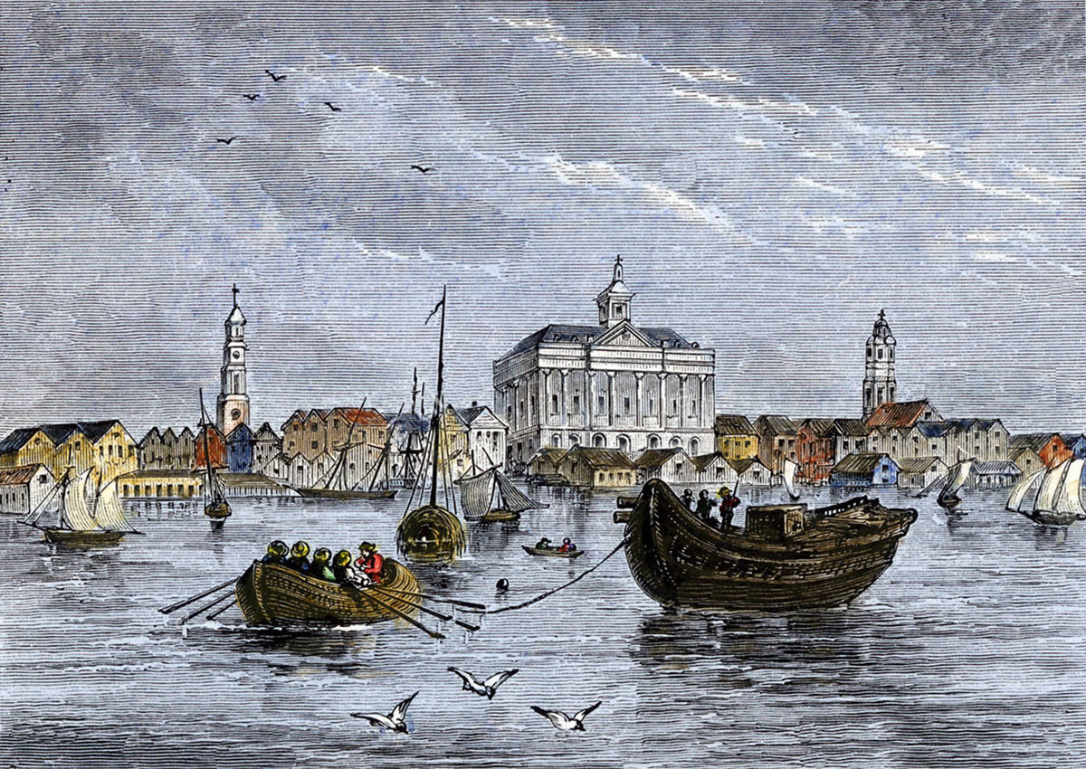
The Southern Campaign
Following the evacuation of Philadelphia and the draw at Monmouth Courthouse, the British once again changed strategies.
They decided that they would have better luck invading and occupying the more British-friendly southern colonies of Georgia, and the Carolinas.
The “Southern Theater” began in 1778 with the British occupation of Savannah, Georgia.
In 1780, the British besieged and eventually captured Charleston, South Carolina. This was a devastating blow to the Patriot cause. Over 5,000 soldiers were captured.

Slide 19
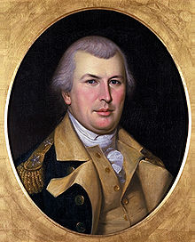
The Southern Campaign
Following another devastating loss at Camden, South Carolina, in 1780, Commander Horatio Gates was replaced by Nathanael Greene.
Greene’s leadership helped the Patriots in the Southern Theater.
Several battles at Cowpens, Guilford Courthouse, and King’s Mountain in the Carolinas resulted in terrible casualties for the British Army, severely weakening it.
In October of 1781, British General Charles Cornwallis set up his battered army’s winter quarters at Yorktown, Virginia, ultimately sealing its fate.
Nathanael Greene

Slide 20
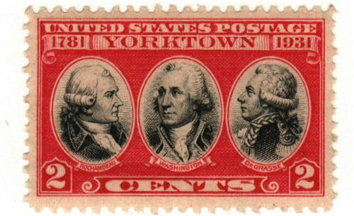
Siege of Yorktown
Commander-in-Chief George Washington and French Commander Comte de Rochambeau drew up a plan to trap Cornwallis.
Washington and Rochambeau would lead soldiers by land from New York, and French naval officer Comte de Grasse would lead a fleet of French soldiers to Yorktown by sea. The plan was to besiege (surround) Cornwallis.

Slide 21
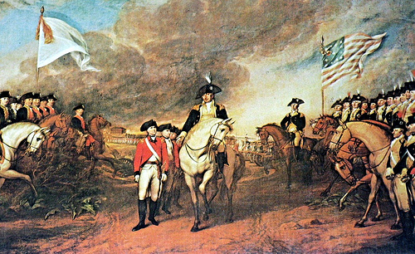
Siege of Yorktown
It worked!
American and French naval and land forced surrounded Cornwallis and began bombarding his position on October 14, 1781.
American and French forces soon moved closer and closer to the British position inside Yorktown.
Cornwallis realized his position was untenable. On October 17th he asked for surrender terms and officially surrendered on October 19th.

Slide 22
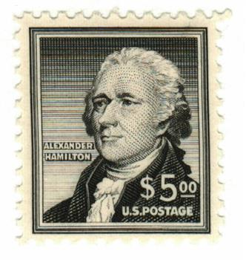
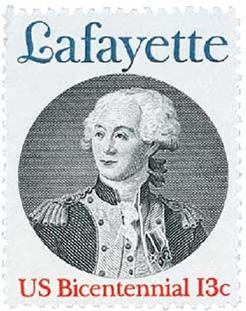
Siege of Yorktown
American forces captured 9,000 British soldiers.
The British defeat at Yorktown was the last major battle of the Revolutionary War. It was clear that America would become a free country.
New French and American heroes emerged from the battle including Alexander Hamilton and Marquis de Lafayette.

Slide 23
Follow up Activity
Do you know what an underdog is? An underdog is a person, team, or, in this case, an army, that seemingly has no chance to win against the opponent. Against all odds, the Continental Army ultimately defeated the British, gaining independence for its nation. Have you ever won as an underdog? Have you ever won on a team that was an underdog? Describe why you or your team was an underdog and how you proved victorious. If you can’t think of a time in your life that you won as an underdog, describe such an event from sports, movies, or literature.

