Slide 1
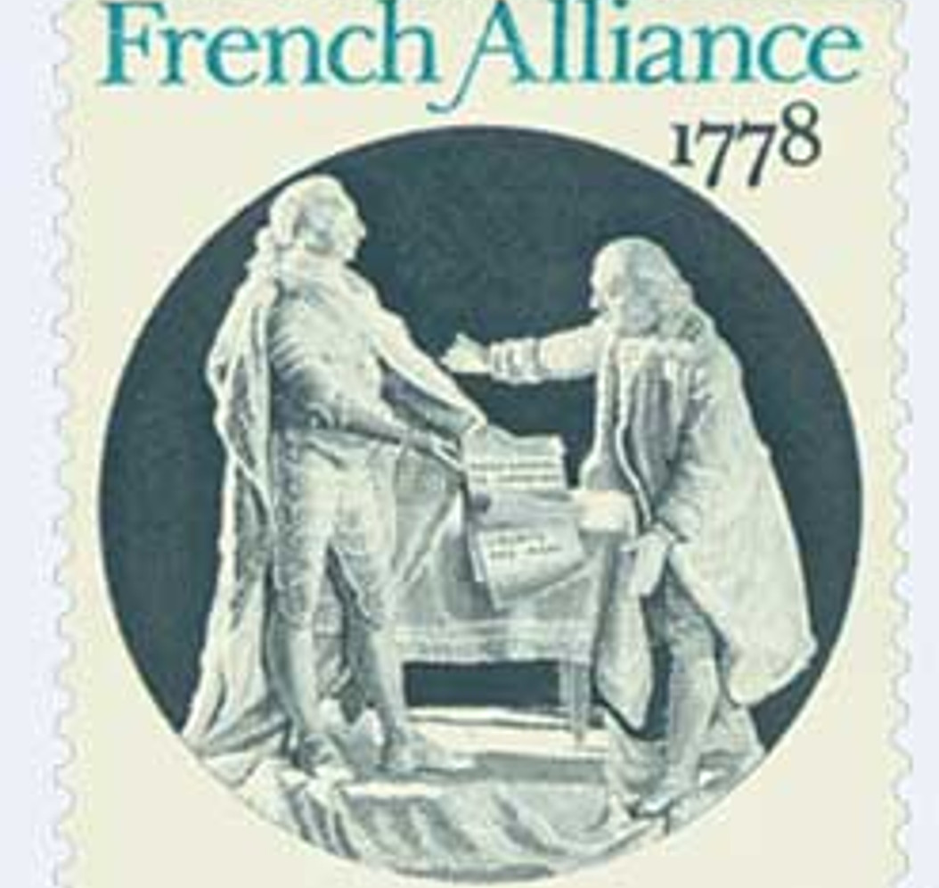
The Treaty of Alliance (1778)
https://learnaboutamerica.com
Notes:
Introduce the Treaty of Alliance as a landmark agreement that connected the American Revolution to global politics.

Slide 2

LearnAboutAmerica.com
*For our presentations, lesson plans, articles, printables, interactives, stories, and games related to the Treaty of Alliance, please visit:
https://learnaboutamerica.com/american-history/revolutionary-war/effects-of-the-revolutionary-war/treaty-of-alliance
* For the greatest American History website for teachers, parents, and students, visit:
https://learnaboutamerica.com

Slide 3
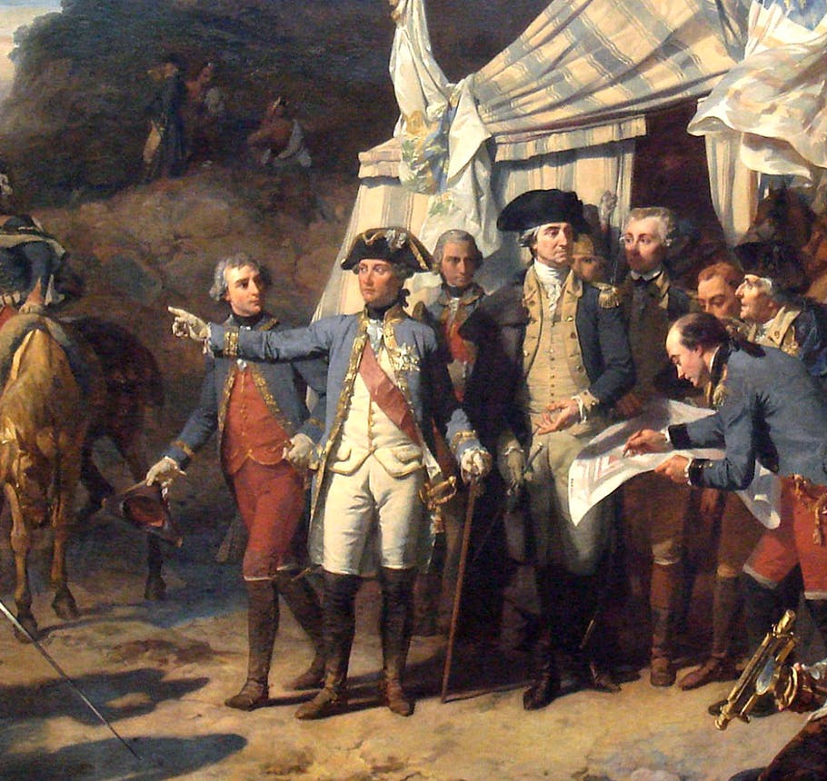
What Was the Treaty of Alliance?
Military alliance between the U.S. and France
Signed February 6, 1778
First formal U.S. alliance
Notes:
Explain that this was the young nation’s first official partnership with a foreign power.

Slide 4
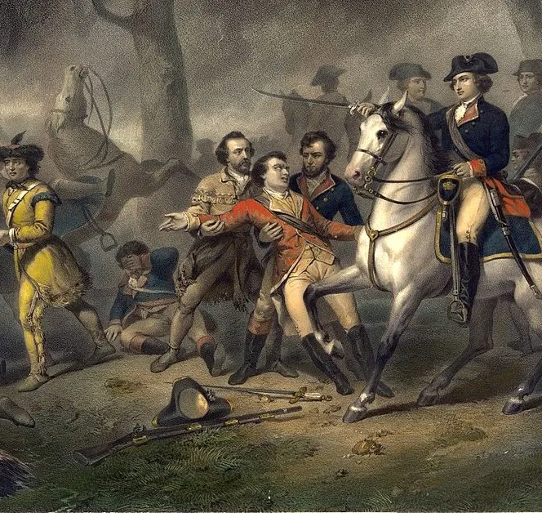
Why France Was Interested
France disliked British dominance
Sought to weaken Great Britain
Saw opportunity in American rebellion
Notes:
Explain France’s motivation was strategic as well as political.

Slide 5
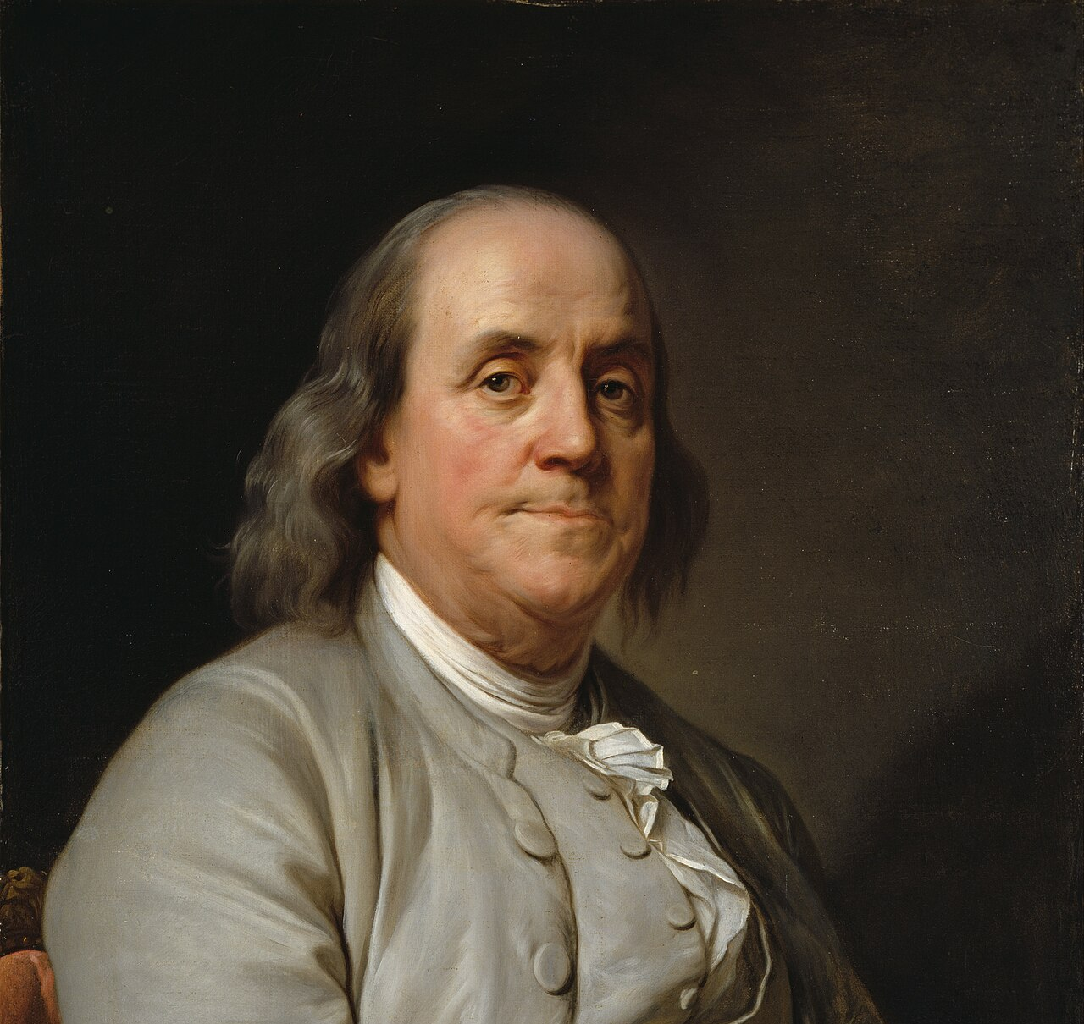
Secret Negotiations
Months of private talks
American diplomats in France
Negotiations kept hidden from Britain
Notes:
Describe why secrecy was necessary and risky.

Slide 6
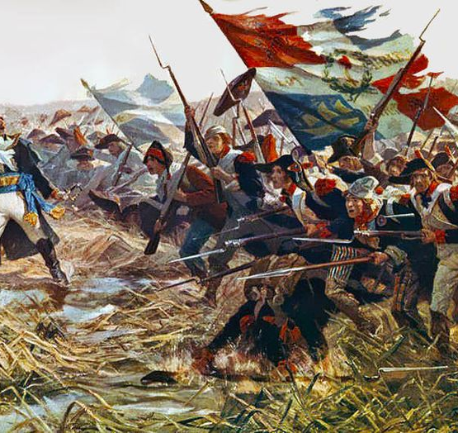
American Diplomacy
United States needed allies
Military and financial support required
France seen as strongest option
Notes:
Explain how desperate the Americans were for foreign help.

Slide 7
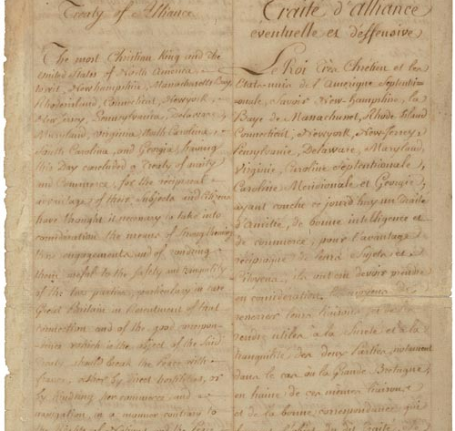
Signing the Treaty
Signed February 6, 1778
Formal agreement reached
Alliance made public
Notes:
Explain the importance of formal recognition for the United States.

Slide 8
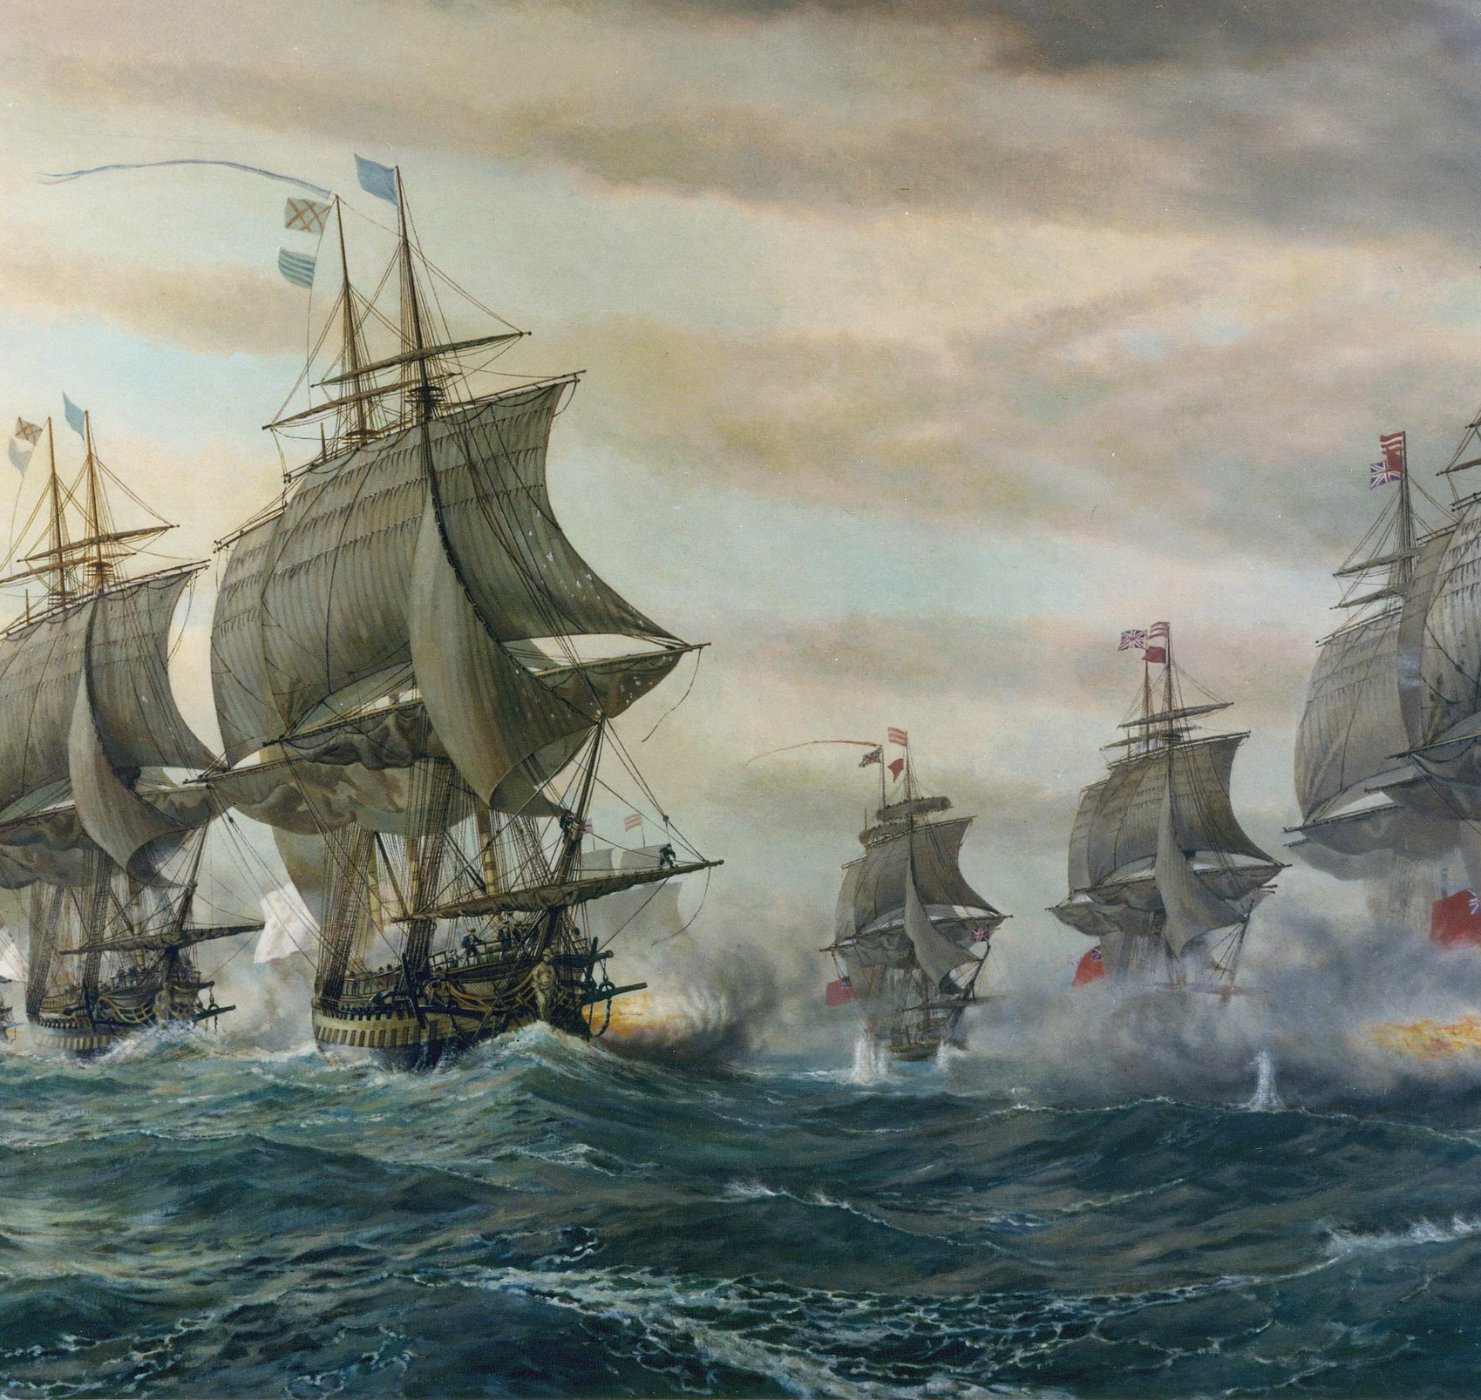
Military Assistance
French troops sent to America
Naval support provided
Supplies and weapons delivered
Notes:
Explain how French military power changed the war.

Slide 9
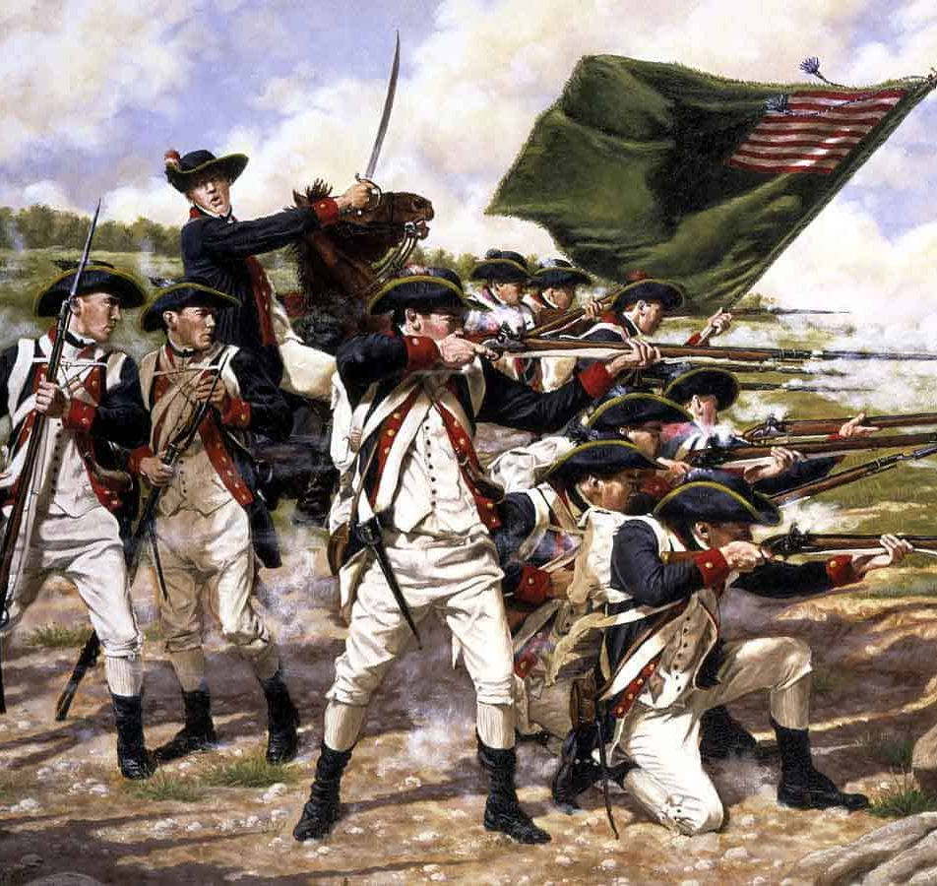
Financial Support
Loans and financial aid
Helped fund the Continental Army
Stabilized the war effort
Notes:
Explain why money was just as important as soldiers.

Slide 10
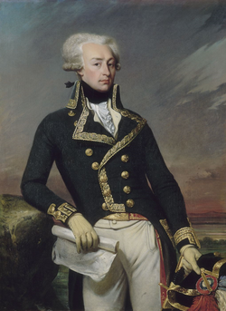
Defensive Alliance
Each nation pledged mutual defense
Protection against British attacks
Shared military responsibility
Notes:
Explain how this commitment increased risks for France.

Slide 11
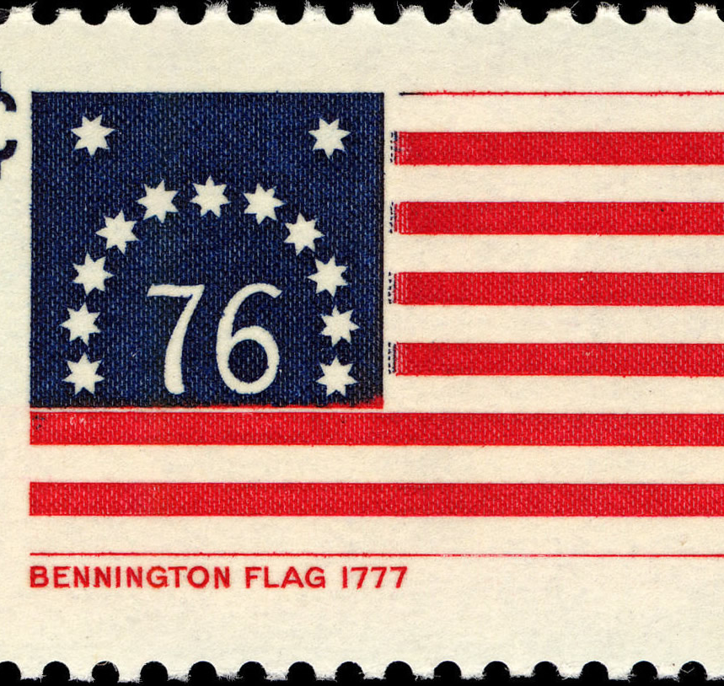
Impact on the Revolutionary War
Boosted American morale
Shifted balance of power
Legitimized American cause
Notes:
Explain why the treaty is considered a turning point.

Slide 12
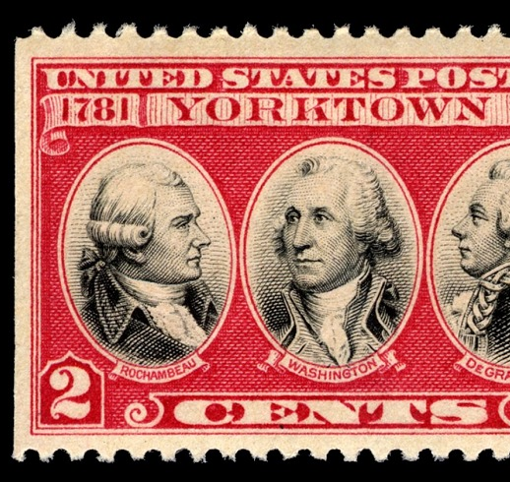
Road to Yorktown
French troops and ships crucial
Naval blockade trapped British
Victory in 1781
Notes:
Explain how French support led directly to victory at Yorktown.

Slide 13

Global Consequences
France officially entered the war
War expanded beyond America
Britain forced to fight worldwide
Notes:
Explain how the conflict became international.

Slide 14
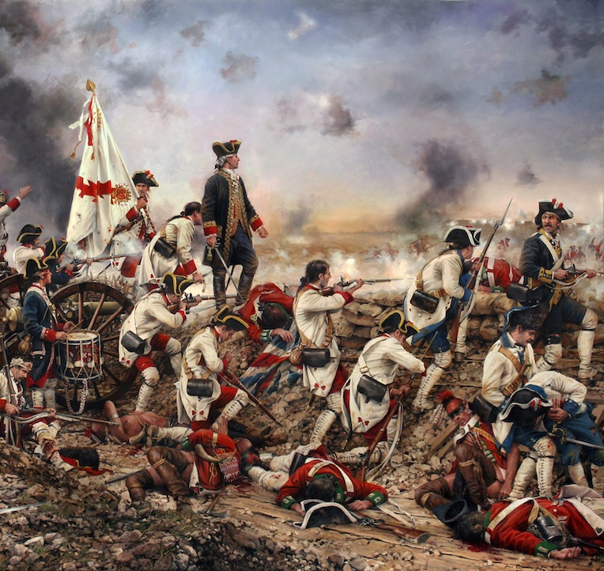
Spain Enters the War
France and Spain allied
Spain declared war in 1779
British resources stretched thin
Notes:
Explain how Spain’s involvement further weakened Britain.

Slide 15
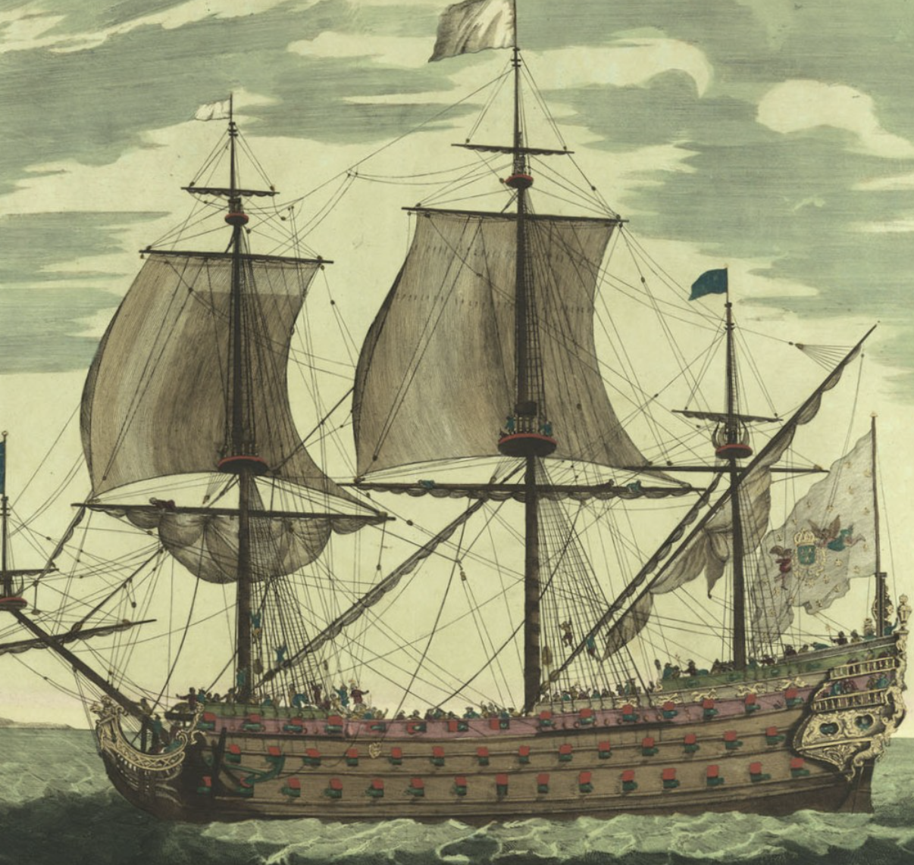
A Global Conflict
Battles in Europe and the Caribbean
Naval warfare increased
American war part of world conflict
Notes:
Explain how independence was tied to global power politics.

Slide 16
Why the Treaty Matters
First U.S. alliance
Key to independence
Long-term diplomatic impact
Notes:
Conclude by emphasizing the treaty’s lasting importance.

