Slide 1
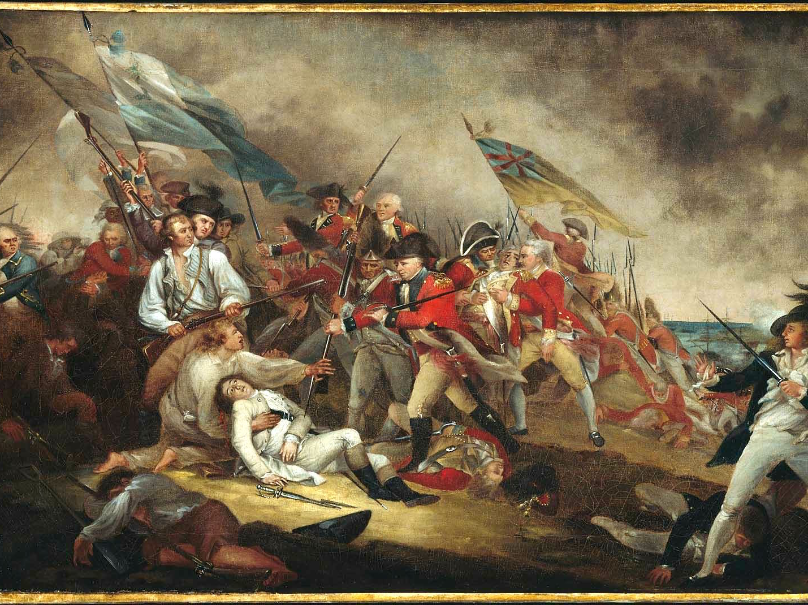

The Battle of Bunker Hill

Slide 2
LearnAboutAmerica.com
*For our presentations, lesson plans, articles, printables, interactives, stories, and games related to the Battle of Bunker Hill, please visit:
https://learnaboutamerica.com/american-history/revolutionary-war/battles-of-the-revolutionary-war/battle-of-bunker-hill
* For the greatest American History website for teachers, parents, and students, visit:
https://learnaboutamerica.com

Slide 3
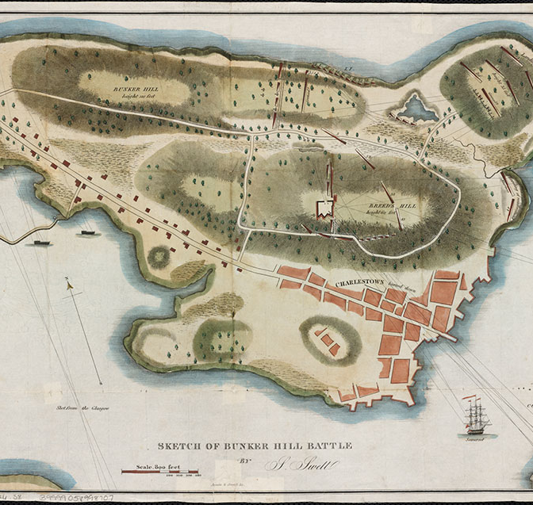
After Lexington and Concord
Patriot militias blocked British land access to Boston
British forces could still use Boston Harbor
Boston was under siege

Slide 4
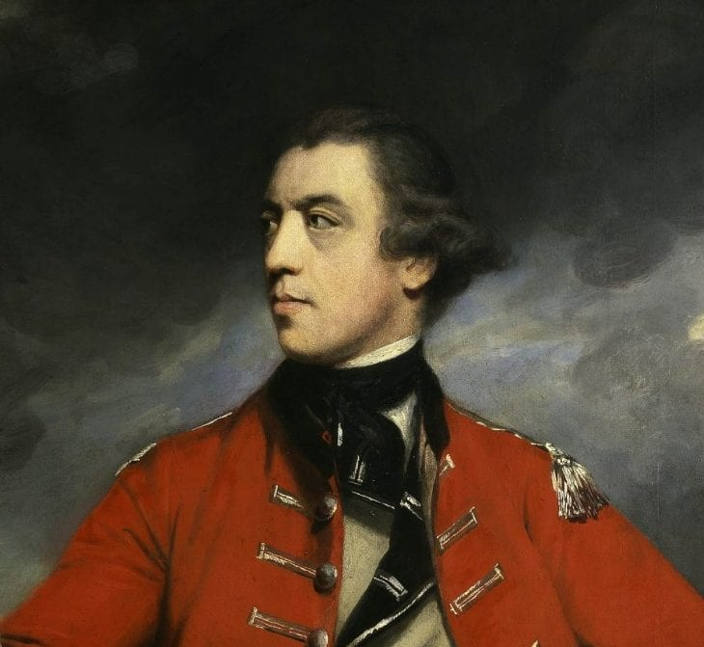
British Commanders Arrive
May 25, 1775
Generals William Howe, John Burgoyne, and Henry Clinton arrived
Planned to break the Patriot siege

Slide 5
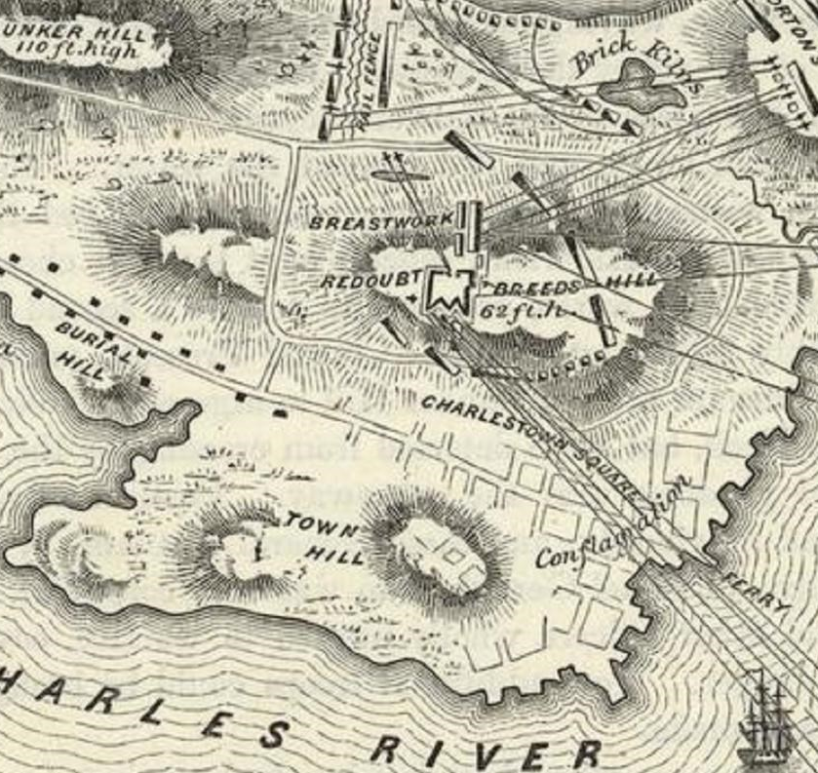
Why the Hills Mattered
High ground overlooked Boston and its harbor
Bunker Hill and Dorchester Heights were key positions
Control meant strategic advantage

Slide 6
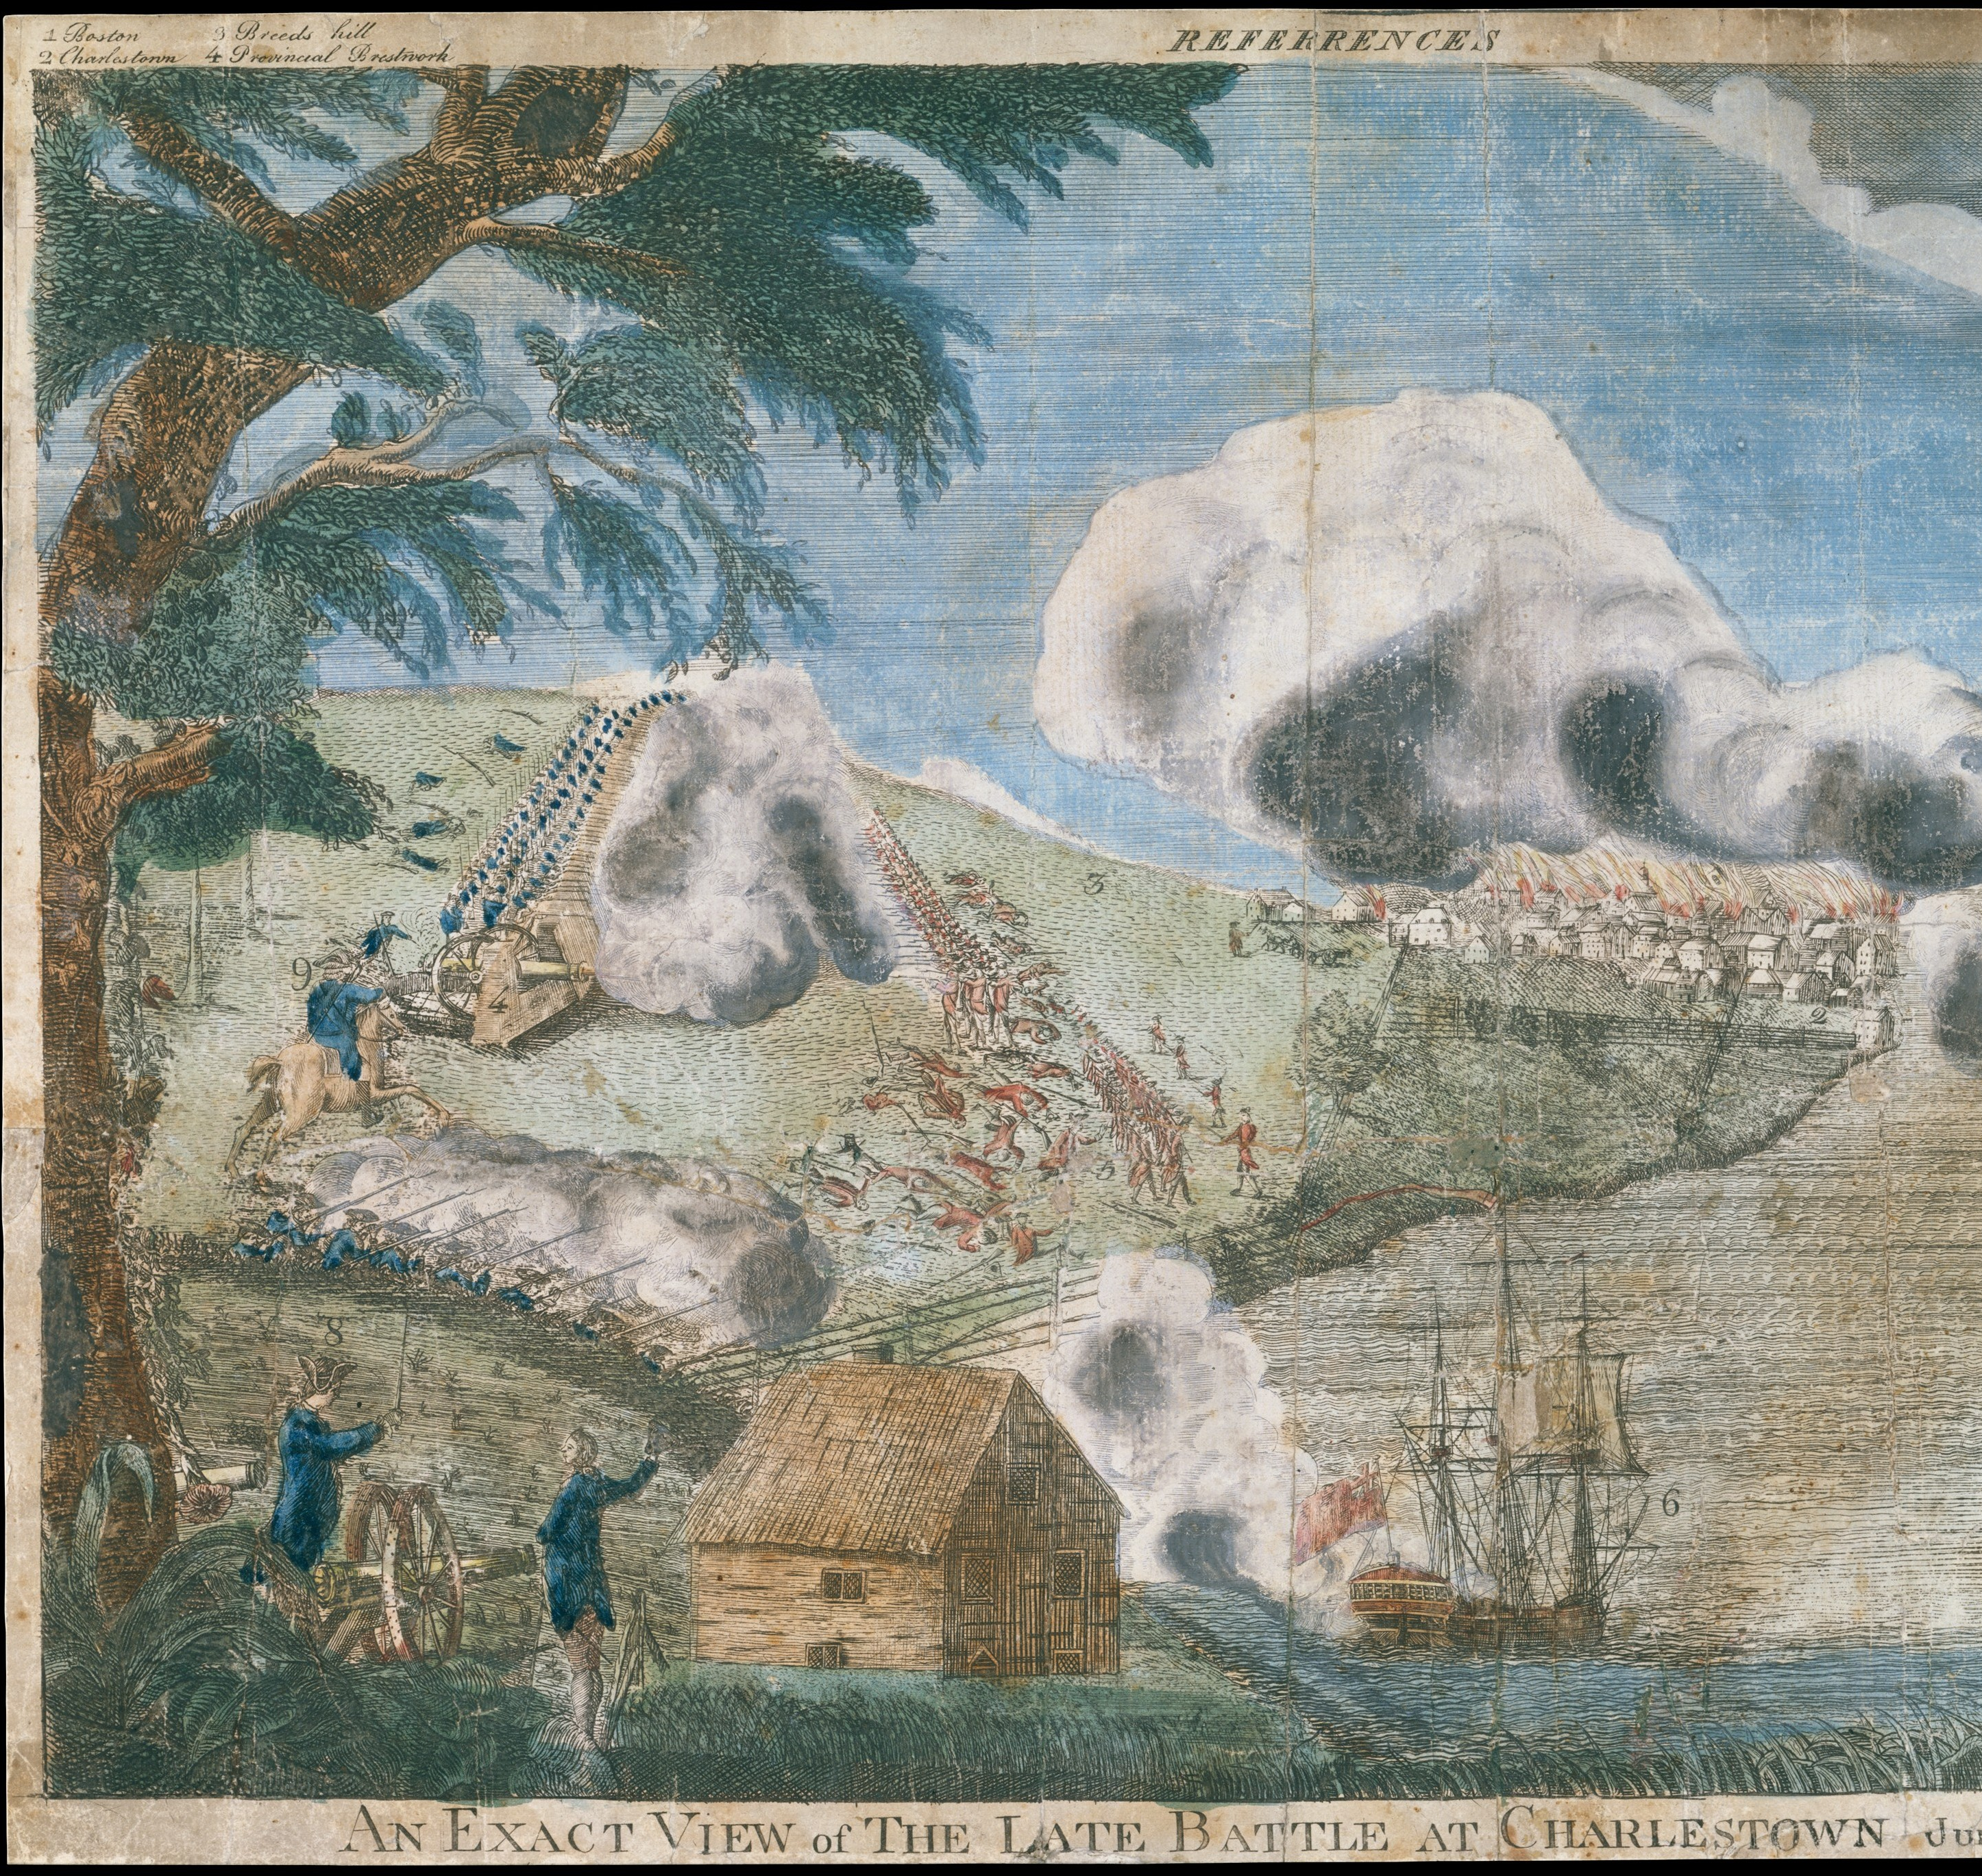
Patriot Fortifications
June 15, 1775
Patriots fortified Bunker Hill and Breed’s Hill
Charlestown Peninsula extended into Boston Harbor

Slide 7
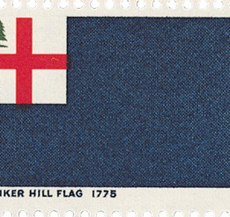
British Underestimate the Patriots
British leaders underestimated Patriot resolve
John Burgoyne called the militia 'untrained rabble'
British chose a direct assault

Slide 8
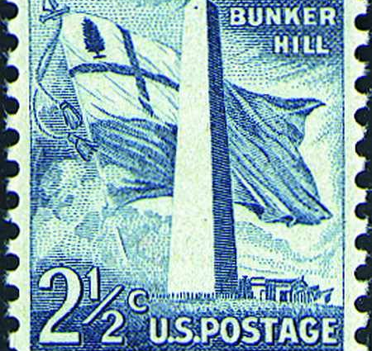
The First British Assault
June 17, 1775, around 3:00 PM
British troops attacked Breed’s Hill
Patriot gunfire repelled the attack

Slide 9
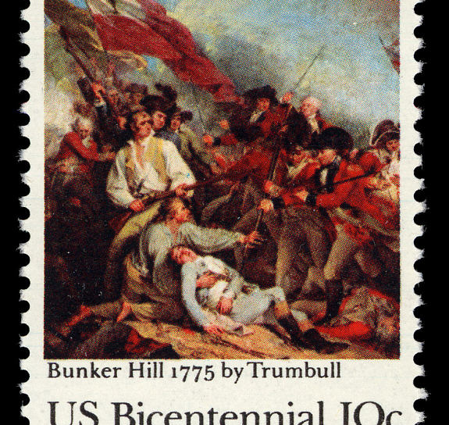
The Second Assault
British regrouped and attacked again
Heavy British casualties continued
Patriot defenses held

Slide 10
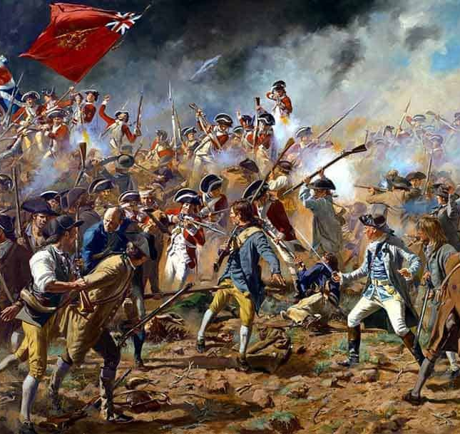
The Third Assault
British focused on Breed’s Hill
Patriots ran out of ammunition
Fighting turned to hand-to-hand combat

Slide 11
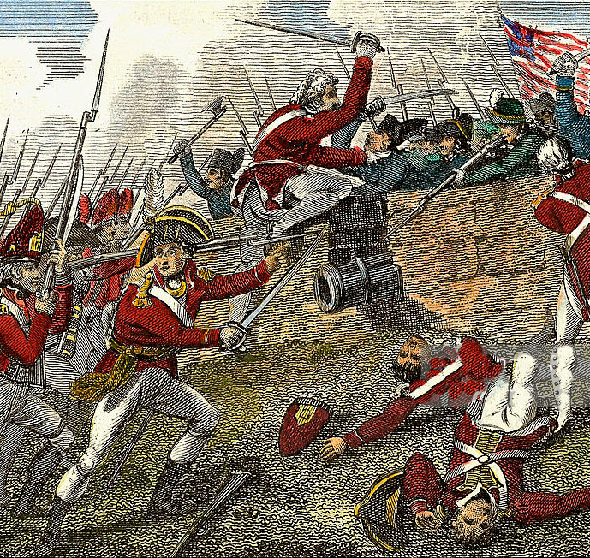
The Patriot Retreat
Patriots retreated due to lack of ammunition
Retreat was orderly and effective
Most soldiers avoided capture

Slide 12
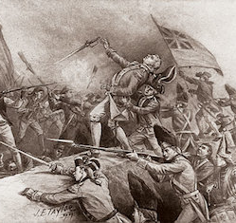
A Pyrrhic British Victory
British gained control of Charlestown Peninsula
Over 1,000 British casualties
About 450 Patriot casualties

Slide 13
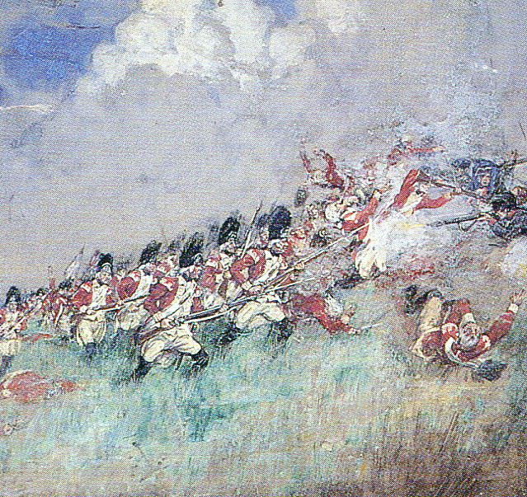
Why It Was Costly
81 British officers were killed or wounded
Losses shocked British leadership
Victory came at a high price

Slide 14
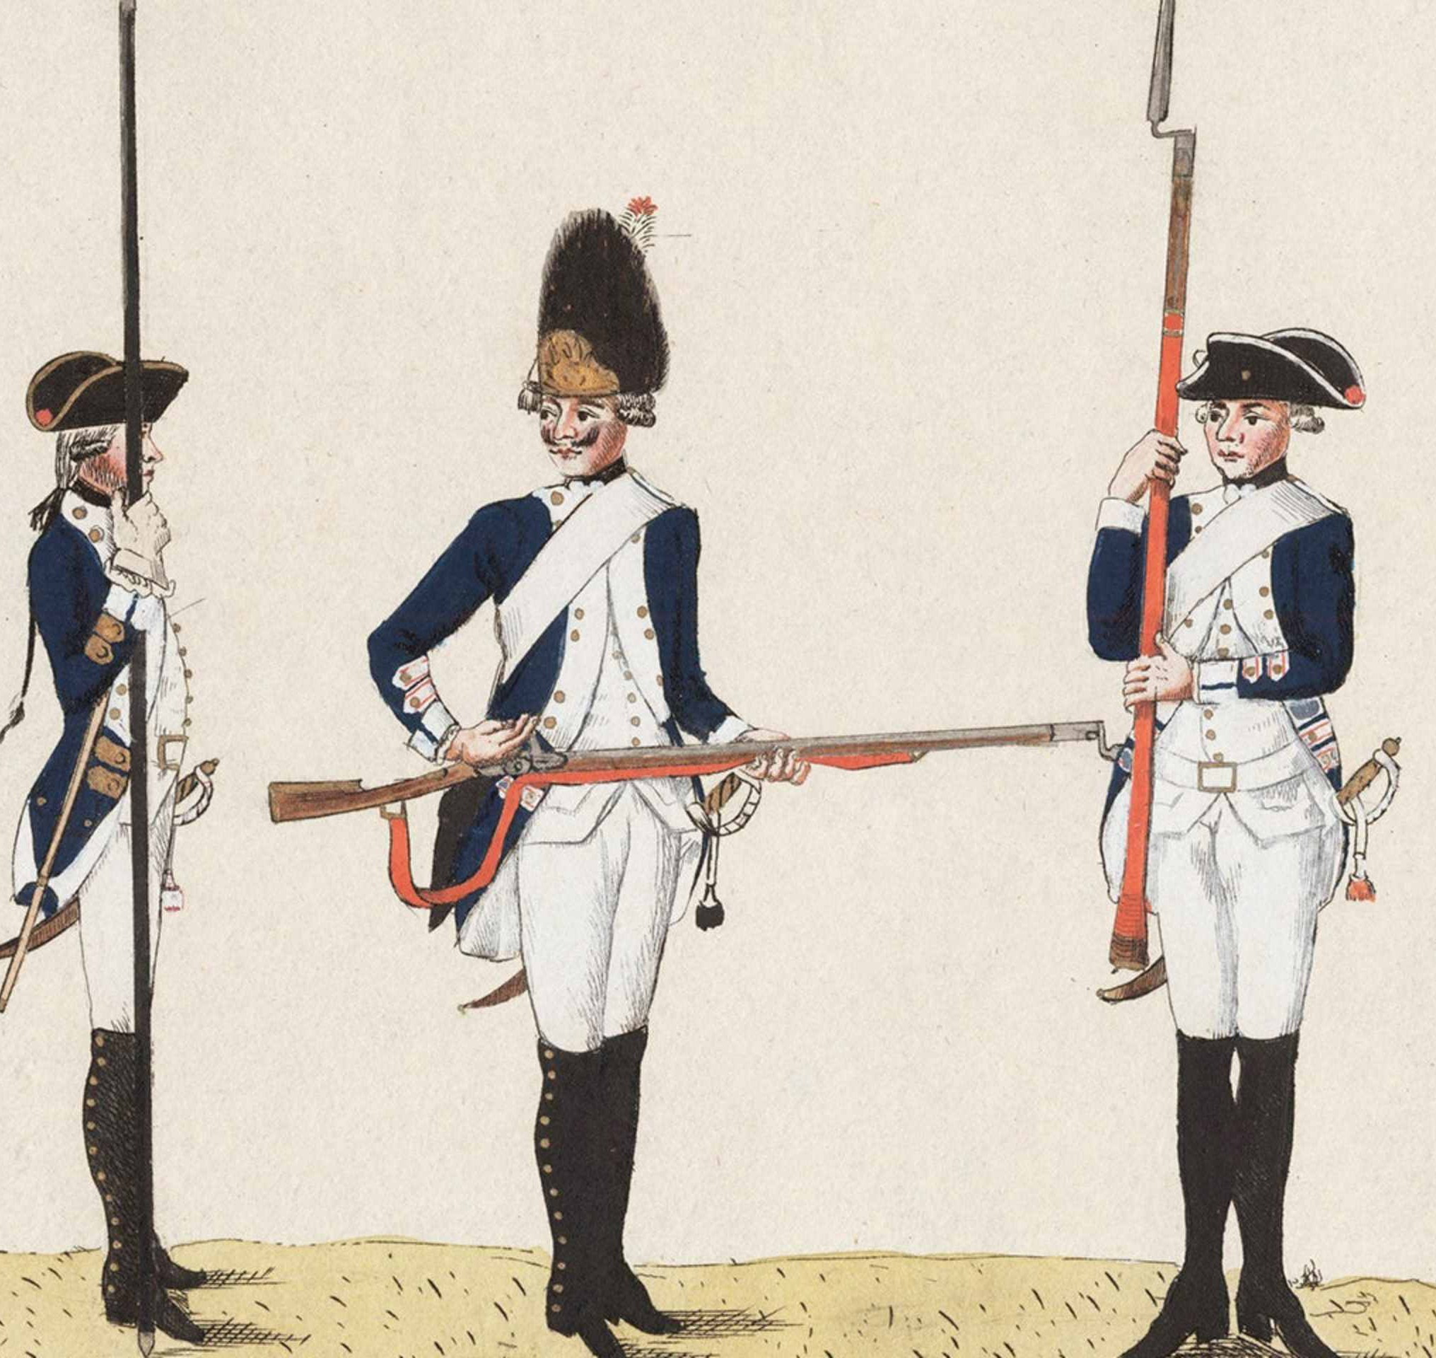
Strategic Changes
British became more cautious attacking fortifications
Decision to hire over 30,000 Hessian soldiers
Needed additional military strength

Slide 15

Impact on the Patriots
Patriot confidence increased
Militia proved capable against British army
Encouraged continued resistance

Slide 16
Why the Battle Matters
Showed the war would be long and difficult
Boosted Patriot morale
Changed British strategy

