Slide 1
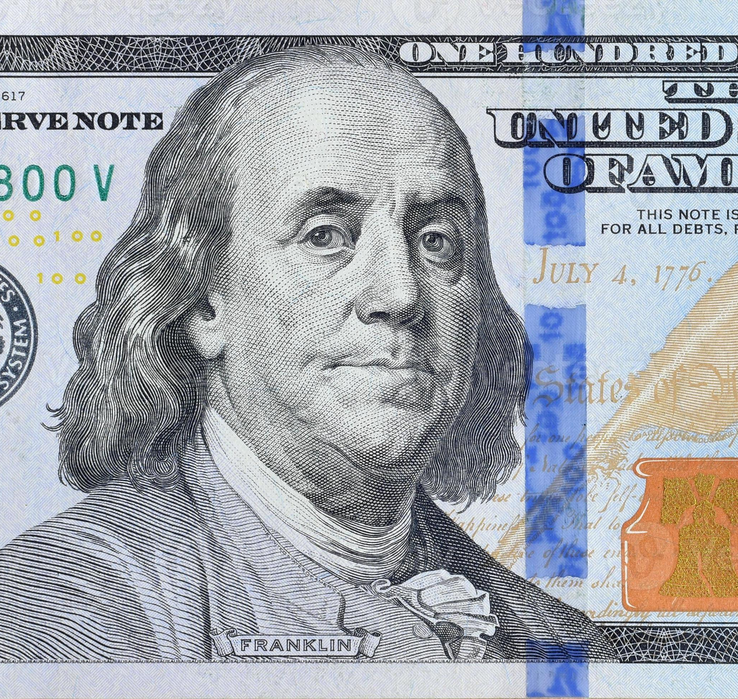
Benjamin Franklin
https://learnaboutamerica.com
Notes:
Introduce Benjamin Franklin as one of the most versatile and influential figures in American history.

Slide 2

LearnAboutAmerica.com
*For our presentations, lesson plans, articles, printables, interactives, stories, and games related to Benjamin Franklin, please visit:
https://learnaboutamerica.com/american-history/revolutionary-war/people-of-the-revolutionary-war/benjamin-franklin
* For the greatest American History website for teachers, parents, and students, visit:
https://learnaboutamerica.com

Slide 3
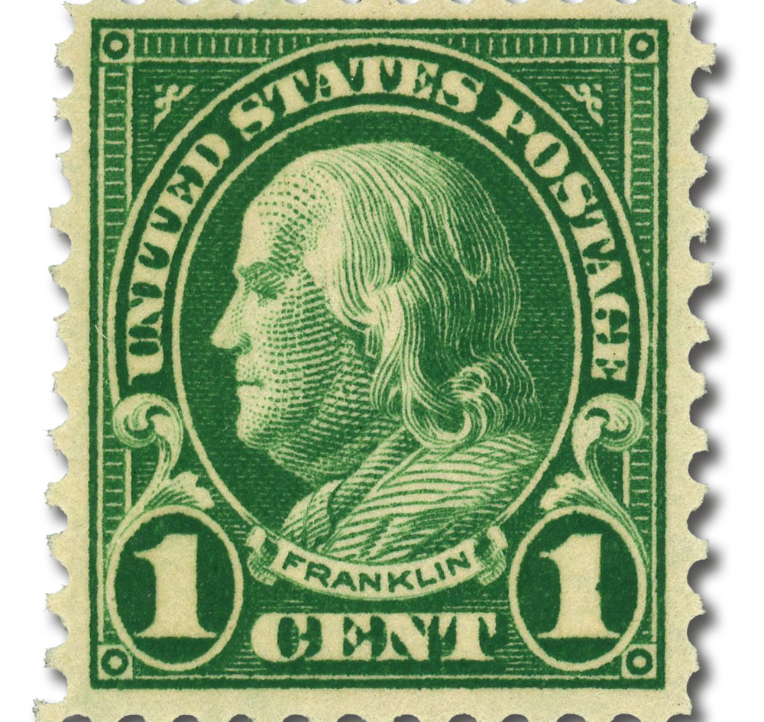
Early Life
Born January 17, 1706 in Boston
One of ten children
Son of a soap maker
Notes:
Explain Franklin’s modest upbringing and limited formal education.

Slide 4
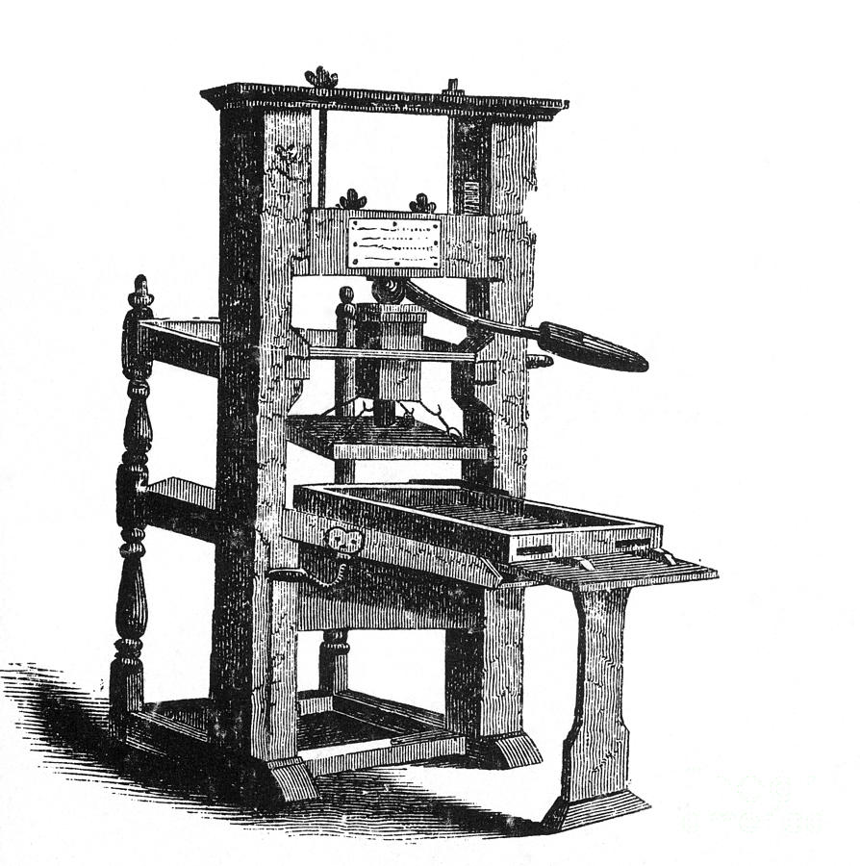
Apprentice Printer
Apprenticed to brother James at age 12
Learned printing and writing skills
Worked long hours
Notes:
Describe how printing shaped Franklin’s love of ideas and communication.

Slide 5
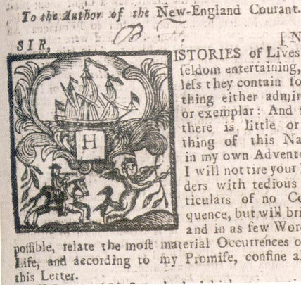
Silence Dogood
Wrote under a pen name
Published popular letters
Criticized society and women’s treatment
Notes:
Explain why Franklin used a pseudonym and why the letters were important.

Slide 6
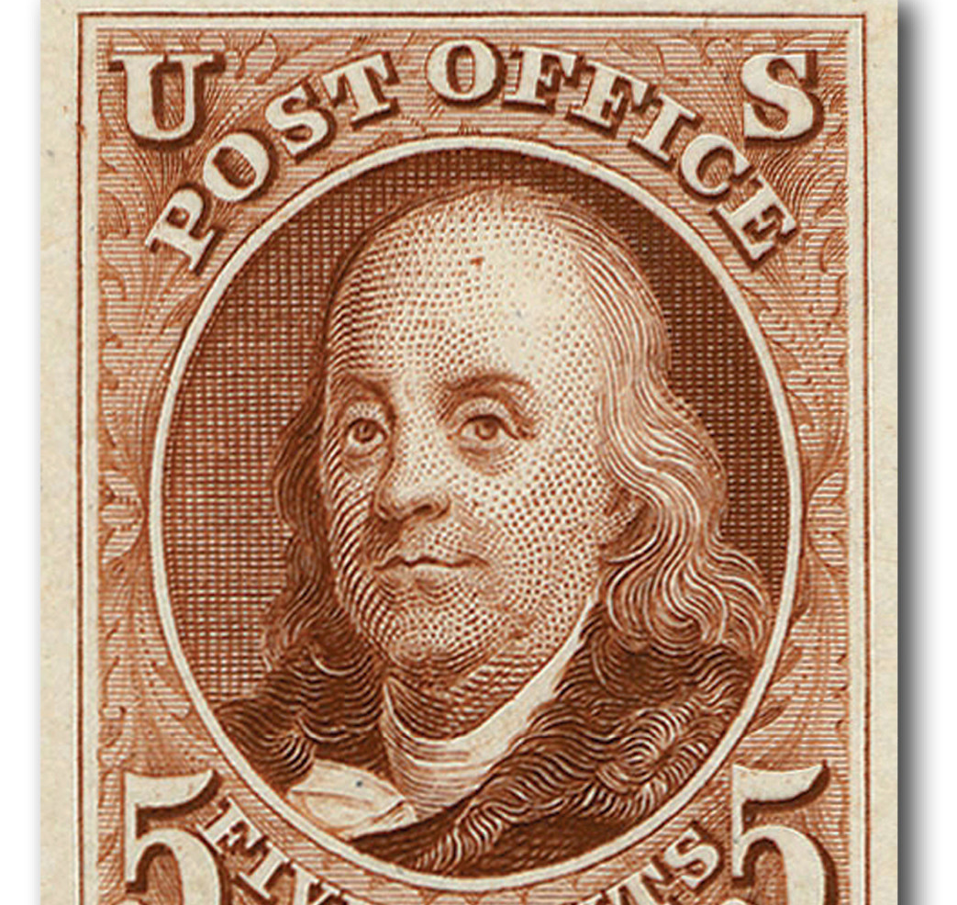
Conflict and Escape
James jailed for criticism
Benjamin ran the paper
Fled Boston in 1723
Notes:
Describe Franklin’s break from his brother and flight to Philadelphia.

Slide 7
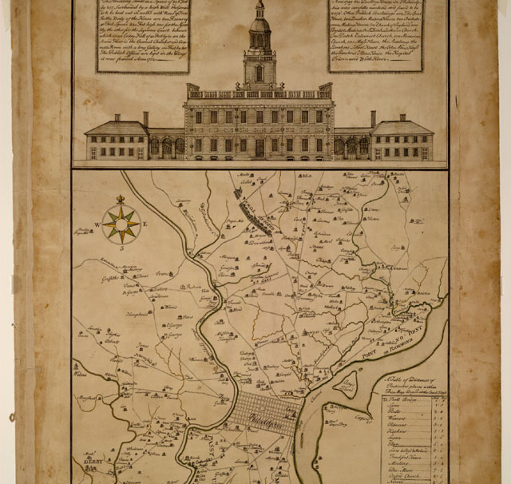
Philadelphia and London
Found work as a printer
Sent to London by governor
Governor broke promise
Notes:
Explain Franklin’s disappointment and growth during his London stay.

Slide 8
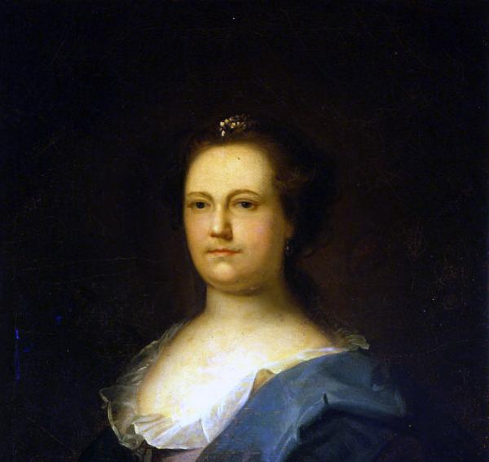
Marriage and Business
Returned to Philadelphia
Started printing business
Married Deborah Read
Notes:
Explain how Franklin became financially successful.

Slide 9
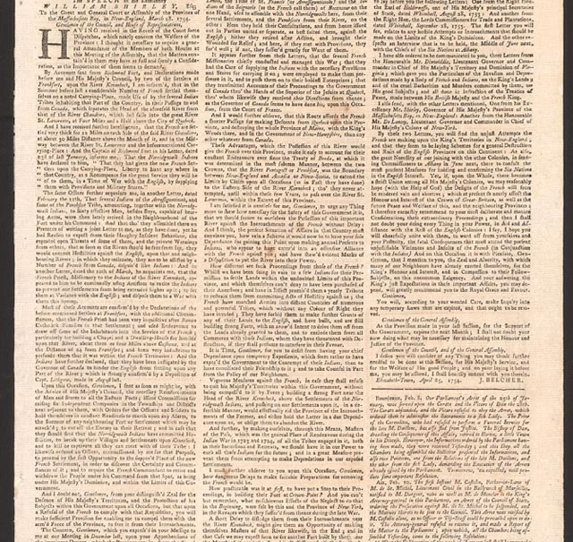
Pennsylvania Gazette
Bought paper in 1729
Most successful colonial newspaper
First political cartoons
Notes:
Discuss Franklin’s influence through journalism.

Slide 10
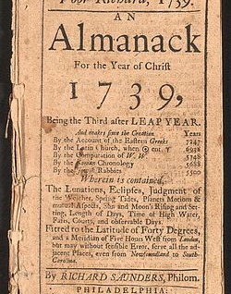
Poor Richard’s Almanac
Published in 1733
Famous sayings
Blended humor and wisdom
Notes:
Explain why the almanac was popular and lasting.

Slide 11
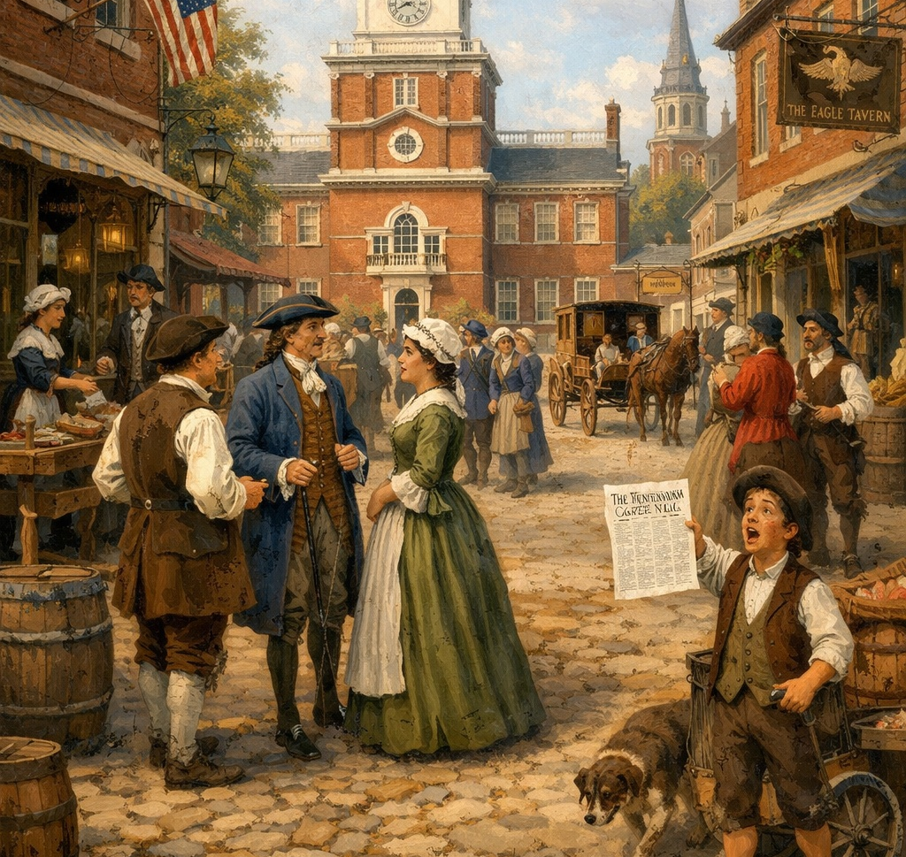
Improving Philadelphia
Street lighting and paving
Public library
Fire company and hospital
Notes:
Show Franklin as a civic-minded reformer.

Slide 12
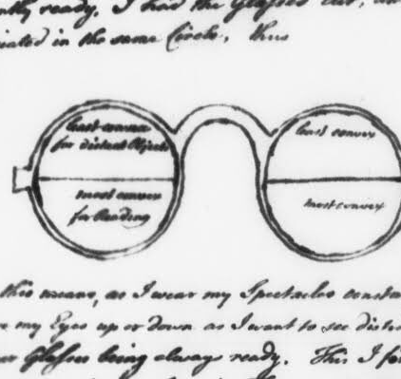
Scientific Achievements
Invented Franklin stove
Invented bifocals
Studied electricity
Notes:
Explain Franklin’s curiosity and practical inventions.

Slide 13
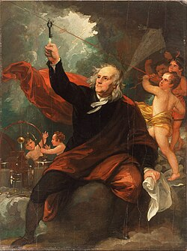
Electricity Experiment
Kite experiment in 1752
Proved lightning was electricity
Gained international fame
Notes:
Explain why this discovery was groundbreaking.

Slide 14
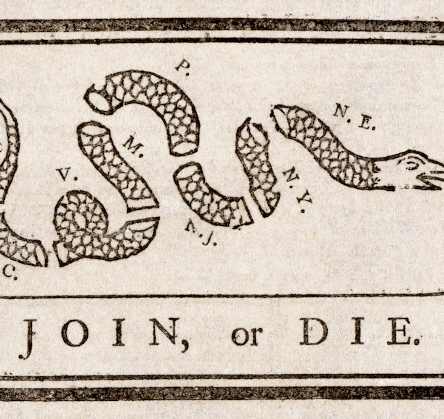
Political Career
Colonial representative in England
Lived abroad for 18 years
Advocated colonial unity
Notes:
Explain Franklin’s role as a diplomat.

Slide 15
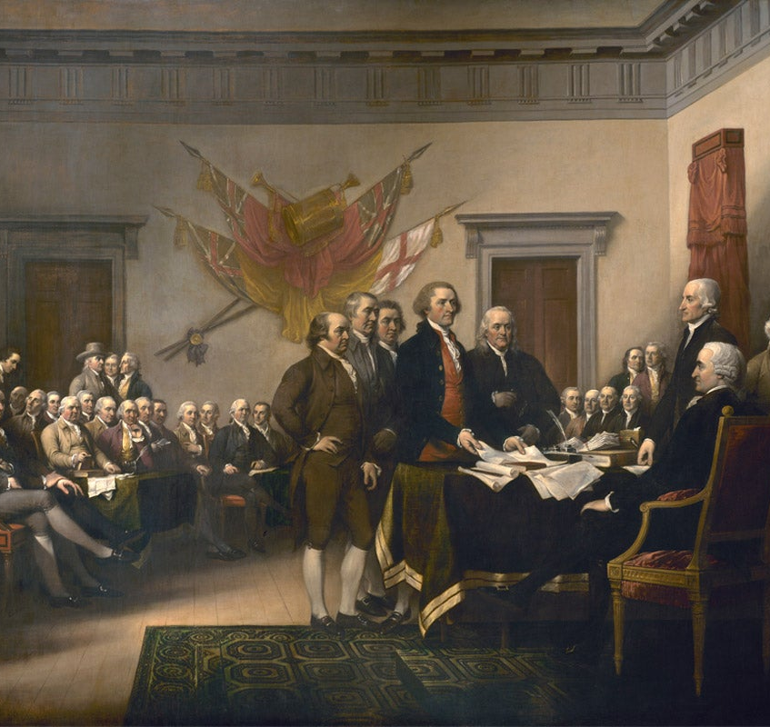
Founding Father
Member of Continental Congress
Helped draft Declaration
Secured French alliance
Notes:
Explain Franklin’s key role in independence.

Slide 16
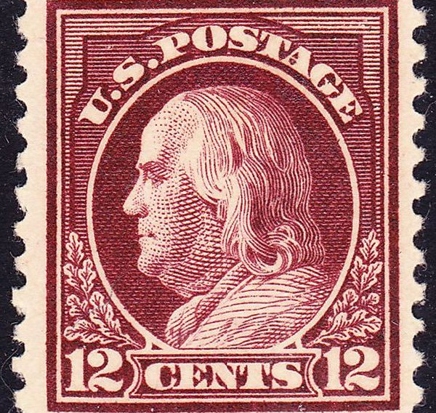
Later Years and Legacy
Signed Constitution
Died in 1790
20,000 attended funeral
Notes:
Summarize Franklin’s lasting impact on America.

