Slide 1
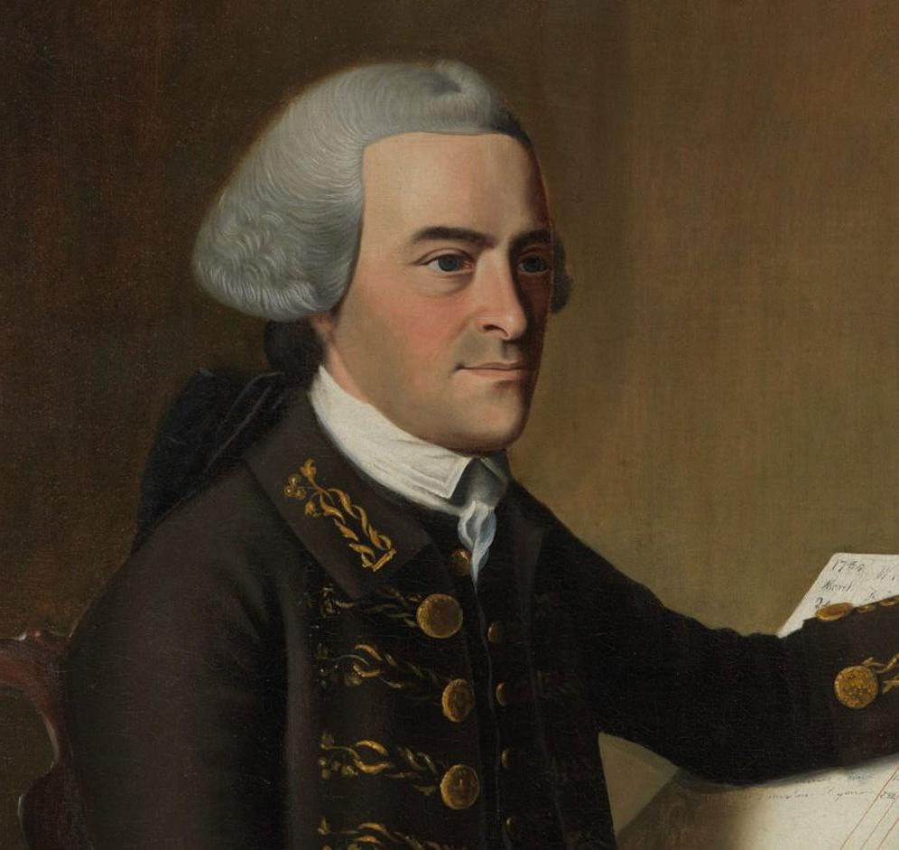

John Hancock

Slide 2
LearnAboutAmerica.com
*For our presentations, lesson plans, articles, printables, interactives, stories, and games related to John Hancock, please visit:
https://learnaboutamerica.com/american-history/revolutionary-war/people-of-the-revolutionary-war/john-hancock
* For the greatest American History website for teachers, parents, and students, visit:
https://learnaboutamerica.com

Slide 3
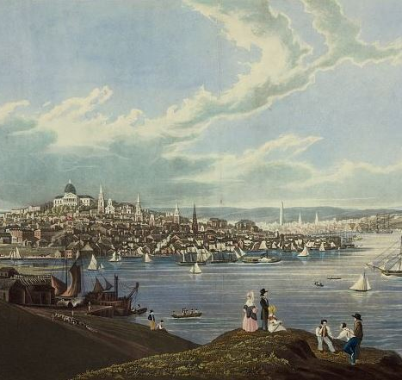
Who Was John Hancock?
Raised by his uncle in Boston, Massachusetts
Attended Harvard University
Partner in his uncle’s shipping company
Became very wealthy after 1764

Slide 4
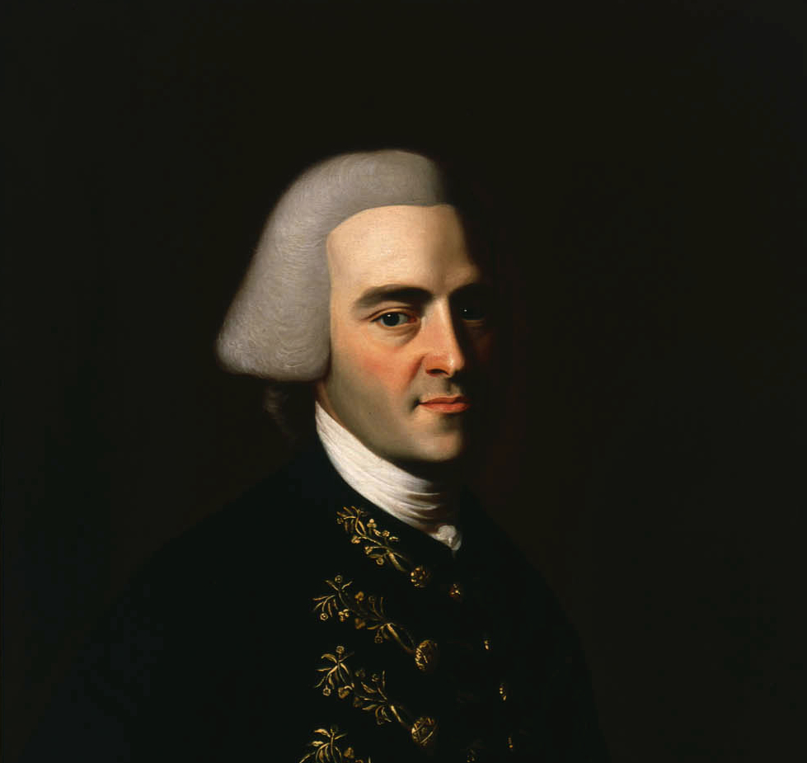
A Wealthy Boston Leader
One of the wealthiest men in colonial America
Used money and influence to support resistance
Prominent Massachusetts leader

Slide 5
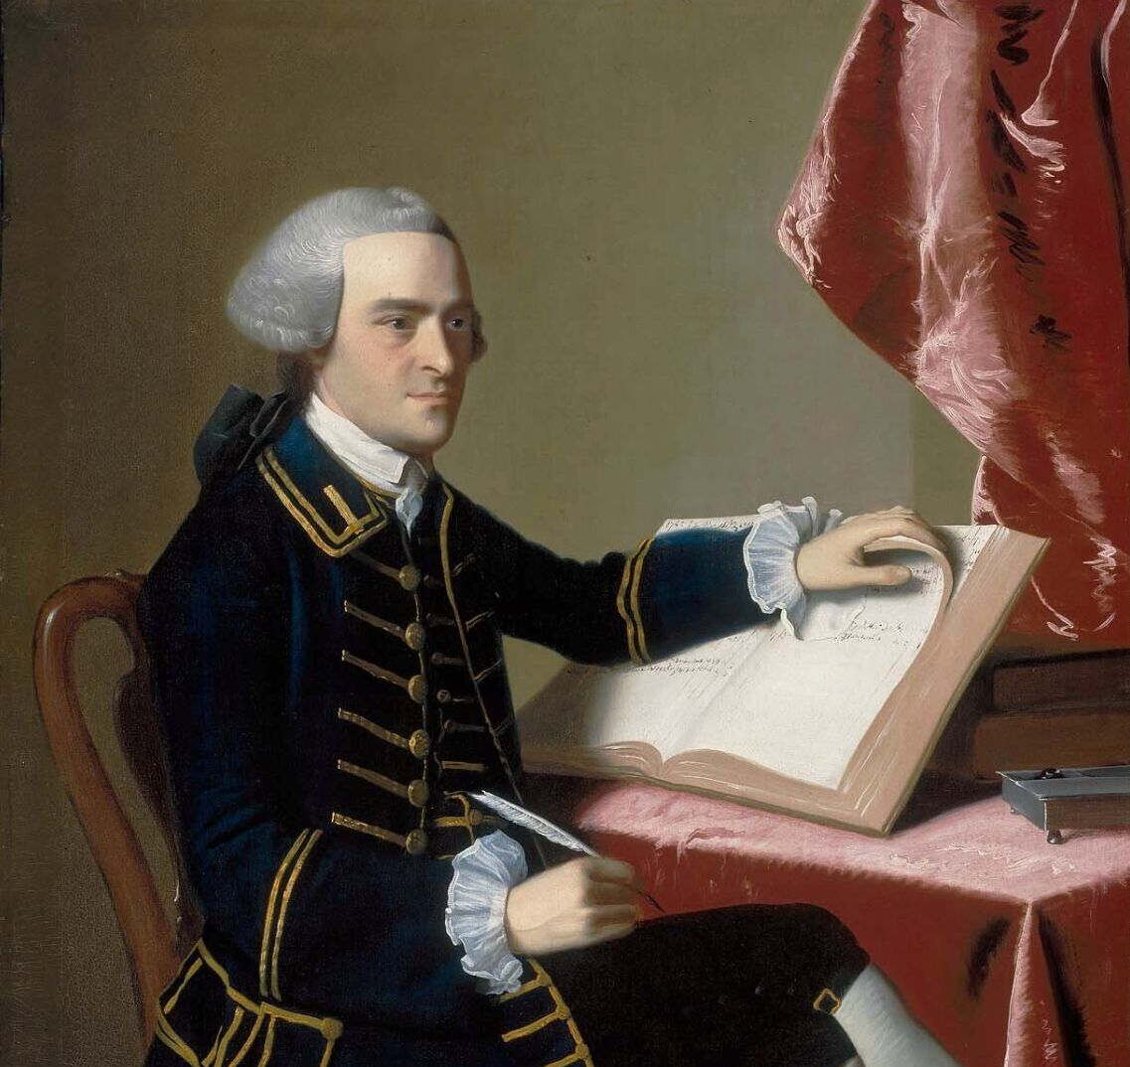
Opposing British Taxes
Elected Boston Selectman in 1765
Joined Samuel Adams and the Sons of Liberty
Strong opponent of the Stamp Act

Slide 6
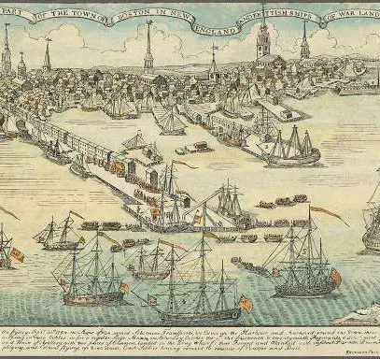
Smuggling to Support Independence
Representative in the Massachusetts Legislature
Shipping business smuggled goods past British laws
Helped finance resistance efforts

Slide 7
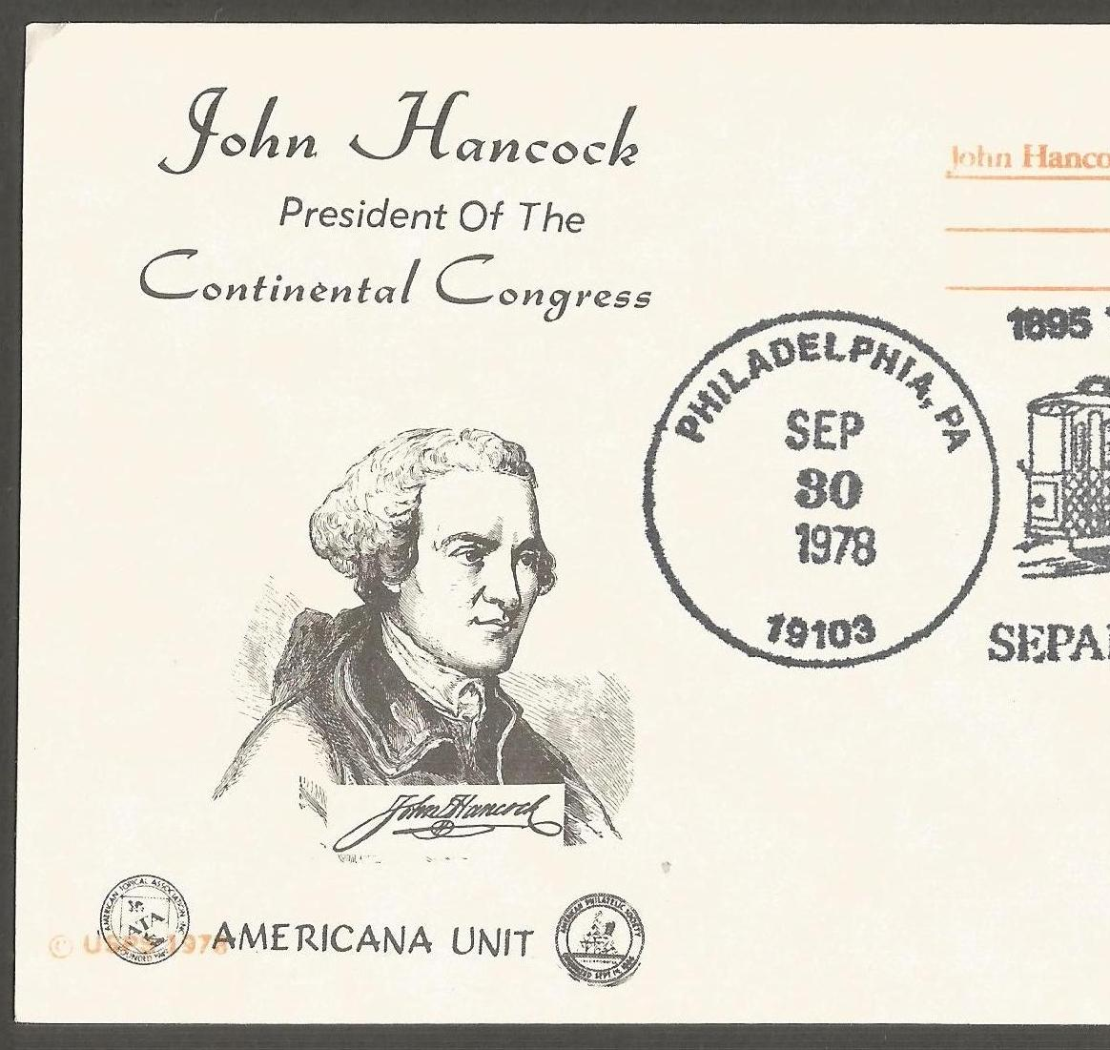
On Britain’s Most Wanted List
Elected president of the Massachusetts Provincial Congress
Accused of treason by Britain
British troops ordered to arrest him

Slide 8
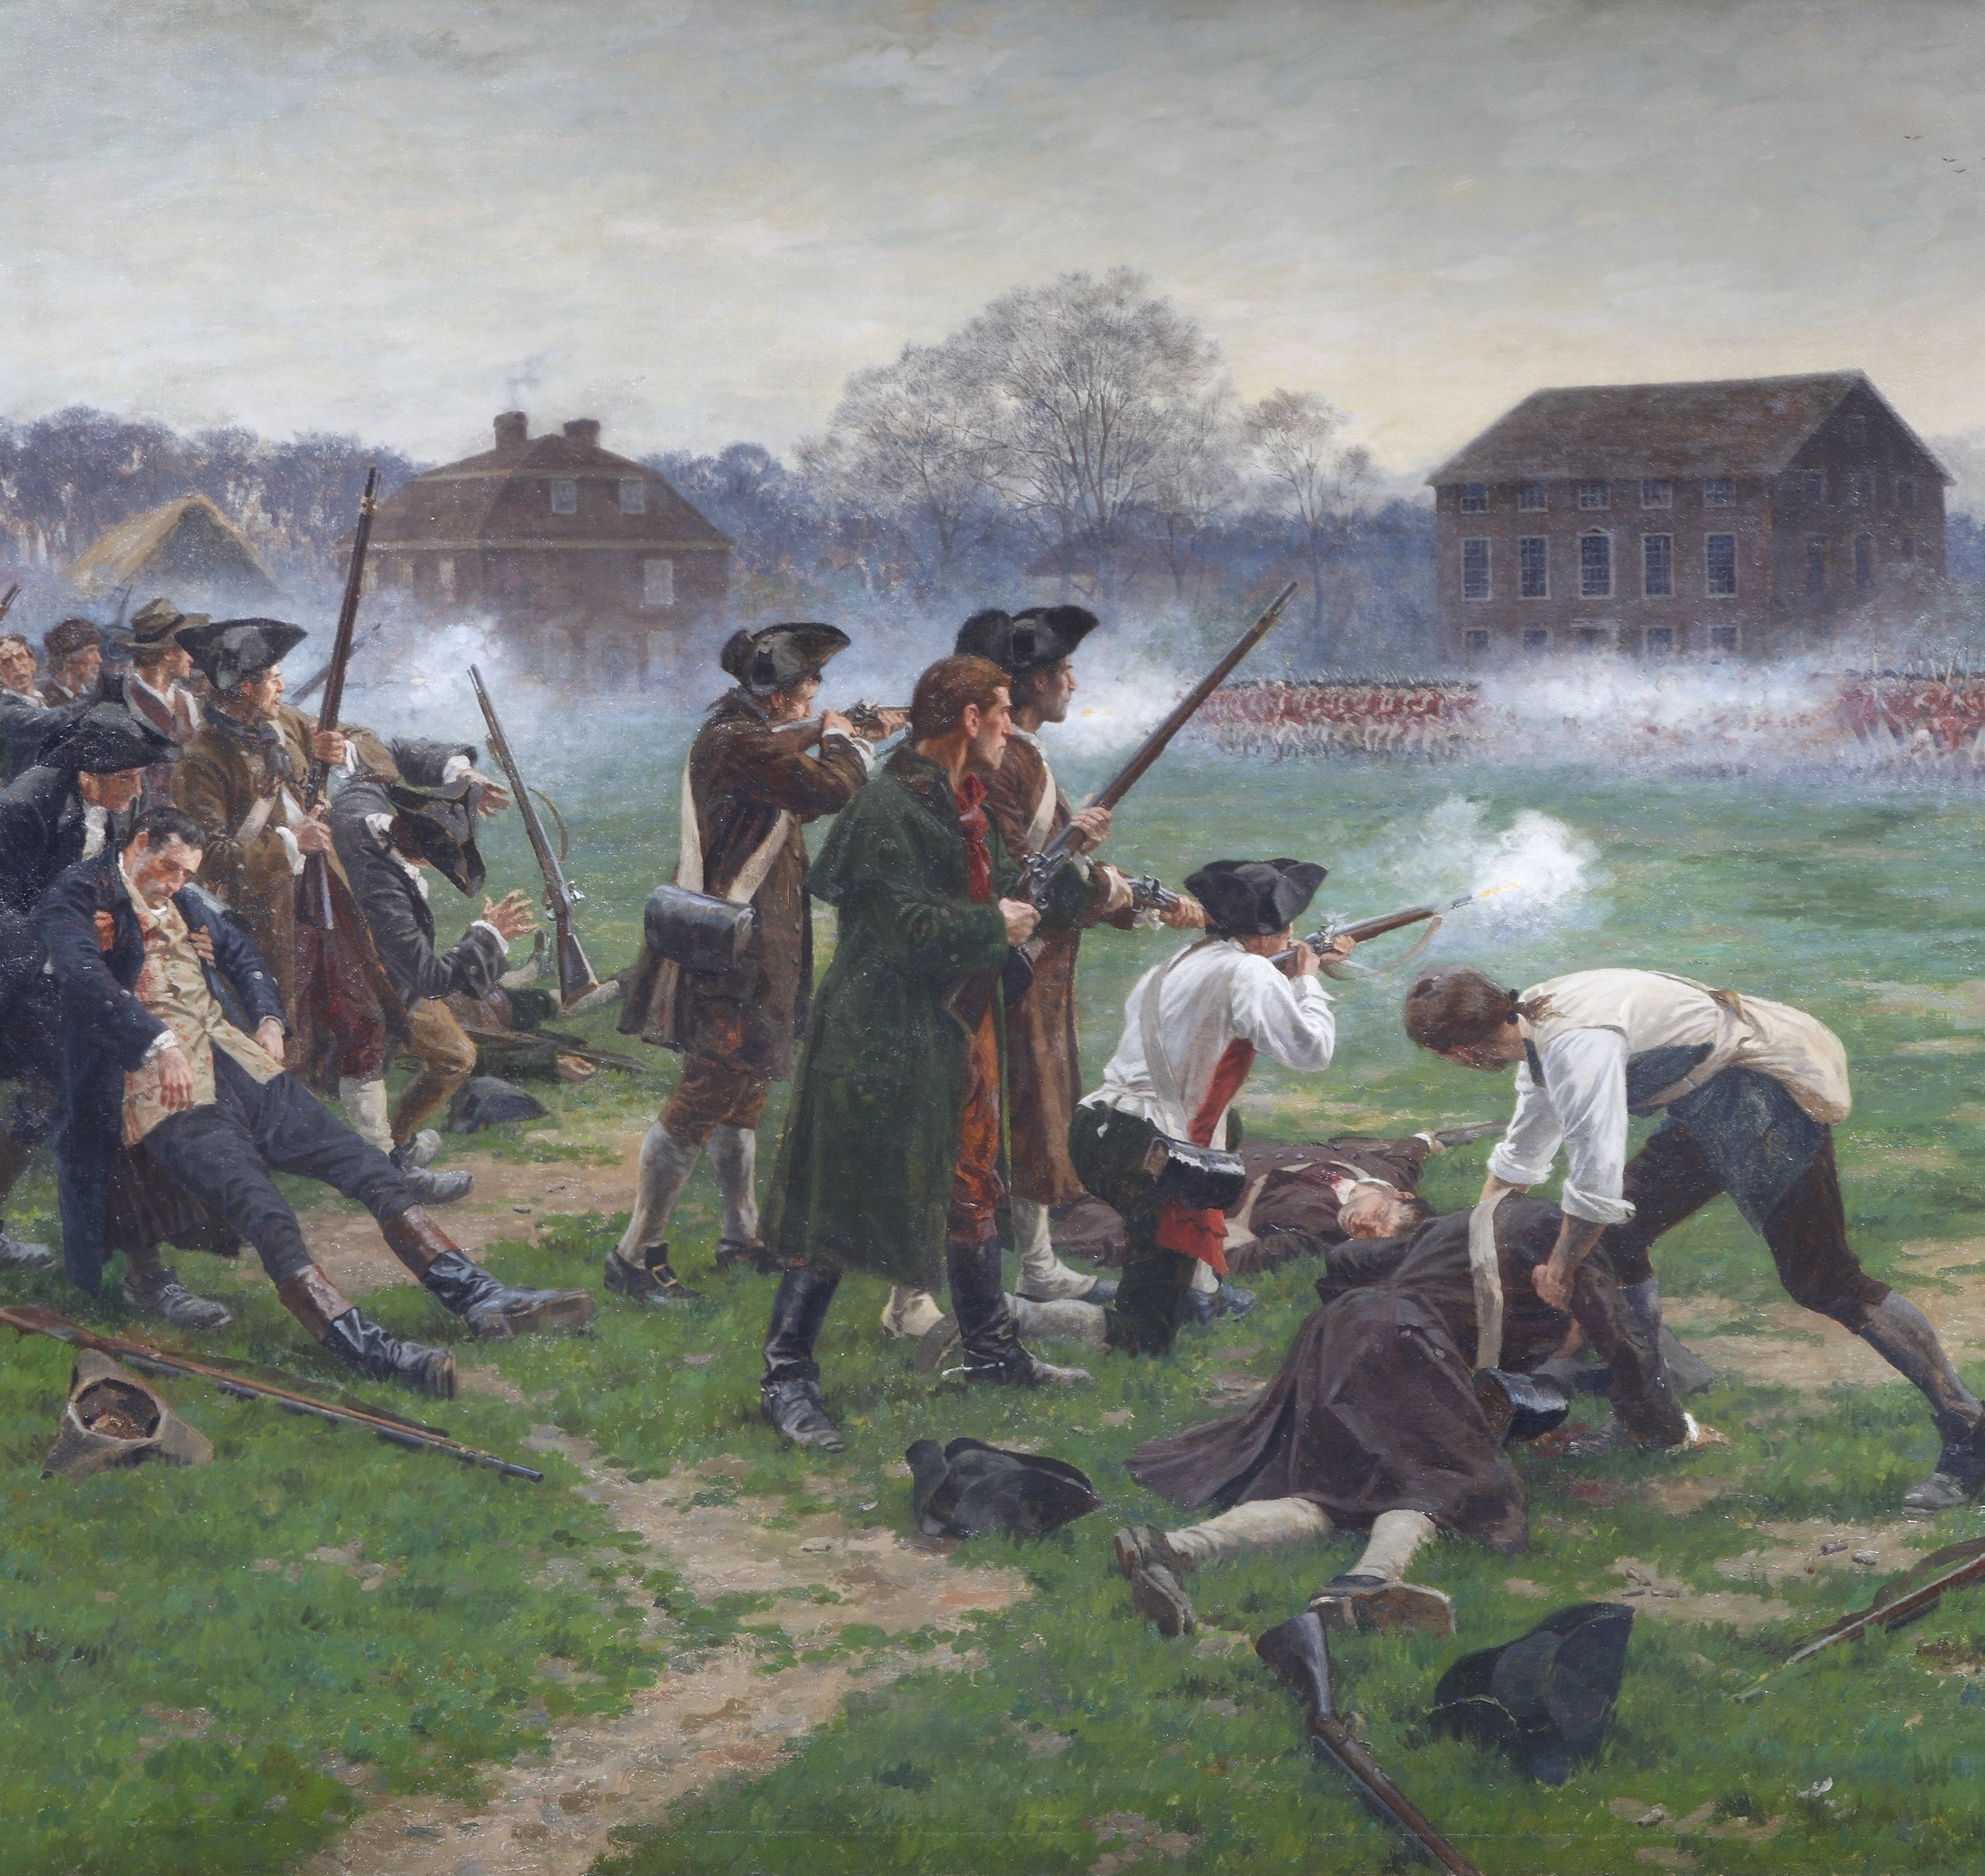
Escape Before War Began
British marched toward Lexington to capture Hancock
Hancock escaped with Samuel Adams
Fighting soon broke out

Slide 9
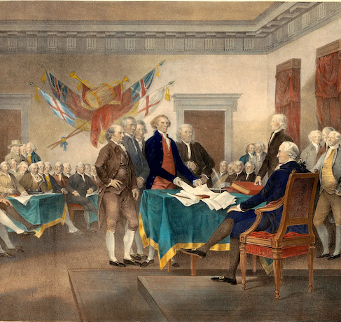
President of the Second Continental Congress
Chosen as president in 1775
Commissioned George Washington as commander in chief
Key leader during wartime

Slide 10
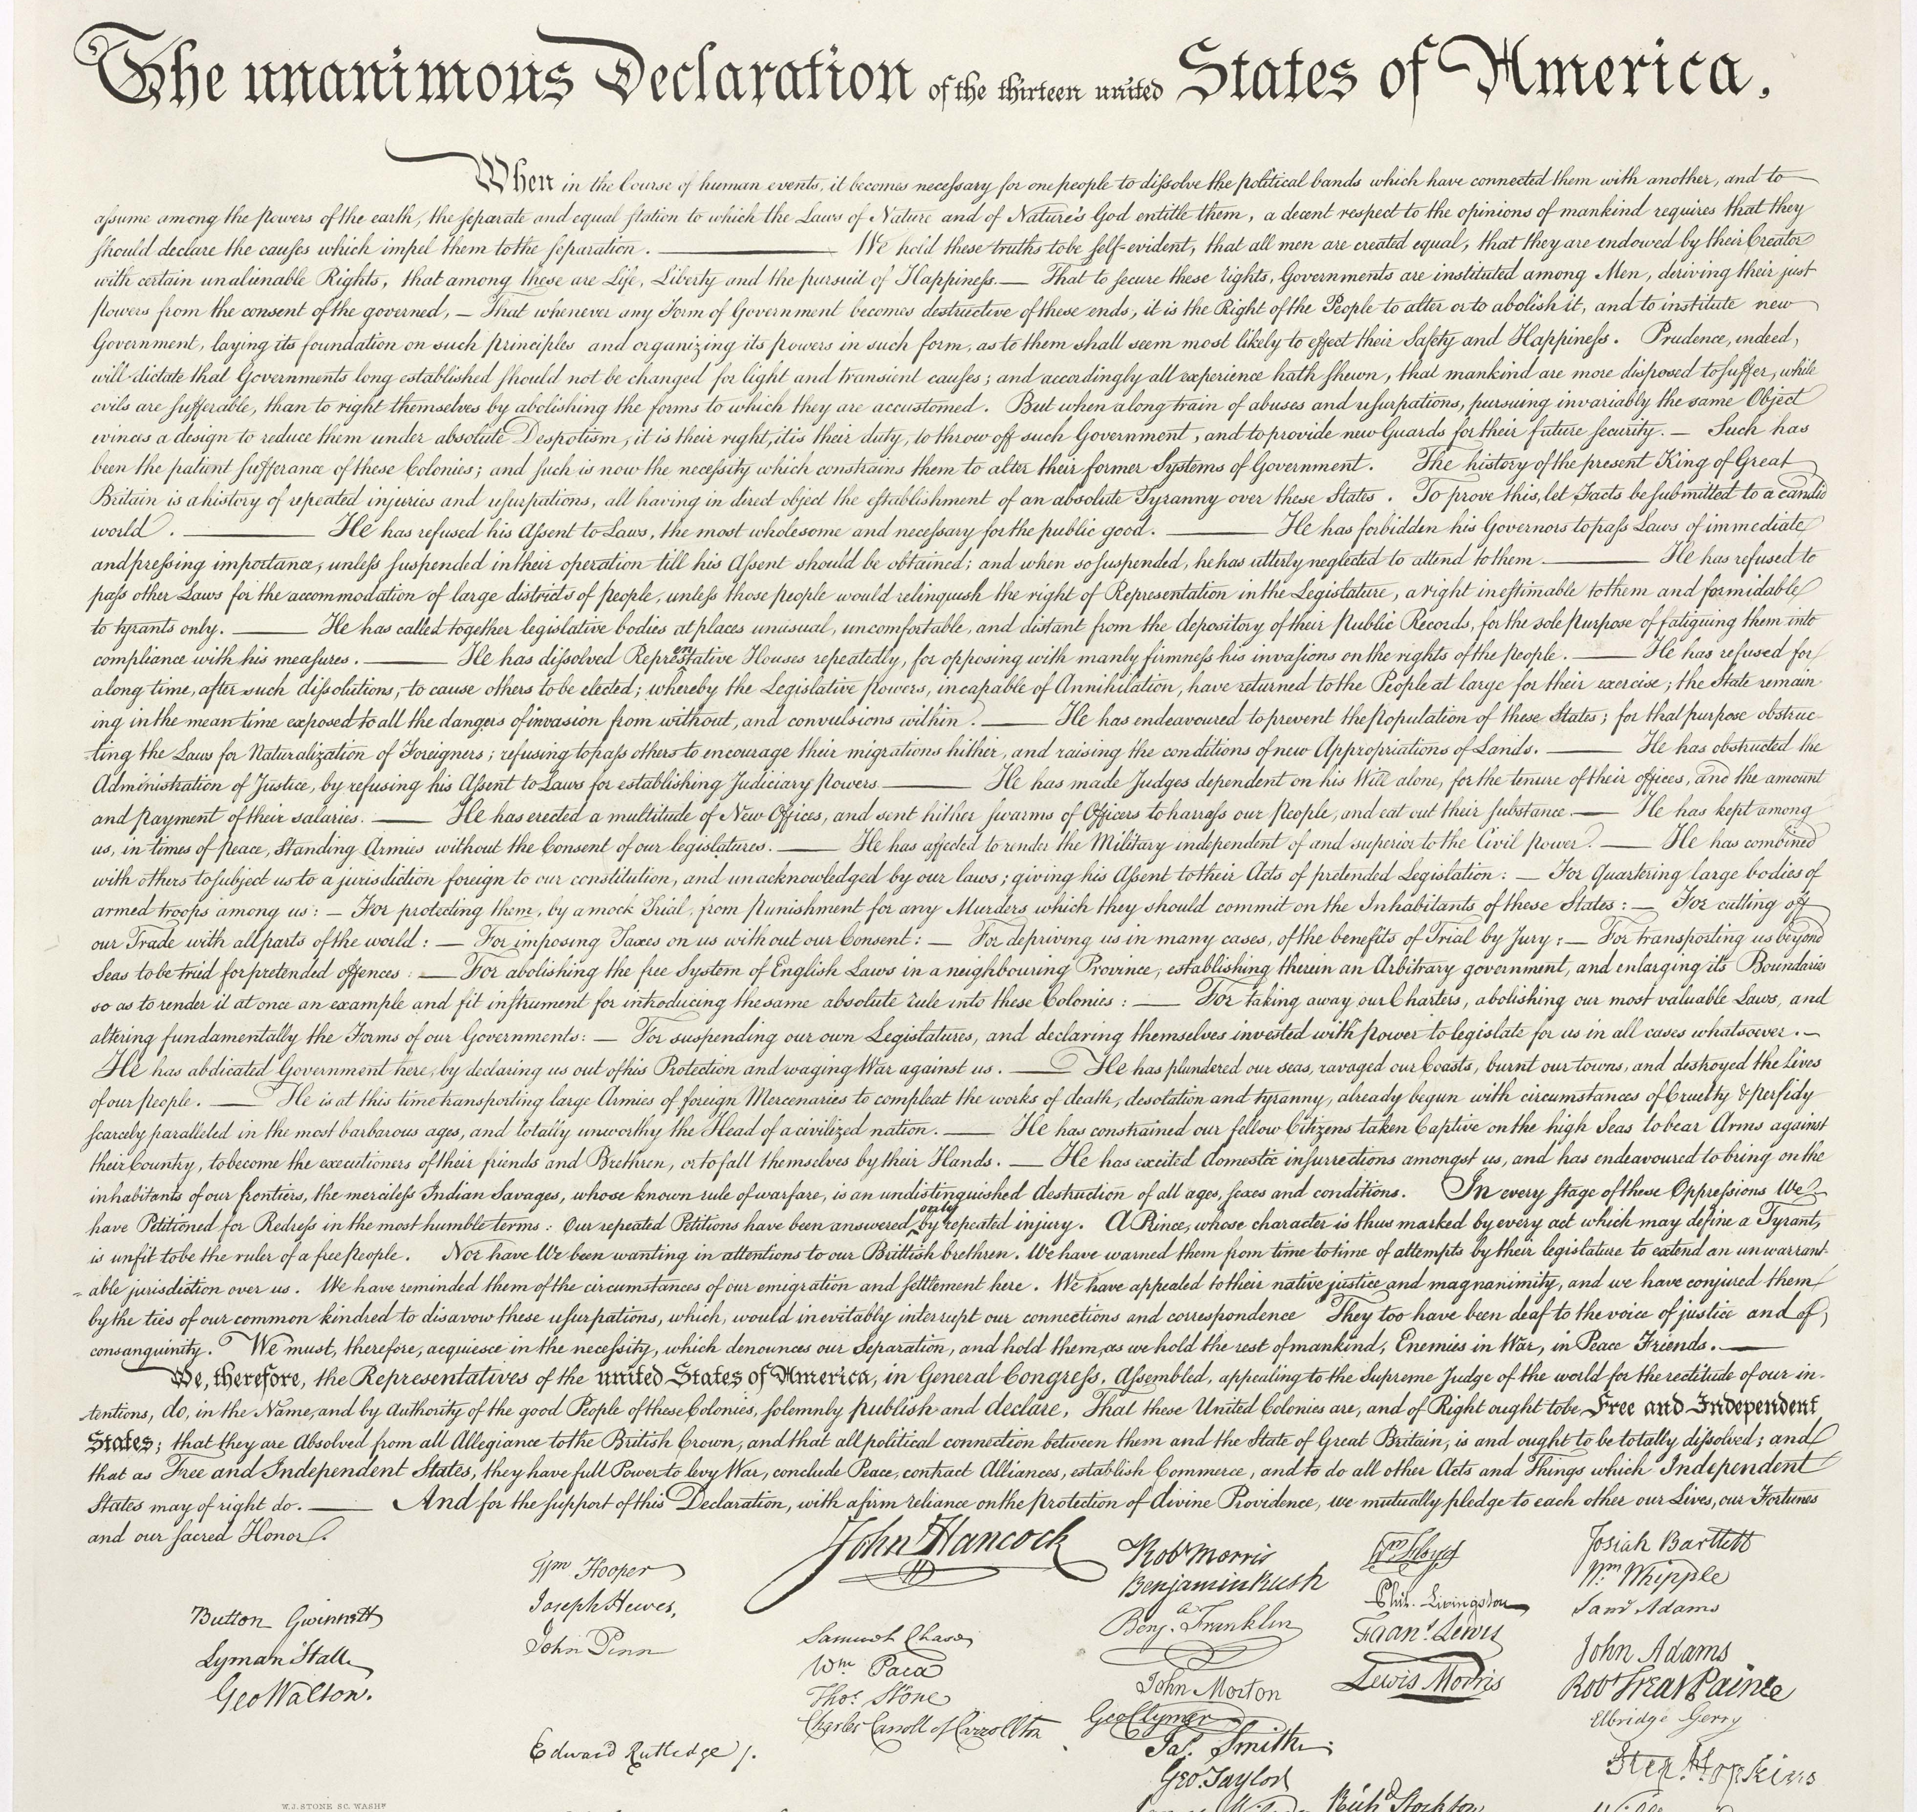
The Declaration of Independence
Signed on July 4, 1776
Hancock signed first
Signature became famous

Slide 11
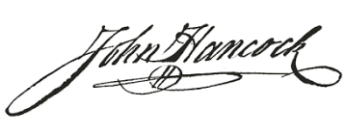
Why Was His Signature So Big?
Signed first with plenty of space
Showed boldness and confidence
Matched his personal writing style

Slide 12
Legend vs. Reality
Legend claims the king could read it easily
Historians believe the story is exaggerated
Signature reflected pride and patriotism

Slide 13
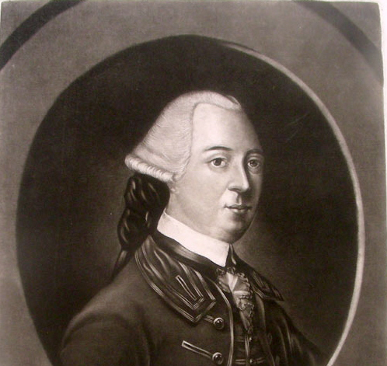
A Fervent Patriot Forever
Helped fund and supply the Continental Army
Elected governor of Massachusetts in 1780
Served nine terms

Slide 14
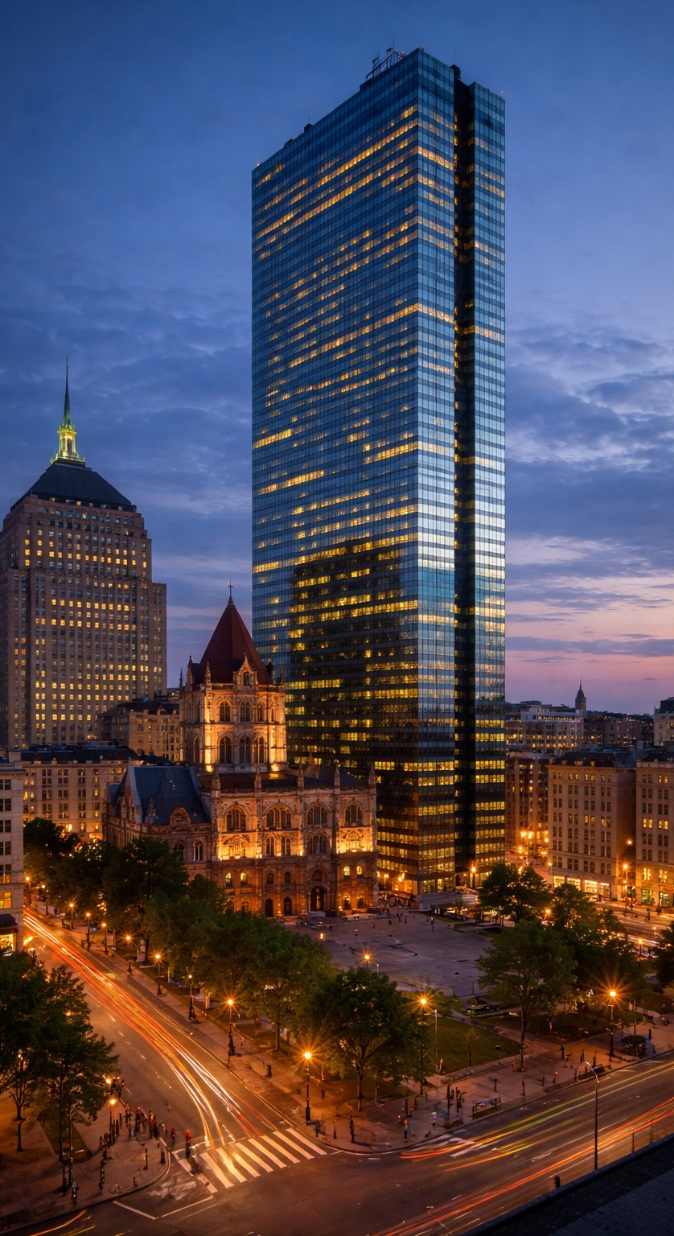
Later Life and Legacy
Died in 1793
Counties in ten states named for him
Boston’s tallest building bears his name

Slide 15
Key Vocabulary
Stamp Act
Sons of Liberty
Intolerable Acts
Treason
Continental Congress

Slide 16
Discussion Questions
Why did Hancock use his wealth to support independence?
What risks did he face?
Why is his signature famous?
How did he serve after independence?

Slide 17
Five Interesting Facts
Extremely wealthy colonist
Personally funded parts of the Revolution
Targeted for arrest by the British
Most famous signature on the Declaration
Boston skyscraper named after him

