Slide 1
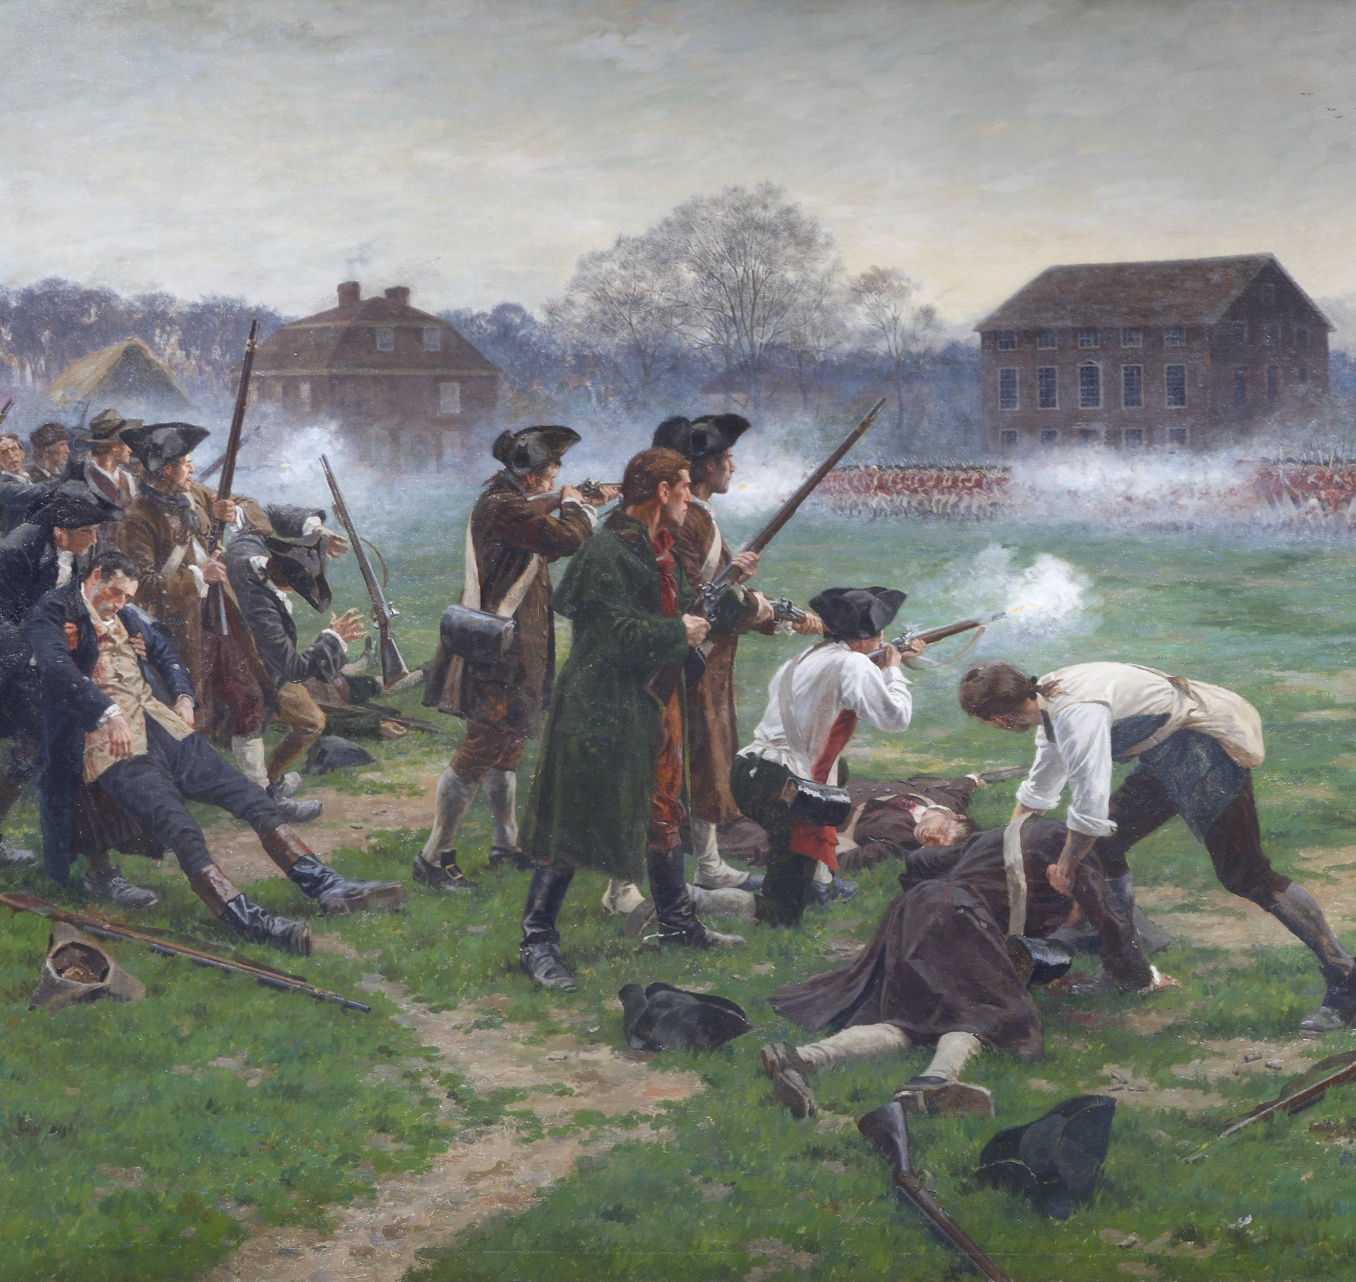
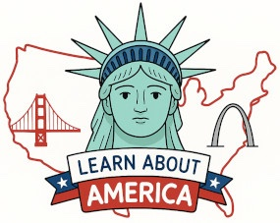
Battles of Lexington and Concord

Slide 2
LearnAboutAmerica.com
*For our presentations, lesson plans, articles, printables, interactives, stories, and games related to the Battles of Lexington and Concord, please visit:
https://learnaboutamerica.com/american-history/revolutionary-war/battles-of-the-revolutionary-war/battles-of-lexington-and-concord
* For the greatest American History website for teachers, parents, and students, visit:
https://learnaboutamerica.com

Slide 3
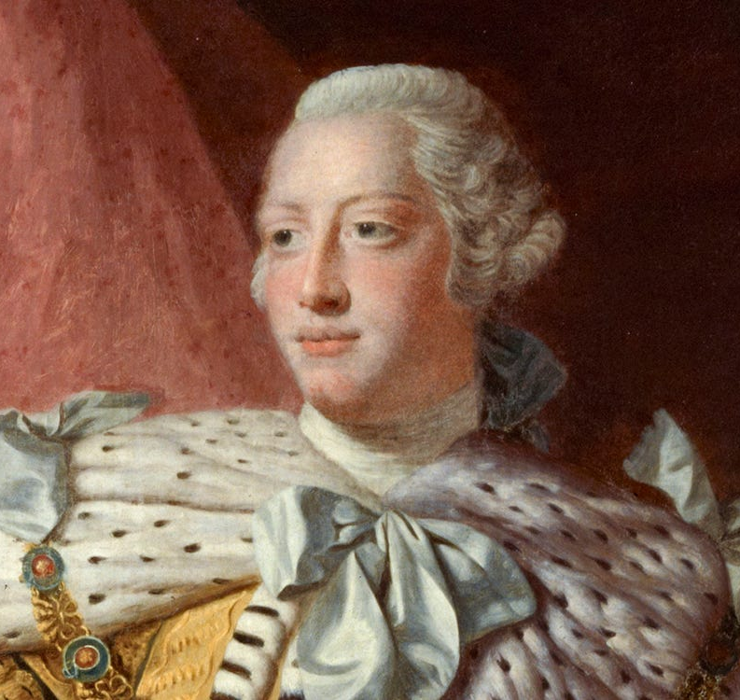
Growing Tensions
Following resolutions by the Continental Congress, armed conflict seemed imminent.
King George III declared the colonies in a state of rebellion.
British troops had occupied Boston since 1768.

Slide 4
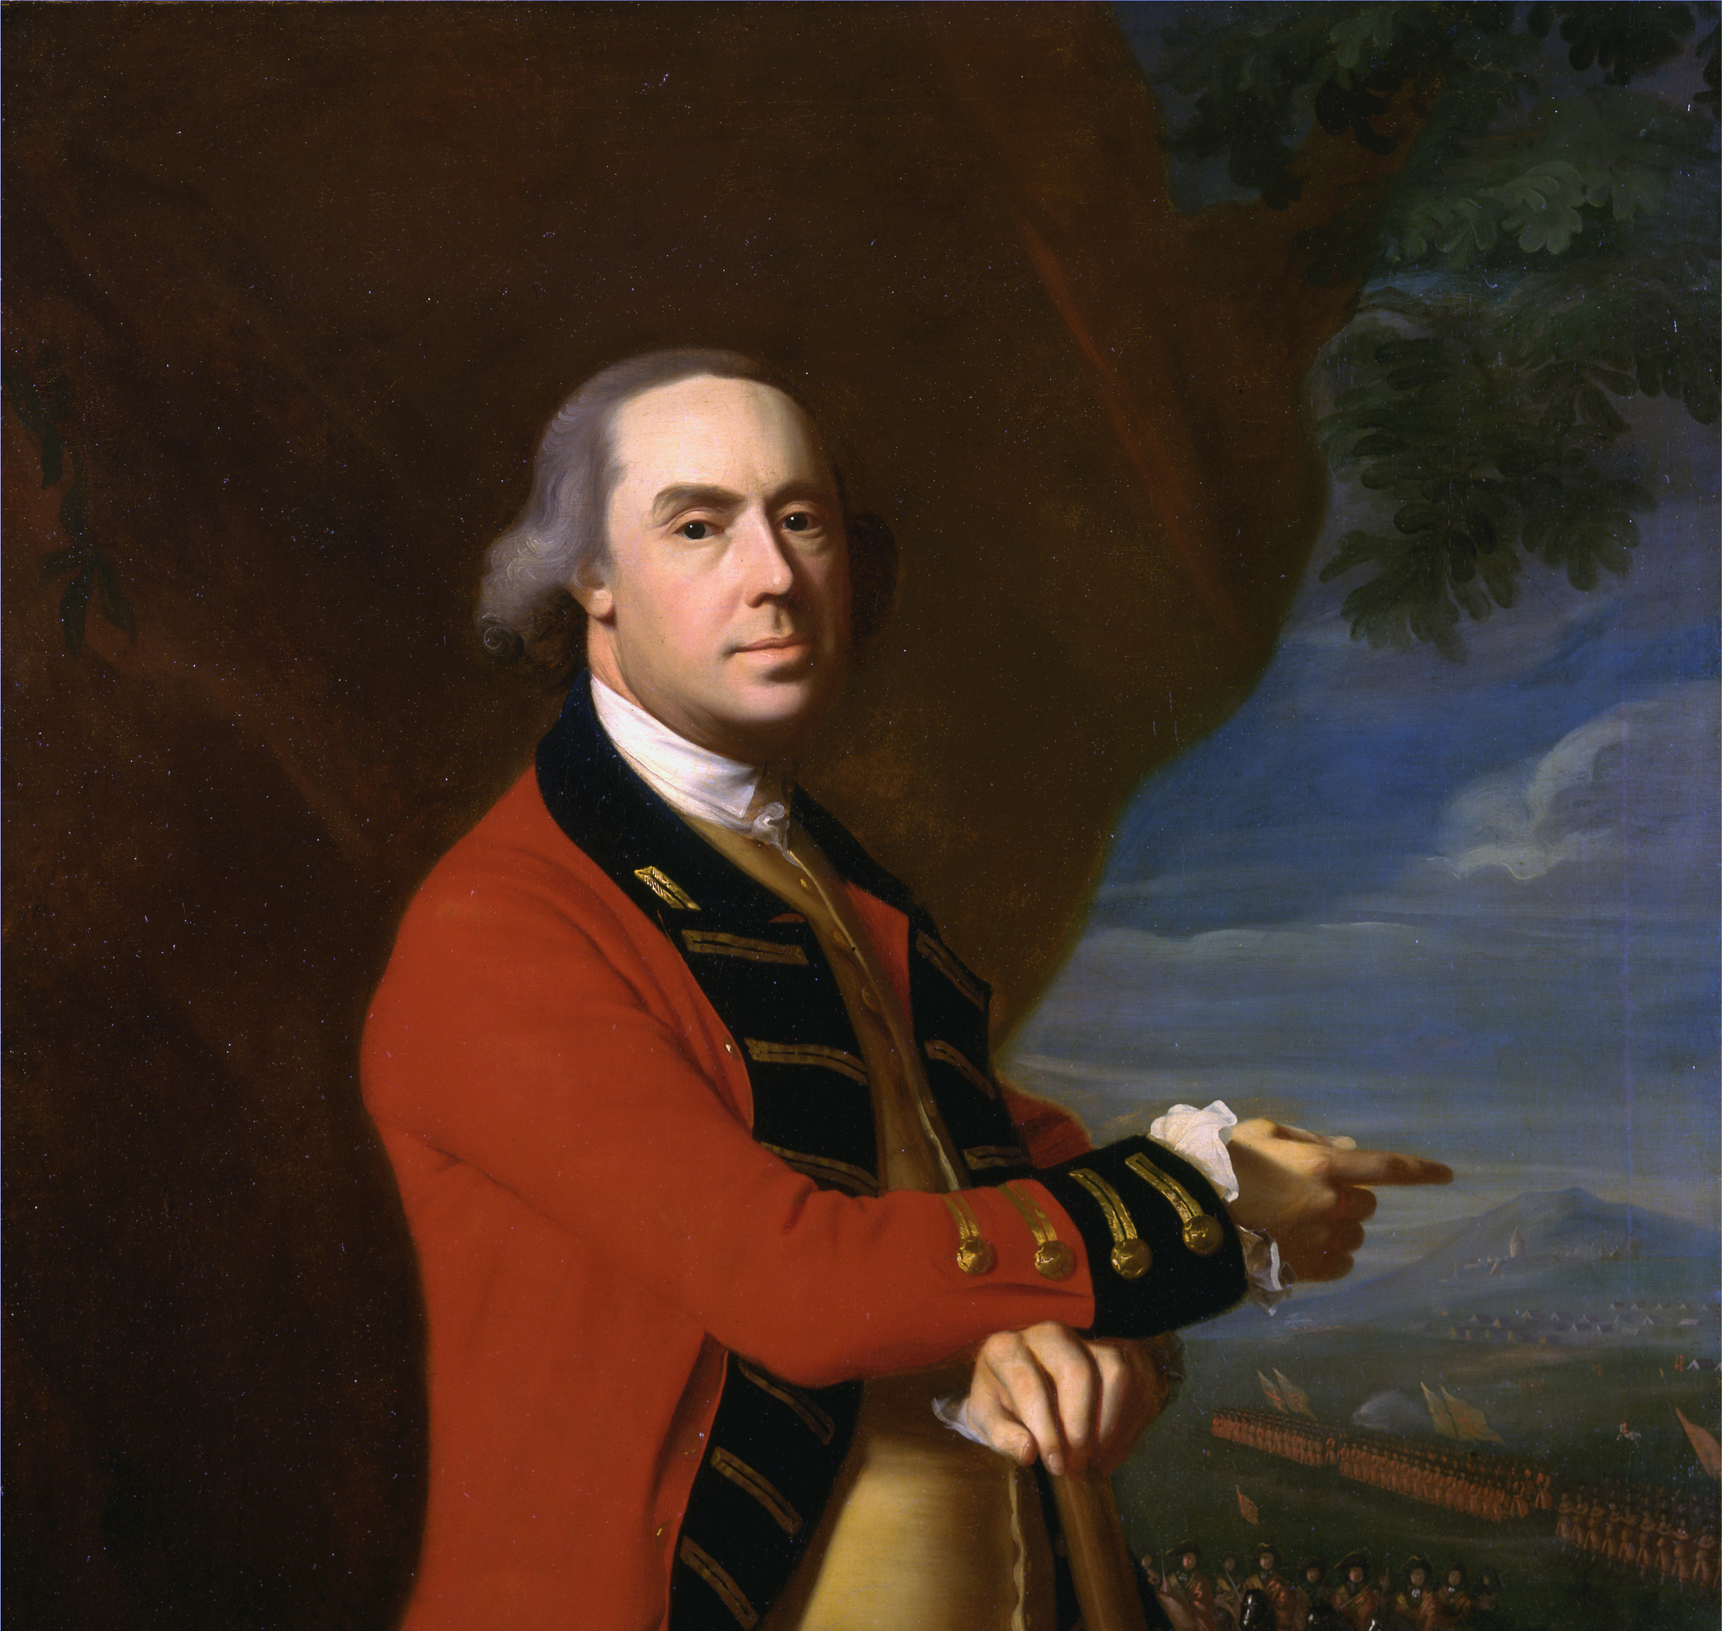
British Plans
General Thomas Gage was sent to Boston.
His mission was to disarm the colonists and arrest John Hancock and Samuel Adams.
A large colonial arsenal was located in Concord.

Slide 5
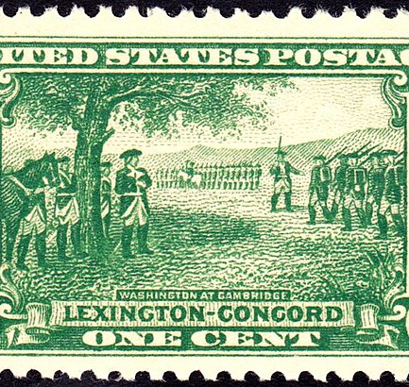
The March to Concord
About 700 British troops marched toward Concord.
Colonists had already moved most weapons to secret locations.

Slide 6
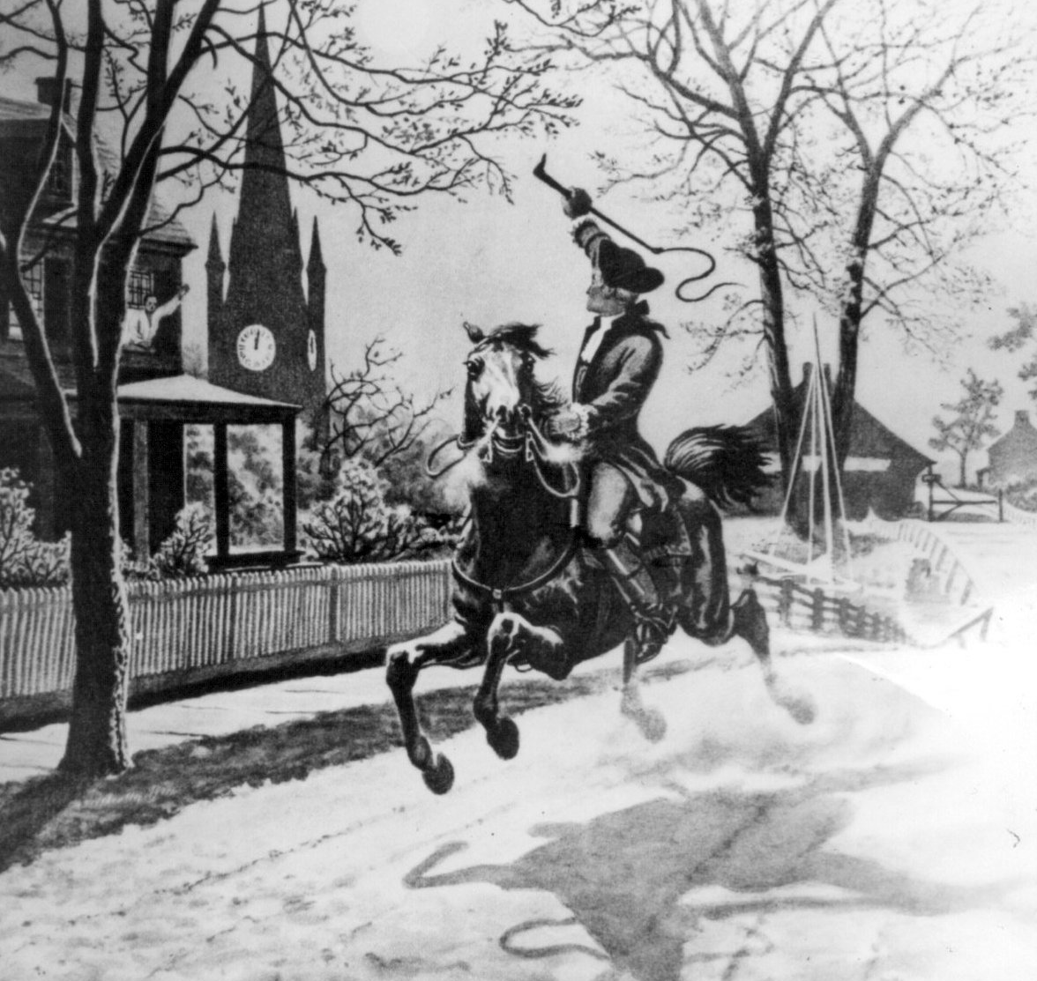
Paul Revere’s Midnight Ride
Dr. Joseph Warren warned Paul Revere and William Dawes.
Revere rode through the countryside warning the militia.
By dawn, about 70 Minutemen gathered in Lexington.

Slide 7
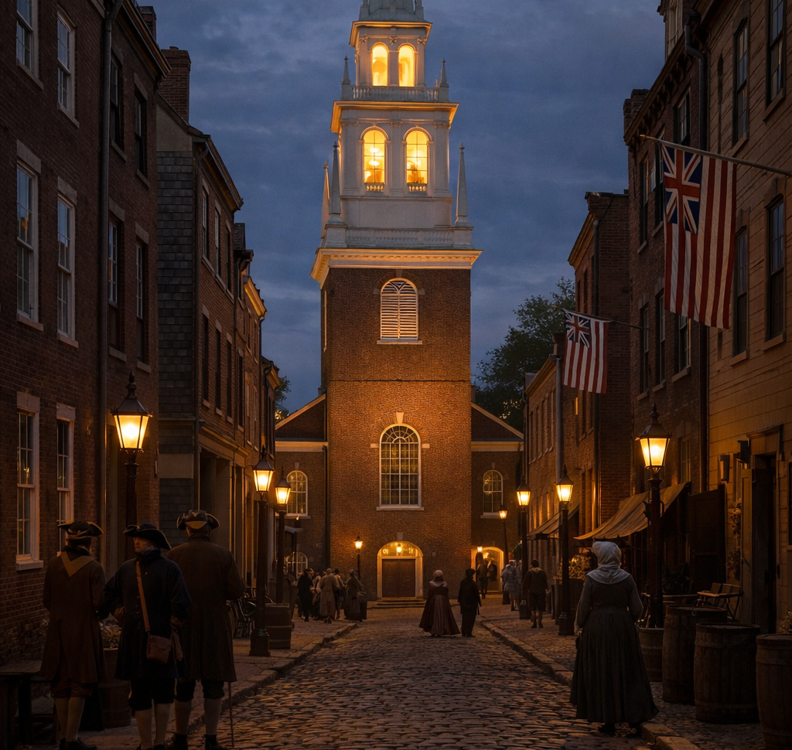
Old North Church Signal
Lanterns were hung in the Old North Church.
One lantern meant land.
Two lanterns meant sea.

Slide 8
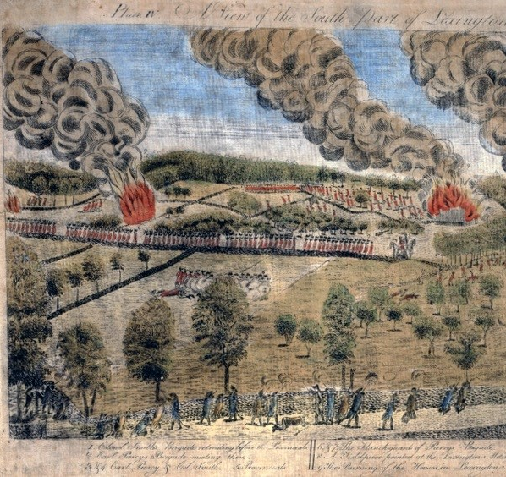
Lexington: The Shot Heard Round the World
British troops arrived in Lexington.
A mysterious shot was fired.
Eight Minutemen were killed and ten wounded.

Slide 9
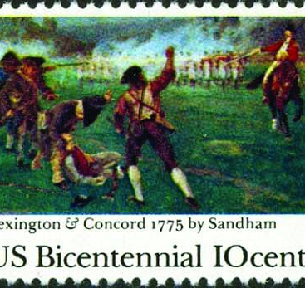
From Lexington to Concord
British troops marched on toward Concord.
Colonial militia numbers grew rapidly.

Slide 10
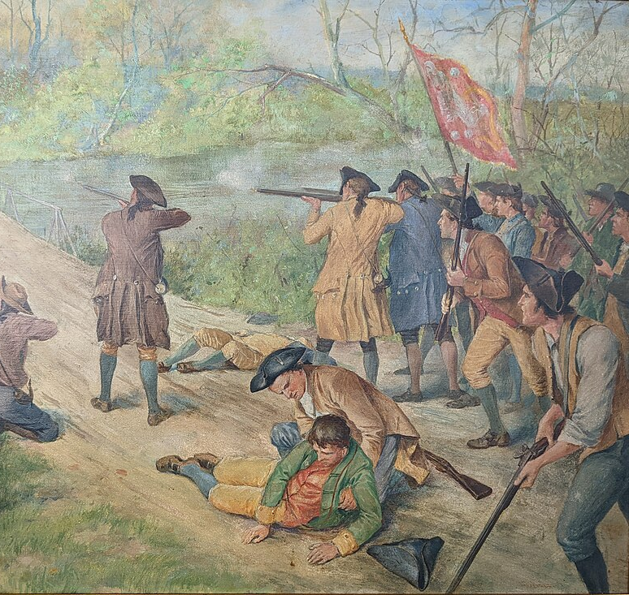
The North Bridge at Concord
British troops destroyed cannons and supplies.
Minutemen held the North Bridge.
British forces were forced to retreat.

Slide 11
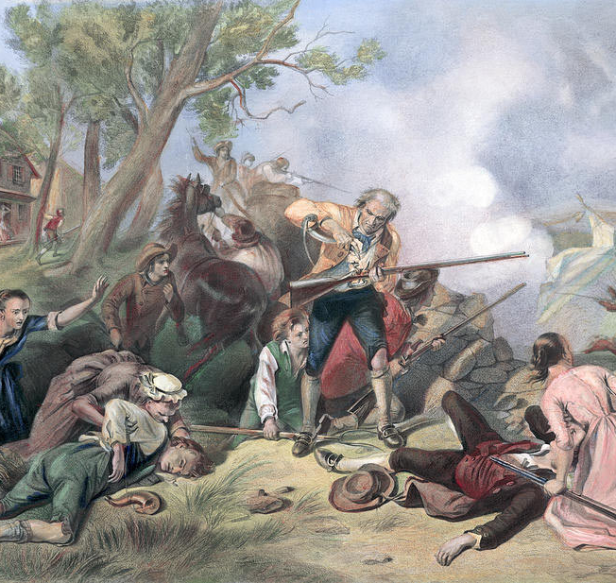
The Retreat to Boston
Colonial fighters attacked from behind trees and buildings.
British troops suffered heavy losses.

Slide 12
The Outcome
73 British soldiers were killed.
174 were wounded.
The American Revolution had officially begun.

