Slide 1
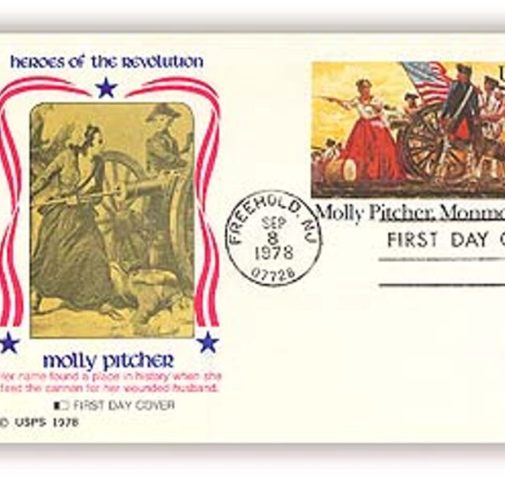
Battle of Monmouth Courthouse (1778)
https://learnaboutamerica.com
Notes:
Introduce the Battle of Monmouth Courthouse as a key test of the Continental Army after Valley Forge and a moment that proved American soldiers could stand toe-to-toe with the British.

Slide 2
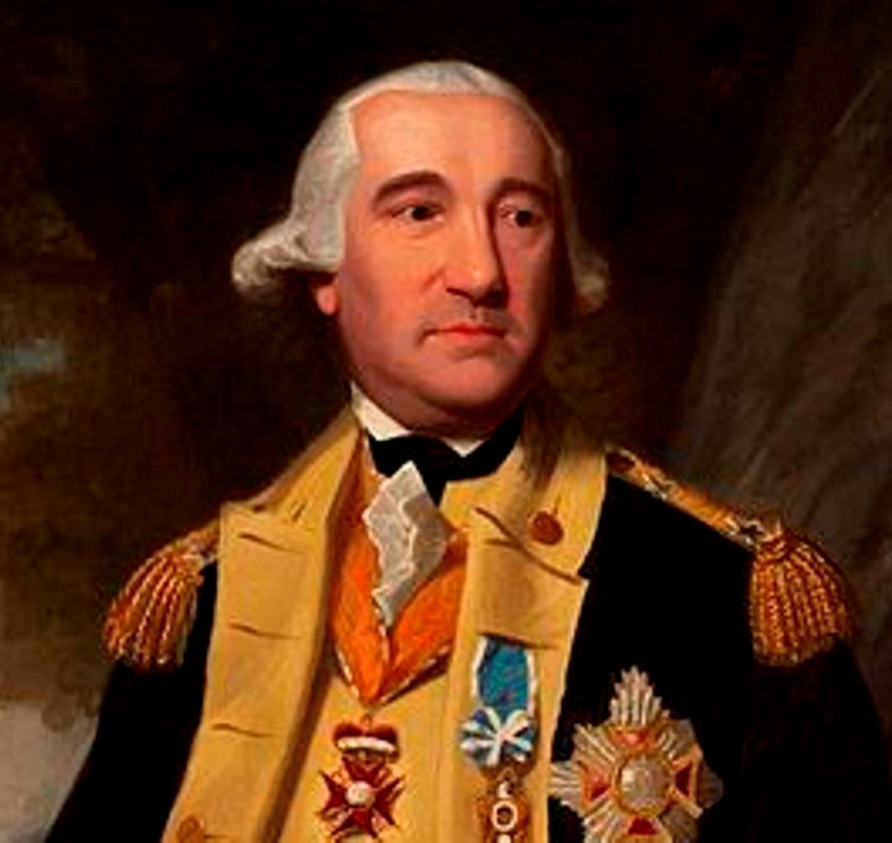
After Valley Forge
Army trained and disciplined
Morale improved
Prepared for open combat
Notes:
Explain how the harsh winter at Valley Forge, combined with Baron von Steuben’s training, transformed the Continental Army into a more effective fighting force.

Slide 3
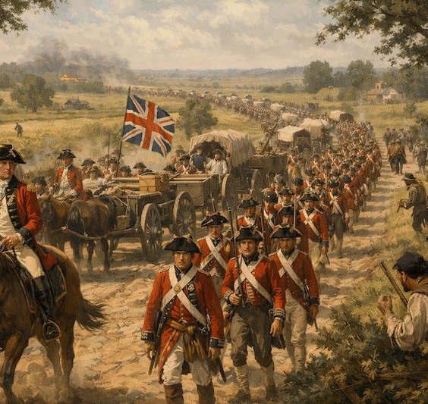
British Evacuate Philadelphia
British feared a French naval blockade
Decision to leave Philadelphia
March back to New York
Notes:
Explain why the British chose to abandon Philadelphia and why this created a military opportunity.

Slide 4
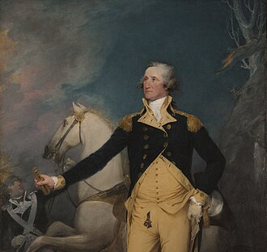
Washington Sees an Opportunity
100-mile march through New Jersey
British vulnerable during retreat
Washington planned an attack
Notes:
Explain Washington’s reasoning and why attacking a moving army was risky but tempting.

Slide 5
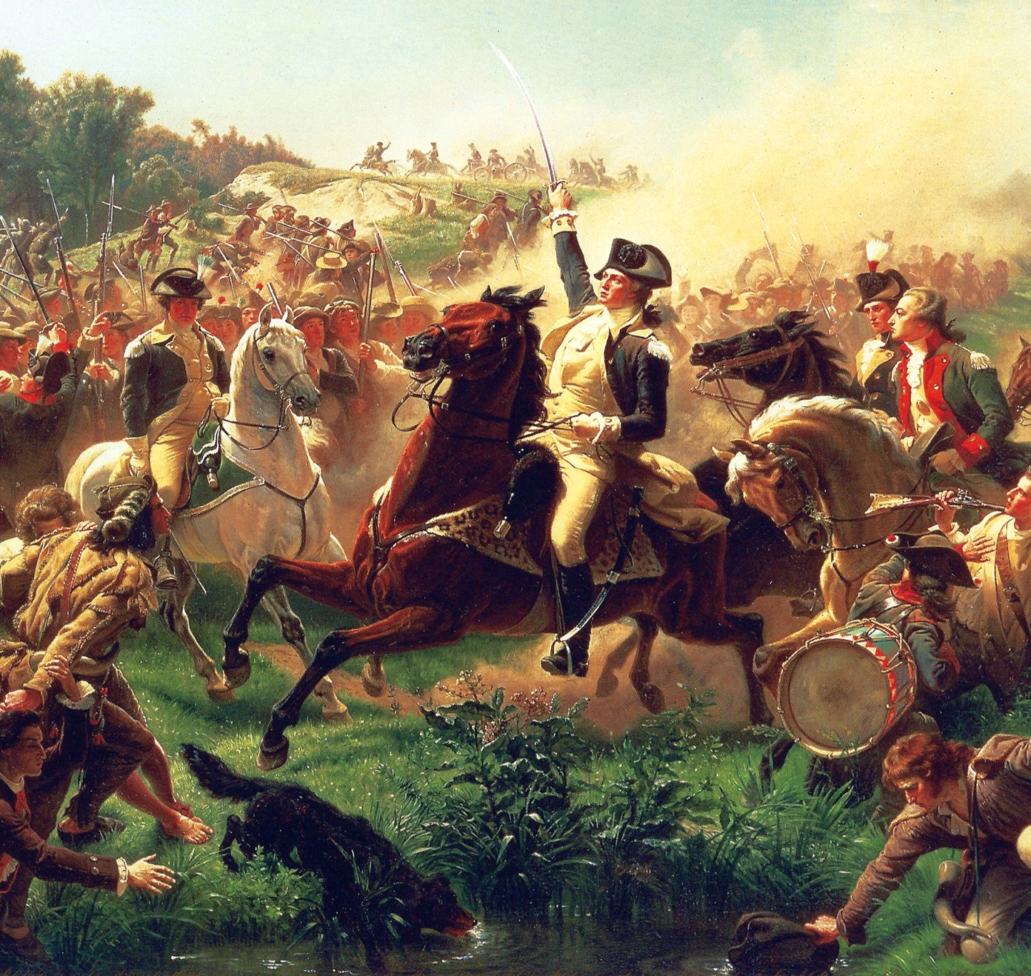
The Attack Begins
June 28, 1778
5,000 Americans sent to strike rear guard
Goal: delay British forces
Notes:
Explain the plan to slow the British until the main American army could arrive.

Slide 6
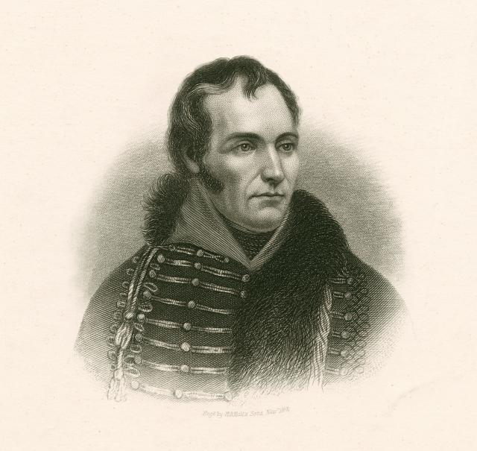
General Charles Lee’s Failure
Lee commanded initial attack
Confusing orders
Disorganized retreat
Notes:
Explain how Lee’s hesitation and poor leadership caused chaos among the American troops.

Slide 7
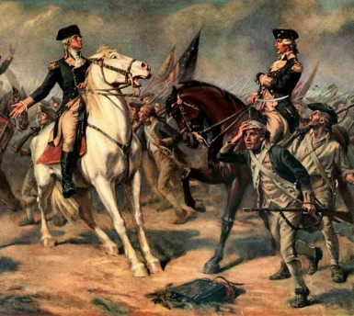
Washington Takes Command
Washington confronted Lee
Took control of retreating troops
Rallied the army
Notes:
Describe Washington’s leadership under fire and how his presence stabilized the situation.

Slide 8
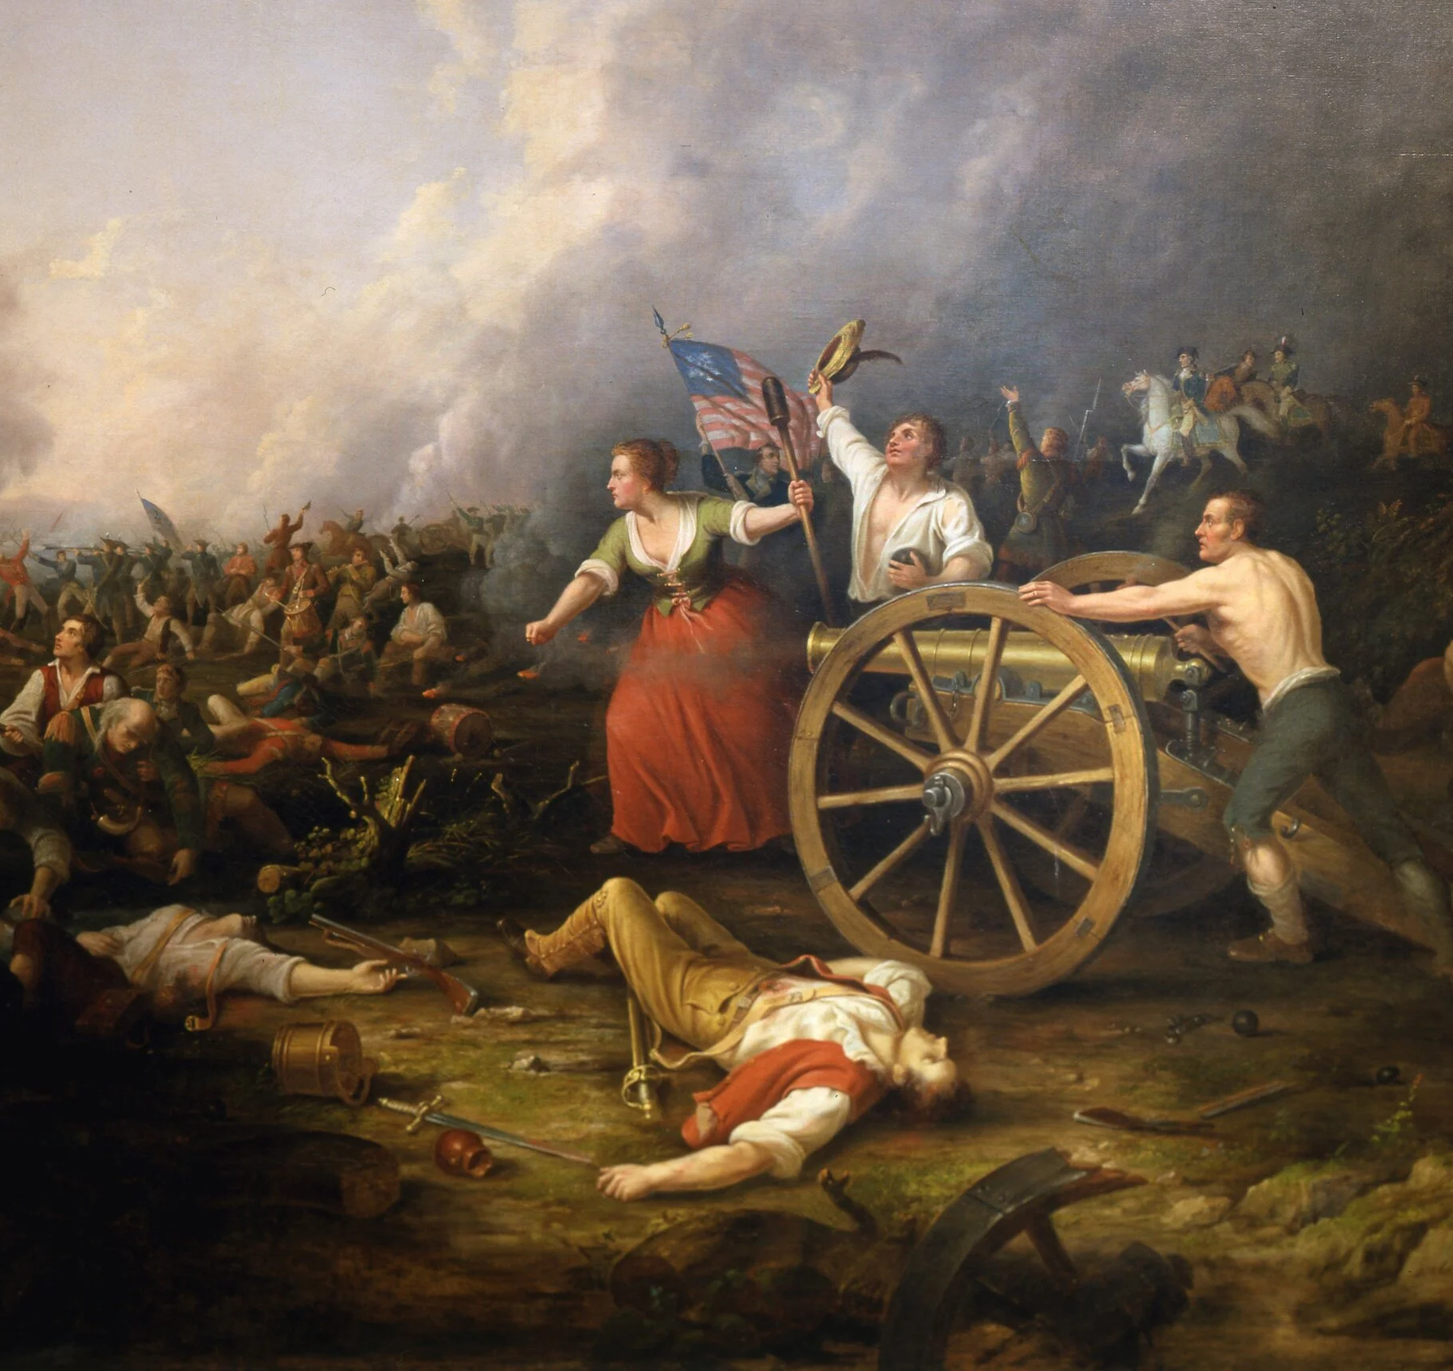
A Brutal Day of Fighting
Blistering summer heat
Battle lasted all day
Neither side gained advantage
Notes:
Explain how extreme heat affected soldiers and made the battle especially deadly.

Slide 9
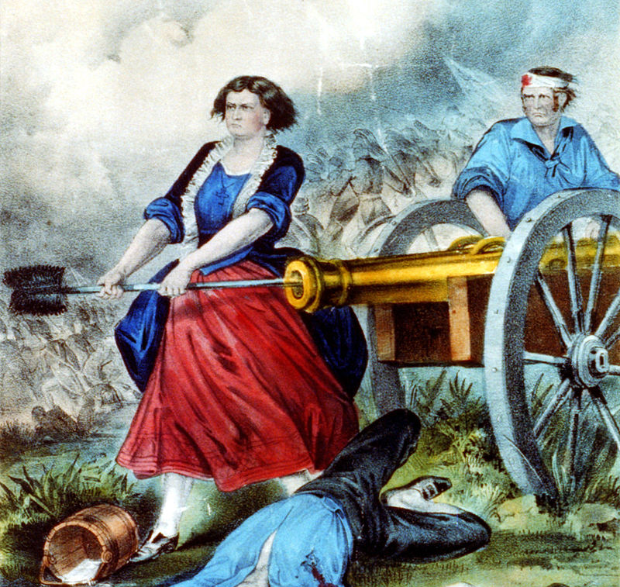
Molly Pitcher
Legend born at Monmouth
Carried water to soldiers
Took over cannon when husband fell
Notes:
Explain the story of Molly Pitcher and how it symbolizes women’s contributions during the war.

Slide 10
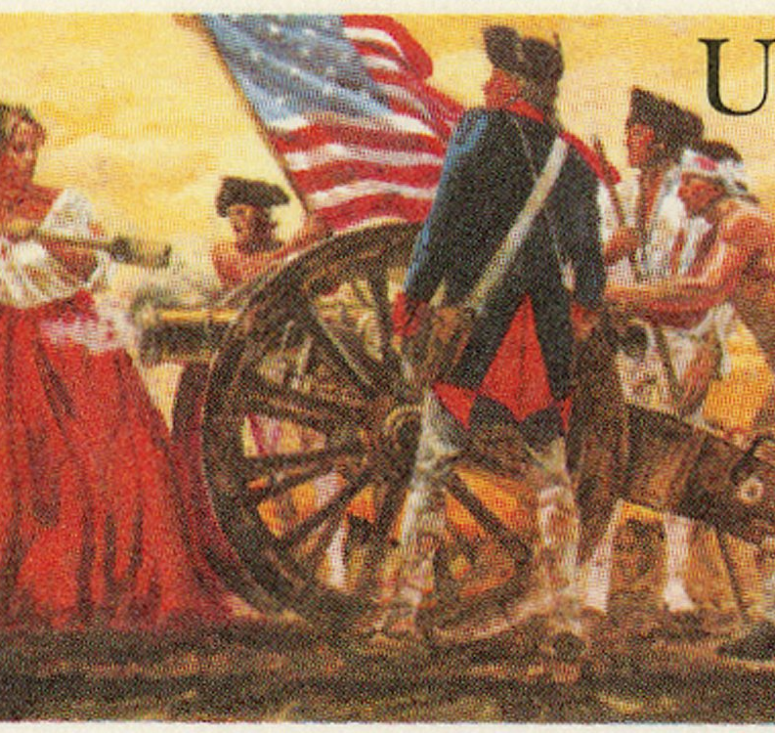
An Encouraging Draw
Patriots: ~500 casualties
British: up to 1,000 casualties
Many deaths from heat stroke
Notes:
Explain why the battle is considered a draw and why casualties were so high.

Slide 11
Why Monmouth Mattered
Americans held ground
Proved effectiveness in open combat
Boosted confidence
Notes:
Explain why Monmouth was a psychological victory for the Patriots.

Slide 12
Aftermath and Legacy
Last major Northern battle
British shifted focus south
American army gained respect
Notes:
Conclude by explaining how Monmouth marked the end of one phase of the war and the beginning of another.

