Slide 1
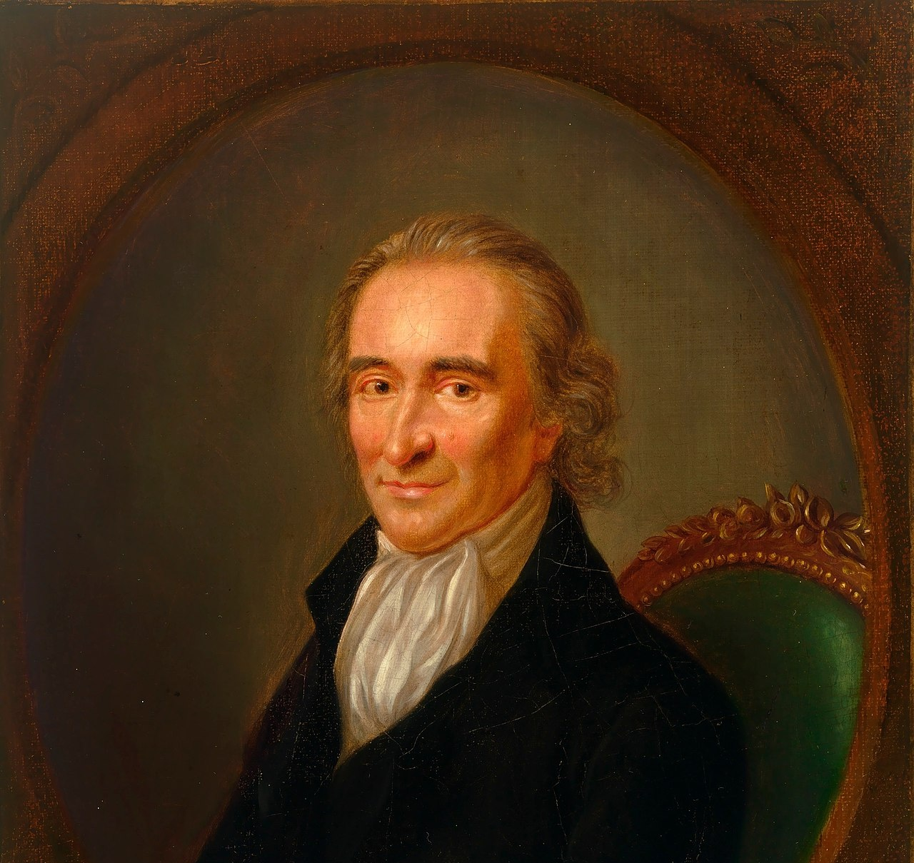

Thomas Paine

Slide 2
LearnAboutAmerica.com
*For our presentations, lesson plans, articles, printables, interactives, stories, and games related to the Declaration of Independence, please visit:
https://learnaboutamerica.com/american-history/revolutionary-war/causes-of-the-revolutionary-war/thomas-paine-and-common-sense
* For the greatest American History website for teachers, parents, and students, visit:
https://learnaboutamerica.com

Slide 3
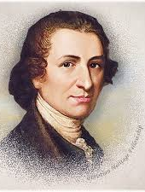
Early Life in England
Born in England in 1737
Son of uneducated farmers
Apprentice in his father’s corset-making business
Later worked as a merchant seaman

Slide 4
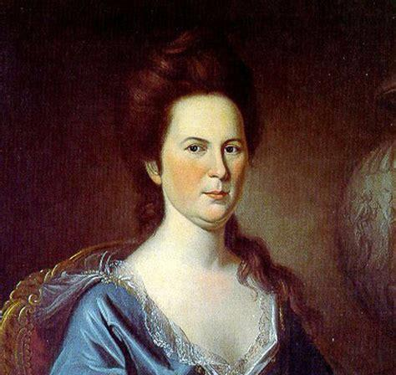
Early Adulthood
Started his own corset business
Married Mary Lambert in 1759
She died during childbirth
Faced personal hardship

Slide 5
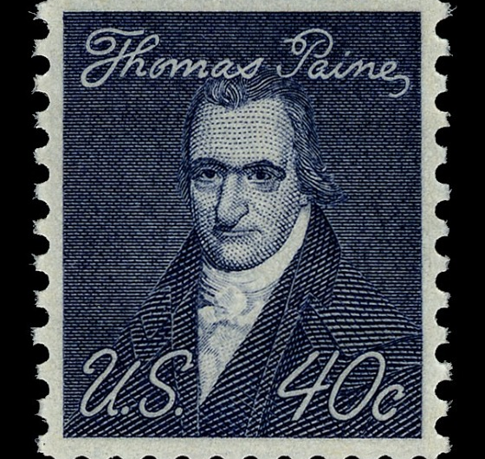
Political Awakening in England
Worked as a servant, teacher, and tax collector
Married Elizabeth Ollive in 1771
Involved in local politics in Lewes
Published The Case of the Officers of Excise

Slide 6
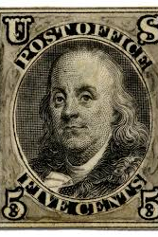
Meeting Benjamin Franklin
Met Benjamin Franklin in 1772
Encouraged to move to America
Received a letter of recommendation

Slide 7
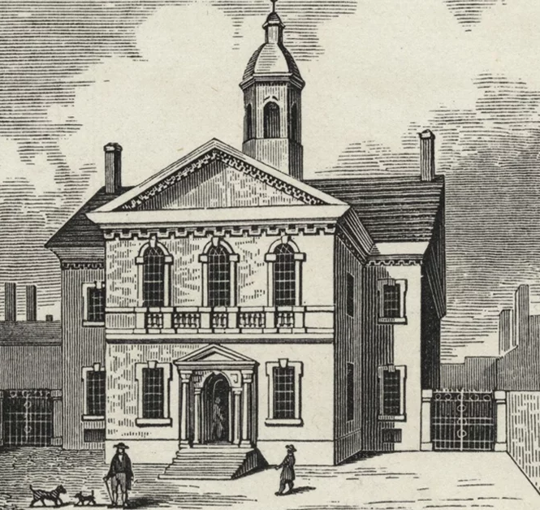
Journey to America
Arrived in Philadelphia on November 30, 1774
Nearly died from typhoid fever
Recovered after six weeks

Slide 8
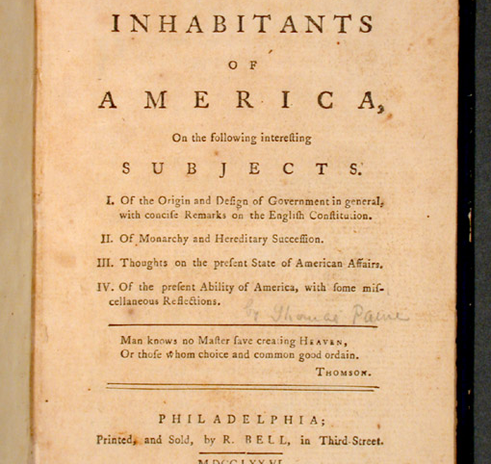
Common Sense
Published anonymously on January 10, 1776
Argued strongly for independence
Written in clear, simple language

Slide 9
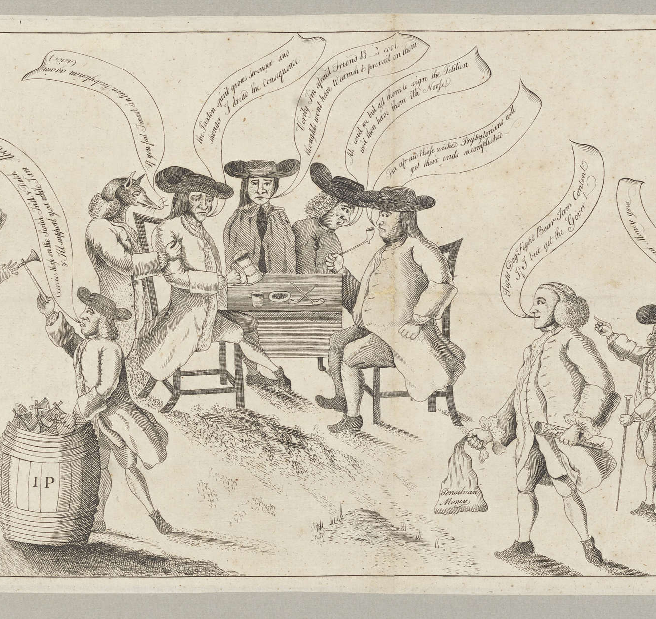
Impact of Common Sense
Spread rapidly among colonists
Influenced public opinion
Top-selling pamphlet of the 18th century

Slide 10
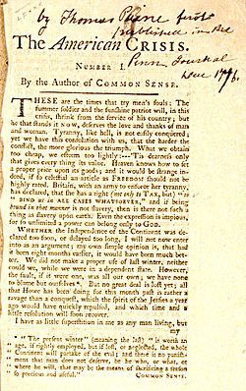
The Crisis
Written during the Revolutionary War
Inspired the Continental Army
Boosted morale

Slide 11
Famous Quote from The Crisis
“These are the times that try men's souls…”
Encouraged perseverance

Slide 12
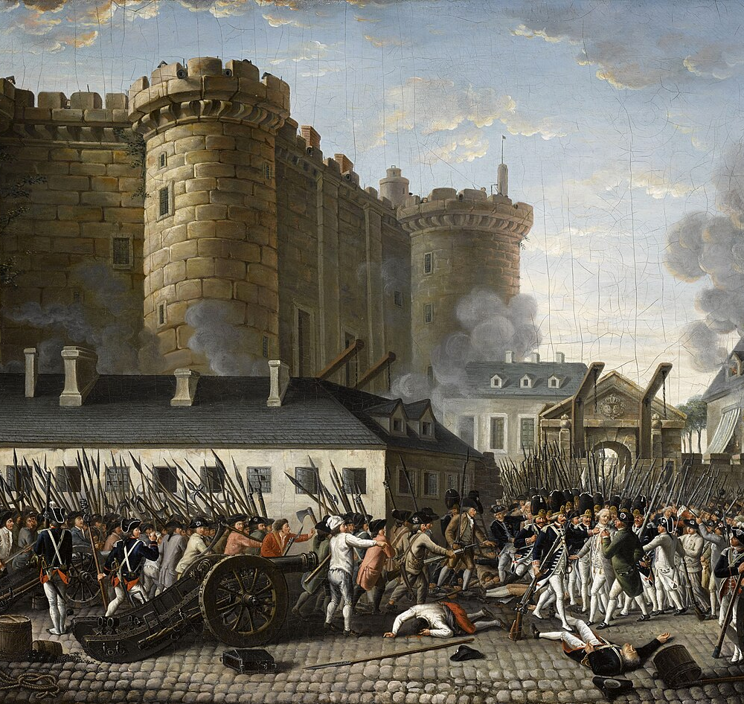
Work in France
Supported the French Revolution
Worked on French-American affairs
Published The Rights of Man

Slide 13
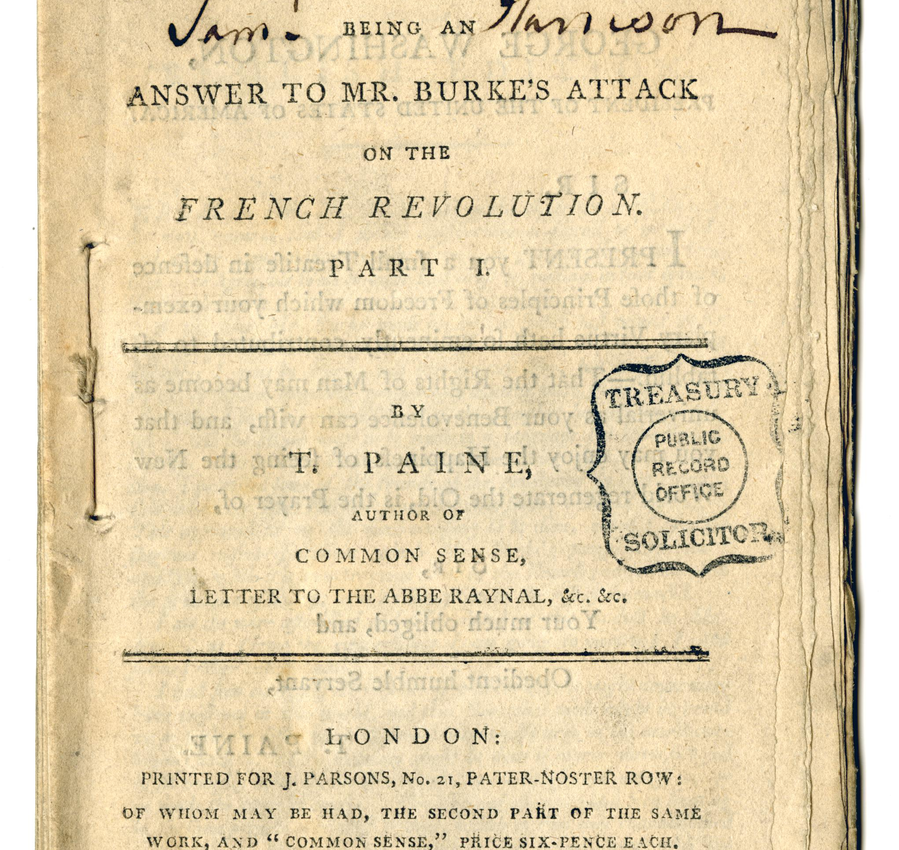
The Rights of Man
Defended revolution
Criticized monarchy
Made Paine famous in Europe

Slide 14
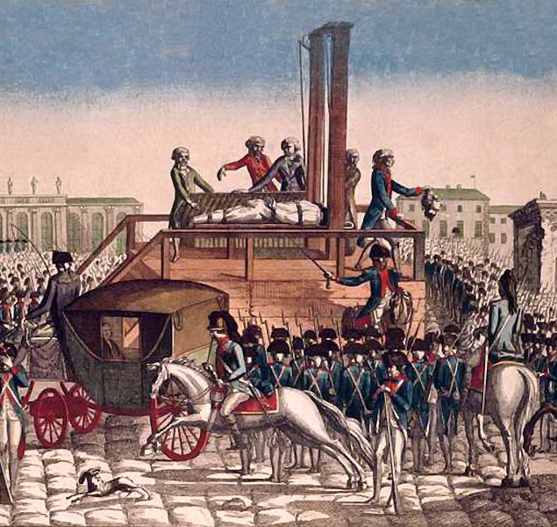
Fall from Favor
Political shifts in France
Arrested and imprisoned
Escaped execution

Slide 15
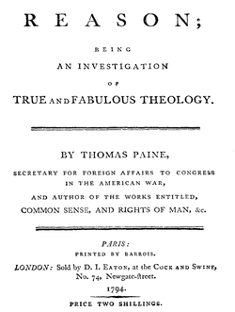
The Age of Reason
Criticized organized religion
Alienated supporters
Damaged reputation

Slide 16
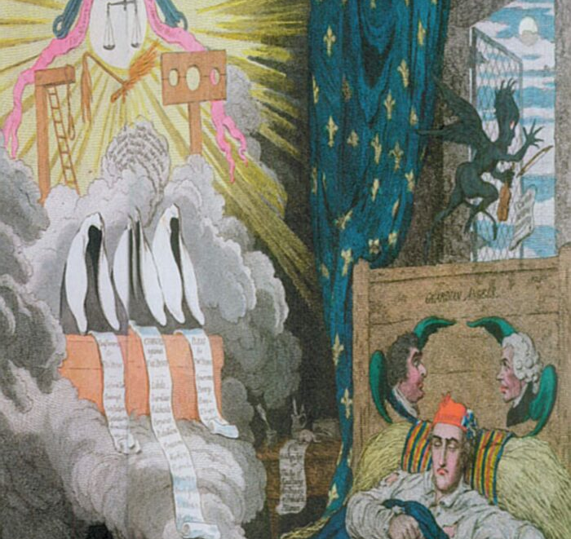
Return to America
Politically isolated
Ignored by former allies

Slide 17
Death and Legacy
Died in 1809 in New York City
Only six attended his funeral
Ideas influenced democracy worldwide

