Slide 1
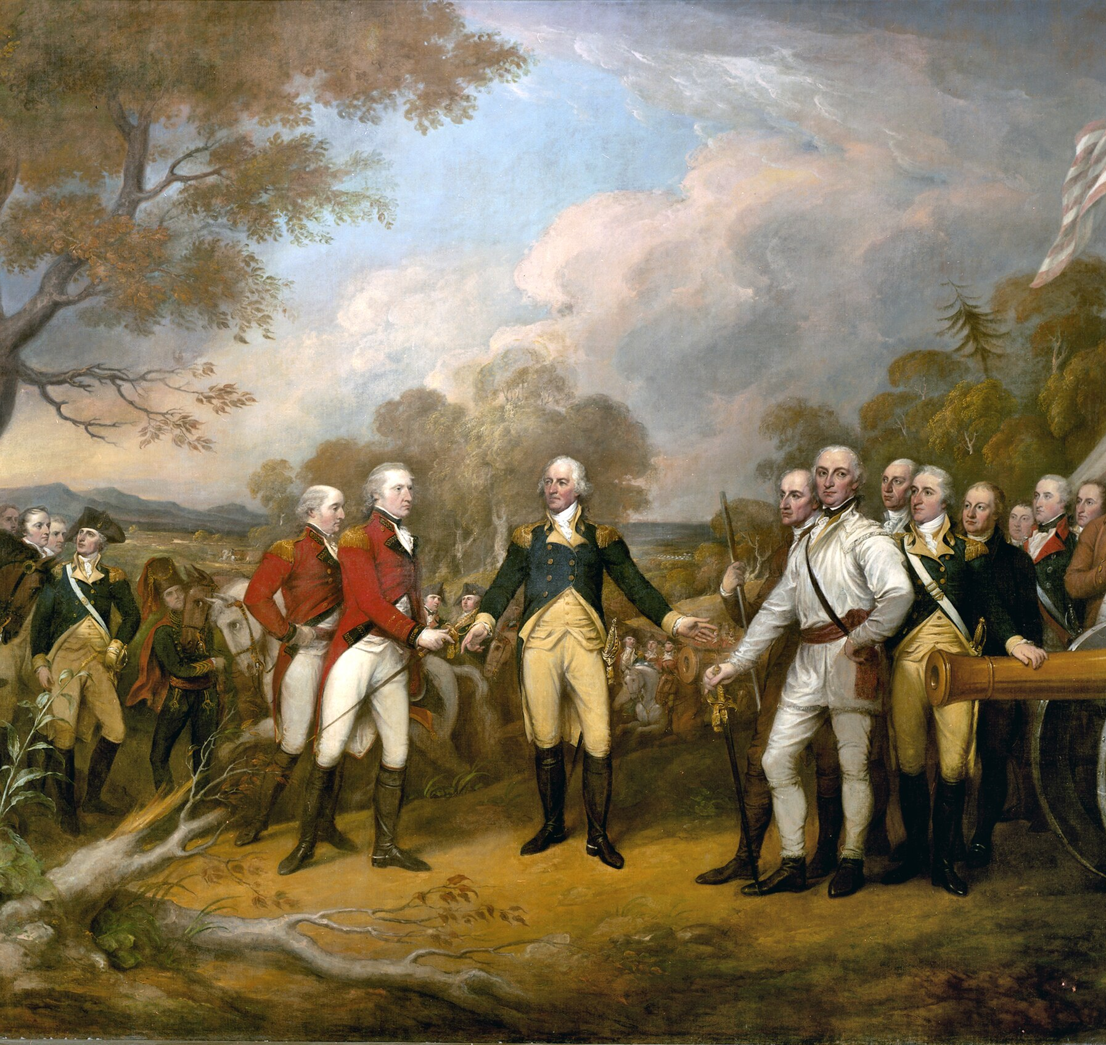
The Saratoga Campaign (1777)
https://learnaboutamerica.com
Notes:
Introduce Saratoga as a major turning point of the American Revolution and explain that it began as a British plan to end the war quickly.

Slide 2

LearnAboutAmerica.com
*For our presentations, lesson plans, articles, printables, interactives, stories, and games related to the Saratoga capmaign, please visit:
https://learnaboutamerica.com/american-history/revolutionary-war/battles-of-the-revolutionary-war/battle-of-saratoga
* For the greatest American History website for teachers, parents, and students, visit:
https://learnaboutamerica.com

Slide 3
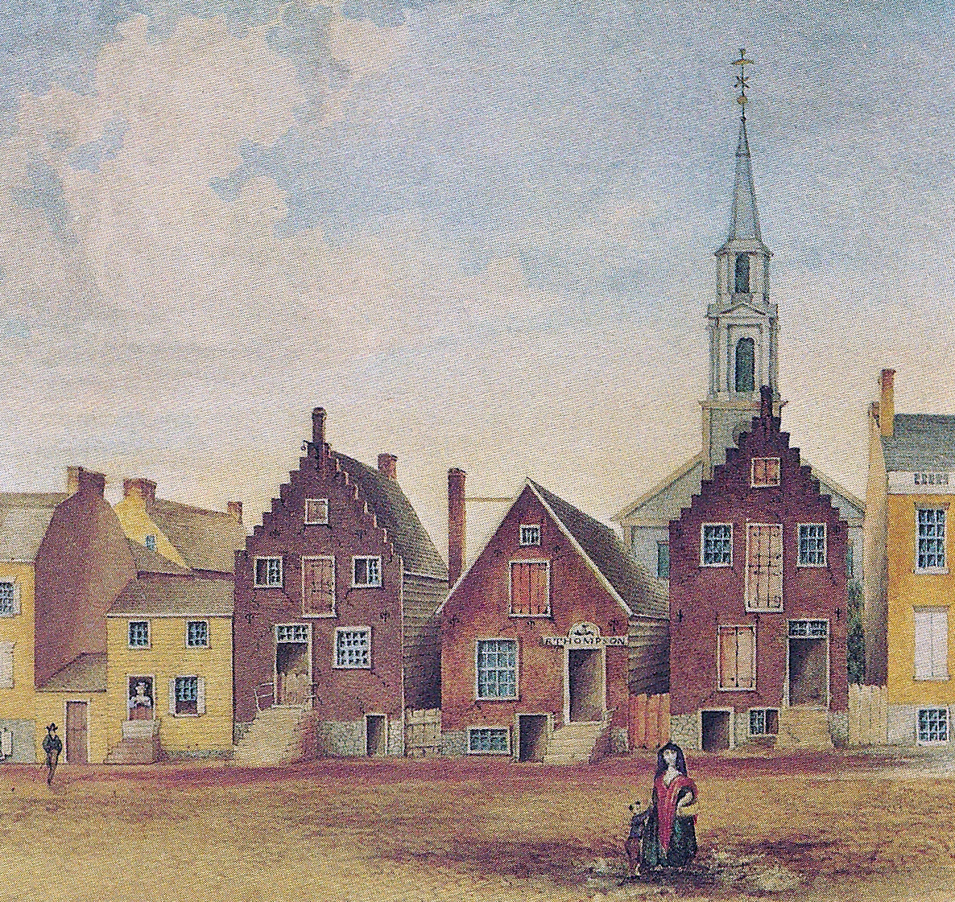
The British Three-Pronged Plan
Sever New England from the colonies
Control New York City, Albany, and the Hudson River
Crush the Patriot armies
Notes:
Explain that British leaders believed isolating New England would destroy the Patriot resistance.

Slide 4
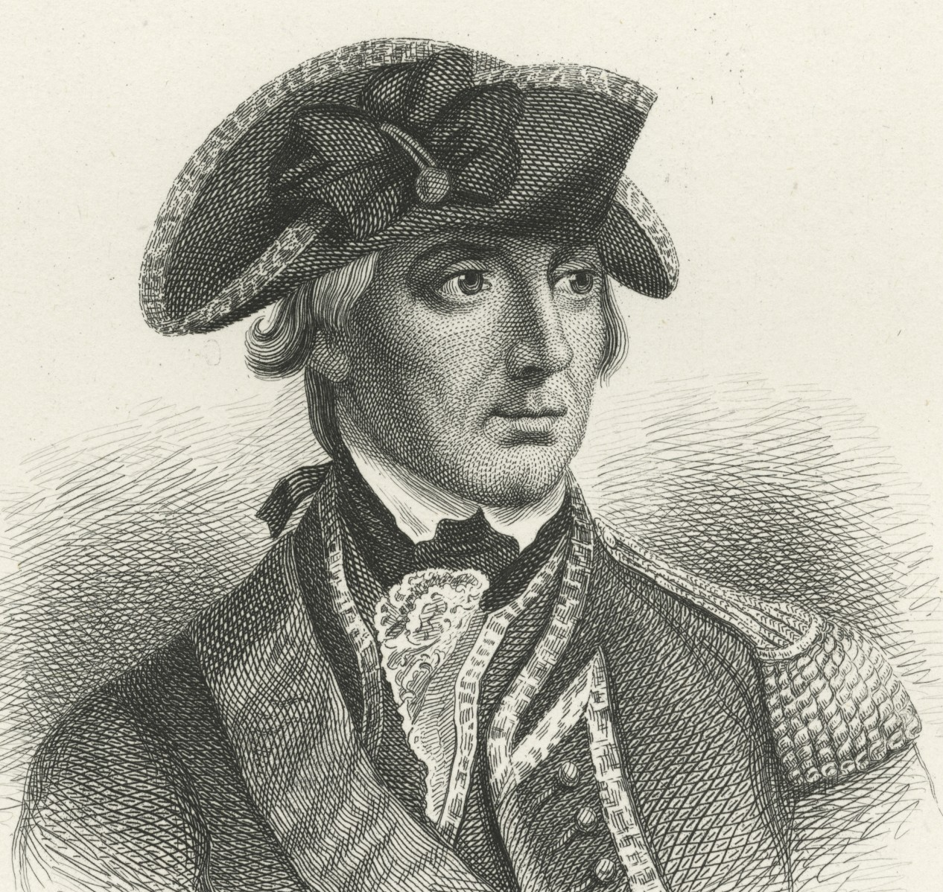
British Commanders
John Burgoyne from Canada
Barry St. Leger from Lake Ontario
William Howe from New York City
Notes:
Describe how all three armies were supposed to meet at Albany.

Slide 5
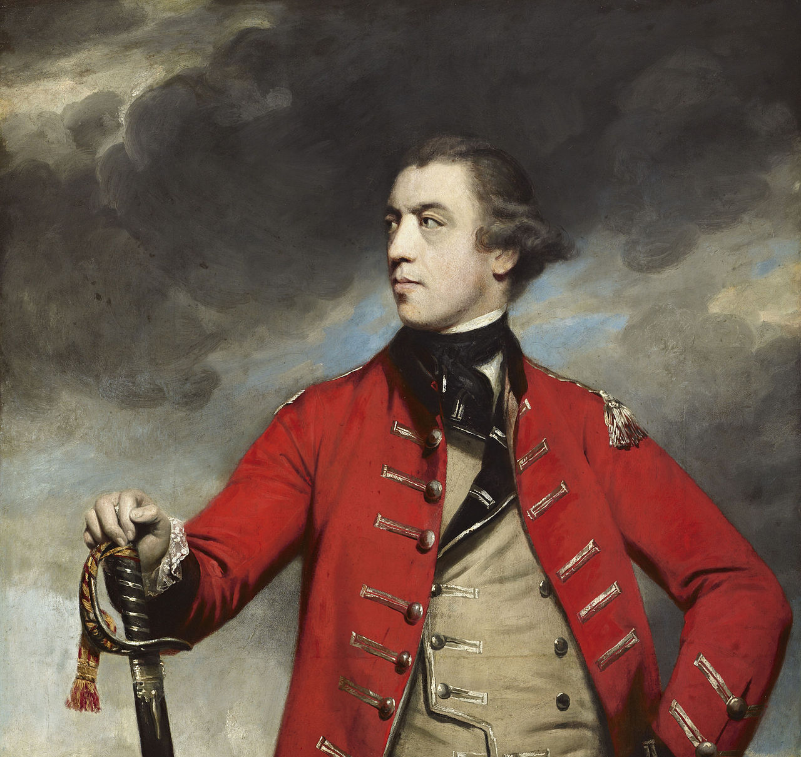
Burgoyne Marches South
8,000 British and German troops
Advanced from Canada toward Albany
Slow, difficult movement
Notes:
Explain the challenges Burgoyne faced moving through wilderness terrain.

Slide 6
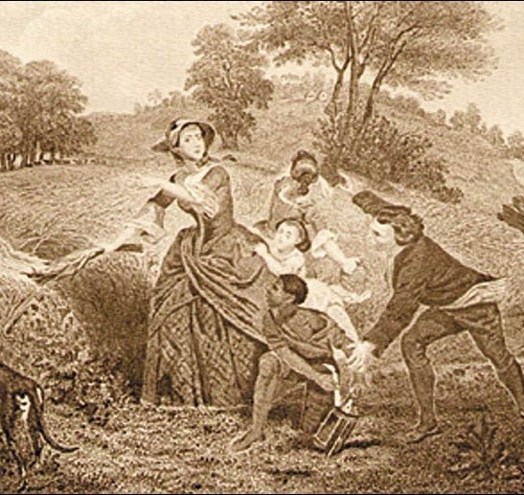
Patriot Resistance
Trees cut down to block roads
Supplies ran low
Large baggage train slowed progress
Notes:
Explain how Patriots used the environment to weaken the British.

Slide 7
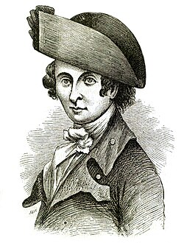
St. Leger’s Failure
Advanced east from Lake Ontario
Patriot resistance at Fort Stanwix
Forced to retreat
Notes:
Explain Benedict Arnold’s role in stopping St. Leger.

Slide 8
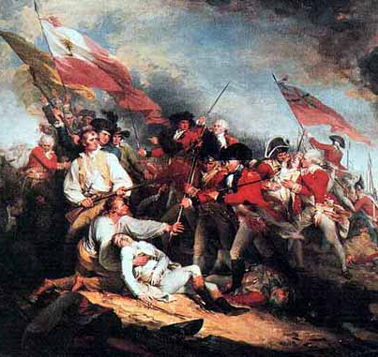
Howe Changes the Plan
Marched south instead of north
Invaded Philadelphia
Did not go to Albany
Notes:
Explain how Howe’s decision disrupted the entire plan.

Slide 9
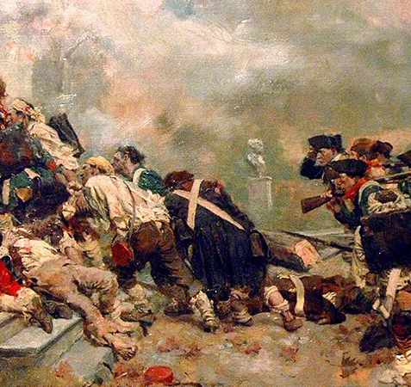
Brandywine and Germantown
British victory at Brandywine
Philadelphia captured
Patriot attack at Germantown failed
Notes:
Explain why these battles mattered but did not end the war.

Slide 10
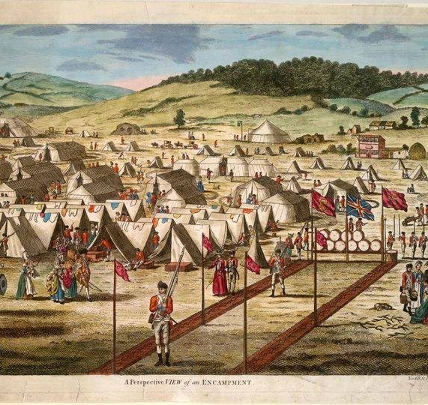
Howe in Philadelphia
Congress fled to York, Pennsylvania
British wintered in the city
Burgoyne left unsupported
Notes:
Emphasize Burgoyne’s growing isolation.

Slide 11
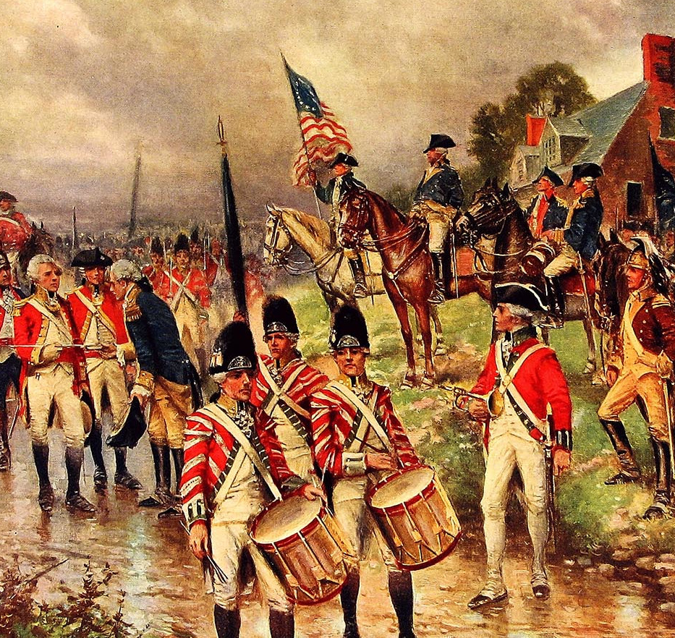
Burgoyne’s Supply Crisis
Supplies running out
Detachment sent to Bennington
Search for food and horses
Notes:
Explain why this was a risky decision.

Slide 12

Defeat at Bennington
American forces led by John Stark
Green Mountain Boys involved
British detachment destroyed
Notes:
Explain the damage this defeat caused Burgoyne.

Slide 13
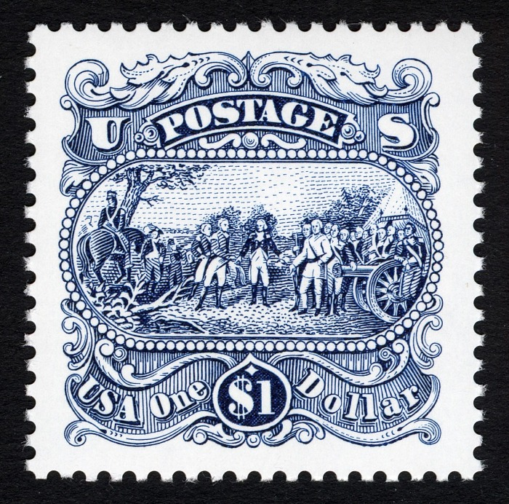
Trapped at Saratoga
Retreated to Saratoga, New York
Blocked by Horatio Gates
No help from Howe or St. Leger
Notes:
Explain why Burgoyne was now trapped.

Slide 14
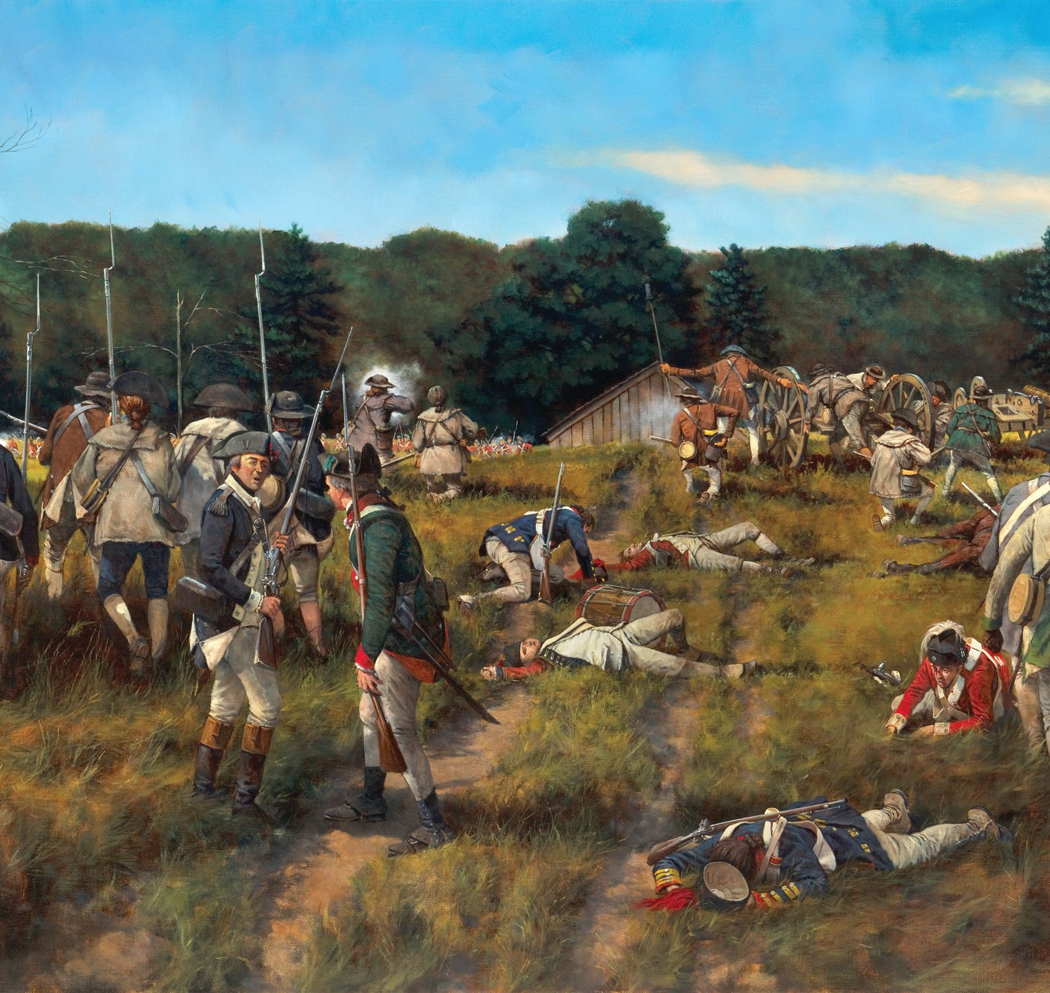
Battles of Saratoga
Freeman’s Farm
Bemis Heights
Arnold’s aggressive leadership
Notes:
Describe how the Patriots gained the advantage.

Slide 15
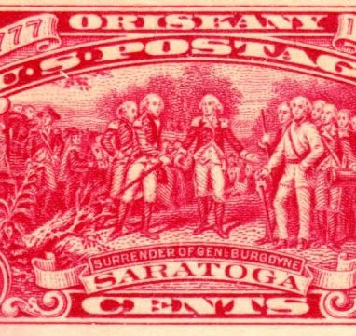
Burgoyne Surrenders
October 17, 1777
British army surrounded
Lack of supplies and heavy losses
Notes:
Explain why surrender was inevitable.

Slide 16
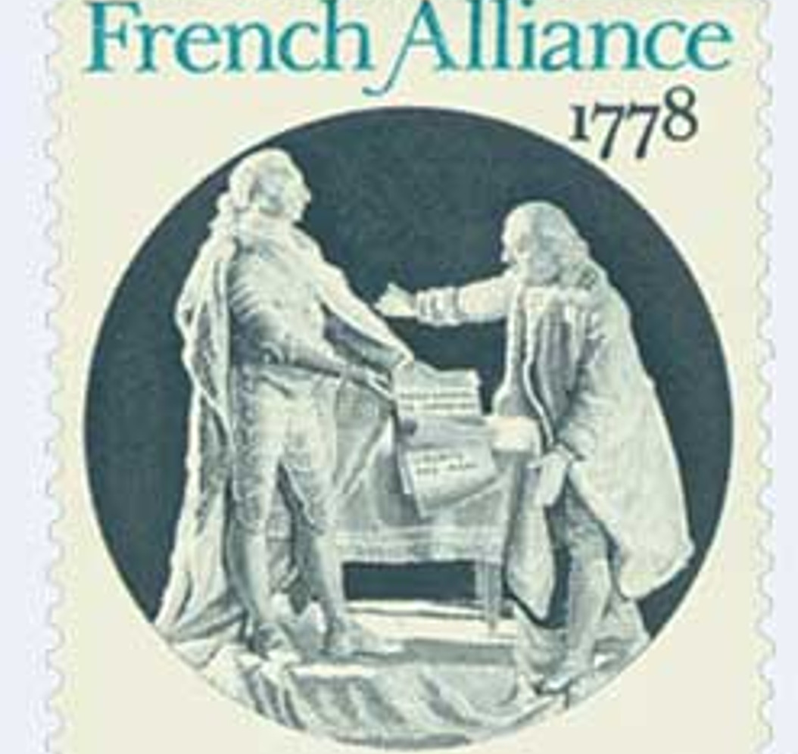
The Turning Point
Boosted Patriot morale
Convinced France to ally with the U.S.
War became global
Notes:
Explain how Saratoga changed the entire course of the war.

