Slide 1
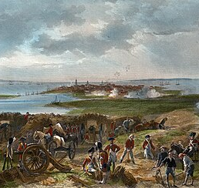
Southern Theater Overview
  The Southern Theater focused on Georgia, South Carolina, North Carolina, and Virginia.
  Britain believed many Southern colonists would support the king.
  The British hoped to regain control by capturing key Southern cities.
  This phase of the war lasted mainly from 1778 to 1781.
https://learnaboutamerica.com

Slide 2
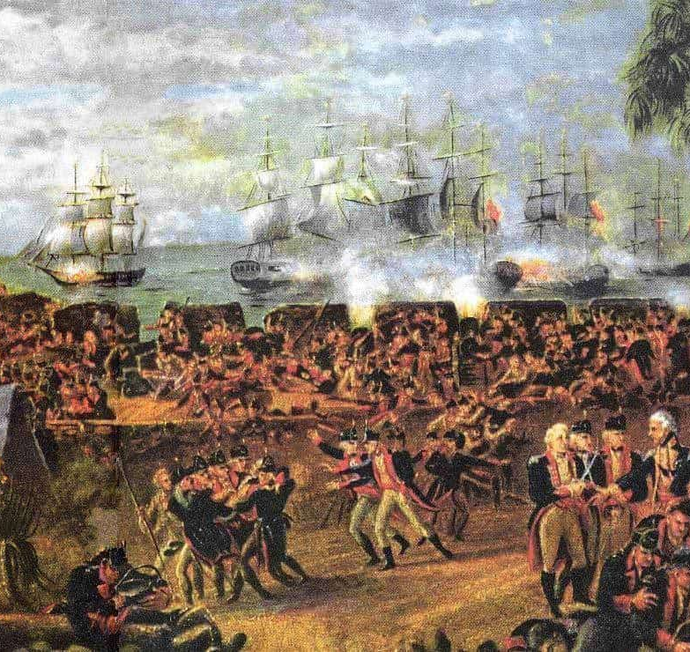
British Southern Strategy
  The British shifted focus after struggling in the North.
  They wanted to protect ports, farms, and trade routes.
  British leaders expected Loyalist support in the South.
  The plan was to win the South and then move north again.

Slide 3
Fall of Savannah
  In 1778, the British captured Savannah, Georgia.
  This victory gave Britain a strong Southern base.
  Savannah provided an important harbor and supply center.
  The loss worried Patriot leaders across the colonies.

Slide 4
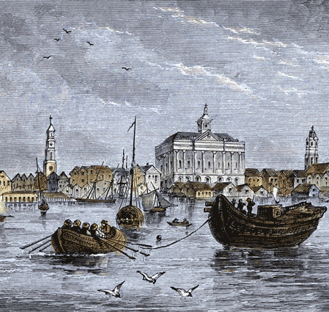
Fall of Charleston
  Charleston fell to the British in 1780 after a long siege.
  Over 5,000 American soldiers were captured.
  It was one of the worst American defeats of the war.
  British confidence in the Southern Strategy increased.

Slide 5
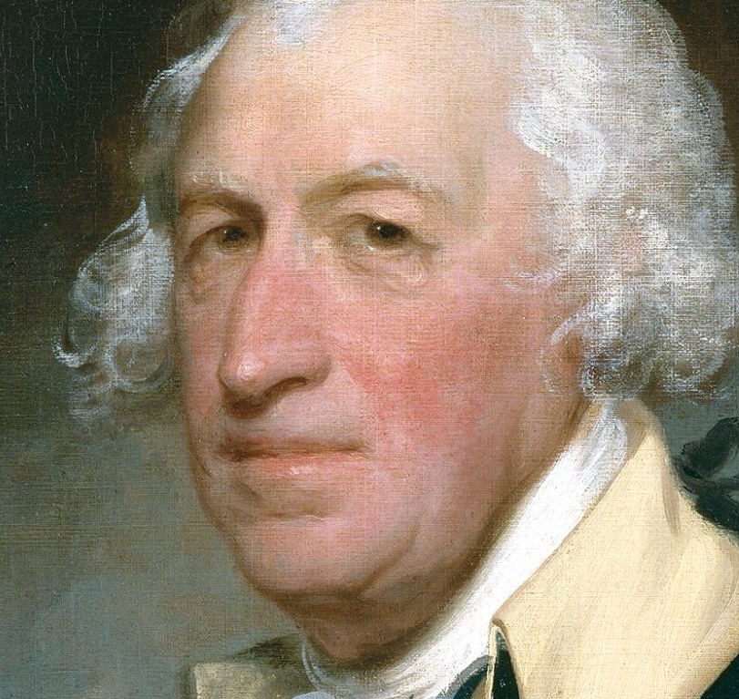
Battle of Camden (1780)
  American forces were led by General Horatio Gates.
  Poor planning and exhausted troops weakened the Patriots.
  When fighting began, many militia soldiers fled.
  Gates later faced charges of cowardice for retreating quickly.

Slide 6
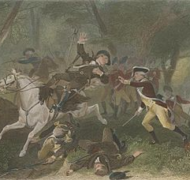
Backcountry Warfare
  The British controlled cities but not the countryside.
  Patriots and Loyalists fought in raids and ambushes.
  Violence often involved neighbors fighting neighbors.
  This made the war personal and unpredictable.

Slide 7
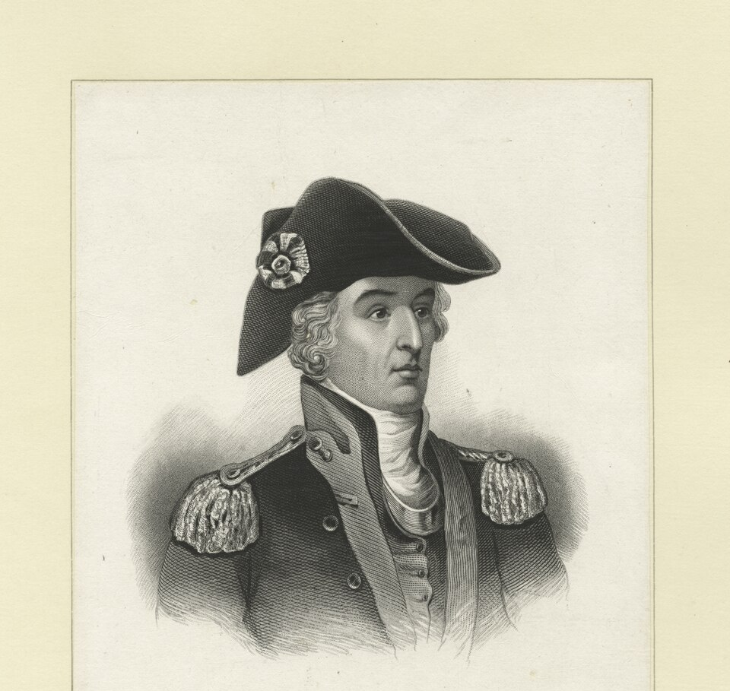
Guerrilla Fighters
  Patriot militias used hit-and-run tactics.
  Francis Marion was known as the 'Swamp Fox.'
  Militia fighters disrupted British supply lines.
  Their tactics frustrated British commanders.

Slide 8
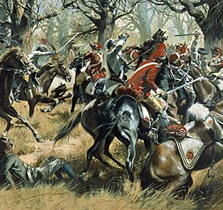
Battle of Cowpens (1781)
  General Daniel Morgan commanded American forces.
  He arranged troops in three lines to trick the British.
  The British thought Americans were retreating.
  The trap led to a major Patriot victory.

Slide 9
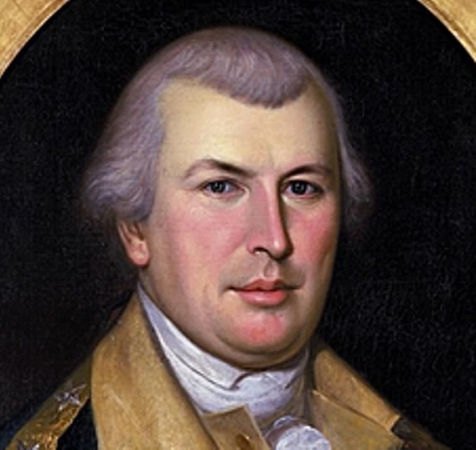
Greene's Strategy
  General Nathanael Greene avoided total destruction.
  He forced the British to chase his army.
  British troops lost supplies and soldiers over time.
  This strategy weakened British control in the South.

Slide 10
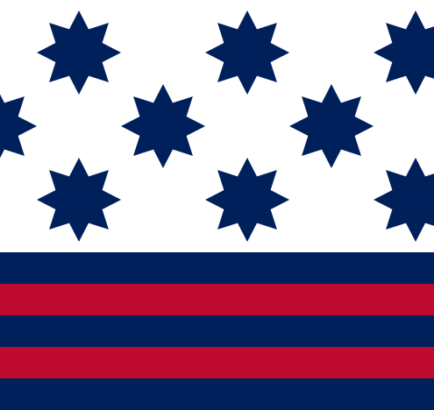
Battle of Guilford Courthouse
  The battle took place in North Carolina in 1781.
  The British technically won the battle.
  However, they suffered heavy casualties.
  The loss weakened their overall campaign.

Slide 11
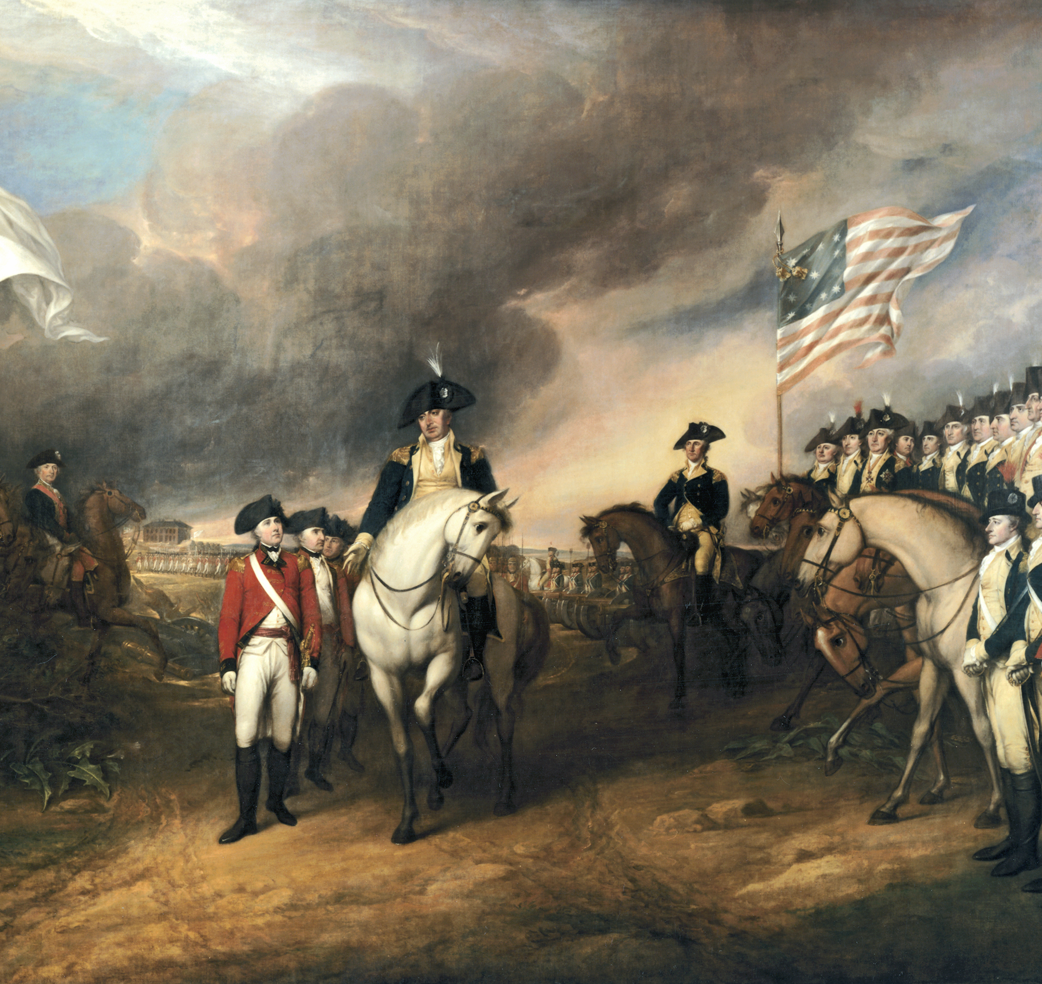
Road to Yorktown
  British General Cornwallis moved into Virginia.
  He expected support from the British navy.
  American and French forces surrounded his army.
  Cornwallis was trapped at Yorktown.

Slide 12
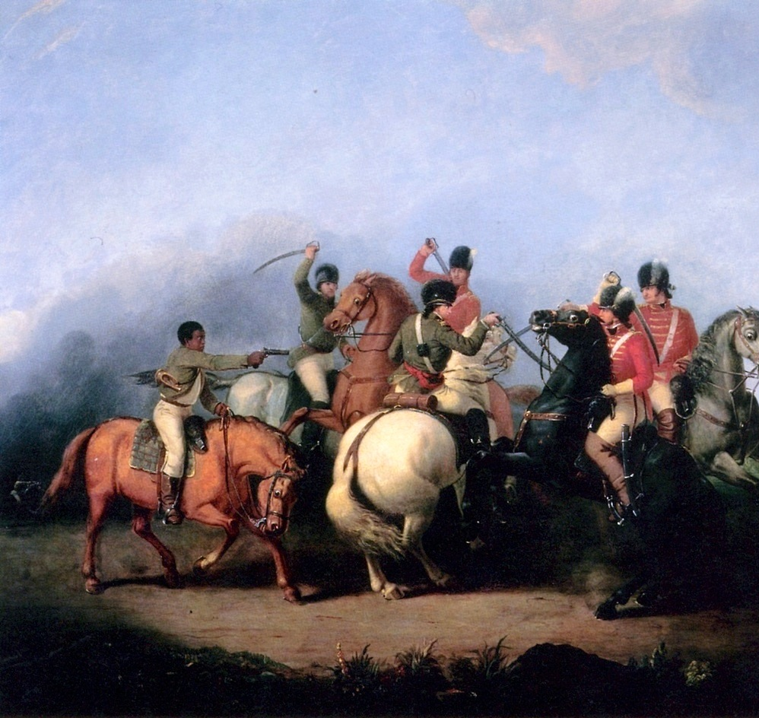
Importance of the Southern Theater
  Southern battles weakened the British army.
  Guerrilla tactics and strategy worked together.
  British resources were stretched thin.
  The Southern Theater helped lead to victory at Yorktown.

