Slide 1
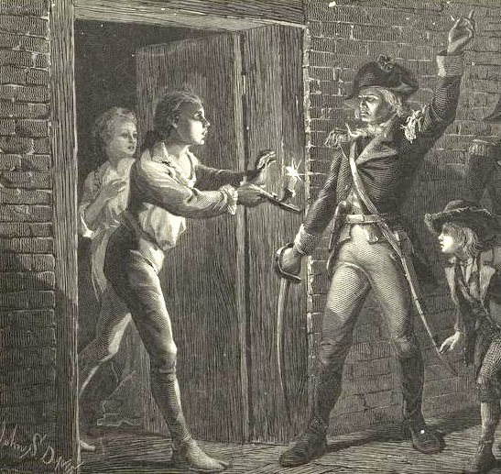

Fort Ticonderoga and the Noble Train of Artillery

Slide 2
LearnAboutAmerica.com
*For our presentations, lesson plans, articles, printables, interactives, stories, and games related to the Seizure of Fort Ticonderoga, please visit:
https://learnaboutamerica.com/american-history/revolutionary-war/battles-of-the-revolutionary-war/the-seizure-of-fort-ticonderoga
* For the greatest American History website for teachers, parents, and students, visit:
https://learnaboutamerica.com

Slide 3
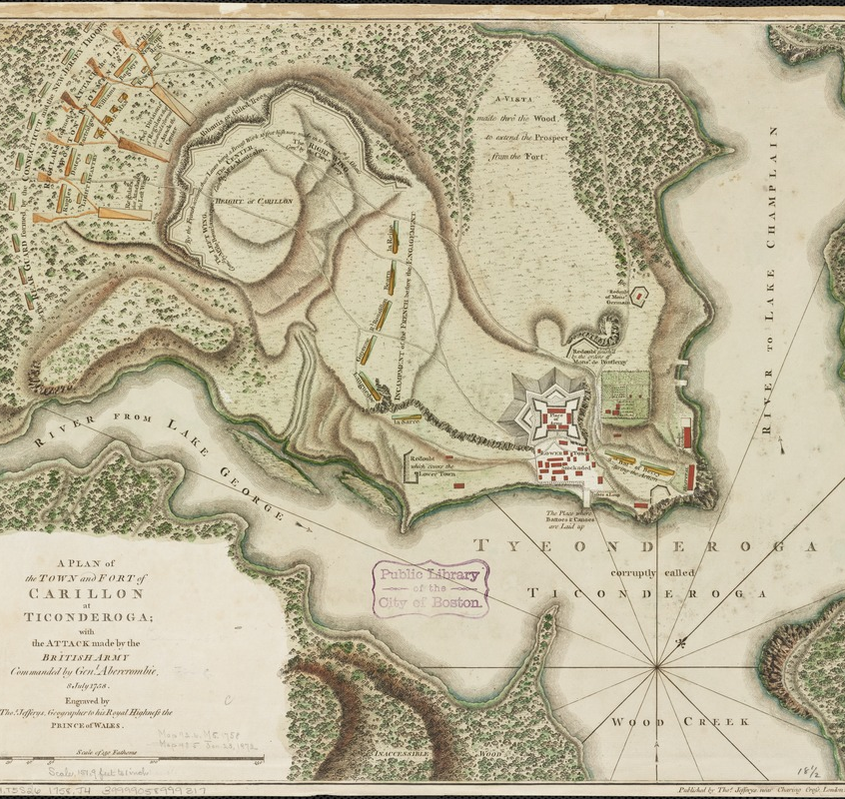
Fort Ticonderoga Before 1775
Small and poorly maintained British fort
Located at the southern tip of Lake Champlain
Known as Fort Carillon during the French and Indian War

Slide 4
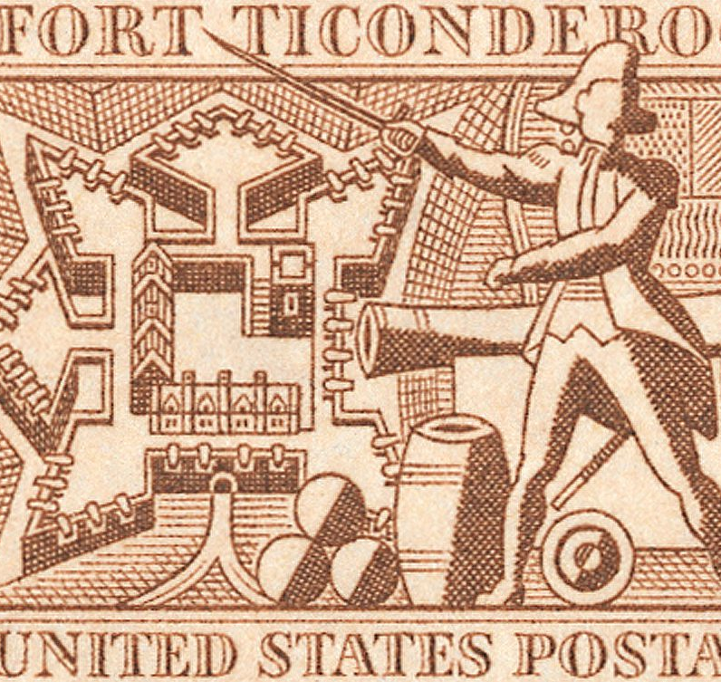
Why Fort Ticonderoga Was Important
Controlled a key route between the colonies and British Canada
Contained valuable cannons, guns, and military supplies
Guarded by only 48 British soldiers

Slide 5
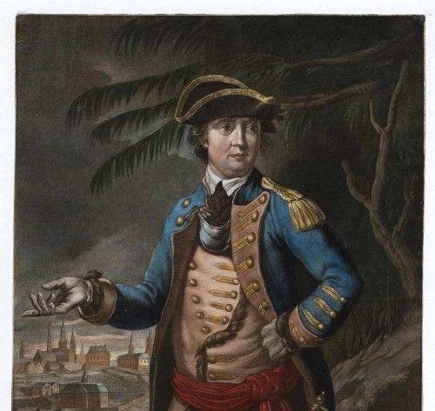
Planning the Seizure
Massachusetts Committee of Safety authorized a secret mission
Colonel Benedict Arnold chosen to lead the operation
Arnold helped recruit about 400 soldiers

Slide 6

A Rival Mission
Connecticut also planned a raid on the fort
Led by Ethan Allen and the Green Mountain Boys
Arnold and Allen agreed to share command

Slide 7
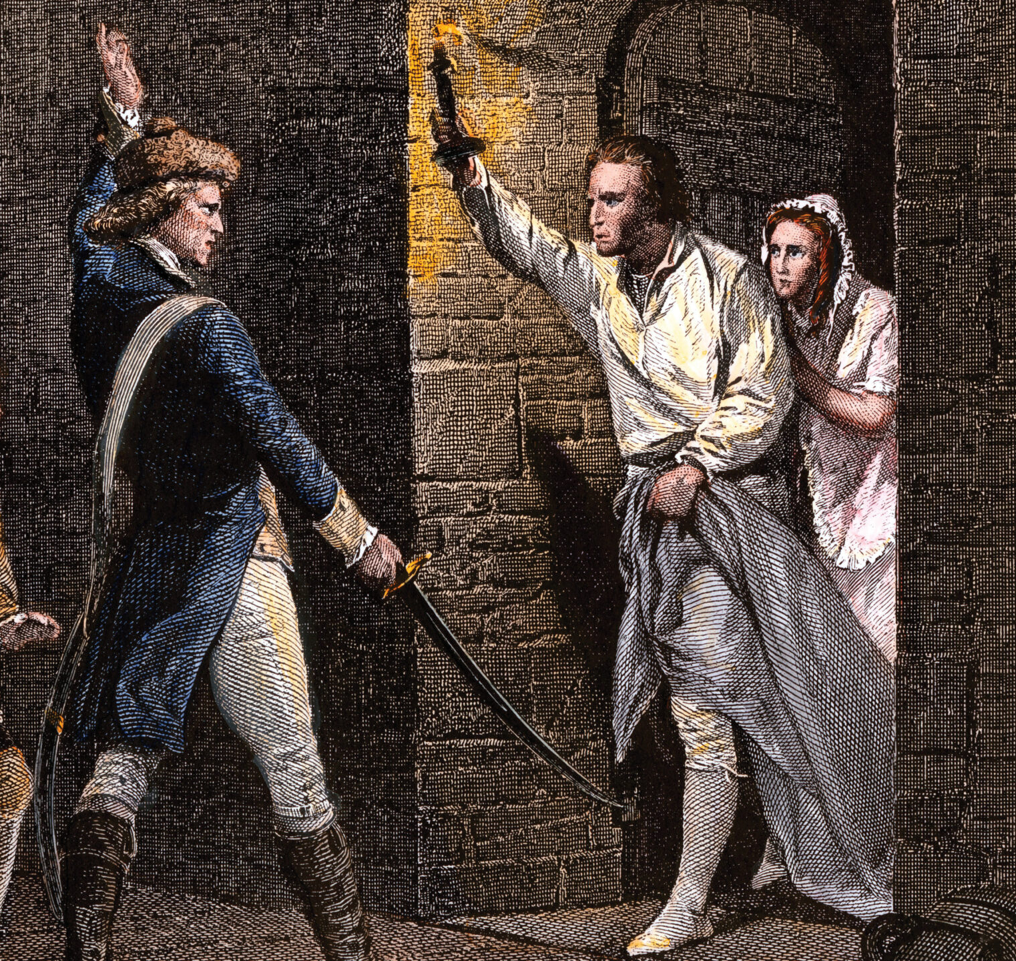
A Bloodless Victory – May 10, 1775
Arnold, Allen, and 83 soldiers attacked the fort
British soldiers were asleep and surrendered
No deaths occurred during the raid

Slide 8
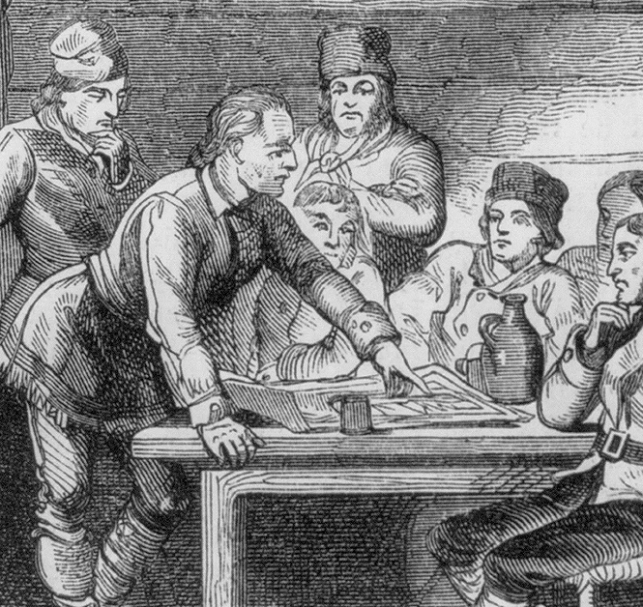
After the Capture
Hundreds of American soldiers arrived afterward
Parts of the fort were damaged in search of supplies
Arnold was angered by the lack of discipline

Slide 9
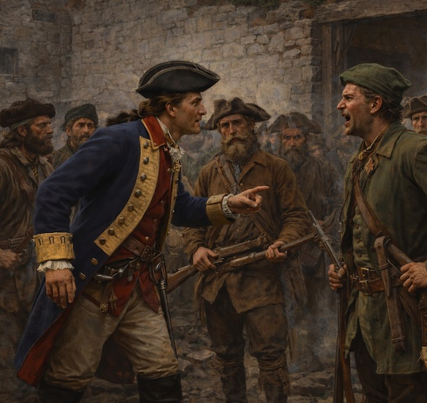
Tension and Credit
Ethan Allen claimed credit for the capture
Arnold felt disrespected and undermined
Conflict grew between Patriot leaders

Slide 10
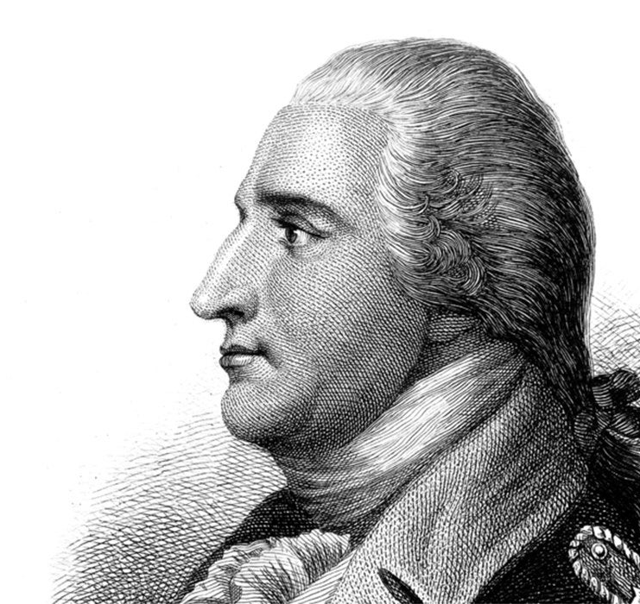
Arnold Removed from Command
Arnold captured nearby Fort Crown Point
More weapons and cannons were seized
Benjamin Hinman relieved Arnold of command

Slide 11
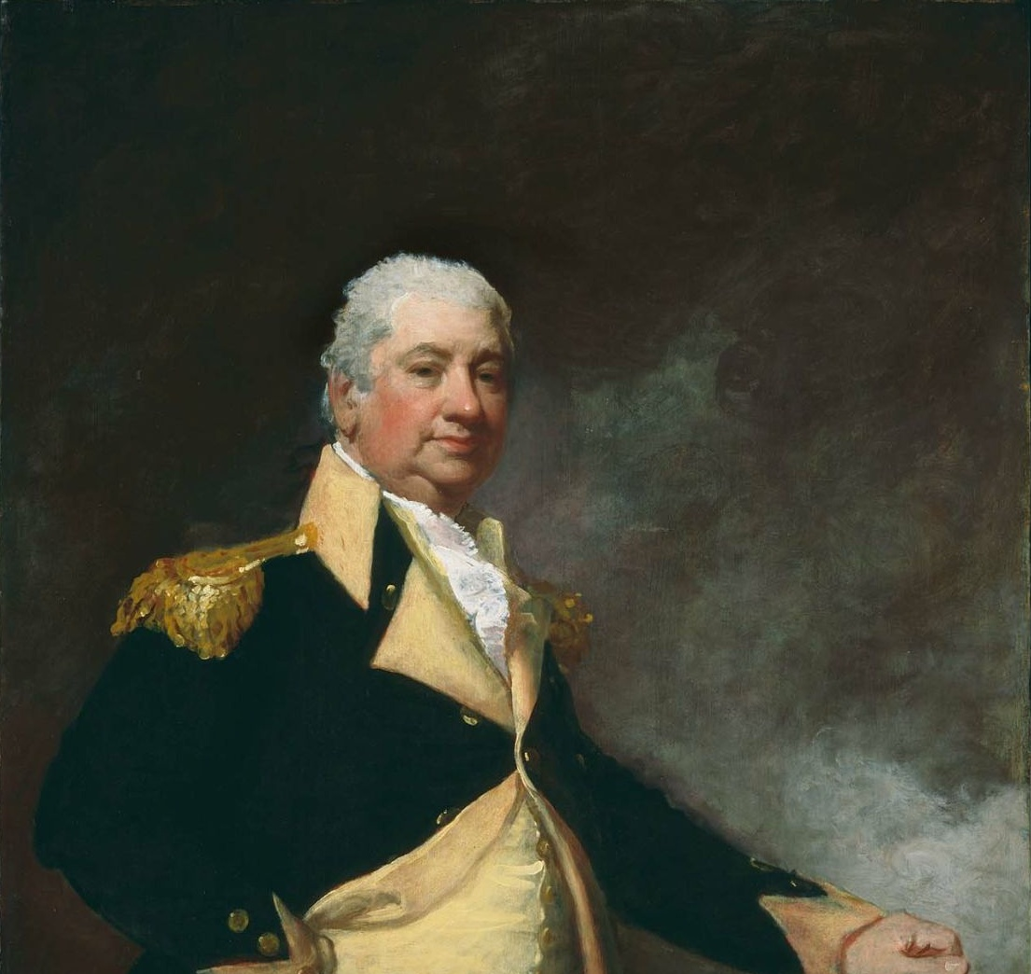
The Cannons’ Journey to Boston
George Washington ordered the weapons moved
Colonel Henry Knox led the transport effort
59 cannons were hauled over 300 miles

Slide 12
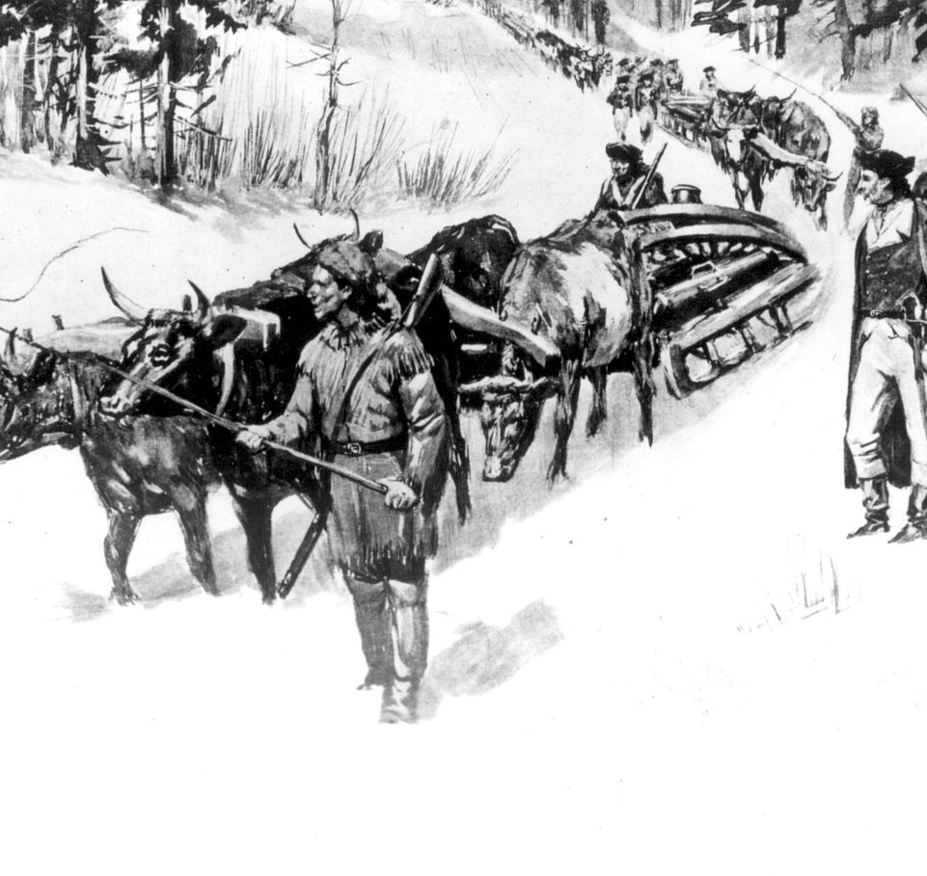
The Noble Train of Artillery
Cannons moved by ox-drawn sleds
Journey took 56 days in winter conditions
Total weight exceeded 60 tons

Slide 13
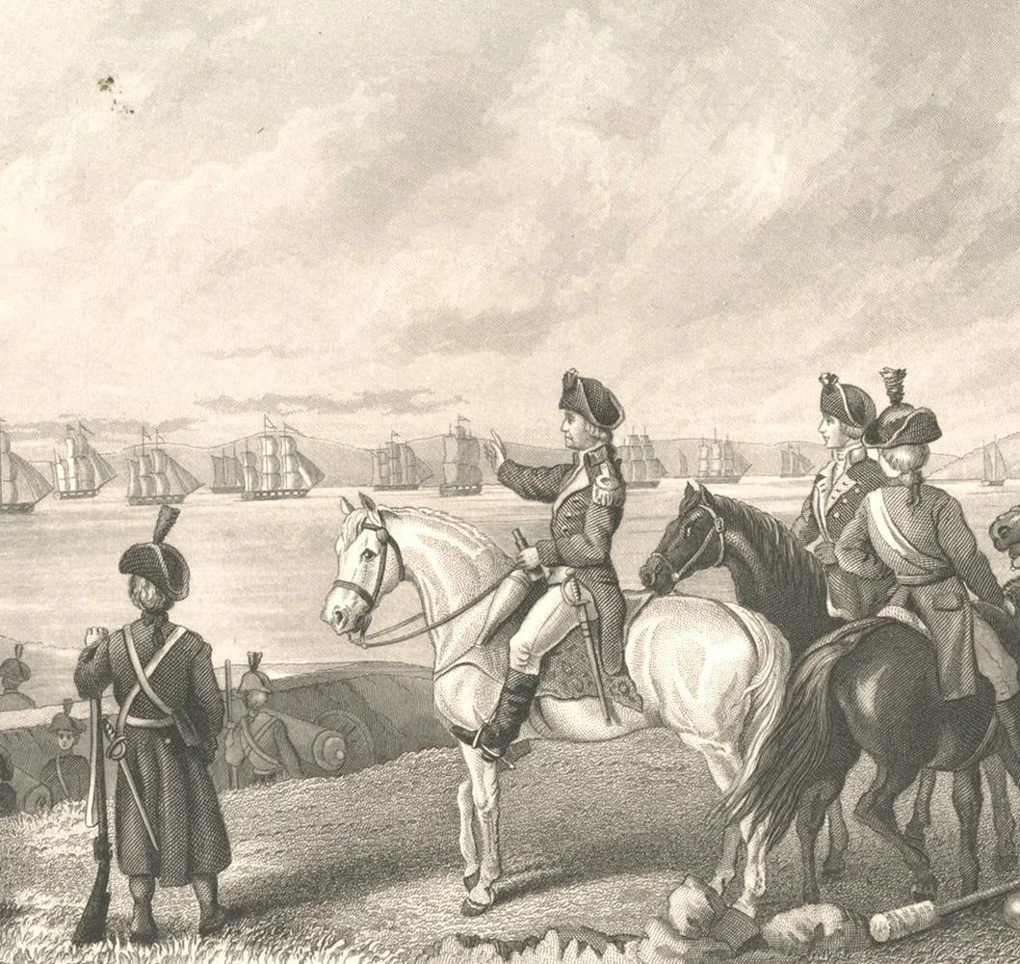
Dorchester Heights
Cannons placed overlooking Boston Harbor
British fleet was threatened
British forces evacuated Boston

Slide 14
Why Fort Ticonderoga Mattered
Provided critical weapons to the Patriot cause
Helped force the British out of Boston
Boosted American confidence early in the war

