Slide 1
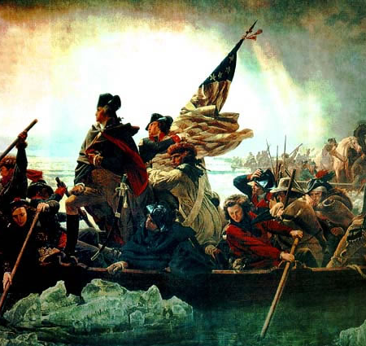
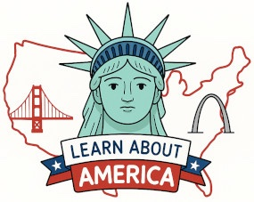
A New Hope: Trenton and Princeton
https://learnaboutamerica.com
Notes:
This presentation explains how the Battles of Trenton and Princeton revived Patriot morale and changed the course of the Revolutionary War.

Slide 2
LearnAboutAmerica.com
*For our presentations, lesson plans, articles, printables, interactives, stories, and games related to the battles at Trenton and Princeton, please visit:
https://learnaboutamerica.com/american-history/revolutionary-war/battles-of-the-revolutionary-war/the-battle-of-trenton
* For the greatest American History website for teachers, parents, and students, visit:
https://learnaboutamerica.com

Slide 3
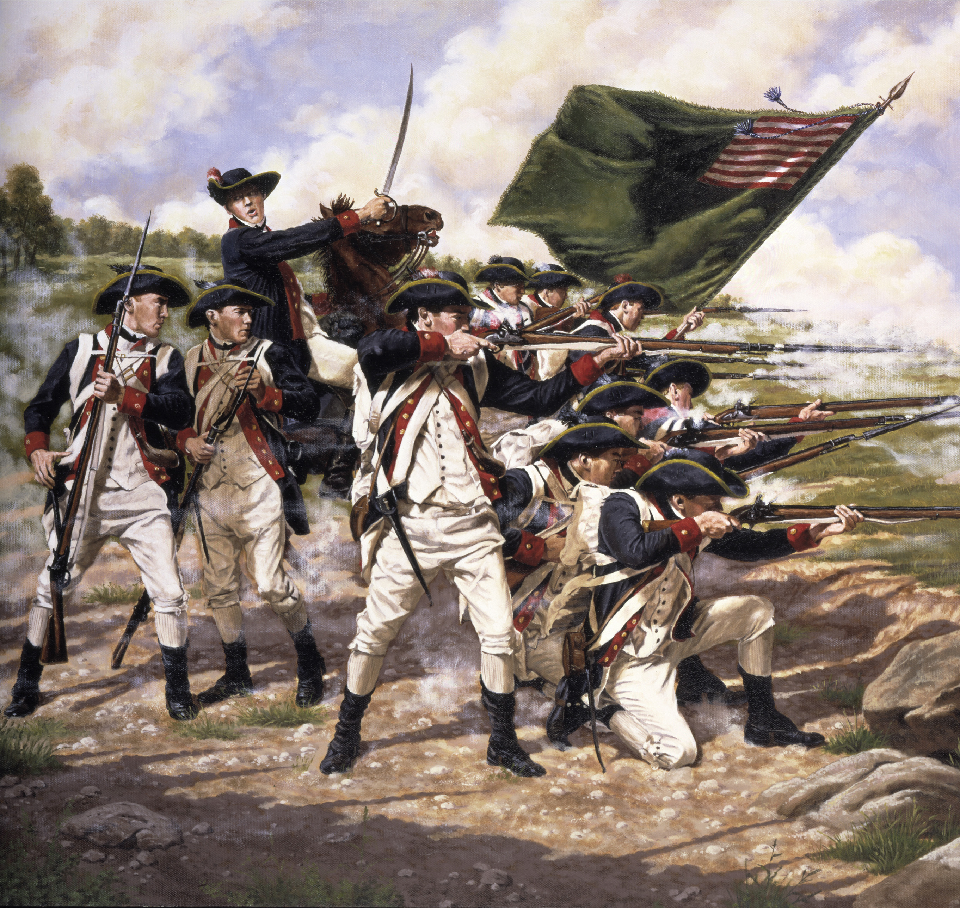
1776: A Brutal Year
Patriot morale was extremely low
Continental Army suffered defeats in New York
Washington retreated across New Jersey
Notes:
Explain that by late 1776 the Revolution appeared close to failure, with defeats piling up and enlistments ending.

Slide 4
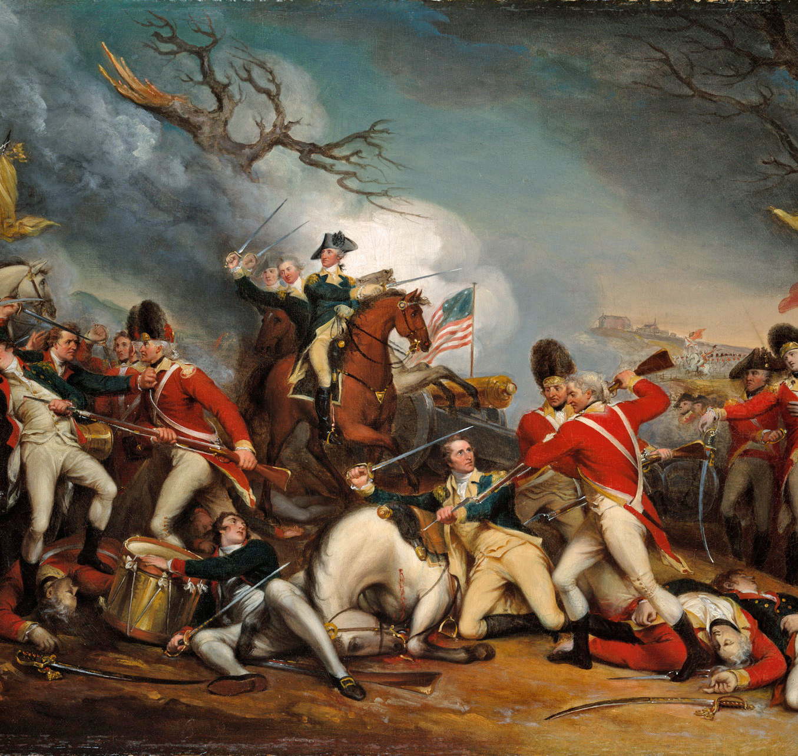
Retreat to the Delaware
Continental Army crossed into Pennsylvania
Army was exhausted, hungry, and poorly supplied
British and Hessian forces occupied New Jersey
Notes:
Describe the desperate condition of Washington’s army and the sense that defeat seemed inevitable.

Slide 5
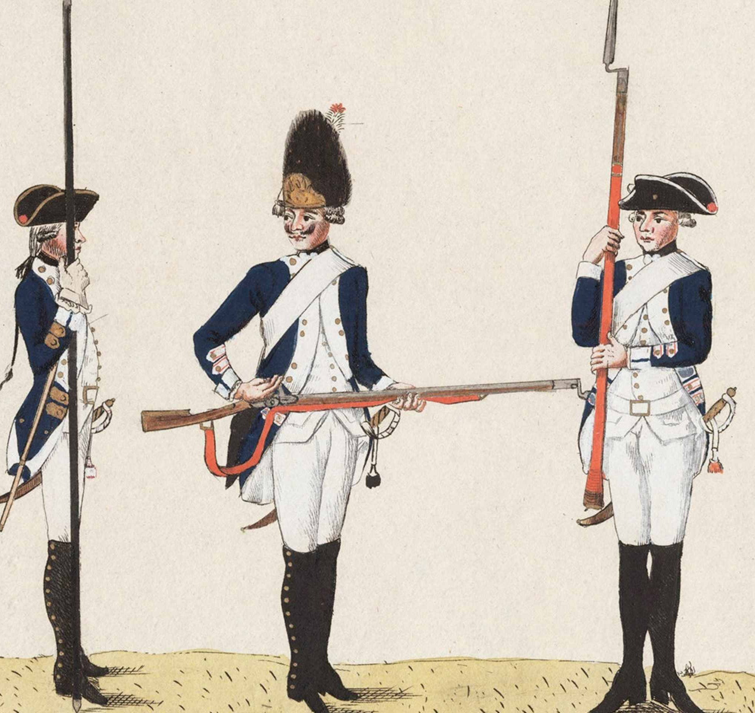
The Hessians at Trenton
Three Hessian regiments in Trenton, NJ
About 1,400 soldiers
Confident and unprepared for attack
Notes:
Explain who the Hessians were and why they underestimated the Continental Army.

Slide 6
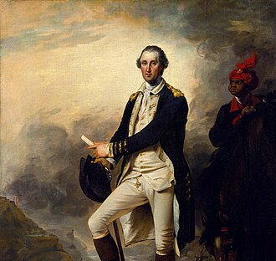
Washington’s Bold Plan
Surprise attack planned for December 26, 1776
Attack from three directions
Risky winter operation
Notes:
Emphasize the danger and boldness of attacking in winter after a retreat.

Slide 7
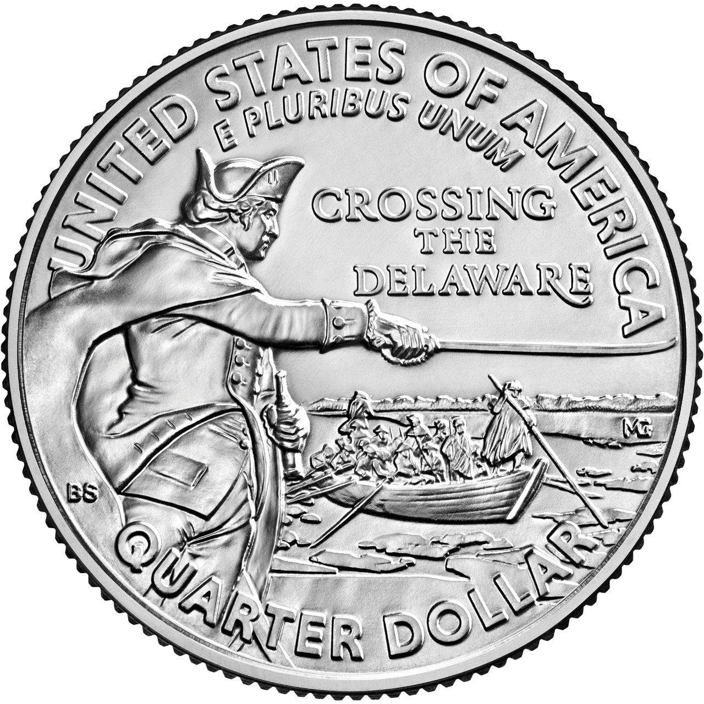
Crossing the Delaware
Sleet and snow delayed the crossing
Army crossed in Durham boats
Artillery and horses ferried across
Notes:
Explain how weather made the crossing extremely difficult and dangerous.

Slide 8
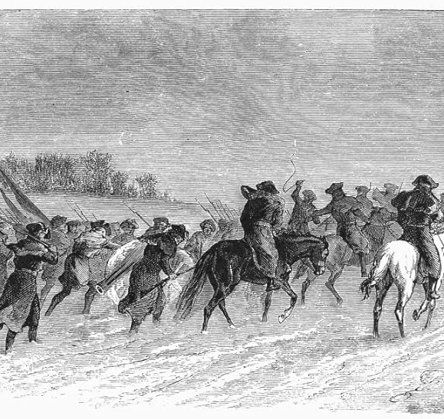
A Nine-Mile March
March began around 4:00 AM
Soldiers lacked shoes
Many bled from their feet
Notes:
Describe Washington’s encouragement of his men and the hardship they endured.

Slide 9
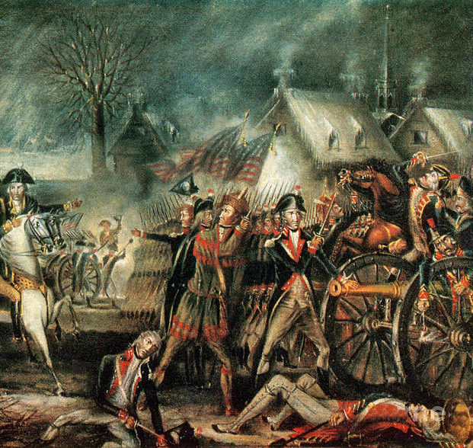
First Shots
Battle began north of Trenton
Hessian outpost retreated
Surprise achieved
Notes:
Explain how the element of surprise was critical to the American success.

Slide 10
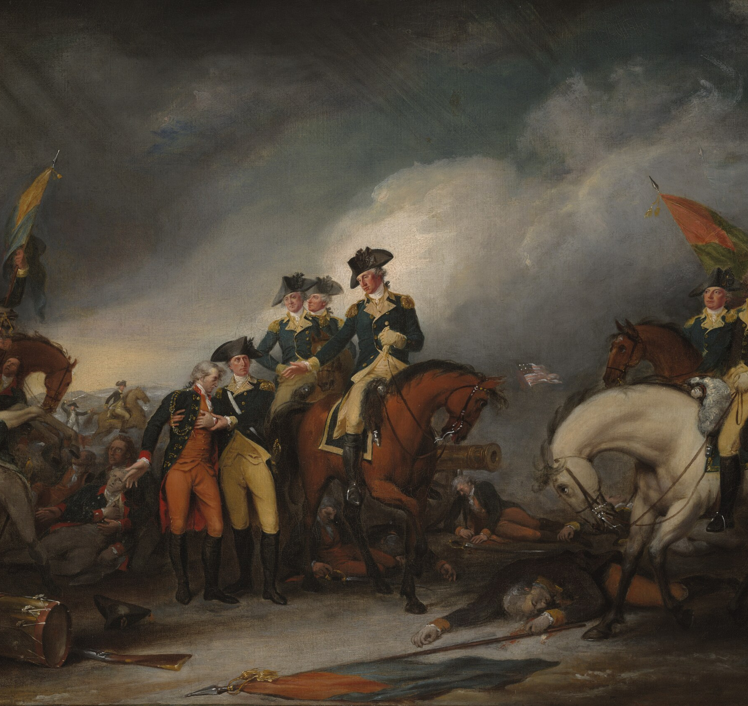
Battle of Trenton
Cannons placed on King and Queen Streets
Hessians trapped and surrounded
Majority forced to surrender
Notes:
Describe the street fighting and how American artillery controlled the city.

Slide 11
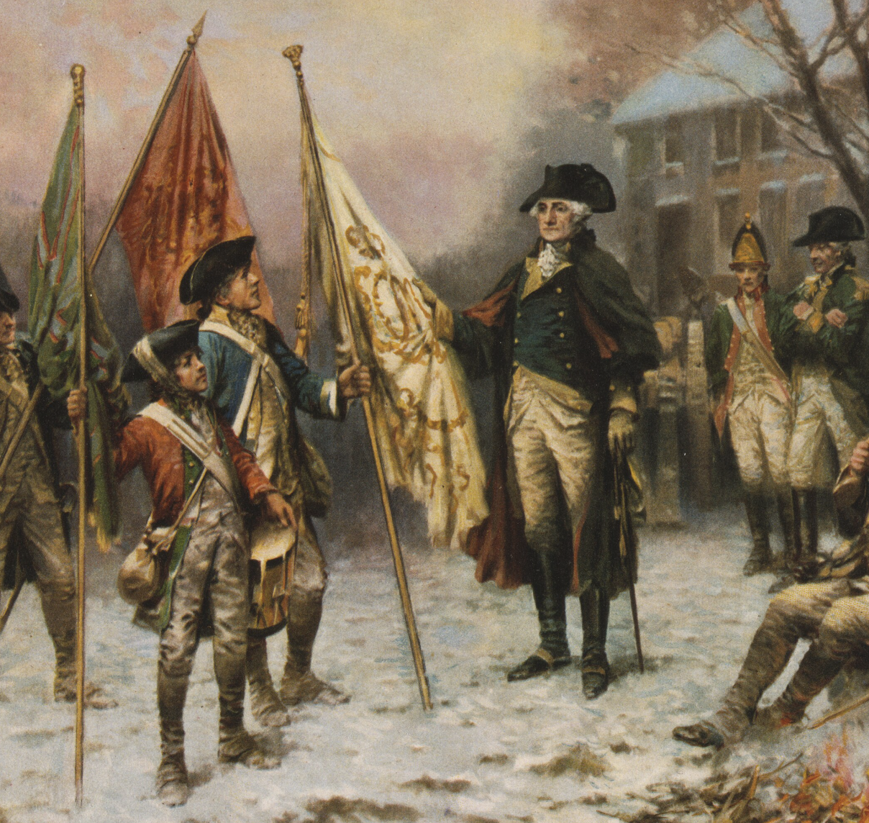
Results at Trenton
2 Americans killed, 5 wounded
Nearly 900 Hessians captured
All Hessian colonels killed
Notes:
Explain why this victory mattered more for morale than strategy.

Slide 12
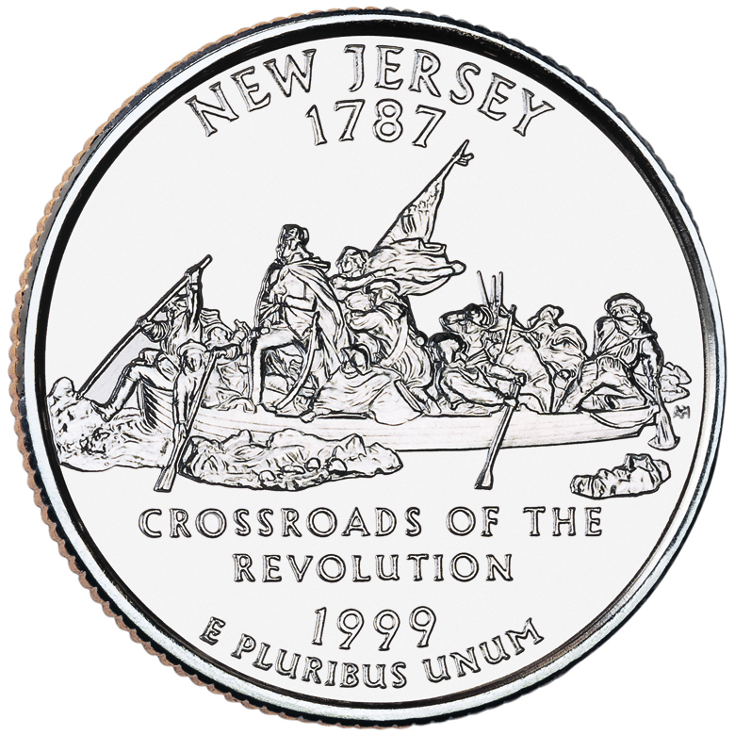
A Boost to Patriot Morale
Army confidence restored
Public support increased
Revolution saved from collapse
Notes:
Explain how Trenton convinced many Americans that victory was still possible.

Slide 13
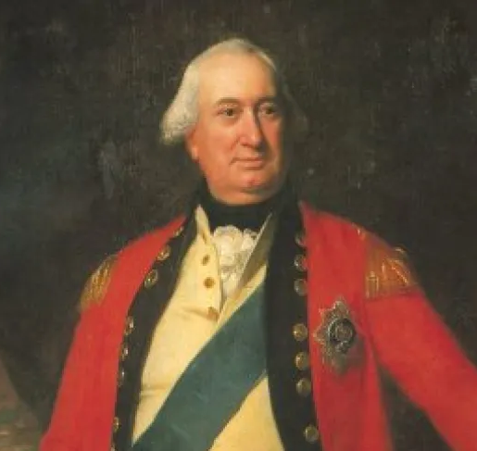
Cornwallis Responds
British General Cornwallis sent to Trenton
Arrived January 2, 1777
Expected Washington to retreat again
Notes:
Describe Cornwallis’s confidence and expectations.

Slide 14
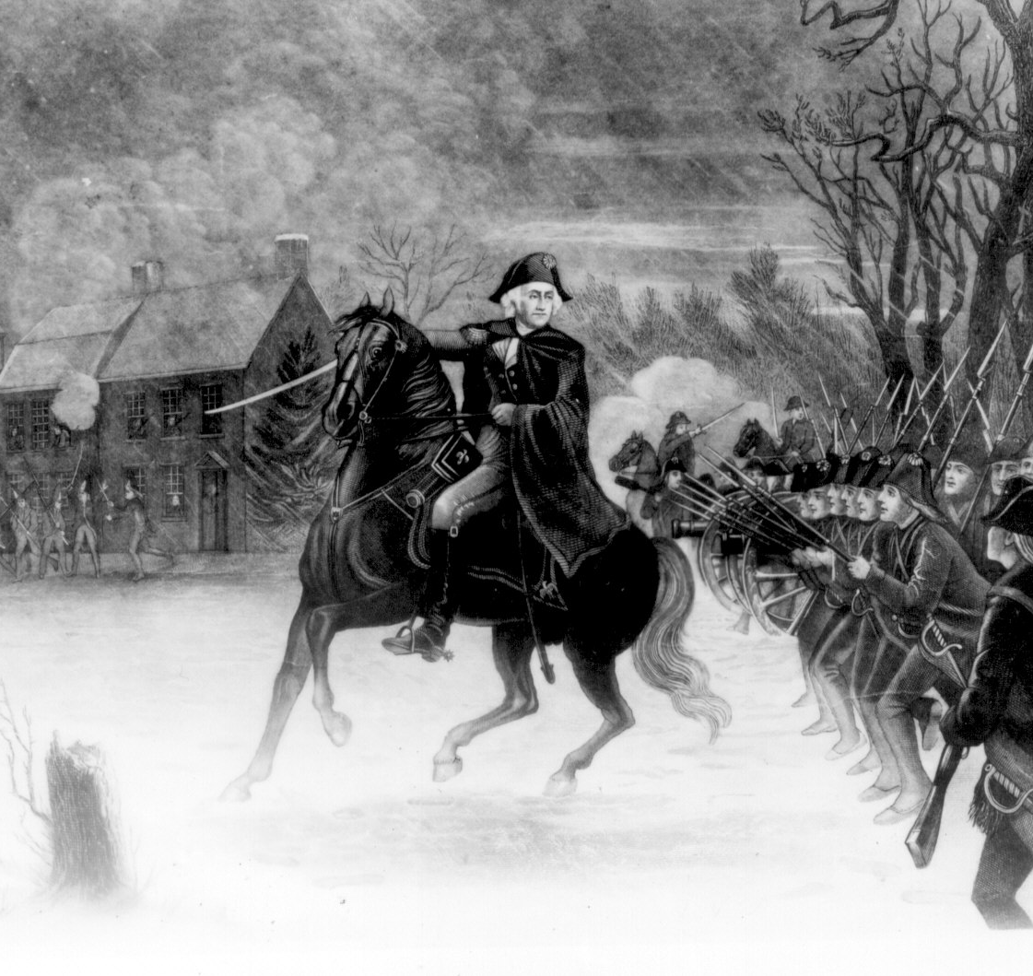
Washington’s Night Escape
Campfires left burning
Wagon wheels muffled
Army slipped past British lines
Notes:
Explain Washington’s clever deception and escape maneuver.

Slide 15
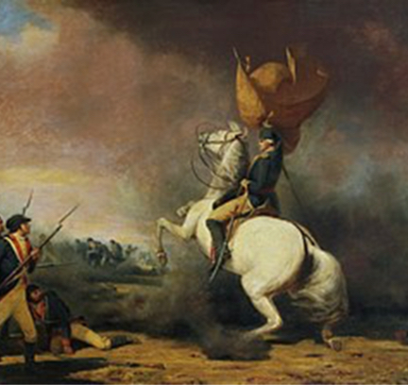
Battle of Princeton
Jan. 3, 1777
Skirmishes near farms and the College of New Jersey
Washington personally led troops
British lines broken
Considered a minor Patriot victory
Notes:
Describe Washington’s leadership and the turning point of the battle.

Slide 16
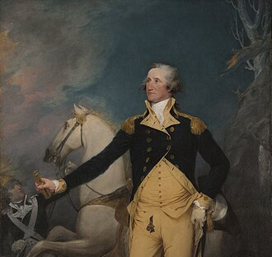
Driving the British from New Jersey
British retreated from much of New Jersey
Second consecutive Patriot victory
Washington proved his leadership
Notes:
Conclude by explaining how Trenton and Princeton together changed the course of the war.

