Slide 1
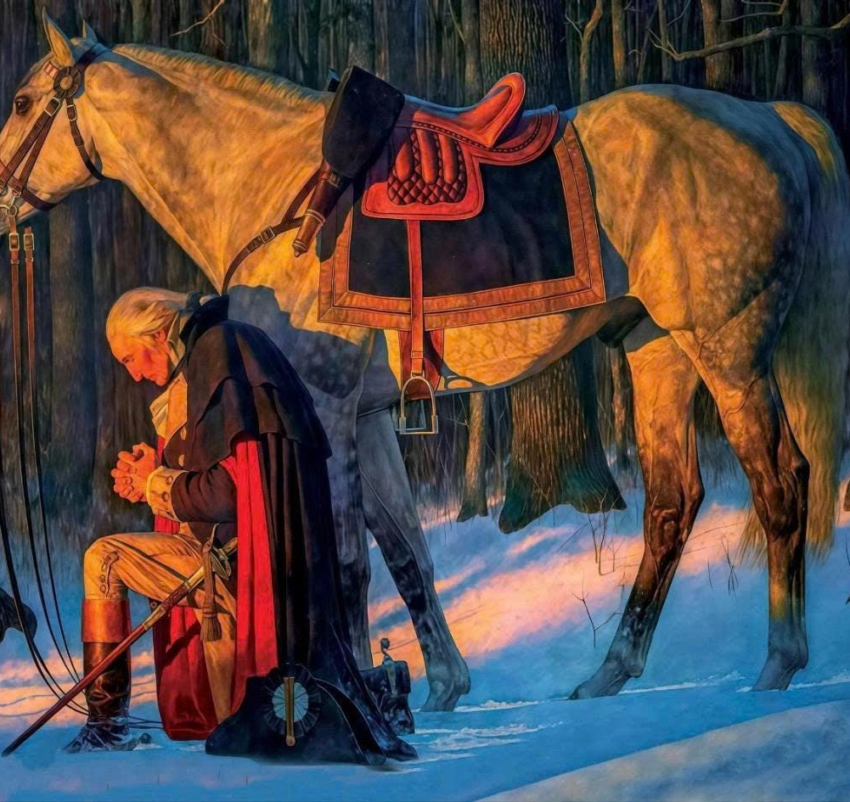
Winter at Valley Forge (1777–1778)
https://learnaboutamerica.com
Notes:
Introduce Valley Forge as one of the most challenging and defining moments of the American Revolution.

Slide 2
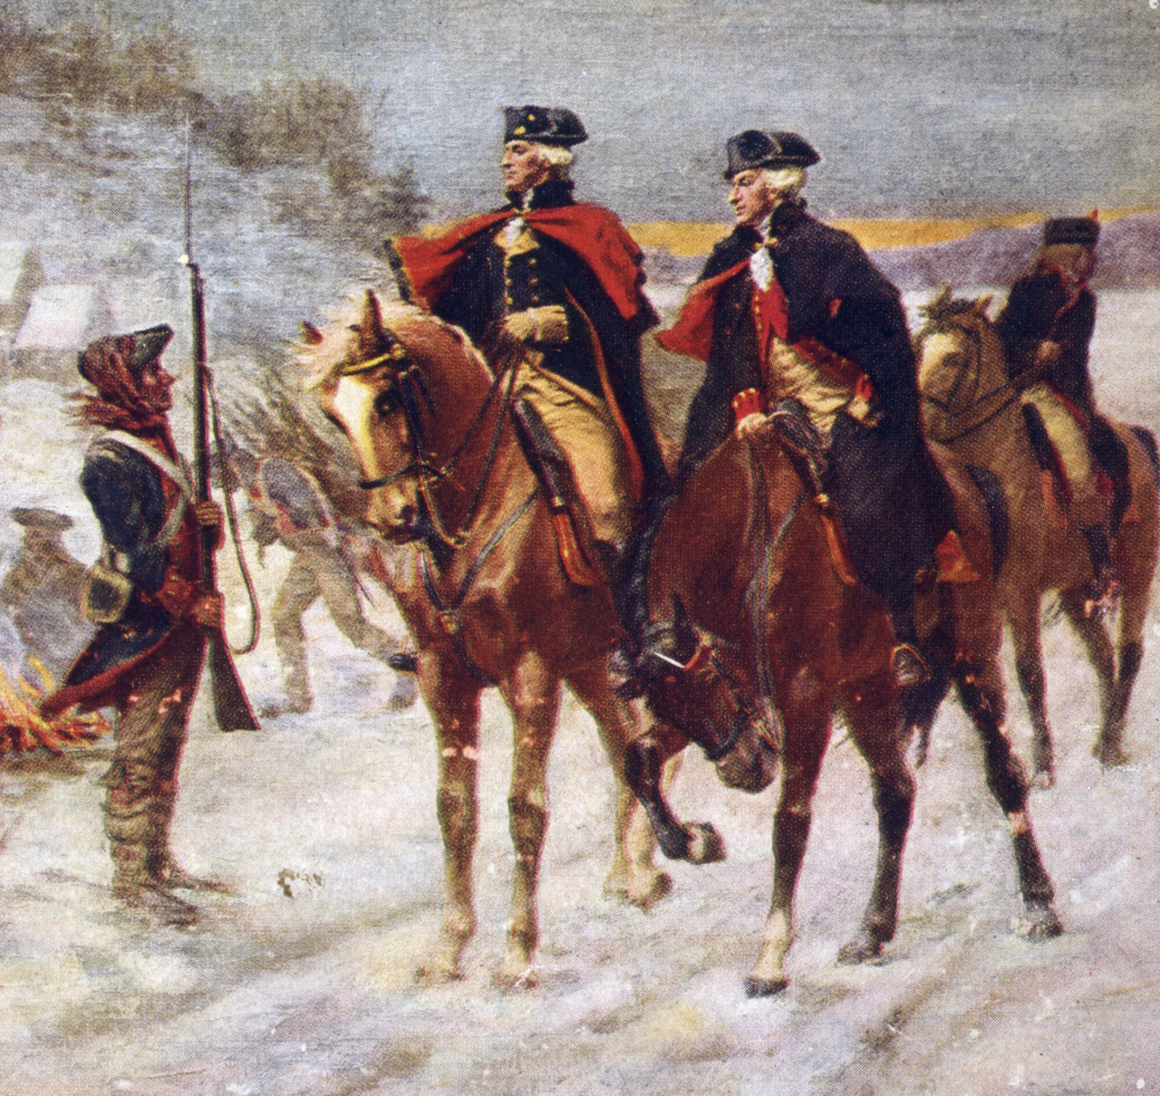
Warfare and Winter
Major fighting often stopped in winter
Armies set up winter encampments
Focus shifted to survival
Notes:
Explain that winter camps were common, but Valley Forge became especially famous because of the suffering endured there.

Slide 3
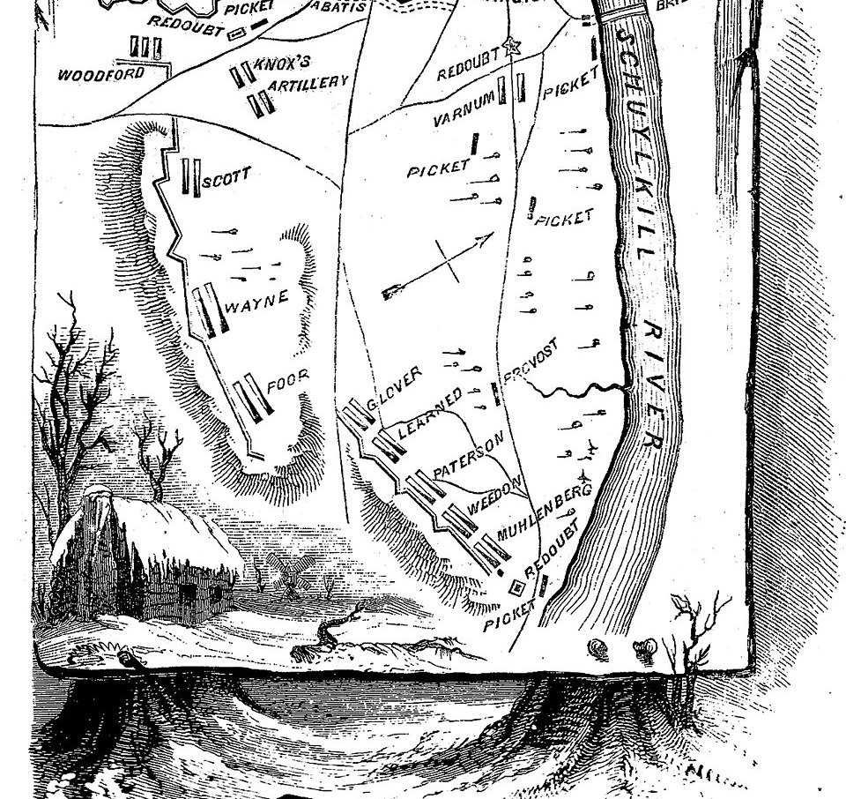
Choosing Valley Forge
Located 18 miles west of Philadelphia
Protected by hills and the Schuylkill River
Safe from surprise attacks
Notes:
Explain why Washington chose Valley Forge as a defensive and strategic location.

Slide 4
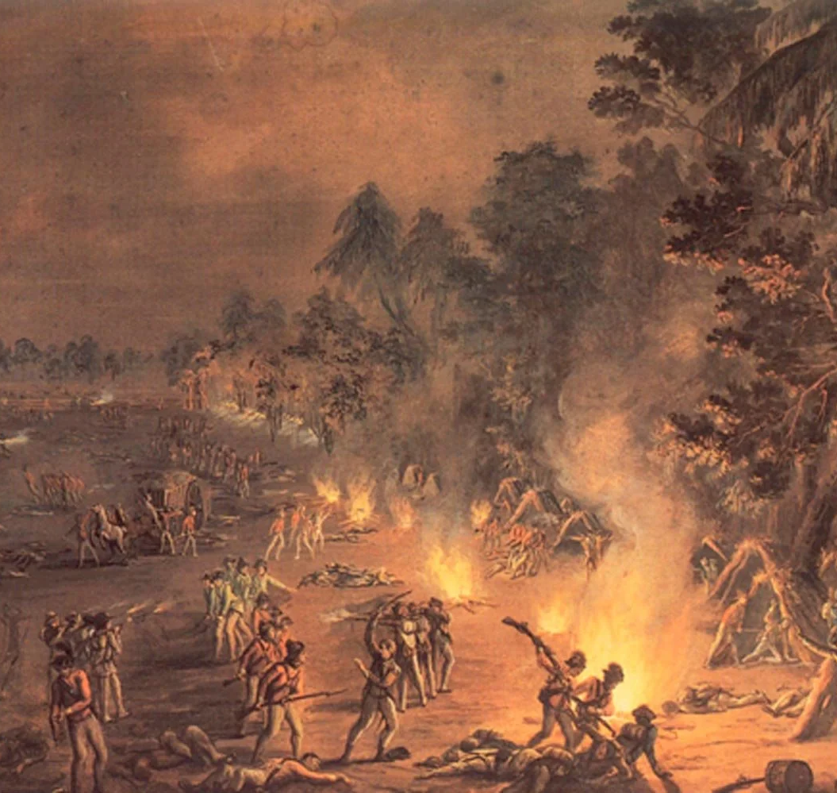
British in Philadelphia
British occupied Philadelphia
Continental Army needed distance
Still close enough to monitor enemy
Notes:
Explain the importance of staying near, but not too close to, the British army.

Slide 5
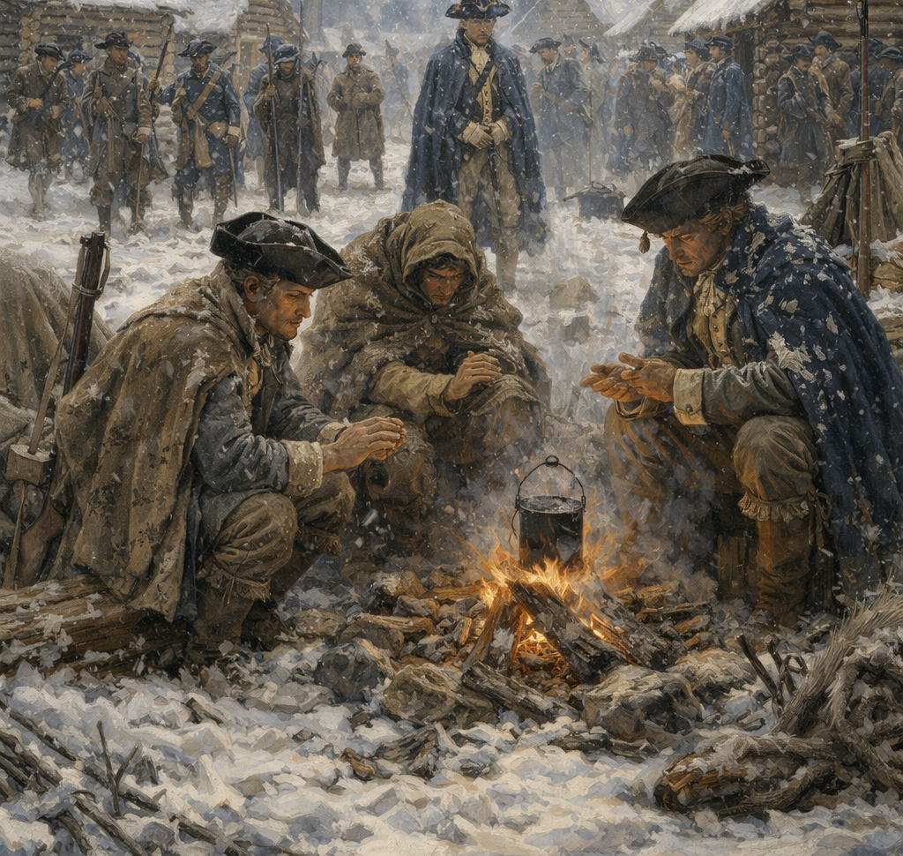
A Crumbling Army
About 12,000 soldiers arrived
Low morale
Shortages of supplies
Notes:
Explain that the army was already weakened before arriving at Valley Forge.

Slide 6
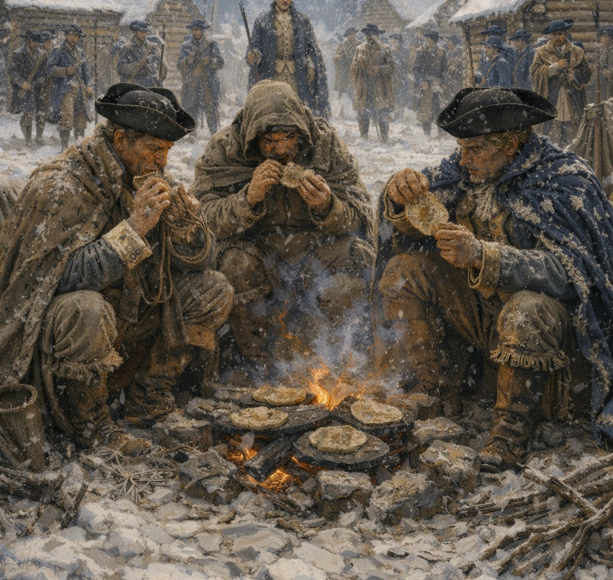
Lack of Food
Soldiers were starving
Main food was 'firecake'
Occasional meat or bread
Notes:
Describe what firecake was and why hunger was constant.

Slide 7
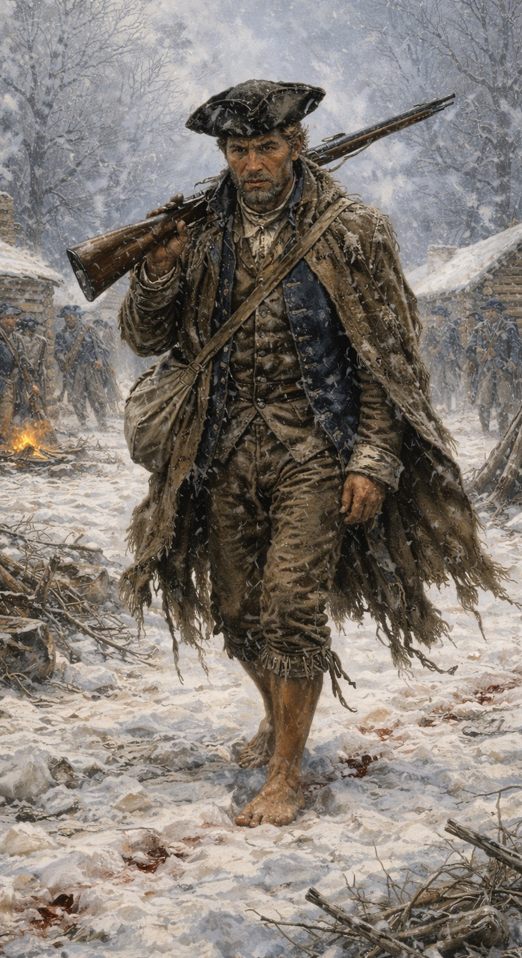
Lack of Clothing
Many soldiers lacked coats
Few blankets available
Many had no shoes
Notes:
Explain how exposure to cold caused suffering and death.

Slide 8
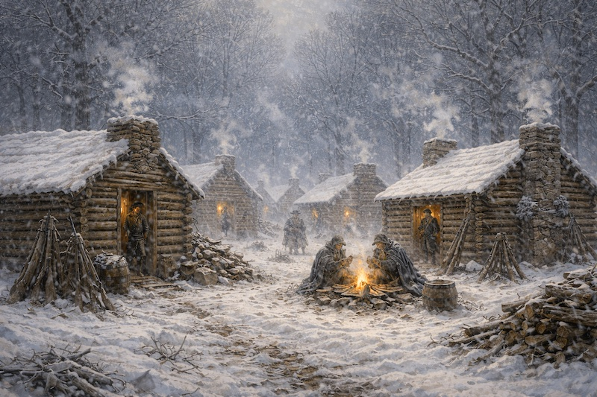
Harsh Living Conditions
Over 1,000 huts built
Rain and melting snow soaked camps
Soldiers often stayed wet
Notes:
Explain how poor shelter made survival difficult.

Slide 9
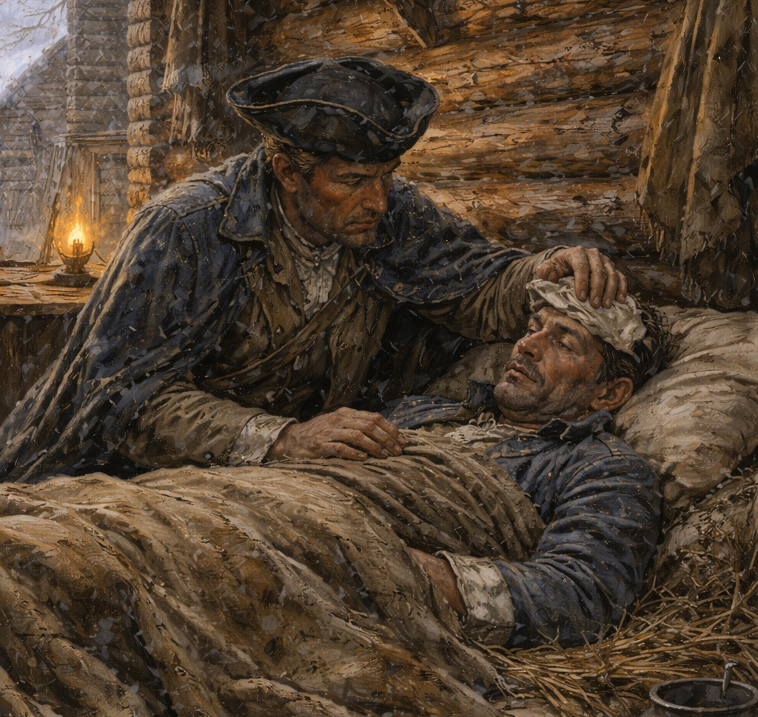
Disease and Death
Unsanitary conditions
Diseases spread quickly
Over 2,000 deaths
Notes:
Explain how sickness, not battle, was the biggest killer at Valley Forge.

Slide 10
Wounded Soldiers
Injuries worsened by cold
Exposure caused deaths
Limited medical care
Notes:
Explain how wounded soldiers were especially vulnerable.

Slide 11
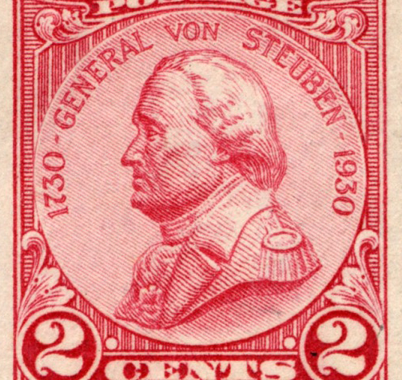
Arrival of Baron von Steuben
Arrived February 23, 1778
Former Prussian officer
Brought discipline and training
Notes:
Introduce von Steuben as a turning point at Valley Forge.

Slide 12
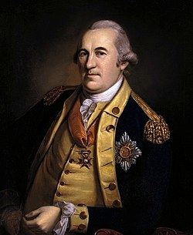
Training the Army
Taught marching and formations
Improved musket and bayonet use
Standardized drills
Notes:
Explain how training turned civilians into soldiers.

Slide 13
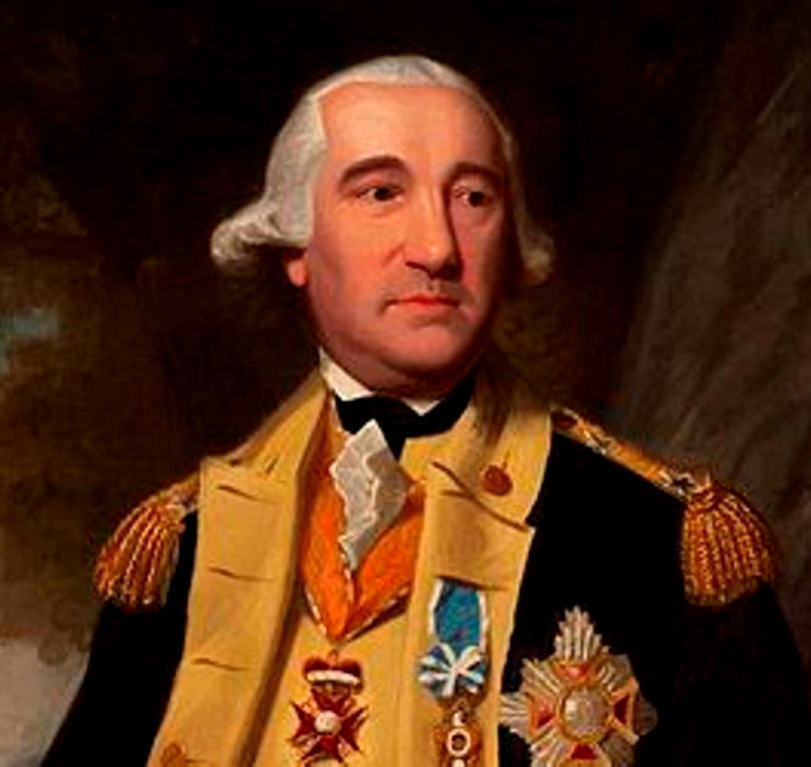
Leadership Style
Worked directly with soldiers
Earned their respect
Boosted morale
Notes:
Explain why von Steuben was admired by the troops.

Slide 14
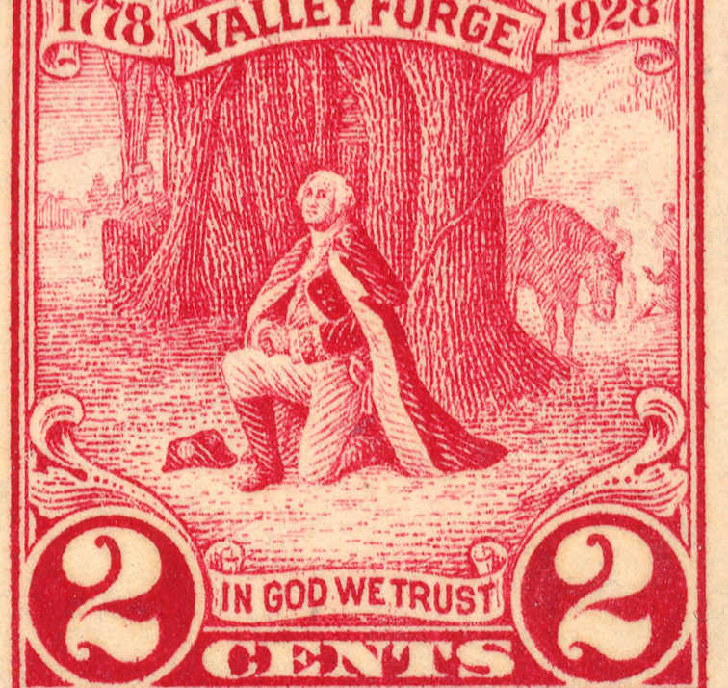
A Stronger Army Emerges
Better discipline
Improved confidence
More effective fighting force
Notes:
Explain how Valley Forge transformed the army.

Slide 15
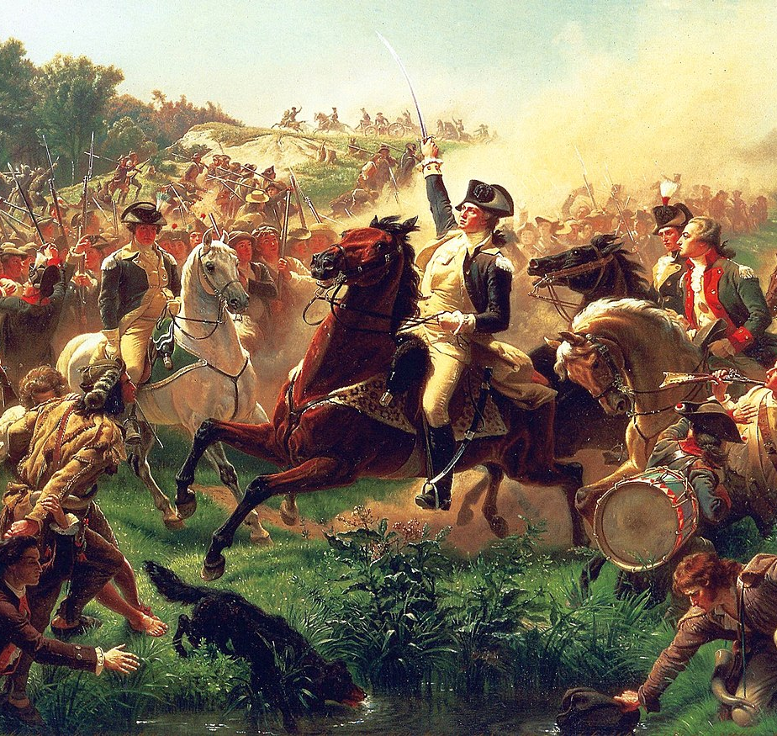
Leaving Valley Forge
June 19, 1778
Army pursued British toward New York
Continental Army reborn
Notes:
Conclude by explaining why Valley Forge is remembered as a symbol of perseverance.

