Slide 1
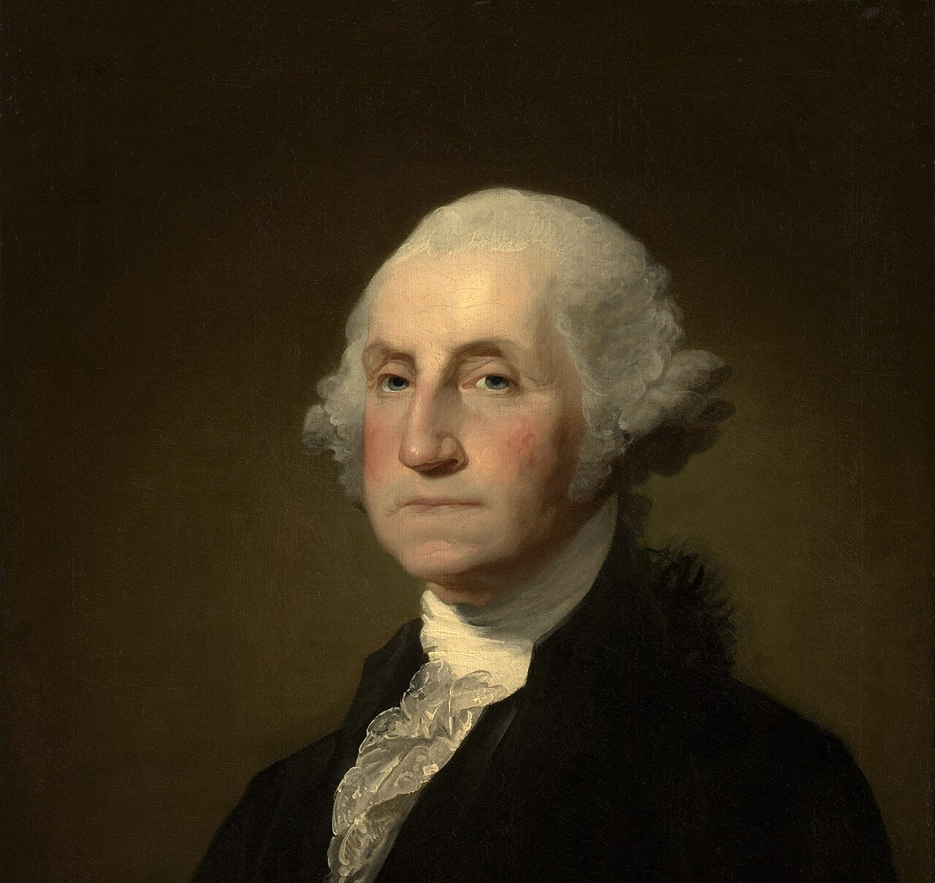

George Washington

Slide 2
LearnAboutAmerica.com
*For our presentations, lesson plans, articles, printables, interactives, stories, and games related to George Washington, please visit:
https://learnaboutamerica.com/american-history/revolutionary-war/people-of-the-revolutionary-war/george-washington
* For the greatest American History website for teachers, parents, and students, visit:
https://learnaboutamerica.com

Slide 3
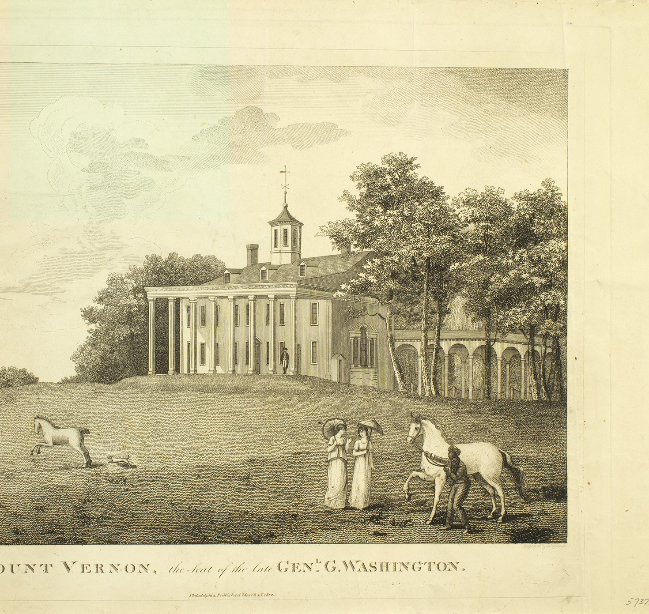
Early Life
Born February 22, 1732 in Westmoreland County, Virginia
Grew up near Fredericksburg
Studied math and surveying
Lived at Mount Vernon with his brother Lawrence

Slide 4
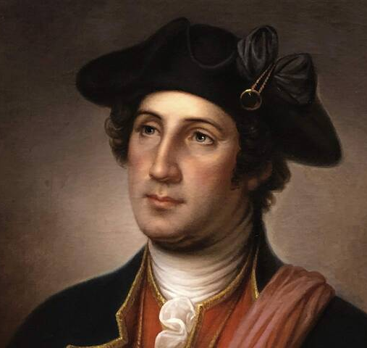
Mount Vernon and Family
Scarred by smallpox before age 20
Inherited Mount Vernon in 1752
Became a successful plantation owner

Slide 5
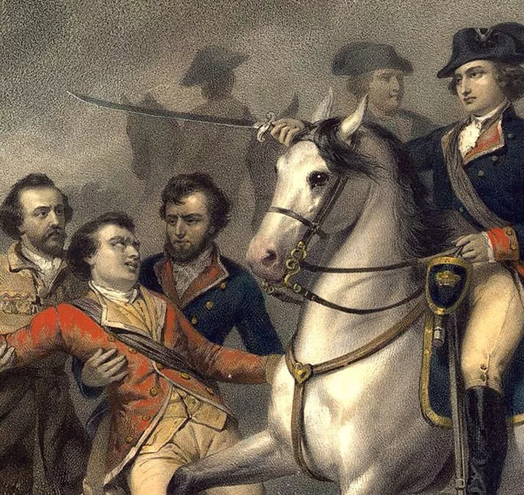
French and Indian War
Military career began in 1753
Sent to Ohio Country to protect British interests
Gained early military experience

Slide 6
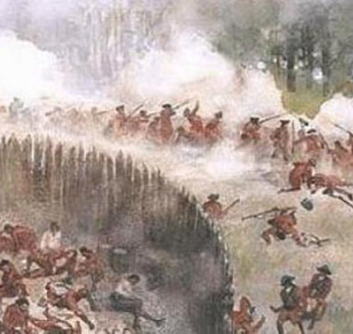
Early Military Setbacks
Defeated and surrendered Fort Necessity in 1754
Served under General Edward Braddock
Survived ambush near Fort Duquesne

Slide 7
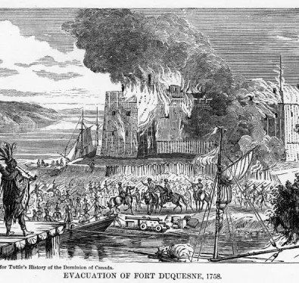
Learning from Defeat
Captured and later released by French forces
Helped retake Fort Duquesne in 1758
Developed leadership and resilience

Slide 8
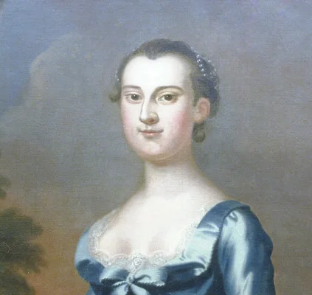
Life Before the Revolution
Married Martha Custis in 1759
Managed plantation and family
Respected Virginia leader

Slide 9
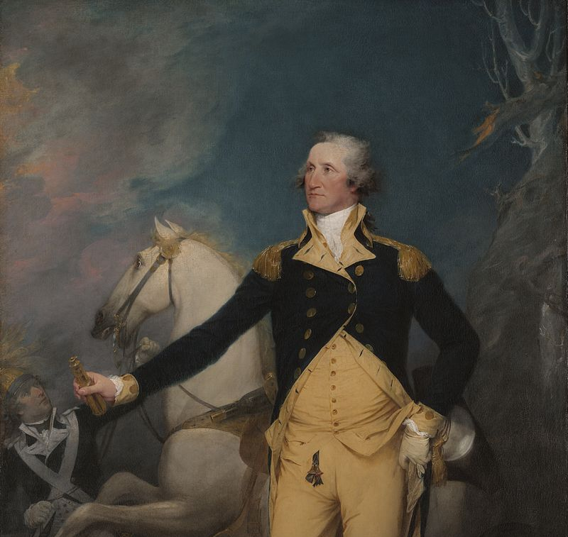
Commander of the Continental Army
Appointed June 15, 1775
Led volunteer soldiers and militia
Faced shortages of food, clothing, and weapons

Slide 10
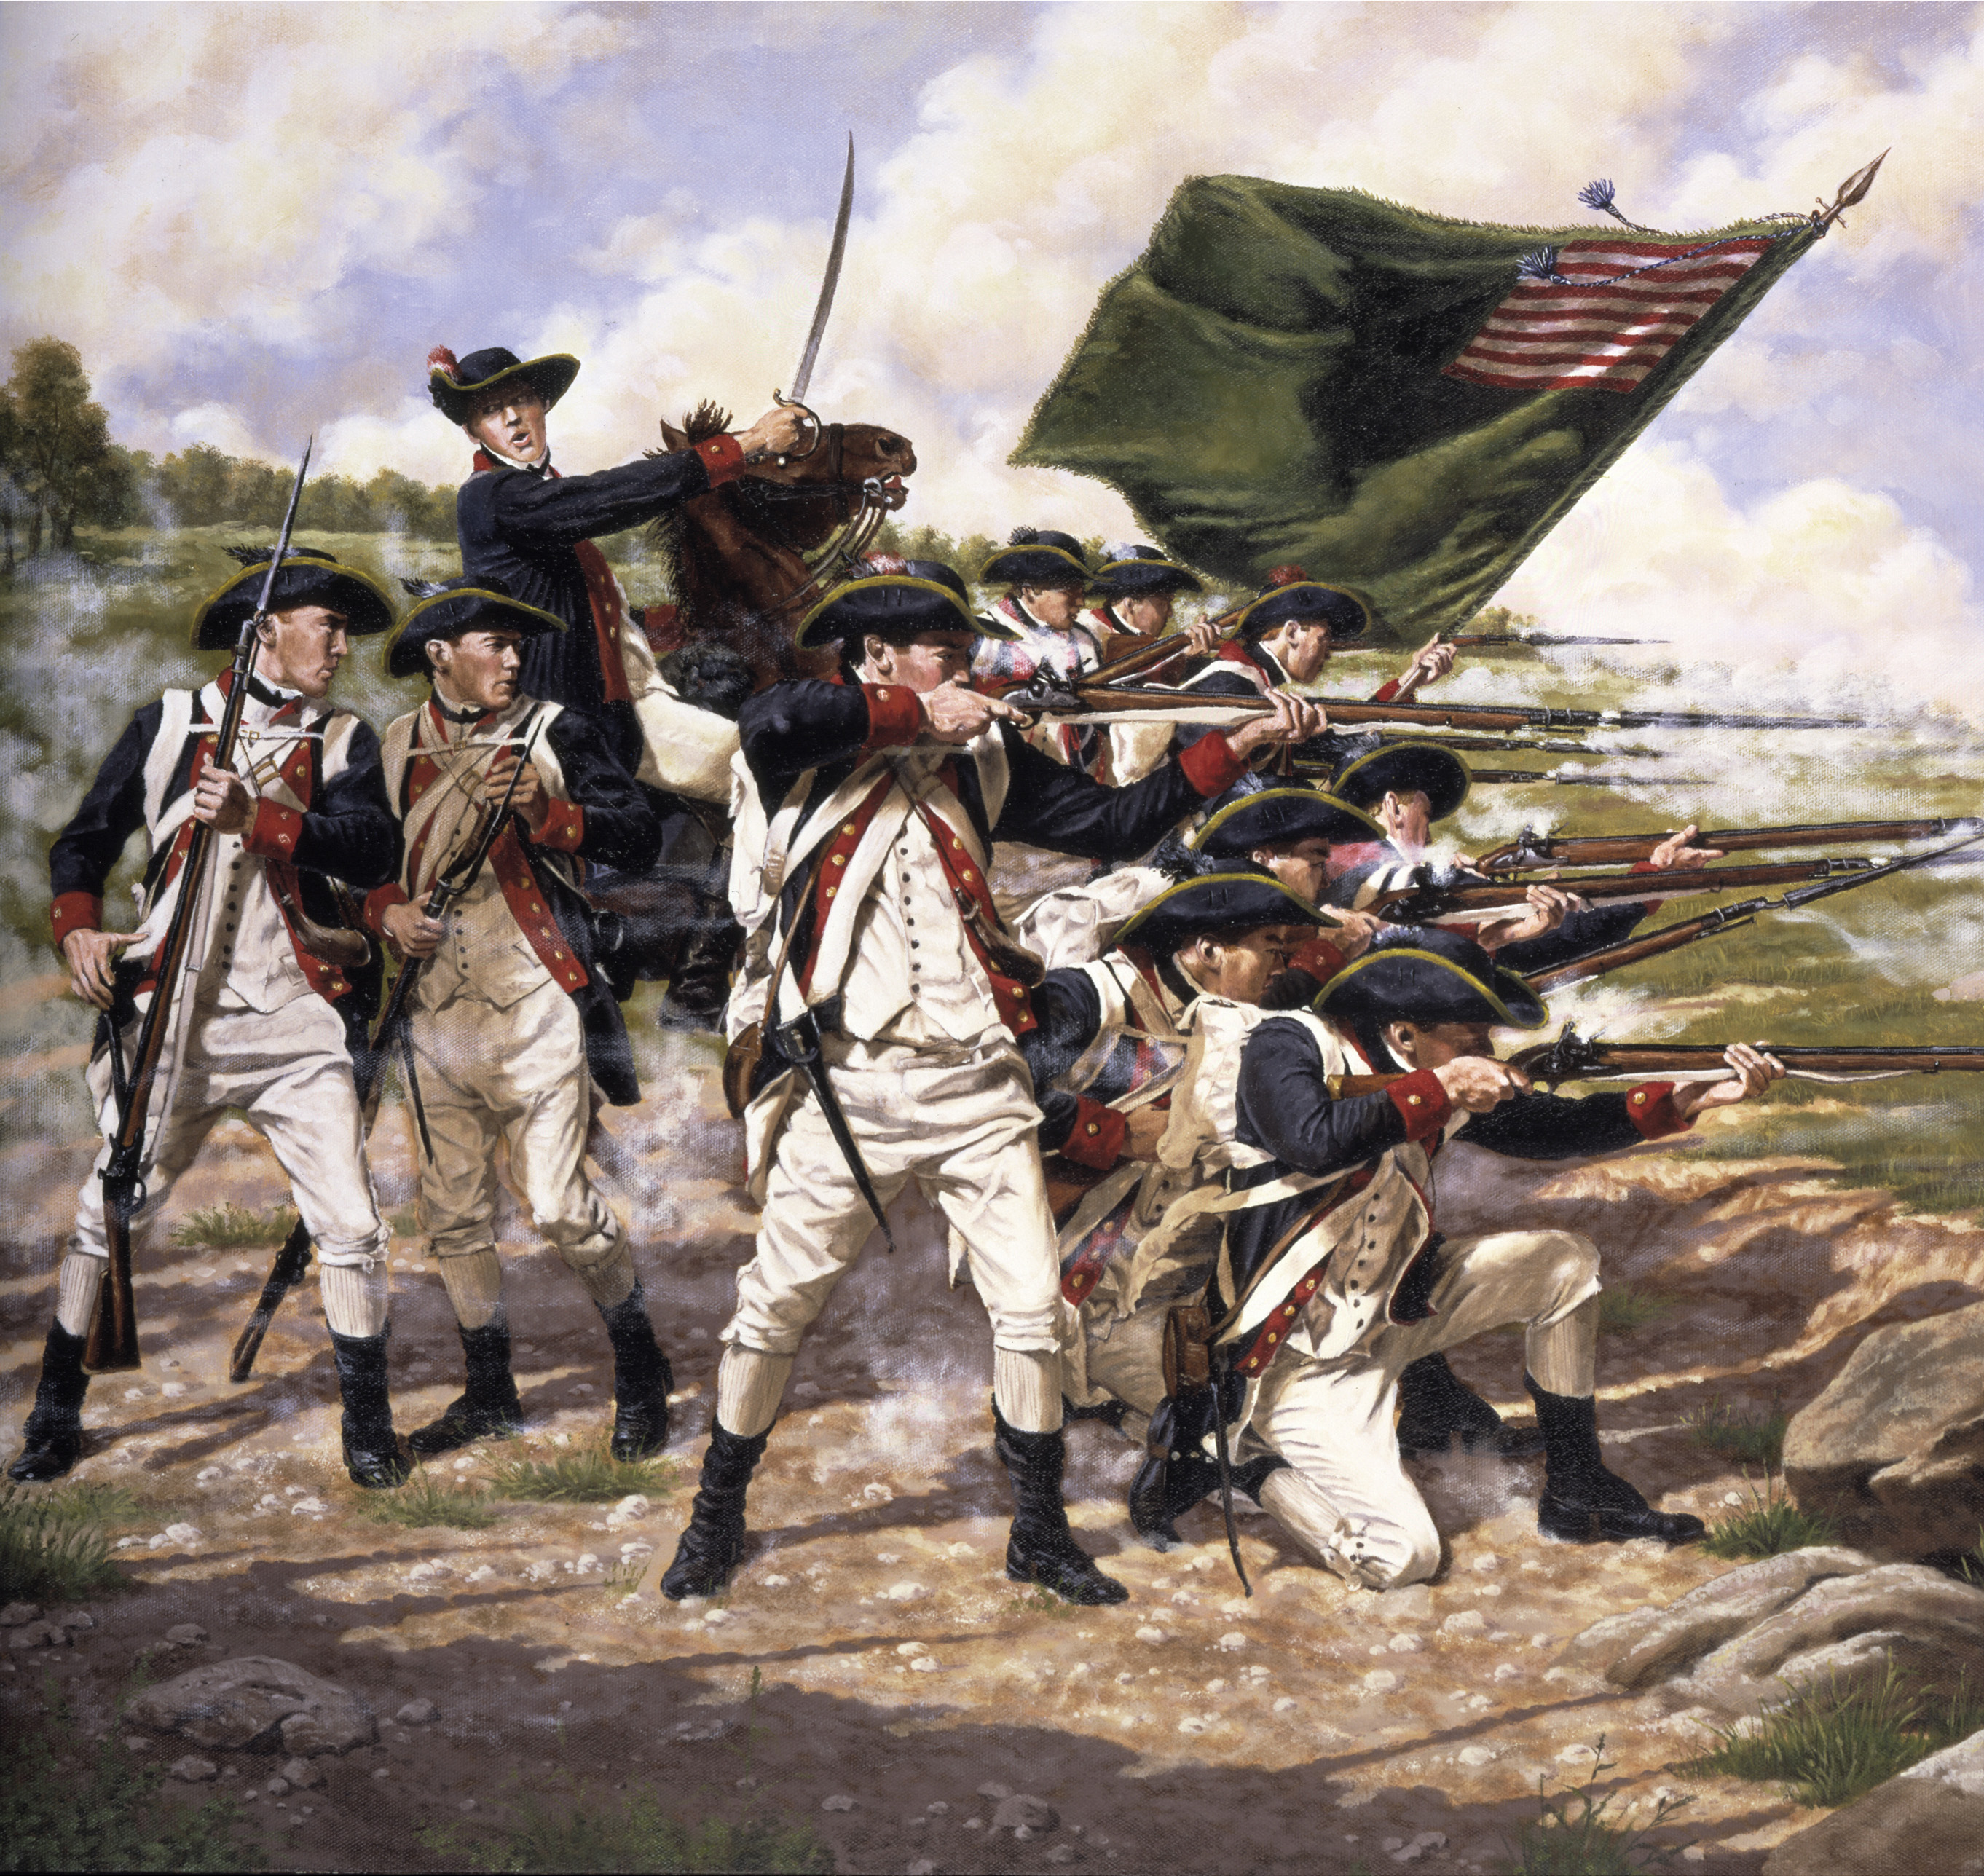
Struggles and Retreats
Defeated in New York in 1776
Forced to retreat into Pennsylvania
Planned a daring counterattack

Slide 11
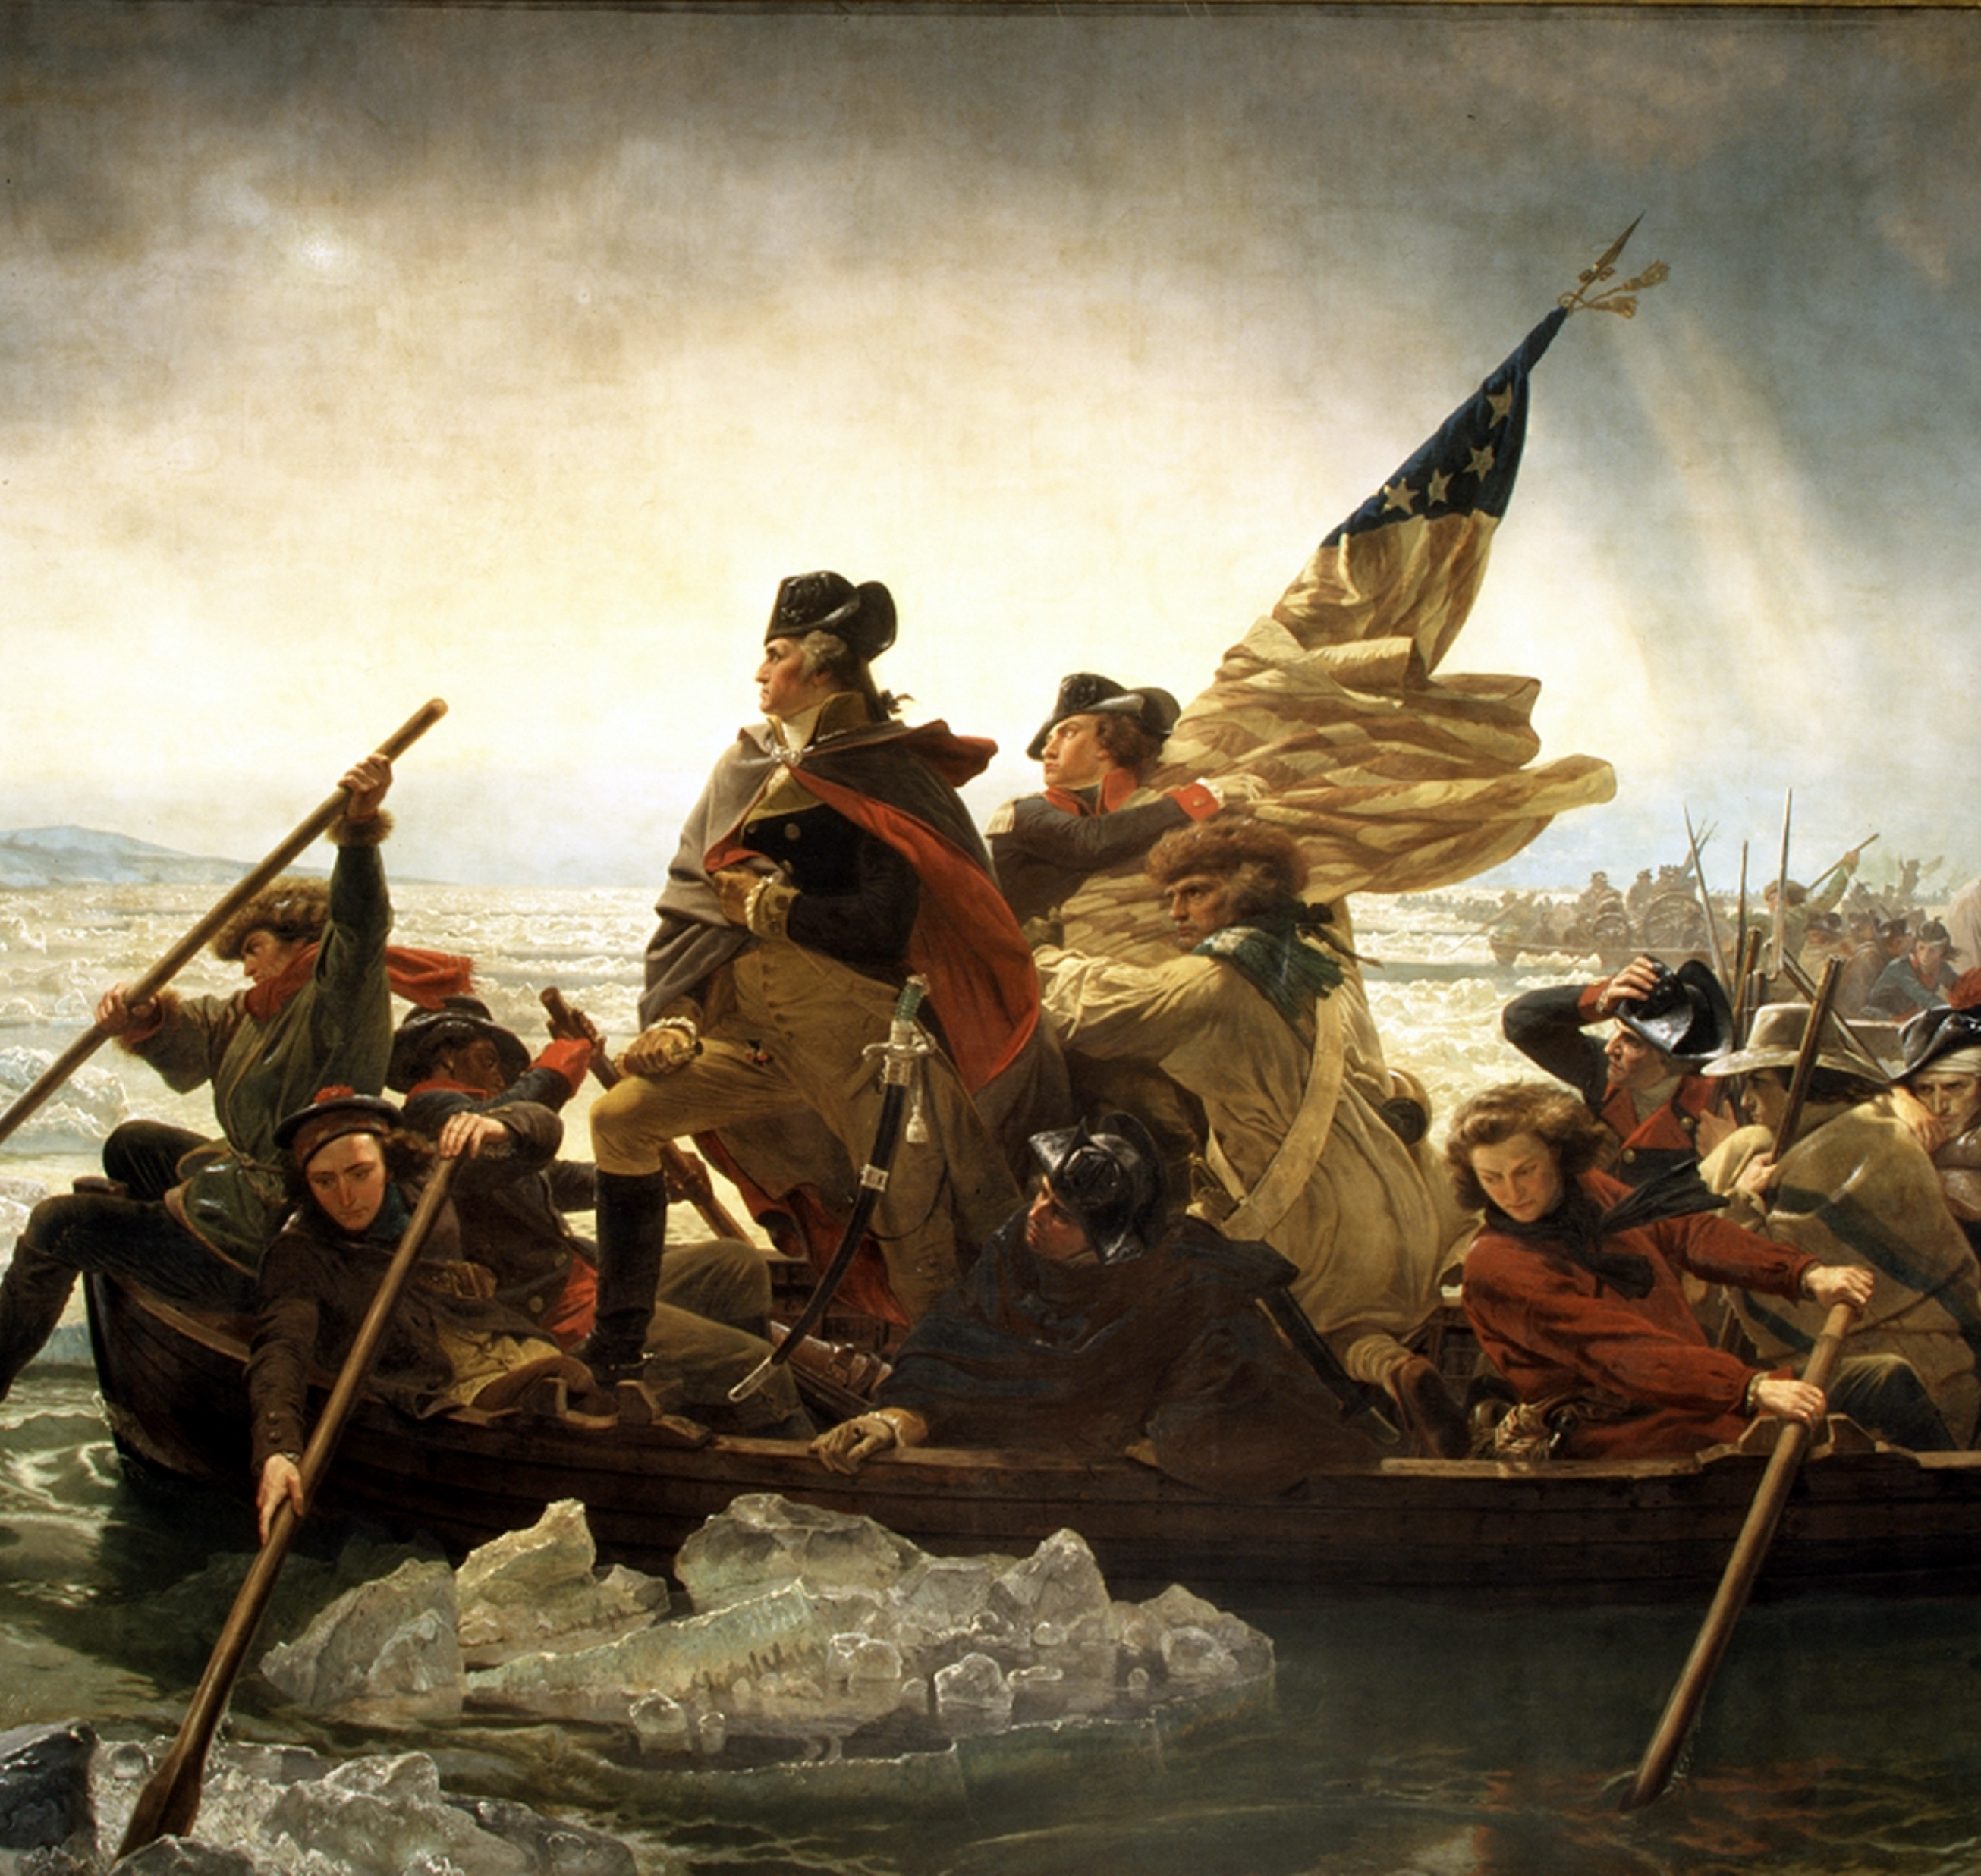
Washington Crosses the Delaware
Christmas night, 1776
Crossed icy Delaware River
Surprised Hessian soldiers at Trenton

Slide 12
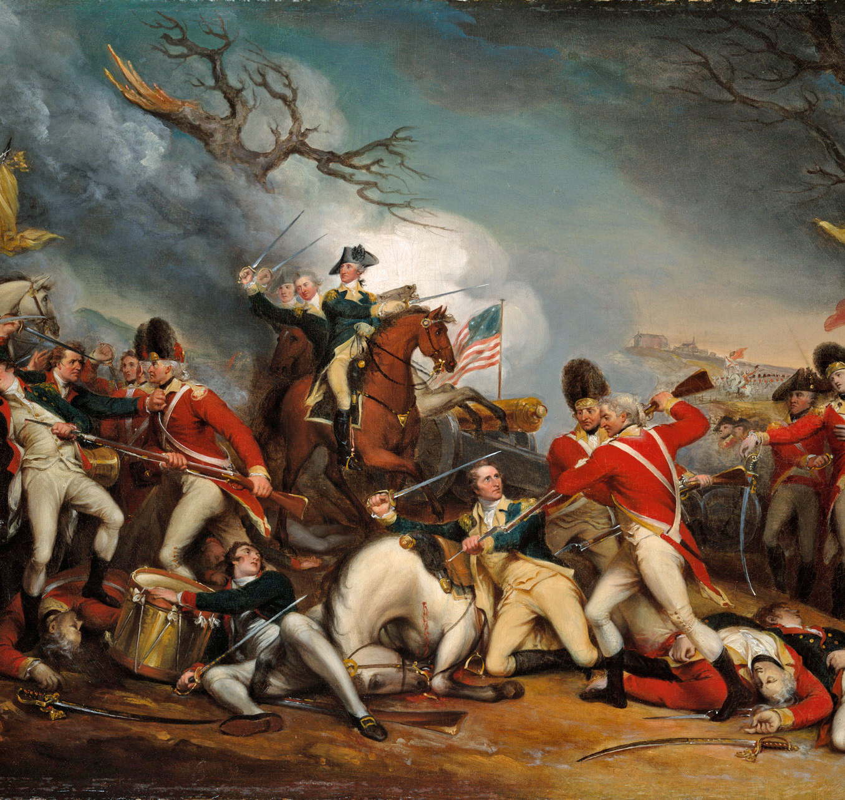
The Battle of Trenton
Captured 800–900 Hessian soldiers
Boosted army morale
Turning point in the war

Slide 13
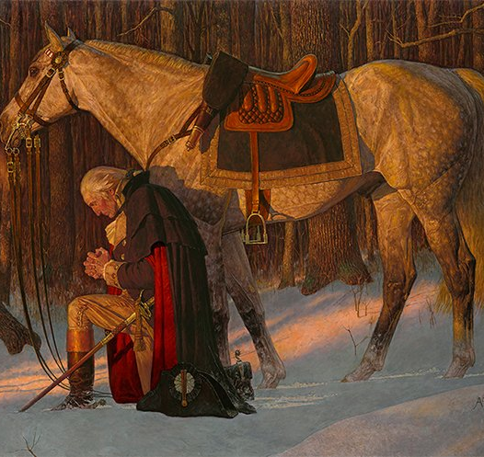
Holding the Army Together
Constantly requested supplies from Congress
Kept the army together despite hardships
Demonstrated determination and leadership

Slide 14
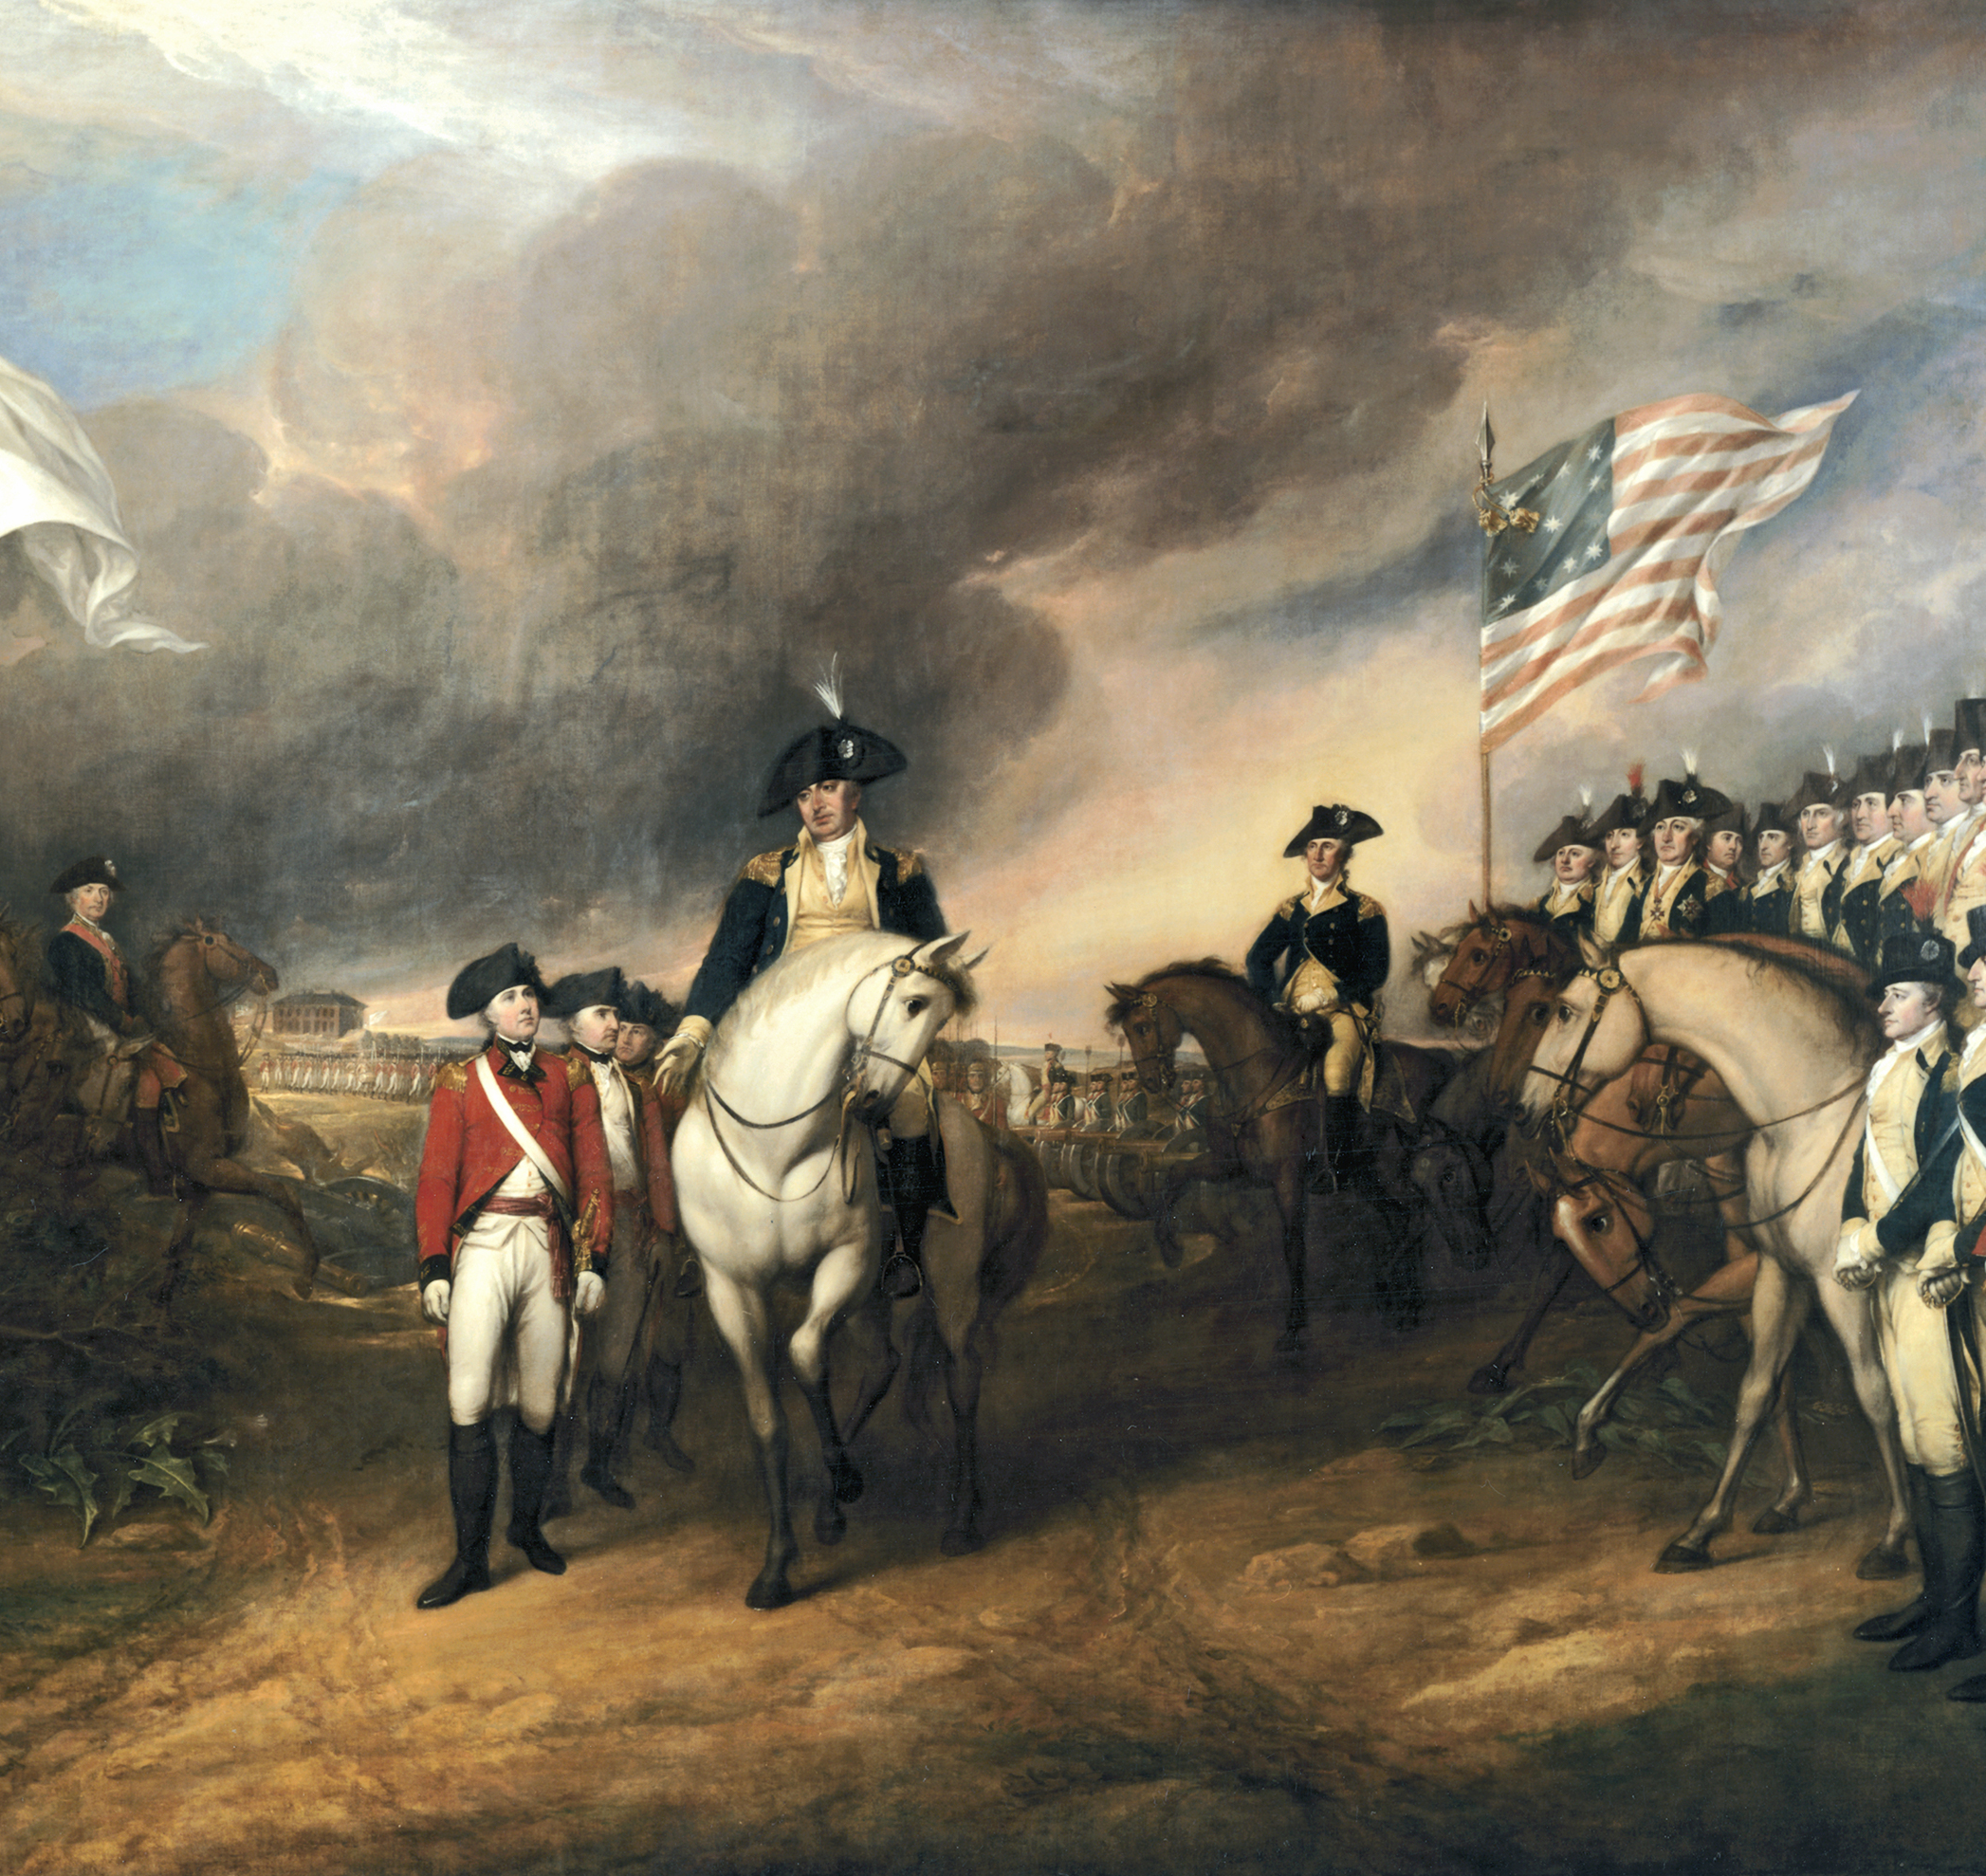
Victory at Yorktown
Worked with French allies
Trapped British forces in Virginia
British surrendered in 1781

Slide 15
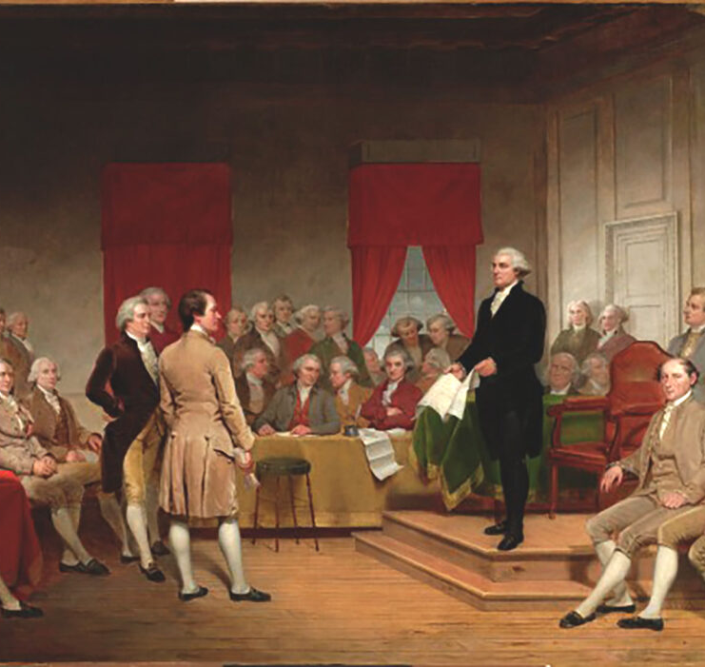
Leader in Peace
Presided over Constitutional Convention
Supported a strong federal government
Helped ratify the Constitution

Slide 16
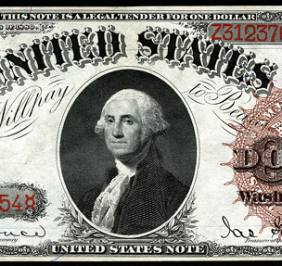
First President
Inaugurated in 1789
Refused to become king
Served two terms and stepped down

Slide 17
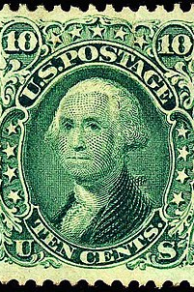
Death and Legacy
Died December 14, 1799
Capital, state, and monuments named after him
Honored on coins and stamps

